Slide 2
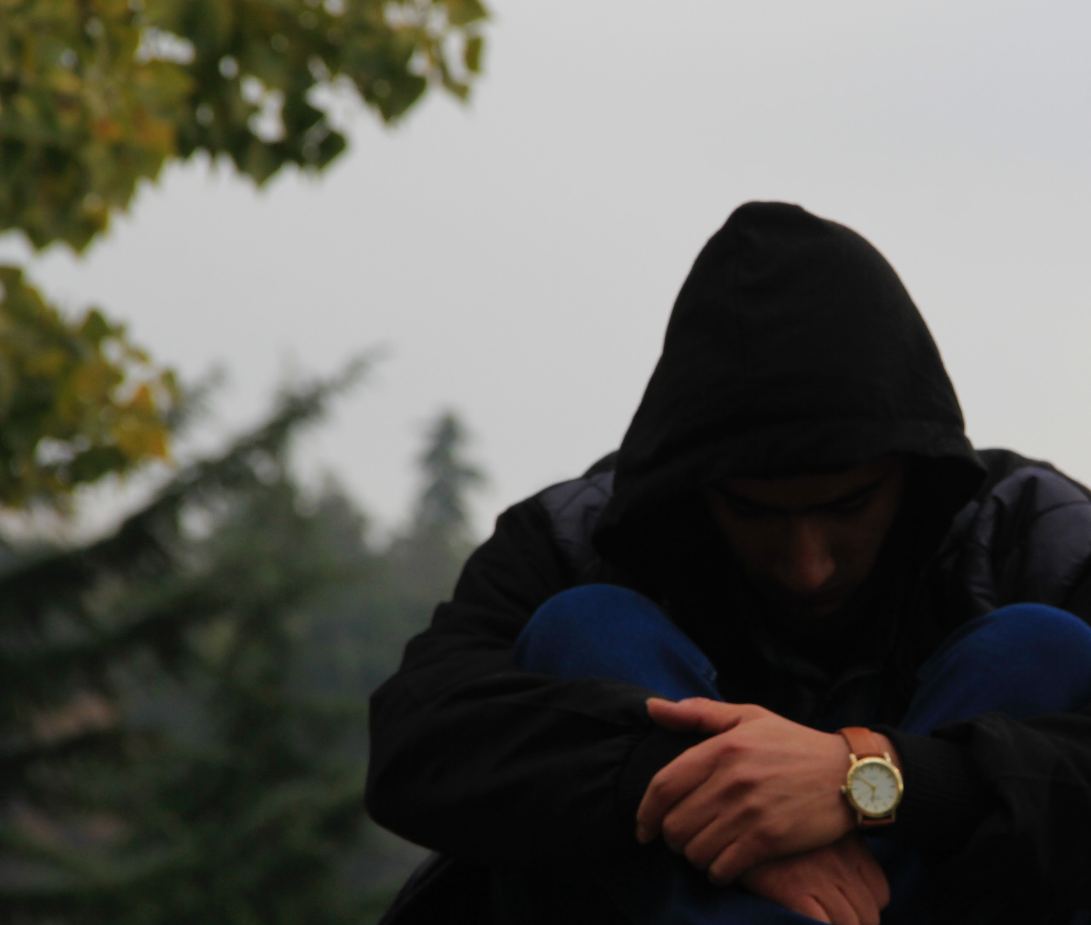
The Challenge of Bitterness
Bitterness starts out small
We replay it in our minds creating deep ruts

Slide 3
The Challenge of Bitterness
We fool ourselves into thinking no one will know, but bitterness has a way of seeping into everything

Slide 4
The Challenge of Bitterness
(Romans 12:18)
“If it is possible, as far as it depends on you, live at peace with everyone”
So how can we do that?

Slide 5
The Challenge of Bitterness
Have you ever struggled with bitterness?
God warns us about the grave danger of bitterness (Heb.12:15)

Slide 6
bit·ter·ness
sharpness of taste; lack of sweetness.
acidity
anger and resentment at being treated unfairly;
animosity, harshness

Slide 7
bit·ter·ness
Cain toward Abel (Gen.4)
Moses at the water of Meribah (Num.20)
Saul toward David (2Sam.18)

Slide 8
bit·ter·ness
“Harboring bitterness is like drinking poison and hoping the other person dies…”
“The more I feed bitterness in my heart, the more it brings death to me”

Slide 9
bit·ter·ness
Bitterness is poison dipped in honey. It tastes sweet going down, then it kills us from the inside out

Slide 10
bit·ter·ness
In this way, bitterness is the poster child for the deceitfulness of sin. Whenever we love something that brings death to us, the devil has us right where he wants us

Slide 11
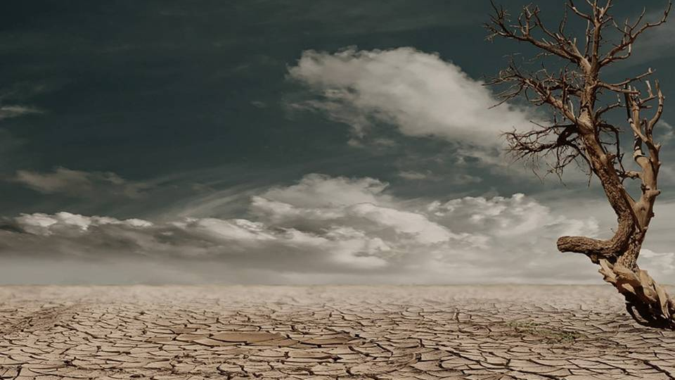
Acts 8:20-23
Poisoned by Bitterness

Slide 12
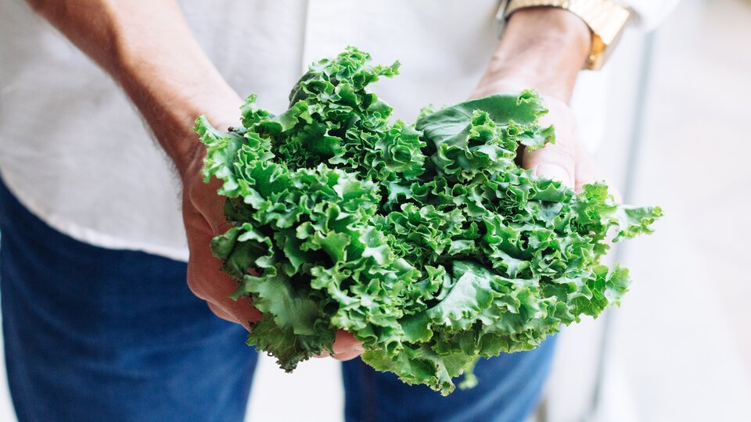
Overcoming Bitterness

Slide 13
Learning From Joseph
The measure of evil committed against him
The longevity of the temptation
Joseph’s initiative
Joseph’s kindness
Joseph’s perspective

Slide 14
What Is the Cure?
Stop feeding it!
Resolve insecurity
Acknowledge that my bitterness is my sin. I own it!
Trust the work of God

Slide 15
What Is the Cure?
The power of God’s grace
Demonstrate love in a practical way
Remember God’s promises
Cast a tree into the bitter water…

