Slide 2
Matthew 6:24-34
²⁴ “No one can serve two masters; for either he will hate the one and love the other, or else he will be loyal to the one and despise the other. You cannot serve God and mammon.

Slide 3
Matthew 6:24-34
²⁵ “Therefore I say to you, do not worry about your life, what you will eat or what you will drink; nor about your body, what you will put on. Is not life more than food and the body more than clothing?

Slide 4
Matthew 6:24-34
²⁶ Look at the birds of the air, for they neither sow nor reap nor gather into barns; yet your heavenly Father feeds them. Are you not of more value than they?

Slide 5
Matthew 6:24-34
²⁷ Which of you by worrying can add one cubit to his stature?

Slide 6
Matthew 6:24-34
²⁸ “So why do you worry about clothing? Consider the lilies of the field, how they grow: they neither toil nor spin; ²⁹ and yet I say to you that even Solomon in all his glory was not arrayed like one of these.

Slide 7
Matthew 6:24-34
³⁰ Now if God so clothes the grass of the field, which today is, and tomorrow is thrown into the oven, will He not much more clothe you, O you of little faith?

Slide 8
Matthew 6:24-34
³¹ “Therefore do not worry, saying, ‘What shall we eat?’ or ‘What shall we drink?’ or ‘What shall we wear?’ ³² For after all these things the Gentiles seek. For your heavenly Father knows that you need all these things.

Slide 9
Matthew 6:24-34
³³ But seek first the kingdom of God and His righteousness, and all these things shall be added to you.

Slide 10
Matthew 6:24-34
³⁴ Therefore do not worry about tomorrow, for tomorrow will worry about its own things. Sufficient for the day is its own trouble.

Slide 11
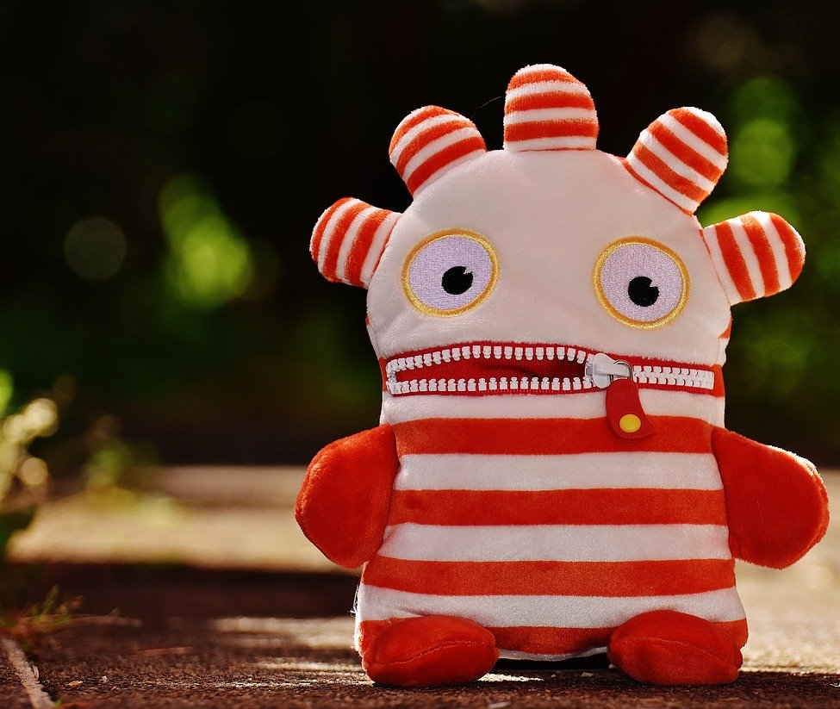
Worry
The amount of devotion to the subject of “worry” or “anxiety” in the Bible reveals its prominence as a problem of life…
…and a weapon that Satan uses against us

Slide 12
Worry: /ˈwərē/
μεριμνάω merimnaō
BDAG:
to be apprehensive, have anxiety, be anxious, be (unduly) concerned

Slide 13
Worry: /ˈwərē/
μεριμνάω merimnaō
Vincent’s Word Studies:
…derived from meris, a part; merizō, to divide; and was explained accordingly as a dividing care, distracting the heart from the true object of life

Slide 14
Worry: /ˈwərē/
μεριμνάω merimnaō
Vincent’s Word Studies:
…derived from meris, a part; merizō, to divide; and was explained accordingly as a dividing care, distracting the heart from the true object of life

Slide 15
Worry: /ˈwərē/
μεριμνάω merimnaō
Vincent’s Word Studies:
…derived from meris, a part; merizō, to divide; and was explained accordingly as a dividing care, distracting the heart from the true object of life

Slide 16
Worry: /ˈwərē/
μεριμνάω merimnaō
Worry or anxiety causes us to be divided in heart or “Double-minded” (Jas.4:8) (Lk.10:41)

Slide 17
Worry
Do you find yourself worrying or anxious about something almost every day?

Slide 18
Worry
Worrying can practically paralyze us in significant areas of our life
We become obsessed with our “concern”

Slide 19
Worry
“Anxiety in the heart of man causes depression, But a good word makes it glad”
(Prov.12:25)

Slide 20
Worry Can Be Controlled
Philippians 4:4-8
⁴ Rejoice in the Lord always. Again I will say, rejoice!
⁵ Let your gentleness be known to all men. The Lord is at hand.

Slide 21
Worry Can Be Controlled
Philippians 4:4-8
⁶ Be anxious for nothing, but in everything by prayer and supplication, with thanksgiving, let your requests be made known to God;

Slide 22
Worry Can Be Controlled
Philippians 4:4-8
⁷ and the peace of God, which surpasses all understanding, will guard your hearts and minds through Christ Jesus.

Slide 23
Worry Can Be Controlled
Philippians 4:4-8
⁷ and the peace of God, which surpasses all understanding, will guard your hearts and minds through Christ Jesus.

Slide 24
Worry Can Be Controlled
Philippians 4:4-8
⁸ Finally, brethren, whatever things are true, whatever things are noble, whatever things are just, whatever things are pure, whatever things are lovely, whatever things are of good report, if there is any virtue and if there is anything praiseworthy—meditate on these things.

Slide 25
Worry Can Be Controlled
Philippians 4:4-8
⁸ Finally, brethren, whatever things are true, whatever things are noble, whatever things are just, whatever things are pure, whatever things are lovely, whatever things are of good report, if there is any virtue and if there is anything praiseworthy—meditate on these things.

Slide 26
Prescription For A Worry-Free Life
Matthew 6:24-34

Slide 27
Prescription For A Worry-Free Life
Get your priorities straight
What comes first in your life? (v.24)
Life is more than food and clothing (temporal things) (v.25)
Concern over “this world” will choke out spiritual life (Matt.13:22)

Slide 28
Prescription For A Worry-Free Life
Trust in the providence of God
God will take care of you (v.30)
God is the giver of life and every good gift (Ac.17:25)
See His providential care for His creation (Matt.6:26-29) (1Pet.5:7)

Slide 29
Prescription For A Worry-Free Life
Don’t worry about what you can’t change
Leave those things in God’s hands (v.27)

Slide 30
Prescription For A Worry-Free Life
Seek first the kingdom of God
Eternal before temporal (v.33) (Lk.10:41-42) (Rom.14:17)

Slide 31
Prescription For A Worry-Free Life
Live one day at a time
While it is called today… (v.34) (Jas.4:14)
“Worry is interest paid on trouble that hasn’t come due”

Slide 32
Prescription For A Worry-Free Life
Matthew 6:24-34

