Slide 2
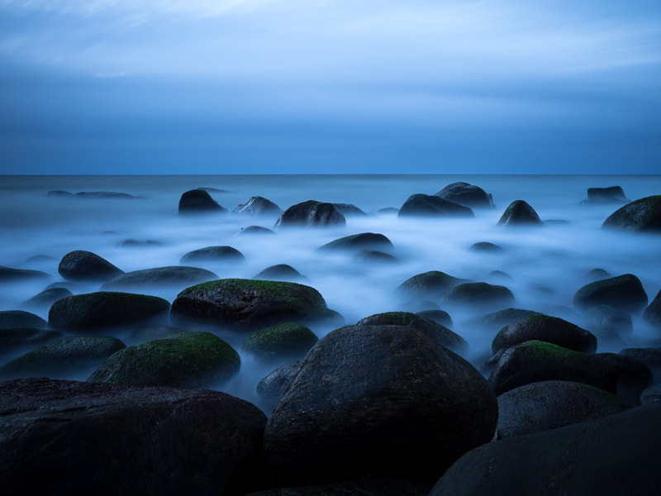
Luke 16:19-31
¹⁹ "There was a certain rich man who was clothed in purple and fine linen and fared sumptuously every day.

Slide 3
Luke 16:19-31
²⁰ But there was a certain beggar named Lazarus, full of sores, who was laid at his gate, ²¹ desiring to be fed with the crumbs which fell from the rich man's table. Moreover the dogs came and licked his sores.

Slide 4
Luke 16:19-31
²² So it was that the beggar died, and was carried by the angels to Abraham's bosom. The rich man also died and was buried. ²³ And being in torments in Hades, he lifted up his eyes and saw Abraham afar off, and Lazarus in his bosom.

Slide 5
Luke 16:19-31
²⁴ "Then he cried and said, 'Father Abraham, have mercy on me, and send Lazarus that he may dip the tip of his finger in water and cool my tongue; for I am tormented in this flame.’

Slide 6
Luke 16:19-31
²⁵ But Abraham said, 'Son, remember that in your lifetime you received your good things, and likewise Lazarus evil things; but now he is comforted and you are tormented.

Slide 7
Luke 16:19-31
²⁶ And besides all this, between us and you there is a great gulf fixed, so that those who want to pass from here to you cannot, nor can those from there pass to us.'

Slide 8
Luke 16:19-31
²⁷ "Then he said, 'I beg you therefore, father, that you would send him to my father's house, ²⁸ for I have five brothers, that he may testify to them, lest they also come to this place of torment.’

Slide 9
Luke 16:19-31
²⁹ Abraham said to him, They have Moses and the prophets; let them hear them.’ ³⁰ And he said, 'No, father Abraham; but if one goes to them from the dead, they will repent.’

Slide 10
Luke 16:19-31
³¹ But he said to him, 'If they do not hear Moses and the prophets, neither will they be persuaded though one rise from the dead.'"

Slide 11
Luke 16:19-31
The rich man’s request for Lazarus to warn his family
Abraham’s reply was “No - The have Moses and the Prophets”
The rich man believed that his family needed more than the Word of God

Slide 12
The Sufficiency of God’s Word
Luke 16:30

Slide 13
Isaiah 55:10-11
"For as the rain comes down, and the snow from heaven, And do not return there, But water the earth, And make it bring forth and bud, That it may give seed to the sower And bread to the eater,

Slide 14
Isaiah 55:10-11
So shall My word be that goes forth from My mouth; It shall not return to Me void, But it shall accomplish what I please, And it shall prosper in the thing for which I sent it.”

Slide 15
God’s Word Is Sufficient…
To Draw Men To Christ
(Jn.6:44-45)
To Save the Lost
(Rom.1:16)
To Edify The Saved
(Acts 20:32)

Slide 16
Why Doesn’t God’s Word Draw More People?
Some are not spiritually minded (Rom.8:5-7)
Some don’t love the Truth (2Thess.2:10-11)

Slide 17
Why Doesn’t God’s Word Draw More People?
Some are not willing to do His will (Jn.7:17)
Some are not willing to abide in His Word (Jn.8:31-32)

Slide 18
Why Doesn’t God’s Word Draw More People?
God’s Word accomplishes what He intends (Matt.11:25-26)

Slide 19
Why Doesn’t God’s Word Draw More People?
Many are trying to “help” God accomplish something that He never intended…

Slide 20
Trying to Draw the Carnally Minded With Carnal Things
Sensationalism
(Lk.16:30)
(1Cor.1:22)
Dynamic Speakers
(1Cor.2:1-5)
Changes in Worship

Slide 21
God’s Word Is Sufficient…
To Draw Men To Christ
(Jn.6:44-45)
To Save the Lost
(Rom.1:16)
To Edify The Saved
(Acts 20:32)

Slide 22
Isaiah 55:11
So shall My word be that goes forth from My mouth; It shall not return to Me void, But it shall accomplish what I please, And it shall prosper in the thing for which I sent it.

Slide 23
The Sufficiency of God’s Word
Luke 16:30

