Slide 2
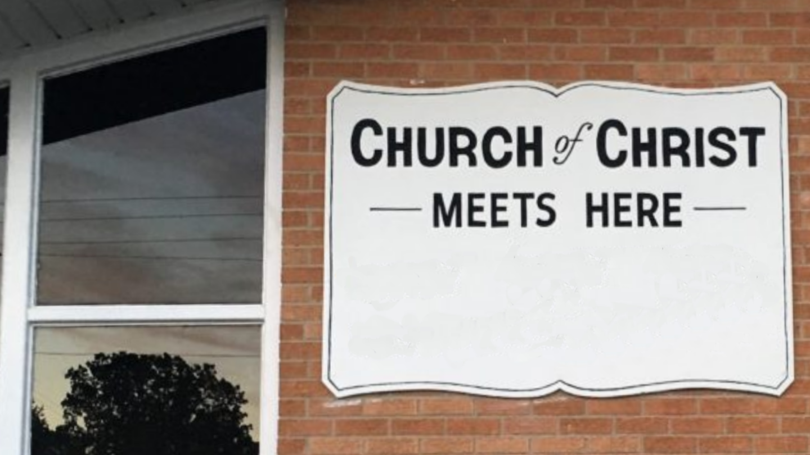
Is Our
Church
Unique?
“The churches of Christ greet you.”
(Romans 16:16)
Notes:
Is Our Church Unique?
The answer to the question is, “It depends…”
Definition: Unique – being the only one of its kind, unlike anything else
It is a superlative – (more unique, most unique are nonsensical)
First, as a congregation of the Lord (“churches of Christ”) we are in no way unique
There are many congregations all over the world, in all ages, that our congregation is like!
Our question is not intended to represent individual congregations, but to contrast the Lord’s church today with all other religious institutions. In that sense, it is unique. It is the only one of its kind. It is unlike anything else.
It alone was established by Jesus
(Matthew 16:18), “And I also say to you that you are Peter, and on this rock I will build My church, and the gates of Hades shall not prevail against it.”
Concerning other religious groups, they are not pleasing to God
(Matthew 15:13-14), [Note: Jesus was referring to the Pharisees, who opposed His teaching], “But He answered and said, “Every plant which My heavenly Father has not planted will be uprooted. ¹⁴ Let them alone. They are blind leaders of the blind. And if the blind leads the blind, both will fall into a ditch.”
Questions to ask.
Am I a part of that unique body.
Can our congregation be described as a group of Christians who are part of that unique body.
The claim is not sufficient. Certain things need to be present to be a part of that unique church
What are some of those things? Consider the following…

Slide 3
Same
Church
AS In
N.T.
Luke 8:11
Notes:
About the Church of Christ
We Strive to be the Same Church Described in the New Testament
Based on the Seed principle
(Luke 8:11), “Now the parable is this: The seed is the word of God.”
Wherever the seed is planted in fertile ground (the word of God), a Christian springs up, just like in the 1st century.
Nothing more and nothing less
We are human, and therefore subject to error, so we recognize the possibility that we may be wrong in our application of the Scriptures.
If we can be shown where we are wrong, by the Scriptures, we are willing and ready to change.

Slide 4
Spiritual
Emphasis,
Not
Social
1 Peter 2:5
1 Timothy 3:15
Notes:
About the Church of Christ
Our Emphasis is Spiritual, not Material or Social
Our building is designed to facilitate our work and worship
While as individuals Christians we seek each others’ association socially, the church is not a social club or agency and therefore the Lord’s money is not used to promote social functions or works.
Our aim is spiritual
(1 Peter 2:5), “you also, as living stones, are being built up a spiritual house, a holy priesthood, to offer up spiritual sacrifices acceptable to God through Jesus Christ.”
(1 Timothy 3:15), “but if I am delayed, I write so that you may know how you ought to conduct yourself in the house of God, which is the church of the living God, the pillar and ground of the truth.”

Slide 5
We Have
No
Human
Authority
Ephesians 1:22-23
1 Peter 5:1-3
Notes:
About the Church of Christ
We Have No Human Authority
There is no man, or group of men who legislate for the church. We have no one to answer to but Christ.
He is the head of the church
(Ephesians 1:22-23), “And He put all things under His feet, and gave Him to be head over all things to the church, ²³ which is His body, the fullness of Him who fills all in all.”
Each congregation is autonomous, with no oversight beyond the level of the local congregation
(1 Peter 5:1-3), “The elders who are among you I exhort, I who am a fellow elder and a witness of the sufferings of Christ, and also a partaker of the glory that will be revealed: ² Shepherd the flock of God which is among you, serving as overseers, not by compulsion but willingly, not for dishonest gain but eagerly; ³ nor as being lords over those entrusted to you, but being examples to the flock”

Slide 6
The
Bible is Our
Guide
Hebrews 1:1-2; 1 Peter 4:11
Deut. 4:2; Proverbs 30:5-6
Notes:
About the Church of Christ
The Bible is Our Guide in Serving God
Therefore we have no man-written creed books to follow.
We are governed in faith and conduct by the Bible alone.
While recognizing and heeding the guiding principles of the Old Testament, we seek to conform to the teachings of the New Testament
(Hebrews 1:1-2), “God, who at various times and in various ways spoke in time past to the fathers by the prophets, ² has in these last days spoken to us by His Son, whom He has appointed heir of all things, through whom also He made the world.”
(1 Peter 4:11), “If anyone speaks, let him speak as the oracles of God. If anyone ministers, let him do it as with the ability which God supplies, that in all things God may be glorified through Jesus Christ, to whom belong the glory and the dominion forever and ever. Amen.”
We accept the Bible as being both verbally inspired and infallible in content
Consequently, when the Bible speaks upon any given subject, its pronouncement is accepted as final.
By its own testimony, no one may with impunity alter a single word of it
(Deuteronomy 4:2), [Moses’ command to Israel], “You shall not add to the word which I command you, nor take from it, that you may keep the commandments of the Lord your God which I command you.”
(Proverbs 30:5-6), “Every word of God is pure; He is a shield to those who put their trust in Him. ⁶ Do not add to His words, lest He rebuke you, and you be found a liar.”

Slide 7
Our
Plea
For
Unity
John 17:20-21; 1 Cor. 1:10
Ephesians 4:1-6; Acts 2:44-46
Notes:
About the Church of Christ
Our Plea for Unity
We plead for unity among all who obediently respond to the doctrines and commandments given in the New Testament.
Such is in harmony with the prayer of Jesus and the pleadings of the apostle
(John. 17:20-21), “I do not pray for these alone, but also for those who will believe in Me through their word; ²¹ that they all may be one, as You, Father, are in Me, and I in You; that they also may be one in Us, that the world may believe that You sent Me.”
(1 Corinthians 1:10), “Now I plead with you, brethren, by the name of our Lord Jesus Christ, that you all speak the same thing, and that there be no divisions among you, but that you be perfectly joined together in the same mind and in the same judgment.”
(Ephesians 4:1-6), “I, therefore, the prisoner of the Lord, beseech you to walk worthy of the calling with which you were called, ² with all lowliness and gentleness, with longsuffering, bearing with one another in love, ³ endeavoring to keep the unity of the Spirit in the bond of peace. ⁴ There is one body and one Spirit, just as you were called in one hope of your calling; ⁵ one Lord, one faith, one baptism; ⁶ one God and Father of all, who is above all, and through all, and in you all.”
We also note that unity and love for each other was a mark of discipleship in the early churches
(Acts 2:44-46), “Now all who believed were together, and had all things in common, ⁴⁵ and sold their possessions and goods, and divided them among all, as anyone had need. ⁴⁶ So continuing daily with one accord in the temple, and breaking bread from house to house, they ate their food with gladness and simplicity of heart.”
Division has always been the result of departure from “the faith which was once delivered unto the saints” (Jude 3)
We believe that division can be healed by a return to the revealed word of God.

Slide 8
So, what is the
Answer?
The church of Christ is indeed unique. Are you a member?
Notes:
The Lord’s church is unique
Invitation: Are you a member of that church?

