Slide 2
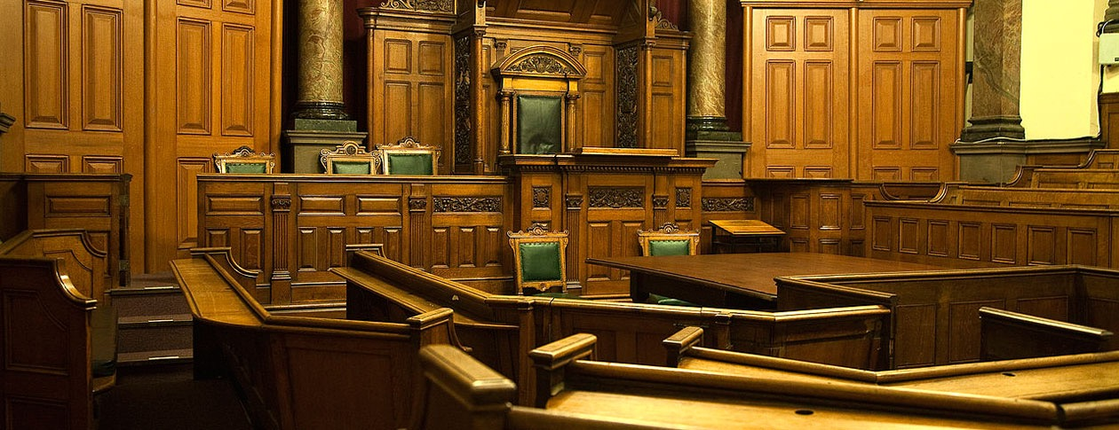
The Defense for My Hope
1 Peter 3:15

Slide 3
The Grounds of My Defense
The Need for a Defense
Defense – apologia – a reasoned statement or argument. (Strong)
Faith and hope are to be established on evidence, not any matter of subjectivity – Acts 17:1-4, 11; Hebrews 11:1
The Standard
The Lordship of Christ – 1 Peter 3:15; John 5:24-27; 12:48
If my hope does not rest on the word of Christ it is false.
The conduct of my defense – “with meekness and fear”

Slide 4
The Defense for My Hope
The Hope
The hope introduced – 1 Peter 1:3-5
(v. 3) – gained by birth from God. (spiritual)
(v. 4) – an inheritance. (spiritual)
(v. 5) – obtained through faith.

Slide 5
The Defense for My Hope
The Hope
The hope introduced – 1 Peter 1:3-5
The “right” of birth where the hope is given – John 1:12-13
“right” – exousia – authority. (Requires obedience – Luke 6:46; Colossians 3:17; 1 Peter 1:13-14)
(v. 13) – those who receive Him and believe in His name become a child of God by being born of God.

Slide 6
The Defense for My Hope
Born of God
Jesus speaks of the new birth – John 3:3-8
(v. 3) – “again” (cf. 1 Peter 1:3 – “begotten again”)
(v. 5) – characteristics of birth introduced – “of water and the Spirit.”
(vv. 4, 6-8) – confusion of Nicodemus and Jesus’ explanation.
(v. 5) – birth to enter the kingdom.
Matthew 19:23-30 – for salvation, and by “regeneration.”
Colossians 1:13-14 – for redemption, and forgiveness of sins.

Slide 7
The Defense for My Hope
Born of Water and the Spirit
New birth expounded upon – 1 Peter 1:22-25
(v. 22) – purified souls. (blessings of the kingdom)
(v. 23) – born of the word of God. (cf. Luke 8:11; 1 John 3:9; James 1:17)
Spirit?
(v. 22) – obeyed truth through the Spirit.
The Spirit’s work is the word’s work – 1 Peter 1:2; John 17:17; 2 Thessalonians 2:13-14; Ephesians 6:17
To be born of the Spirit is to be born of the word of God.

Slide 8
The Defense for My Hope
Born of Water and the Spirit
Born of the Spirit = born of the word.
Water?
Word of God = gospel – 1 Peter 1:25
Gospel’s command – Mark 16:15-16 – believe and be baptized.
Baptism in water in the name of the Lord – Acts 2:38; 10:47-48
Born of water and the Spirit = baptism in water in the name of the Lord

Slide 9
The Defense for My Hope
Born of Water and the Spirit
Born of the Spirit = born of the word.
Born of water and the Spirit = baptism in water in the name of the Lord
Supporting Evidence:
Washing of regeneration and renewing of the Holy Spirit – Titus 3:5 (Synonymous with John 3:3, 5)
Hebrews 10:22; 9:13-14 – washed with water to cleanse conscience.
1 Peter 3:21 – conscience cleansed in baptism.

Slide 10
The Defense for My Hope
Validity of My Hope Defended and Established
I have been born again and am God’s child.
This happened when I was born of water and the Spirit.
This happened when I was baptized in water in the name of the Lord where I received a clear conscience through the removal of my sins.
Having been born again, I have been given a living hope, i.e. an inheritance, for which I am kept by faith for salvation in the end. (cf. 1 Peter 1:3-5)

Slide 11
The Defense for My Hope
A Final Defense for My Hope – Galatians 3:26-29
I AM a son of God through faith
Because I HAVE been baptized into Christ
Thus I HAVE put on Christ
And I AM Abraham’s seed and an heir according to the promise.

Slide 12
The Defense for My Hope
A Final Defense for My Hope – Galatians 3:26-29
I AM NOT a son of God through faith
Because I HAVE NOT been baptized into Christ
Thus I HAVE NOT put on Christ
And I AM NOT Abraham’s seed and an heir according to the promise.

Slide 13
The Defense for My Hope
1 Peter 3:15

