Slide 1
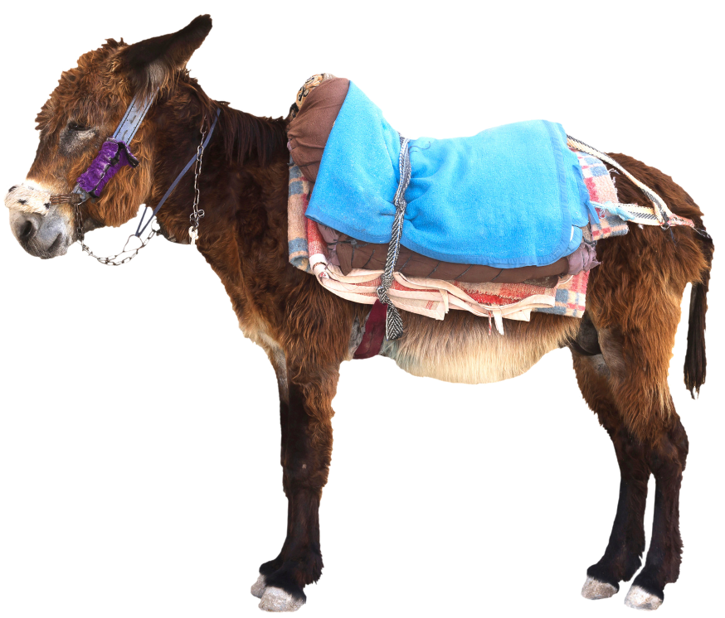
Jesus’ Entry into Jerusalem
Matthew 21:1-11
Mark 11:1-11
Luke 19:28-40
John 12:12-19
Notes:
Matthew 21:1-11
At Mount of Olives Jesus sent Disciples to find Donkey & Colt to bring to him.
When stated “The Lord has need of them” will be given permission
Fulfillment of Prophecy (Zechariah 9:9)
Daughter of Zion
King is Coming
Lowly on a donkey, a colt, the foal of a donkey
Multitude laid coats and others cut down branches from trees and spread them on the road
Multitude before and following cried out. “Hosanna to the Son of David”. Blessed is He who comes in the name of the Lord. Hosanna in the highest.” (Psalm 118:26; Matthew 23:39)
Came into Jerusalem (ALL the city was moved, saying “who is this”
Answer (from multitudes) Jesus, the prophet from Nazareth of Galilee
Mark 11:1-11
Mentions only the colt, the foal that Jesus sat upon
Here added “Blessed is the kingdom of our Father David”
Jesus went into Jerusalem and into the temple. Went back to Bethany with the 12.
Luke 19:28-40
Also, “Peace in Heaven and glory in the highest”
Pharisees asked Jesus to rebuke them
His response: “I tell you that if these should keep silent, the stones would immediately cry out.”
John 12:12-19
Great multitude went to Jesus when they heard he was coming to Jerusalem
They took branches of palm trees and wen out to meet him,
Called Him “The King of Israel!”
Jesus sat on a donkey, fulfilling prophecy (Zechariah 9:9)
Disciples did not grasp significance until Jesus was glorified (Ascension into heaven?) and they remembered that these things were written about him and that they had done these things to him.
Witnesses of Lazarus being raised from dead testified
Others also met Him, because they had heard of this thing. (The resurrection of Lazarus
The Pharisees acknowledged the influence that Jesus was gaining.
Note: Except for a few small details, the synoptic gospels all basically say the same
John includes commentary of the disciples misunderstanding, and that the Pharisees despaired, but left out other details.

Slide 2
What We Learn from Matthew XXI
What God wants He Gets! (2-3)
Isaiah 46:9-11; Acts 17:24-26
Fulfilled Prophecy! (4-5)
Matthew 1:1, 22-23; 27:35
Jesus Was A Big Thing! (10-11)
Revelation 1:10-18; 5:1-10
Notes:
What We Learn from Matthew 21
What God Wants He Gets! (vs. 2-3)
(Isaiah 46:9-11), [God’s warning to the ungodly] “Remember the former things of old, for I am God, and there is no other; I am God, and there is none like Me, ¹⁰ Declaring the end from the beginning, and from ancient times things that are not yet done, saying, My counsel shall stand, and I will do all My pleasure,’ ¹¹ Calling a bird of prey from the east, the man who executes My counsel, from a far country. Indeed I have spoken it; I will also bring it to pass. I have purposed it; I will also do it.”
(Acts 17:24-26), “God, who made the world and everything in it, since He is Lord of heaven and earth, does not dwell in temples made with hands. ²⁵ Nor is He worshiped with men’s hands, as though He needed anything, since He gives to all life, breath, and all things. ²⁶ And He has made from one blood every nation of men to dwell on all the face of the earth, and has determined their preappointed times and the boundaries of their dwellings,”
[CLICK] Jesus actions here fulfilled Prophecy (vs. 4-5)
The purpose of fulfilling prophecy was to prove (especially to the Jews) that He was the Christ
Conservatively, it is estimated that Jesus fulfilled well over 300 prophecies in His earthy ministry
This is only one of them
From His being the descendent of Abraham to Isaac
(Matthew 1:1), “The book of the genealogy of Jesus Christ, the Son of David, the Son of Abraham:”
God coming into the World
(Matthew 1:22-23), “So all this was done that it might be fulfilled which was spoken by the Lord through the prophet, saying: ²³ “Behold, the virgin shall be with child, and bear a Son, and they shall call His name Immanuel,” which is translated, “God with us.”
To His death on the cross!
(Matthew 27:35), “Then they crucified Him, and divided His garments, casting lots, that it might be fulfilled which was spoken by the prophet: “They divided My garments among them, and for My clothing they cast lots.”
Jesus was truly the subject of Messianic prophecy, the true anointed of God, His only Begotten Son!
[CLICK] There are skeptics, who accept Jesus existed, but claim that his life and ministry were inconsequential. He was only an itinerant preacher, whose influence and significance were miniscule. Not So!, Jesus was a Big Thing! (vs. 10-11)
In fact, Jesus was the biggest thing, He has changed the world
Our calendars are based on his birth (B.C, A.D., not CE, BCE)
He is the reason for Easter, Thanksgiving and Christmas in America
The Christian faith breaks down borders (they are found in every nation)
More importantly, Jesus is THE Big thing, Spiritually, heavenly, and eternal!
(Revelation 1:10-18), “I was in the Spirit on the Lord’s Day, and I heard behind me a loud voice, as of a trumpet, ¹¹ saying, “I am the Alpha and the Omega, the First and the Last,” and, “What you see, write in a book and send it to the seven churches which are in Asia: to Ephesus, to Smyrna, to Pergamos, to Thyatira, to Sardis, to Philadelphia, and to Laodicea.” ¹² Then I turned to see the voice that spoke with me. And having turned I saw seven golden lampstands, ¹³ and in the midst of the seven lampstands One like the Son of Man, clothed with a garment down to the feet and girded about the chest with a golden band. ¹⁴ His head and hair were white like wool, as white as snow, and His eyes like a flame of fire; ¹⁵ His feet were like fine brass, as if refined in a furnace, and His voice as the sound of many waters; ¹⁶ He had in His right hand seven stars, out of His mouth went a sharp two-edged sword, and His countenance was like the sun shining in its strength. ¹⁷ And when I saw Him, I fell at His feet as dead. But He laid His right hand on me, saying to me, “Do not be afraid; I am the First and the Last. ¹⁸ I am He who lives, and was dead, and behold, I am alive forevermore. Amen. And I have the keys of Hades and of Death.”
(Revelation 5:1-10), “And I saw in the right hand of Him who sat on the throne a scroll written inside and on the back, sealed with seven seals. ² Then I saw a strong angel proclaiming with a loud voice, “Who is worthy to open the scroll and to loose its seals?” ³ And no one in heaven or on the earth or under the earth was able to open the scroll, or to look at it. ⁴ So I wept much, because no one was found worthy to open and read the scroll, or to look at it. ⁵ But one of the elders said to me, “Do not weep. Behold, the Lion of the tribe of Judah, the Root of David, has prevailed to open the scroll and to loose its seven seals.” ⁶ And I looked, and behold, in the midst of the throne and of the four living creatures, and in the midst of the elders, stood a Lamb as though it had been slain, having seven horns and seven eyes, which are the seven Spirits of God sent out into all the earth. ⁷ Then He came and took the scroll out of the right hand of Him who sat on the throne. ⁸ Now when He had taken the scroll, the four living creatures and the twenty-four elders fell down before the Lamb, each having a harp, and golden bowls full of incense, which are the prayers of the saints. ⁹ And they sang a new song, saying: “You are worthy to take the scroll, And to open its seals; For You were slain, And have redeemed us to God by Your blood Out of every tribe and tongue and people and nation, ¹⁰ And have made us kings and priests to our God; And we shall reign on the earth.”

Slide 3
Conclusion
Jesus deserved the worship He received upon entering Jerusalem those few days before His betrayal and death.
(Revelation 5:11-14)
Notes:
Conclusion:
Jesus deserved the worship He received in our text
He deserves every note of praise we offer each day of our lives
He deserves our songs of praise, and the praise of our prayers and voices in worship
(Revelation 5:11-14), “Then I looked, and I heard the voice of many angels around the throne, the living creatures, and the elders; and the number of them was ten thousand times ten thousand, and thousands of thousands, ¹² saying with a loud voice: “Worthy is the Lamb who was slain to receive power and riches and wisdom, and strength and honor and glory and blessing!” ¹³ And every creature which is in heaven and on the earth and under the earth and such as are in the sea, and all that are in them, I heard saying: “Blessing and honor and glory and power be to Him who sits on the throne, and to the Lamb, forever and ever!” ¹⁴ Then the four living creatures said, “Amen!” And the twenty-four elders fell down and worshiped Him who lives forever and ever.”

