Slide 1
Characters & Qualities
Job
Peter
Nehemiah
Elijah
Daniel
Abraham
Perseverance
Impetuosity
Leadership
Courage
Conviction
FAITH

Slide 2
Abraham: The Father Of The Faithful
Rom. 4:11: ¹¹And he received the sign of circumcision, a seal of the righteousness of the faith which he had while still uncircumcised, that he might be the father of all those who believe, though they are uncircumcised, that righteousness might be imputed to them also,

Slide 3
Abraham: The Father Of The Faithful
Rom. 4:16: ¹⁶Therefore it is of faith that it might be according to grace, so that the promise might be sure to all the seed, not only to those who are of the law, but also to those who are of the faith of Abraham, who is the father of us all

Slide 4
Those Who Are Of Faith Are: The Sons Of Abraham
Gal. 3:6-7: ⁶just as Abraham “believed God, and it was accounted to him for righteousness.” ⁷Therefore know that only those who are of faith are sons of Abraham.

Slide 5
Those Who Are Of Faith Are: The Sons Of Abraham
Gal. 3:26-29: ²⁶For you are all sons of God through faith in Christ Jesus. ²⁷For as many of you as were baptized into Christ have put on Christ. ²⁸There is neither Jew nor Greek, there is neither slave nor free, there is neither male nor female; for you are all one in Christ Jesus. ²⁹And if you are Christ’s, then you are Abraham’s seed, and heirs according to the promise.

Slide 6
Those Who Are Of Faith Are: Blessed With Abraham
Gal. 3:9: ⁹So then those who are of faith are blessed with believing Abraham.

Slide 7
Faith Is Essential
Heb 11:6: ⁶But without faith it is impossible to please Him, for he who comes to God must believe that He is, and that He is a rewarder of those who diligently seek Him.
Jn. 8:24: ²⁴Therefore I said to you that you will die in your sins; for if you do not believe that I am He, you will die in your sins.”

Slide 8
Not All Faith Will Save (Jas. 2:14-26)
14
Faith – Works = Unsaved
17
Faith – Works = Dead
18
Faith – Works = Indemonstrable
20
Faith – Works = Dead
22
Faith + Works = Made Perfect (Complete)
24
Works + Faith = Justified
26
Faith – Works = Dead

Slide 9
Unsaved Believers
The Jews (Jn. 8:30-32, 44)
The rulers (Jn. 12:42-43)
King Agrippa (Acts 26:27-29)
The demons (Jas. 2:19)

Slide 10
We Must Have A Faith Like: The Faith Of Abraham
Rom. 4:16: ¹⁶Therefore it is of faith that it might be according to grace, so that the promise might be sure to all the seed, not only to those who are of the law, but also to those who are of the faith of Abraham, who is the father of us all

Slide 11
We Must Have A Faith That: Walks In Abraham’s Steps
Rom. 4:11-12: ¹¹And he received the sign of circumcision, a seal of the righteousness of the faith which he had while still uncircumcised, that he might be the father of all those who believe, though they are uncircumcised, that righteousness might be imputed to them also, ¹²and the father of circumcision to those who not only are of the circumcision, but who also walk in the steps of the faith which our father Abraham had while still uncircumcised.

Slide 12
We Must Have A Faith That: Walks In Abraham’s Steps
Jn. 8:39: ³⁹They answered and said to Him, “Abraham is our father.” Jesus said to them, “If you were Abraham’s children, you would do the works of Abraham.
This does not mean that we must do everything that God commanded Abraham to do
It means that we must do whatever God instructs us to do with the same kind of faith that Abraham had

Slide 13
I’m Not Saying…
Your faith must lead to sinlessness
Abraham was not sinless (Gen. 12:10-20; 20:1-18)
You must have the same strength or maturity of faith right now
Abraham grew in faith (Gen. 17:15ff; Rom. 4:18ff)
God expects us to grow in faith (2 Th. 1:3)

Slide 14
I Am Saying…
You must have the same kind of faith as Abraham’s faith
Not just any kind of faith is saving faith
The rulers (Jn. 12:42-43)
The demons (Jas. 2:19-24)

Slide 15
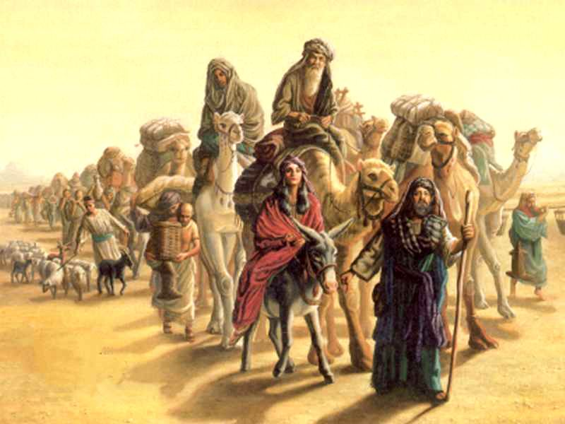
The Faith Of Abraham

Slide 16
The Faith Of Abraham
Call (Gen. 12:1-4; Heb. 11:8-10)
Circumcision (Gen. 17:9-14, 23-27; Rom. 4:11)
Offering (Gen. 22:1-14; Heb. 11:17-19)

Slide 17
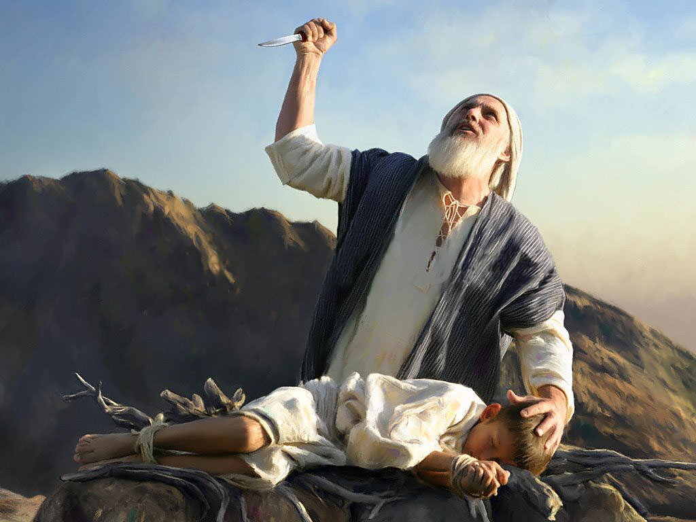
The Faith Of Abraham
Believes
Does
Gives

Slide 18
Others, Like Abraham
Moses (Heb. 11:24-27)
OT worthies (Heb. 11:32-40)
Remnant (Ezra 10:1-4, 10-11)
Saul of Tarsus (Phil. 3:4-8)
Corinthians (1 Cor. 6:9-11)
Stephen, Antipas, & Paul (Acts 7:54-60; Rev. 2:13; 2 Tim. 4:6-8)

