Slide 1
A Significant Difference
Mt. 8:5-7: ⁵ Now when Jesus had entered Capernaum, a centurion came to Him, pleading with Him, ⁶ saying, “Lord, my servant is lying at home paralyzed, dreadfully tormented.” ⁷ And Jesus said to him, “I will come and heal him.”
Lk. 7:2-3: ² And a certain centurion’s servant, who was dear to him, was sick and ready to die. ³ So when he heard about Jesus, he sent elders of the Jews to Him, pleading with Him to come and heal his servant.

Slide 2
Centurion’s Servant
“Lying at home paralyzed, dreadfully tormented” (Mt. 8:6)
“Sick and ready to die” (Lk. 7:2)

Slide 3
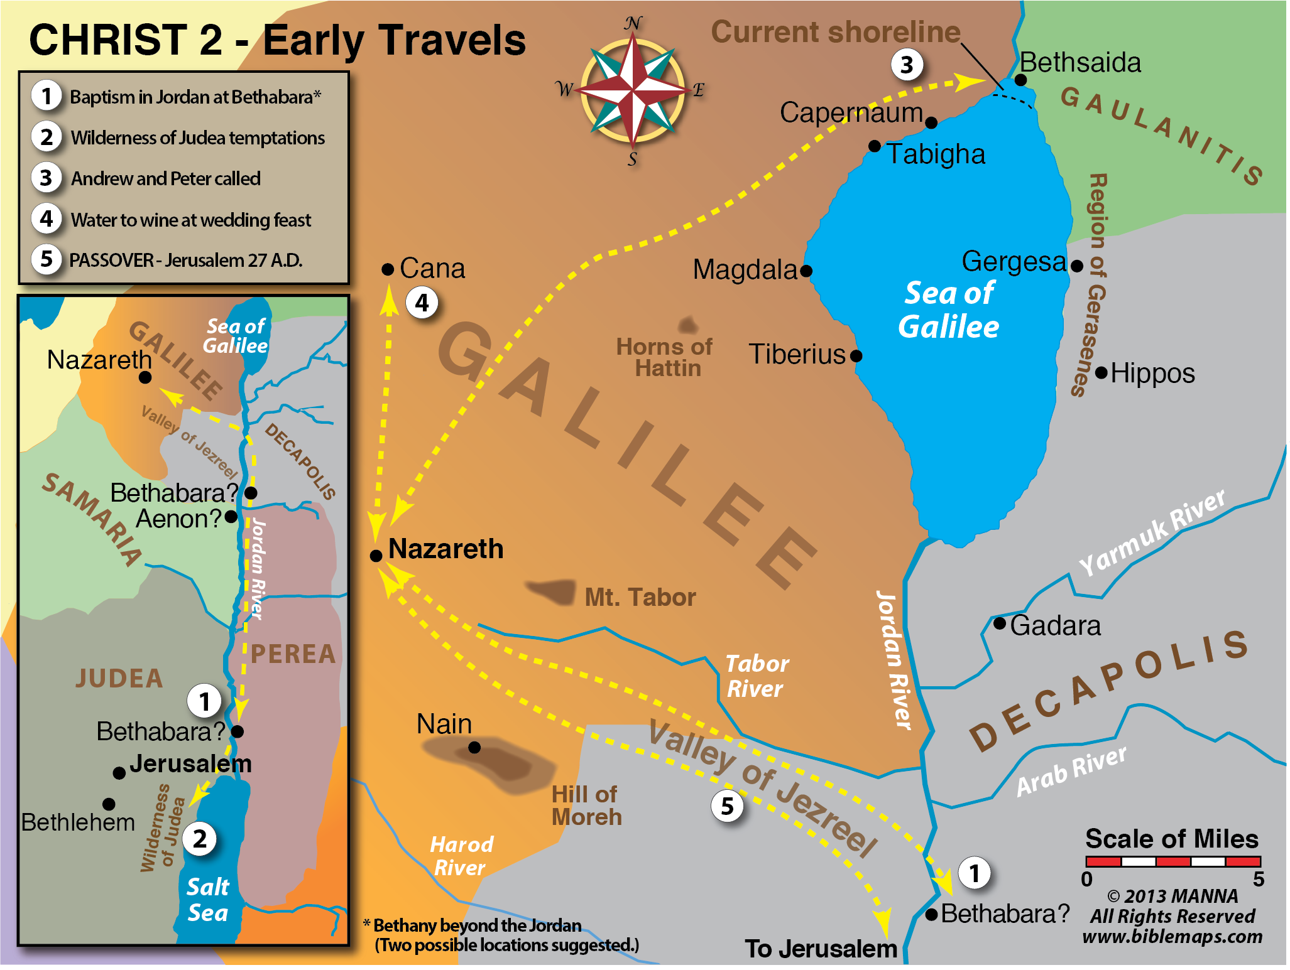
Centurion
Lived in Capernaum (Mt. 8:5; Lk. 7:1)
Centurion (Mt. 8:5; Lk. 7:2)
Gentile (Lk. 7:3-5, 9)
Good relationship with the Jews (Lk. 7:3-5)
Some wealth (Lk. 7:2, 5)

Slide 4
Centurion
Made some financial sacrifice (Lk. 7:5)
Loved his servant (Lk. 7:2, 3-4)
A very humble man (Mt. 8:8; Lk. 7:6-7)
A man of rare faith (Lk. 7:3, 6-7; Mt. 8:10)

Slide 5
The Centurion
Heard about Jesus (Lk. 7:3)
Confident of Jesus’ power (Lk. 7:7; Mt. 8:8)
Understood authority (Lk. 7:8; Mt. 8:9)

Slide 6
A Centurion’s Rare Faith

Slide 7
A Centurion’s Rare Faith
It’s Possible To Believe Without Seeing
Authority Is The Right And Power To Command
Being Under Authority Means That You Do What You’re Told To Do

Slide 8
“Authority”
“The right and power to command, enforce laws, exact obedience, determine, or judge.”
--The American Heritage Dictionary:

Slide 9
Christ Has All Authority (Mt. 28:18)
Angels, authorities, and powers (1 Pet. 3:22)
Principalities and powers (Col. 2:9-10, 14-15)
Rule, authority, power, dominion, every name (Eph. 1:20-21)
All things to the church (Eph. 1:22-23)
All flesh (Jn. 17:1-2)
All things (Jn. 13:3; 1 Cor. 15:27; Eph. 1:22)
Kings (1 Tim. 6:14-15; Rev. 1:5; 17:14; 19:15-16)
Death and Hades (Rev. 1:18)

Slide 10
A Centurion’s Rare Faith
Sometimes Great Faith Is Exhibited By Unlikely People
Many Sons Of The Kingdom Will Be Rejected

Slide 11
“O You Of Little Faith”
Worry
Worrying about food, shelter, & clothing (Mt. 6:25-34; cf. Lk. 12:22-32)
Calming the storm (Mt. 8:23-27; cf. Mk. 4:35-41; Lk. 8:22-25)
Walking on the water Mt. 14:22-23; (Mk. 6:45-52; Jn. 6:15-21)
Beware of the leaven of the Pharisees (Mt. 16:5-12; cf. Mk. 8:13-21)
Fear
Doubt
Imperceptiveness

Slide 12
A Centurion’s Rare Faith

Slide 13
Four Lessons
His Humility (Mt. 5:3; 23:11-12; 1 Pet. 5:6)
Worthy in the eyes of the Jewish elders
Unworthy in his own eyes
His Faith (Jn. 20:39)
Heard, not seen
No prior evidence of healing at a distance with just a word (cf. Jn. 4:46-53)
Lacked heritage of OT revelation

Slide 14
Unsaved Believers
The Jews (Jn. 8:30-32, 44)
The rulers (Jn. 12:42-43)
King Agrippa (Acts 26:27-29)
The demons (Jas. 2:19)
Satan

Slide 15
Faith
Different kinds of faith
Strong faith develops over time
Faith can regress (Heb. 3:12)
Produced by the word (Rom. 10:17)
Evidence to produce conviction (Jn. 20:30-31)
Faithful promises to build trust (Lk. 5:1-13)
Commands that call for surrender (Lk. 6:46)

Slide 16
Four Lessons
His Understanding Of Authority (Mt. 28:18)
The Sons Of This World Are Wiser Than The Sons Of Light (Lk. 16:8)

Slide 17
Different Kinds Of Faith
Little (Mt. 6:30; 8:26; 14:31; 16:8; Lk. 12:28) | Great (Mt. 8:10; Lk. 7:9)
Weak (Rom. 14:1) | Strong (Rom. 15:1)
Dead (Jas. 2:17, 26) | Living
Non-working (Jas. 2:14, 17) | Working (Jas. 2:18)
Demonic (Jas. 2:19) | Saving
Barren (Jas. 2:20) | Productive

Slide 18
The Centurion
Regarded his slave highly (Lk. 7:2)
Heard about Jesus (Lk. 7:3)
Highly respected by Jews (Lk. 7:4)
Loved Jews (Lk. 7:5)
Built synagogue (Lk. 7:5)
Humble (Lk. 7:6-7; Mt. 8:8)
Confident of Jesus’ power (Lk. 7:7; Mt. 8:8)
Understood authority (Lk. 7:8; Mt. 8:9)

