Slide 1
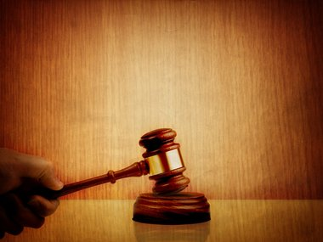
THE DAY OF JUDGMENT
Acts 17:30-31

Slide 2
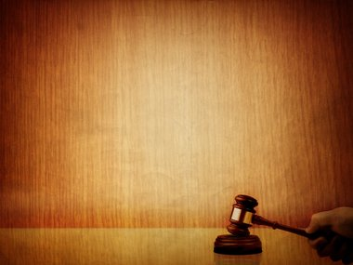
It Speaks Of Those Who Will Be Judged.
It Speaks Of The Great Judge.
It Speaks Of The Rule Or Standard Of Judgment.
It Speaks Of The Purpose Of Judgment.
THE DAY OF JUDGMENT
Acts 17:30-31

Slide 3
We Will Be Judged According To:
Our Deeds
Our Words
Our Thoughts
The Finality Of Judgment.
THE DAY OF JUDGMENT
Acts 17:30-31

Slide 4
There Will Be Some Things That You Will
Remember At The Time Of Judgment, If You Are LOST.
The Opportunities You Had To Obey The Gospel.
The Opportunities You Had To Be Restored To The Lord.
The Times You Put Other Things Before The Lord.
THE DAY OF JUDGMENT
Acts 17:30-31

Slide 5
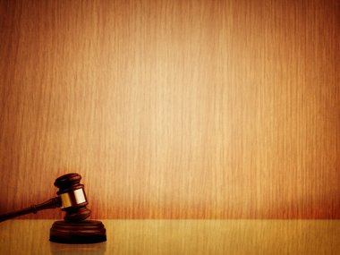
WHAT KIND OF DAY WILL
THE JUDGMENT BE FOR YOU?
WHAT WILL YOUR ANSWER BE?

