Slide 1
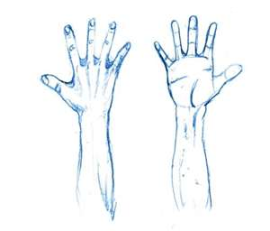
Why We Do Not Use Handmade Music In Worship
Acts 17:22-28

Slide 2
Our worship is not in handmade tabernacles – Heb 9:11
Worship therefore cannot be handmade – Acts 17:25
Christ not in handmade temple – Acts 17:24; Heb 9:24
God is not worshipped by manmade system – Mt 15:9
Worship must be in Spirit and Truth – Jn 4:24

Slide 3
A. Our Reasons For Opposing the Instrument in Worship
Must not go beyond the doctrine of Christ – 1Cor 4:6
Must not add to what is written – Rev 22:18
Must walk by faith – 2Cor 5:7
a. Faith obtained only through words – Rom 10:17
b. Whatsoever is not faith, is sin – Rom 14:23

Slide 4
A. Our Reasons For Opposing the Instrument in Worship
4. Instrument not a part of truth – Jn 16:13
a. Worship must be in truth – Jn 4:24
b. Not a part of the counsel of God – Acts 20:27
c. Peter never bound it – Mt 16:19
5. God is not worshipped with man’s hands – Acts 17:24

Slide 5
A. Our Reasons For Opposing the Instrument in Worship
6. We do not pray with machinery – 1Cor 14:15
a. Why use it in worship in singing?
7. God’s silence is not authority for anything
a. If silence is authority then scripture is nothing – 2Tim 3:16-17

Slide 6
B. Our Objections to the Instrument:
It was not used in OT worship before David
It was condemned by Amos – Amos 6:1-5
Cannot justify NT worship by OT scriptures – Gal 5:4
We are opposed to worship AS tradition – Mk 7:1-9
Introduced by Pope Vitalian in 666AD

Slide 7
C. The New Testament - Authorizes & Commands Singing
Jesus introduced it – Mt 26:30; Mk 14:26
Practiced by apostles – Acts 16:25; James 5:13
Taught to disciples – Eph 5:19; Col 3:16; 1Cor 14:15
Singing in Worship is For:
a. Edification – Col 3:19; Acts 16 (Paul/Silas)
b. Praise – Rom 15:9; Heb 2:12
c. Joy – James 5:13

Slide 8
CONCLUSION: How does the matter look to you? Had you not rather be right and be saved, than to be wrong and be lost?

