Slide 1
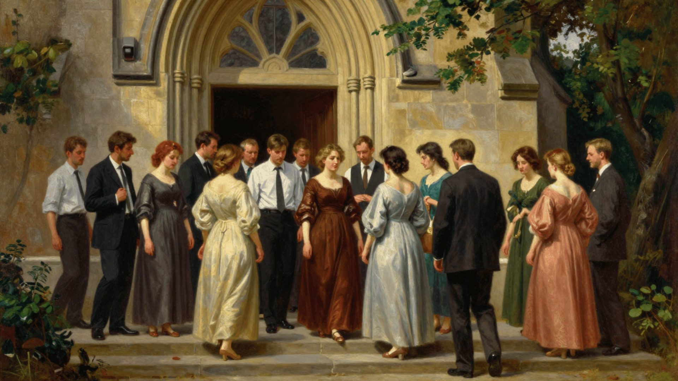
Local Church Autonomy
God’s Design
Matthew 16:18-19; Acts 2:41,47; Ephesians 1:22-23
Men alter the Plan!
Our Focus: Scriptural Concept of Autonomy

Slide 2

Universal VS Local
No institutional structure
for the universal church
    Acts 2:46-47
Structure: Local churches
    Romans 16:16
Local work and worship
    Acts 20:7; Hebrews 10:24-25; 1 Corinthians 5:4-5
Not Denominationalism

Slide 3
Concept: Autonomy
A Scriptural Concept
    Eph. 1:22-23; Matt. 28:18
    Jn. 14:15; 1 Cor. 16:1
God’s Safeguard
    Phi. 1:1-2; 1 Pet. 5:1-4
    Acts 20:28
Consider Nature of Apostasy
    2 Tim. 4:3-4
Nothing Greater Than Local
    Acts 20:28

Slide 4
A Different Distortion
Hiding behind Autonomy
    Jude 3; 1 Timothy 1:18-20
We can do what we want?
    1 Corinthians 5:9-11
A Word About the Eldership
    Matthew 28:18
    2 Corinthians 5:5-10

Slide 5
Conclusion
The Concept of Local Church Autonomy allows a congregation to stand firm doing Christ's will, no matter what others may do!

