Slide 1
Dangers For Every Generation

Slide 2
Dangers For Every Generation
Joshua 24:15 “And if it seem evil unto you to serve Jehovah, choose you this day whom ye will serve; whether the gods which your fathers served that were beyond the River, or the gods of the Amorites, in whose land ye dwell: but as for me and my house, we will serve Jehovah.”
We all make choices. (Romans 6:16-18)

Slide 3
The Loss Of The Godly Home
Man’s role… is to provide leadership for his wife and love her as Christ also loved the church. Ephesians 5:22-33; Cf. 1 Corinthians 13:4-8.
Leave and cleave. Genesis 2:24
Dwell with her. 1 Peter 3:7
Provide spiritually. Ephesians 6:4

Slide 4
The Loss Of The Godly Home
Woman's role… is a role of quiet subjection.
Ephesians 5:22-24, 33. (Fobeoo, Gk.)
“To have such awe or respect for a person as to involve a measure of fear - 'to fear, to show great reverence for, to show great respect for.’ (from Greek-English Lexicon Based on Semantic Domain)
To reverence, venerate, to treat with deference or reverential obedience: (Thayer's Greek Lexicon)
To love her husband, to love her children. Titus 2:4-5

Slide 5
The Loss Of The Godly Home
Woman's role… Place of importance.
Proverbs 18:22 “Whoso findeth a wife findeth a good thing, and obtaineth favor of the Lord.”
Genesis 2:18 “Not good for man to be alone…” “help meet..”

Slide 6
The Loss Of The Godly Home
Woman's role… Place of importance.
Proverbs 31:26-29 “She openeth her mouth with wisdom; And the law of kindness is on her tongue. She looketh well to the ways of her household, And eateth not the bread of idleness. Her children rise up, and call her blessed; Her husband (also), and he praiseth her, (saying): Many daughters have done worthily, But thou excellest them all.”

Slide 7
The Loss Of The Godly Home
Evidence of change.
1. A Pew Forum (JANUARY 6, 2011) survey said 39 percent of Americans believe marriage is obsolete.
2. More than half (54%) of Americans say marriage is important but not essential to leading a fulfilling life. (FEBRUARY 14, 2020)
3. The U.S. Census reports that 41 percent of births in America are to parents who are unmarried.
4. In 2021, seventy-two percent, up from 53% in 2001, consider sex between an unmarried man and woman morally acceptable.” (https://news.gallup.com/poll/316223/fewer-say-important-parents-married.aspx)
5. (KNX 1070 NEWS RADIO, 9-27-12)By next year, same sex marriage will be before the Supreme Court of the United States.

Slide 8
The Loss Of The Godly Home
Effect upon children.
Little chance of survival. Cf. Deuteronomy 4:6; Judges 2:10
No example. Ephesians 6:4
Unresolved sin develops the “I’m through” attitude. Cf. Ephesians 4:31-32
Moral values decline.
Even in the church. 1 Corinthians 5:6
No ability to blush. Jeremiah 6:15; Shame. Ephesians 5:12
Believe we have freedom without consequence. Jeremiah 23:17; Cf. Galatians 6:7-8

Slide 9
The Loss Of Hunger For Righteousness
“Prophesy not unto us right things, speak unto us smooth things, prophesy deceits” (Isaiah 30:10)
“Blessed are those who hunger and thirst for righteousness, for they shall be satisfied.” (Matthew 5:6; Note 1 Peter 2:1)
The Lord is the RIGHTEOUS JUDGE (2 Timothy 4:8).
We will be judged by a righteous standard. (John 12:48)

Slide 10
The Loss Of Hunger For Righteousness
What will the next generation be? Judges 2:10
Fear of losing our young people turns the church into a social club.
Perverted the mission of the church.

Slide 11
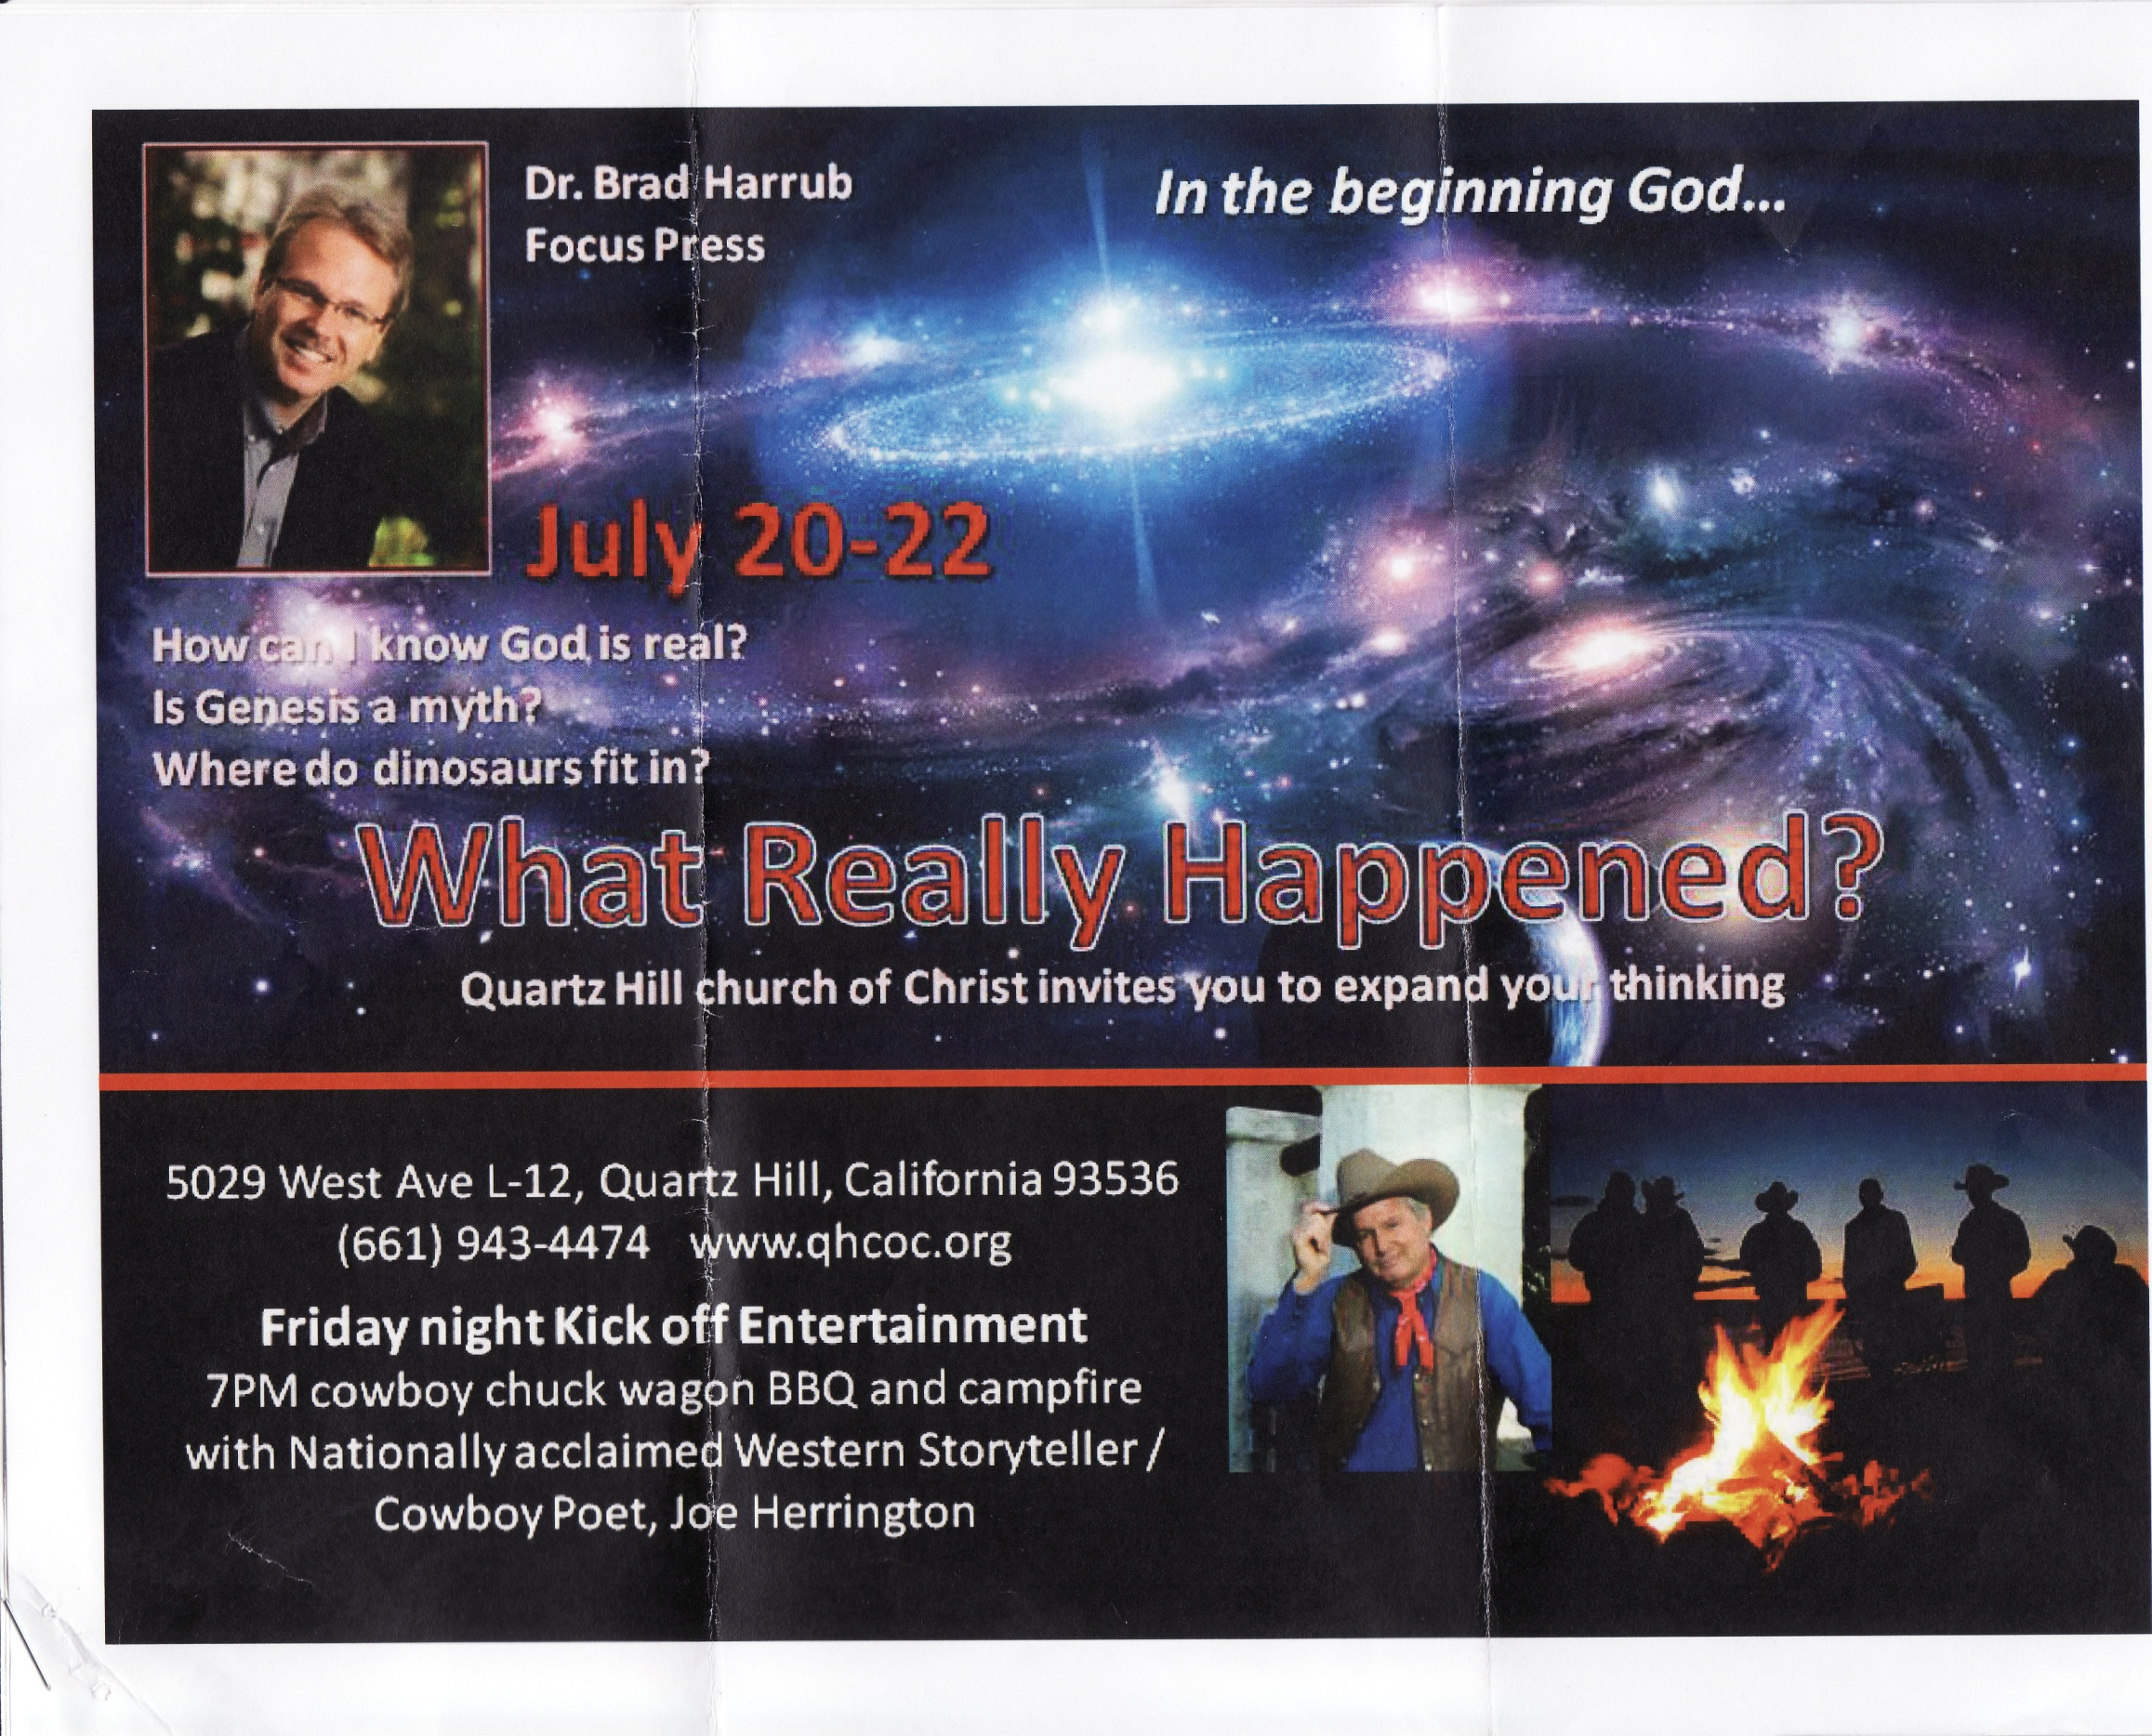

Slide 12
The Loss Of Hunger For Righteousness
The reason people remain faithful is godly teaching and spiritual training. (Cf. Titus 2:11-14)
Motivated to greater evangelism
If viewed the people from - spiritual condition. (Ephesians 2:1-2)
If view them without hope. (Ephesians 2:12)

Slide 13
The Loss Of The Sacred
Sacred -- “to be devoutly revered.” (Thayer)
2 Timothy 3:15 “And that from a babe thou hast known the sacred writings which are able to make thee wise unto salvation through faith which is in Christ Jesus.”

Slide 14
The Loss Of The Sacred
Profane - “...always with reference to the distance of persons or their actions from salvation: 1 Timothy 1:9: ungodly, godless in a vice list.. elsewhere with reference to human speech: (1 Timothy 4:7)” (from Exegetical Dictionary of the New Testament © 1990 by William B. Eerdmans Publishing Company.)
Note the use of our word “profanities.”

Slide 15
The Loss Of The Sacred
Profane –
1 Timothy 1:9 “...as knowing this, that law is not made for a righteous man, but for the lawless and unruly, for the ungodly and sinners, for the unholy and profane, for murderers of fathers and murderers of mothers, for manslayers,...”

Slide 16
The Loss Of The Sacred
Illustrations of the Sacred.
Sabbath day. (Exodus 20:8; cf. Numbers 15:32-36)
Moses drew near the burning bush in the wilderness, God said, “Draw not nigh hither: put off thy shoes from off thy feet, for the place whereon thou standest is holy ground” (Exodus 3:5)
Nadab and Abihu. “I will be sanctified in them that come nigh me, and before all the people I will be glorified” (Leviticus 10:3).

Slide 17
The Loss Of The Sacred
Illustrations of the Sacred.
The Scriptures. Jews in Nehemiah’s day, when the law was read. (Nehemiah 8:5)
Worship. “Let us have grace, whereby we may offer service well-pleasing to God with reverence and awe: for our God is a consuming fire” (Hebrews 12:28-29).
NOTE: To treat what is holy, “sacred” as if it were common profanes it. (Cf. 2 Samuel 6; 1 Chronicles 15:2, 12ff)

Slide 18
The Loss Of Distinctiveness
Distinctions in Scripture. 1 Peter 2:9
Wide way from the narrow way. (Matthew 7:13-14)
Wise from the foolish. (Matthew 7:24-27)
Kingdom of darkness from the Kingdom of Christ. (Colossians 1:13-14)

Slide 19
The Loss Of Distinctiveness
Distinctions In Scripture.
One way from all others. (John 14:6)
The one gospel from all others. (Galatians 1:6-9)
One body from all others. (Ephesians 1:22-23; 4:4)
One baptism from all others. (Ephesians 4:5)

Slide 20
The Loss Of Distinctiveness
We cannot blend God’s way with man’s way. (Proverbs 14:12)
Desire of the people for a king. (1 Samuel 8; Deuteronomy 17)
Peter’s desire to build three tabernacles. (Matthew 17:1-5)

Slide 21
The Loss Of Confrontation
Immodest attire, filthy language, fornication, adulterous remarriages, homosexuality…
Must preach the whole counsel of God. (Acts 20:27)

Slide 22
The Loss Of Confrontation
God Despises Sin
Proverbs 15:9 “The way of the wicked is an abomination to Jehovah”
Proverbs 28:9 “He that turneth away his ear from hearing the law, Even his prayer is an abomination.”

Slide 23
The Loss Of Confrontation
The Gospel Is Confrontational
Evangelism is not possible without confrontation. (Cf. Acts 2:36; 3:12-15; 4:8-10)
Demands accountability for sin. (Romans 14:12; 2 Corinthians 5:10)
Repentance commanded. (Acts 17:30-31)
Paul called on churches to put to death the deeds of the body. (Colossians 3:5-11)

Slide 24
Dangers For Every Generation
The Loss Of The Godly Home
The Loss Of Hunger For Righteousness
The Loss Of The Sacred
The Loss Of Distinctiveness
The Loss Of Confrontation

Slide 25
Dangers For Every Generation
Joshua 24:15 “… choose you this day whom ye will serve; whether the gods which your fathers served that were beyond the River, or the gods of the Amorites, in whose land ye dwell: but as for me and my house, we will serve Jehovah.”

Slide 26
Dangers For Every Generation
Judges 2:10 “And also all that generation were gathered unto their fathers: and there arose another generation after them, that knew not Jehovah, nor yet the work which he had wrought for Israel.”

