Slide 1
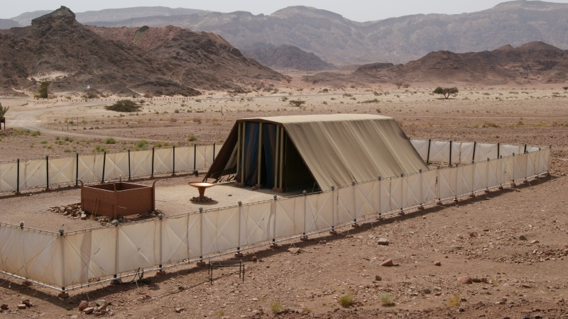
More Than
Enough
Exodus 35:4-9; 36:2-7
Notes:
So often we HAVE to deal with the problem of lukewarmness, and a lack of diligence among the people of God
(Revelation 3:15-16) [Laodicea], “I know your works, that you are neither cold nor hot. I could wish you were cold or hot. ¹⁶ So then, because you are lukewarm, and neither cold nor hot, I will vomit you out of My mouth.”
The exhortations are important
(Hebrews 3:7-19) READ
Israel, in the midst of the wilderness wanderings (did not obey/unbelief)
We should learn from their example
(vs. 12-14)
Unbelief is associated with sin, and an unwillingness to remain steadfast in our practice
However, let us examine a time early in the wilderness, when the children of Israel were new in their rededication to the Lord (after their departure from Egypt.
The call to build a tabernacle when Moses came down from Sinai, and God’s covenant with Israel was renewed.
(Exodus 35:4-9), “And Moses spoke to all the congregation of the children of Israel, saying, “This is the thing which the Lord commanded, saying: ⁵ “Take from among you an offering to the Lord. Whoever is of a willing heart, let him bring it as an offering to the Lord: gold, silver, and bronze; ⁶ blue, purple, and scarlet thread, fine linen, and goats’ hair; ⁷ ram skins dyed red, badger skins, and acacia wood; ⁸ oil for the light, and spices for the anointing oil and for the sweet incense; ⁹ onyx stones, and stones to be set in the ephod and in the breastplate.”
Gifted artisans were chosen to make the tabernacle, the mercy seat, and all of the furnishings
(Exodus 35:21), “Then everyone came whose heart was stirred, and everyone whose spirit was willing, and they brought the Lord's offering for the work of the tabernacle of meeting, for all its service, and for the holy garments.”
(Exodus 35:29), “The children of Israel brought a freewill offering to the Lord, all the men and women whose hearts were willing to bring material for all kinds of work which the Lord, by the hand of Moses, had commanded to be done.”
Free will regarding the amount. But, a command had been given for the work to be done.
Consider the Israelites response
(Exodus 36:2-7), “Then Moses called Bezalel and Aholiab, and every gifted artisan in whose heart the Lord had put wisdom, everyone whose heart was stirred, to come and do the work. ³ And they received from Moses all the offering which the children of Israel had brought for the work of the service of making the sanctuary. So they continued bringing to him freewill offerings every morning. ⁴ Then all the craftsmen who were doing all the work of the sanctuary came, each from the work he was doing, ⁵ and they spoke to Moses, saying, “The people bring much more than enough for the service of the work which the Lord commanded us to do.” ⁶ So Moses gave a commandment, and they caused it to be proclaimed throughout the camp, saying, “Let neither man nor woman do any more work for the offering of the sanctuary.” And the people were restrained from bringing, ⁷ for the material they had was sufficient for all the work to be done—indeed too much.”
There are lessons about ZEAL to be learned from this narrative!

Slide 2
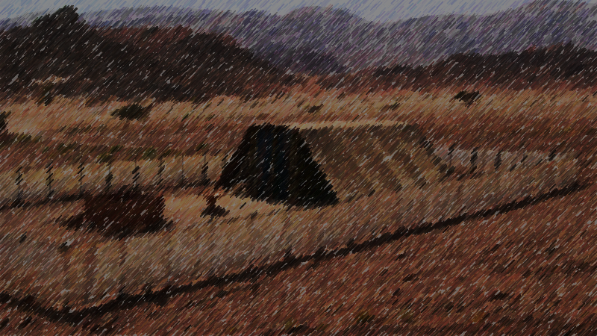
The Zeal of the Faithful
Zeal Must Be Maintained
Hebrews 5:9-12
The Free Will of the Zealous
2 Corinthians 8:1-5; Acts 8:1-4
We Need to Examine our Zeal
Hebrews 2:1; Luke 17:5-10
Notes:
Zeal Must be Maintained!
The Israelites started out zealous to God, but tested in the wilderness, they became unfaithful
Our faith is often strongest at the first. The natural tendency to “lose our first love must be resisted!”
(Hebrews 5:9-12) [After talking of apostasy through neglect], “But, beloved, we are confident of better things concerning you, yes, things that accompany salvation, though we speak in this manner. ¹⁰ For God is not unjust to forget your work and labor of love which you have shown toward His name, in that you have ministered to the saints, and do minister. ¹¹ And we desire that each one of you show the same diligence to the full assurance of hope until the end, ¹² that you do not become sluggish, but imitate those who through faith and patience inherit the promises.”
The Free Will of the Zealous [CLICK]
The Israelites, when zealous, brought free will offerings that were sufficient! Their Zeal was a powerful thing!
The obvious parallel is our own offerings to God
(2 Corinthians 8:1-5), “Moreover, brethren, we make known to you the grace of God bestowed on the churches of Macedonia: ² that in a great trial of affliction the abundance of their joy and their deep poverty abounded in the riches of their liberality. ³ For I bear witness that according to their ability, yes, and beyond their ability, they were freely willing, ⁴ imploring us with much urgency that we would receive the gift and the fellowship of the ministering to the saints. ⁵ And not only as we had hoped, but they first gave themselves to the Lord, and then to us by the will of God.”
However, diligence in every regard accomplishes so much! (ex: The persecuted preaching)
(Acts 8:1-4), “At that time a great persecution arose against the church which was at Jerusalem; and they were all scattered throughout the regions of Judea and Samaria, except the apostles. ² And devout men carried Stephen to his burial, and made great lamentation over him. ³ As for Saul, he made havoc of the church, entering every house, and dragging off men and women, committing them to prison. ⁴ Therefore those who were scattered went everywhere preaching the word.”
We Need to Examine our Zeal [CLICK]
The Israelites’ Zeal led them to do “more than enough” at the start, but their faithfulness waned as time passed. Perhaps it was a slow drift, imperceptible to the unwary…
For example: When tested by God’s call for them to enter the land, the people refused, unlike at the beginning when they did “more than enough”
(Hebrews 2:1), “Therefore we must give the more earnest heed to the things we have heard, lest we drift away.”
Are you still willing to do “more than enough?” Consider the attitude we should have to our service to the Lord
(Luke 17:5-10), “And the apostles said to the Lord, “Increase our faith.” ⁶ So the Lord said, “If you have faith as a mustard seed, you can say to this mulberry tree, ‘Be pulled up by the roots and be planted in the sea,’ and it would obey you. ⁷ And which of you, having a servant plowing or tending sheep, will say to him when he has come in from the field, “Come at once and sit down to eat’? ⁸ But will he not rather say to him, “Prepare something for my supper, and gird yourself and serve me till I have eaten and drunk, and afterward you will eat and drink’? ⁹ Does he thank that servant because he did the things that were commanded him? I think not. ¹⁰ So likewise you, when you have done all those things which you are commanded, say, ‘We are unprofitable servants. We have done what was our duty to do.’”

Slide 3
God wants us freely willing to sacrifice our lives and purpose in His service!
Galatians 2:20; Acts 2:41-47
Notes:
God wants us freely willing to sacrifice our lives and purpose in His service
(Galatians 2:20), “I have been crucified with Christ; it is no longer I who live, but Christ lives in me; and the life which I now live in the flesh I live by faith in the Son of God, who loved me and gave Himself for me.”
Remember when the church was new, and the zeal and joy present among the disciples in those early days!
(Acts 2:41-47), “Then those who gladly received his word were baptized; and that day about three thousand souls were added to them. ⁴² And they continued steadfastly in the apostles’ doctrine and fellowship, in the breaking of bread, and in prayers. ⁴³ Then fear came upon every soul, and many wonders and signs were done through the apostles. ⁴⁴ Now all who believed were together, and had all things in common, ⁴⁵ and sold their possessions and goods, and divided them among all, as anyone had need. ⁴⁶ So continuing daily with one accord in the temple, and breaking bread from house to house, they ate their food with gladness and simplicity of heart, ⁴⁷ praising God and having favor with all the people. And the Lord added to the church daily those who were being saved.”
May be all strive to have the same attitudes and exhibit the same willingness and zeal as they!

