Slide 1
My Will
VS
Thy Will
“There are two kinds of people: those who say to God, ‘Thy will be done,’ and those to whom God says, ‘All right, then, have it your way.’”
– C.S Lewis
Notes:
Based on sermon prepared by Jeremiah Cox
Print Slides 1,2,11,13,14

Slide 2
Man Has Free Will
1 Corinthians 10:13
Philippians 2:12-13
2 Peter 3:9
Notes:
I. Man has free will.
1 Cor. 10:13
Phil. 2:12-13
2 Peter 3:9; Matt. 7:13-14
(Choose only between two things, life/death) Deut. 30:19-20; Joshua 24:14-15
Wouldn’t tell us not to if we couldn’t. Or tell us to do if we couldn’t not do.
10 Commandments (Exodus 20) “You Shall Not”

Slide 3
1 Corinthians 10:13
No temptation has overtaken you except such as is common to man; but God is faithful, who will not allow you to be tempted beyond what you are able, but with the temptation will also make the way of escape, that you may be able to bear it.
(The concept of temptation indicates choice. We choose to resist, or to indulge.)

Slide 4
Philippians 2:12-13
Therefore, my beloved, as you have always obeyed, not as in my presence only, but now much more in my absence, work out your own salvation with fear and trembling; ¹³ for it is God who works in you both to will and to do for His good pleasure.

Slide 5
2 Peter 3:9
The Lord is not slack concerning His promise, as some count slackness, but is longsuffering toward us, not willing that any should perish but that all should come to repentance.
(Christ wants no one to perish, and yet some will. Why? Some choose to not repent!)

Slide 6
Two Choices
Light or Darkness
John 8:12; John 3:19
Notes:
II. There is an obvious distinction between two choices (Always two; no other choice).
A. Light or Darkness.
John 8:12
John 3:19
B. Spirit or Flesh.
John 6:63
Rom. 8:1-11
C. Rock (Thy will) or Sand (My will)
Matt. 7:24-27

Slide 7
John 8:12
Then Jesus spoke to them again, saying, "I am the light of the world. He who follows Me shall not walk in darkness, but have the light of life."

Slide 8
John 3:19
And this is the condemnation, that the light has come into the world, and men loved darkness rather than light, because their deeds were evil.

Slide 9
Two Choices
Light or Darkness
John 8:12; John 3:19
Spirit or Flesh
John 6:63
Notes:
II. There is an obvious distinction between two choices (Always two; no other choice).
A. Light or Darkness.
John 8:12
John 3:19
B. Spirit or Flesh.
John 6:63
Rom. 8:1-11
C. Rock (Thy will) or Sand (My will)
Matt. 7:24-27

Slide 10
John 6:63
It is the Spirit who gives life; the flesh profits nothing. The words that I speak to you are spirit, and they are life.

Slide 11
Two Choices
Light or Darkness
John 8:12; John 3:19
Spirit or Flesh
John 6:63
Rock or Sand
Matthew 7:24-27
Notes:
II. There is an obvious distinction between two choices (Always two; no other choice).
A. Light or Darkness.
John 8:12
John 3:19
B. Spirit or Flesh.
John 6:63
Rom. 8:1-11
C. Rock (Thy will) or Sand (My will)
Matt. 7:24-27

Slide 12
Matthew 7:24-27
Therefore whoever hears these sayings of Mine, and does them, I will liken him to a wise man who built his house on the rock: ²⁵ and the rain descended, the floods came, and the winds blew and beat on that house; and it did not fall, for it was founded on the rock. ²⁶ “But everyone who hears these sayings of Mine, and does not do them, will be like a foolish man who built his house on the sand: ²⁷ and the rain descended, the floods came, and the winds blew and beat on that house; and it fell. And great was its fall.”

Slide 13
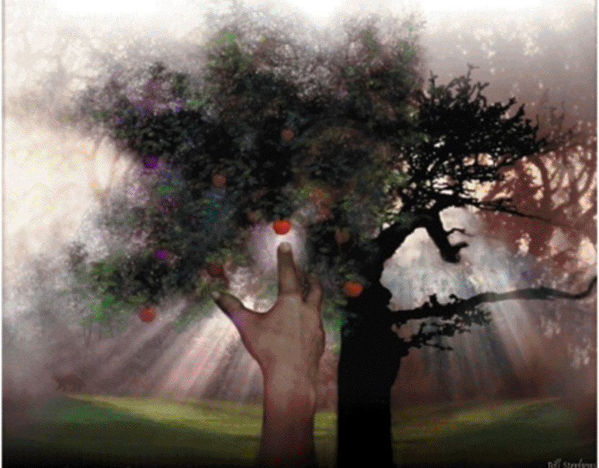
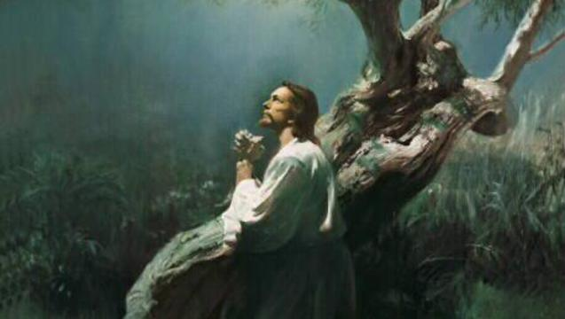
My Will or Thy Will
Garden of Gethsemane
(Mark 14:32-39)
Garden of Eden
(Genesis 2:8-3:24)
Notes:
D. Thy Will or My Will.
Two Gardens
Garden of Eden (Genesis 2:8-3:24)
(2:8-9, 15-17) immediately two choices (two trees).
(3:1-5) Serpent makes “My Will” seem appealing.
(3:6-7) Adam and Eve choose their will over God’s.
Garden of Gethsemane (Matt. 26:36-46; Mark 14:32-42; Luke 22:39-46; John 18:1-11)
(Mark 14:32-39) Jesus recognized two choices (I will or You will).
(John 18:1-11) Jesus chose God’s will.

Slide 14
Conclusion
The choice of “My” will VS “Thy” will is significant with regard to the consequence of the choice made!
My Will (Matthew 6:19)
Thy Will (Matthew 6:20)
Notes:
III. There are consequences for both choices.
A. Specific consequences of Garden scenes.
Romans 5:12-21
B. General choice of God’s will or our will.
My Will
Temporal Pleasure – Matt. 6:19
Eternal Agony – Luke 12:20-21 (Rich Fool)
Thy Will
Temporal Suffering – Matt. 6:20; Luke 16:20-22
Eternal Salvation – Luke 16:25 (Lazarus and Rich Man)

Slide 15
Matthew 6:19
Do not lay up for yourselves treasures on earth, where moth and rust destroy and where thieves break in and steal.
Treasure only on earth. Temporal, eventually destroyed at judgment (cf. 2 Peter 3:10)

Slide 16
Matthew 6:20
But lay up for yourselves treasures in heaven, where neither moth nor rust destroys and where thieves do not break in and steal.
Treasure in heaven. Eternal, and joy beyond measure.

