Slide 1
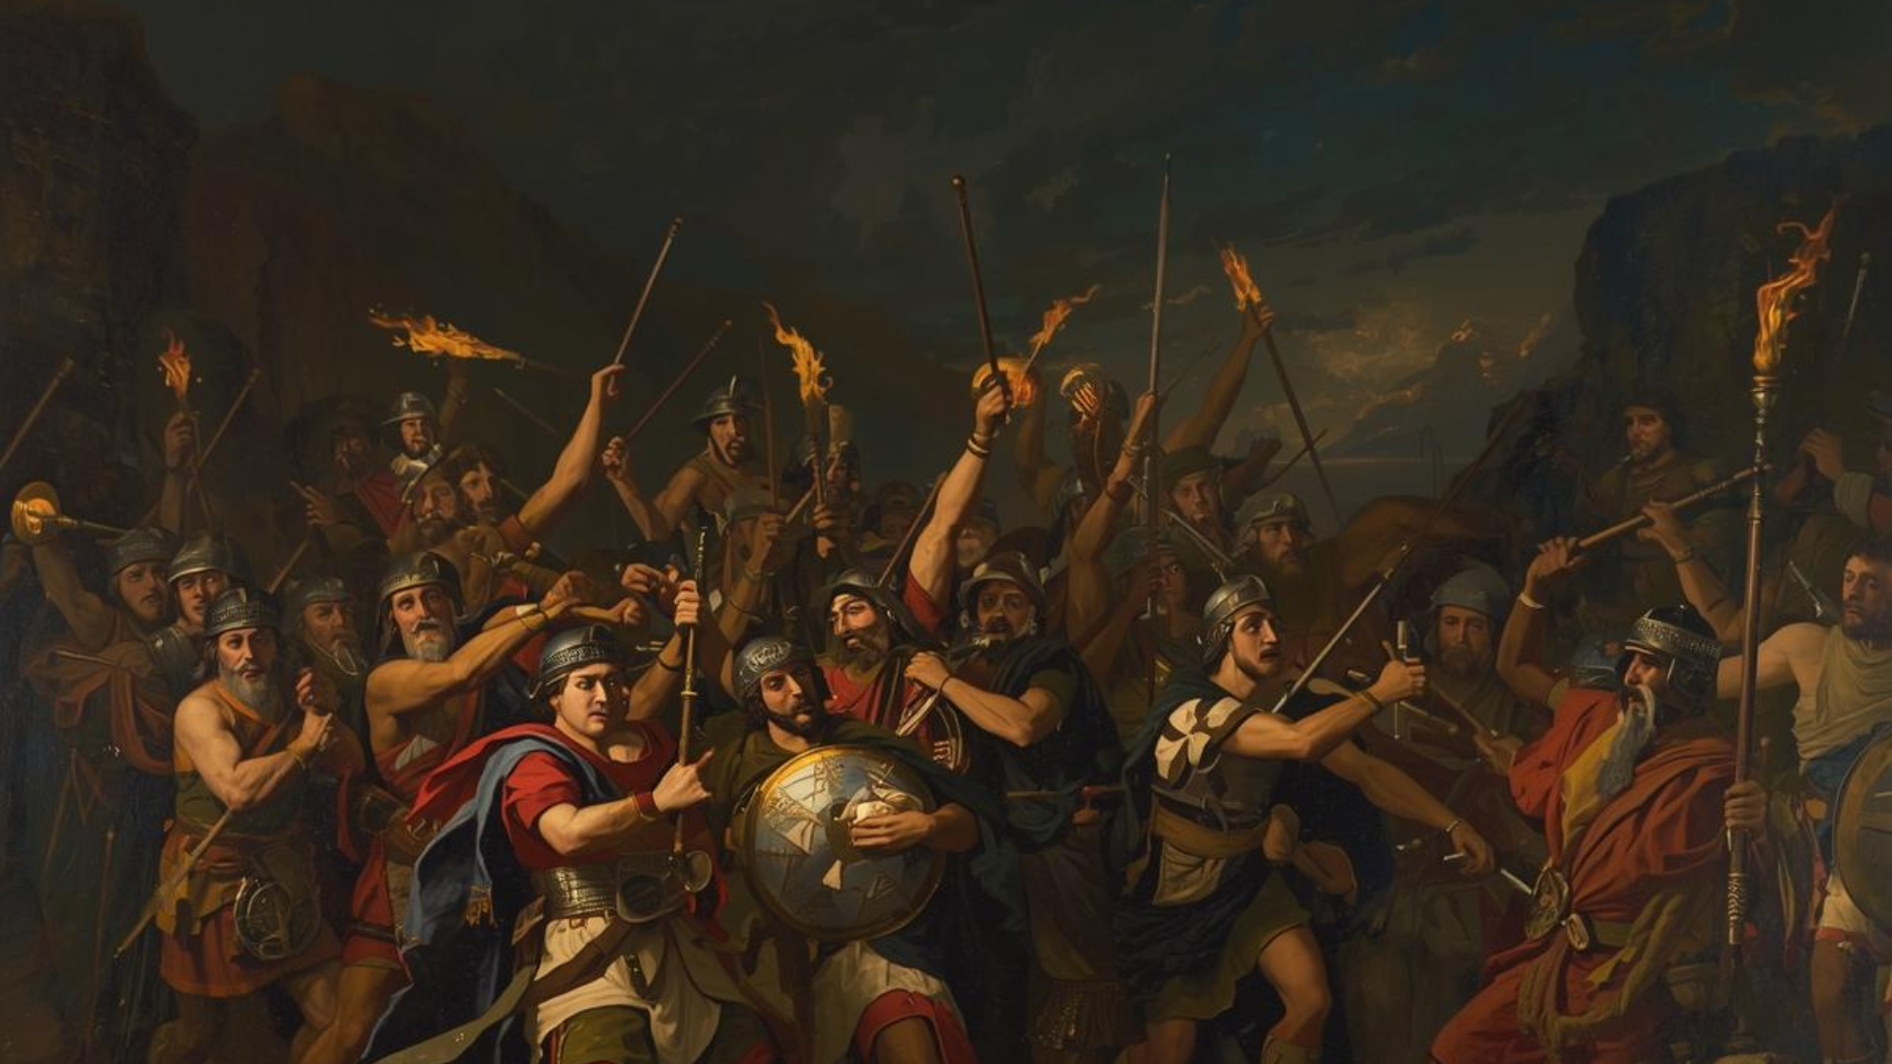
Our Calling (Illustrated)
2 Thessalonians 2:13-15
Judges 7

Slide 2

The Illustration (Gideon & His Army of 300)
Salvation by grace (7:2)
Romans 6:22-23
God does not call all (7:4, 5-6)
1 Corinthians 6:9-11
God established the prerequisites (7:7)
Mark 16:15-16
Victory assured for those who believe (7:13-15)
John 3:16
The victory: Authored & owned by God (7:9)
Ephesians 2:8-9

Slide 3
Conclusion
God has promised and will do His part
What does God expect from us? To act appropriately as one of the elect!
2 Thessalonians 2:15

