Slide 1
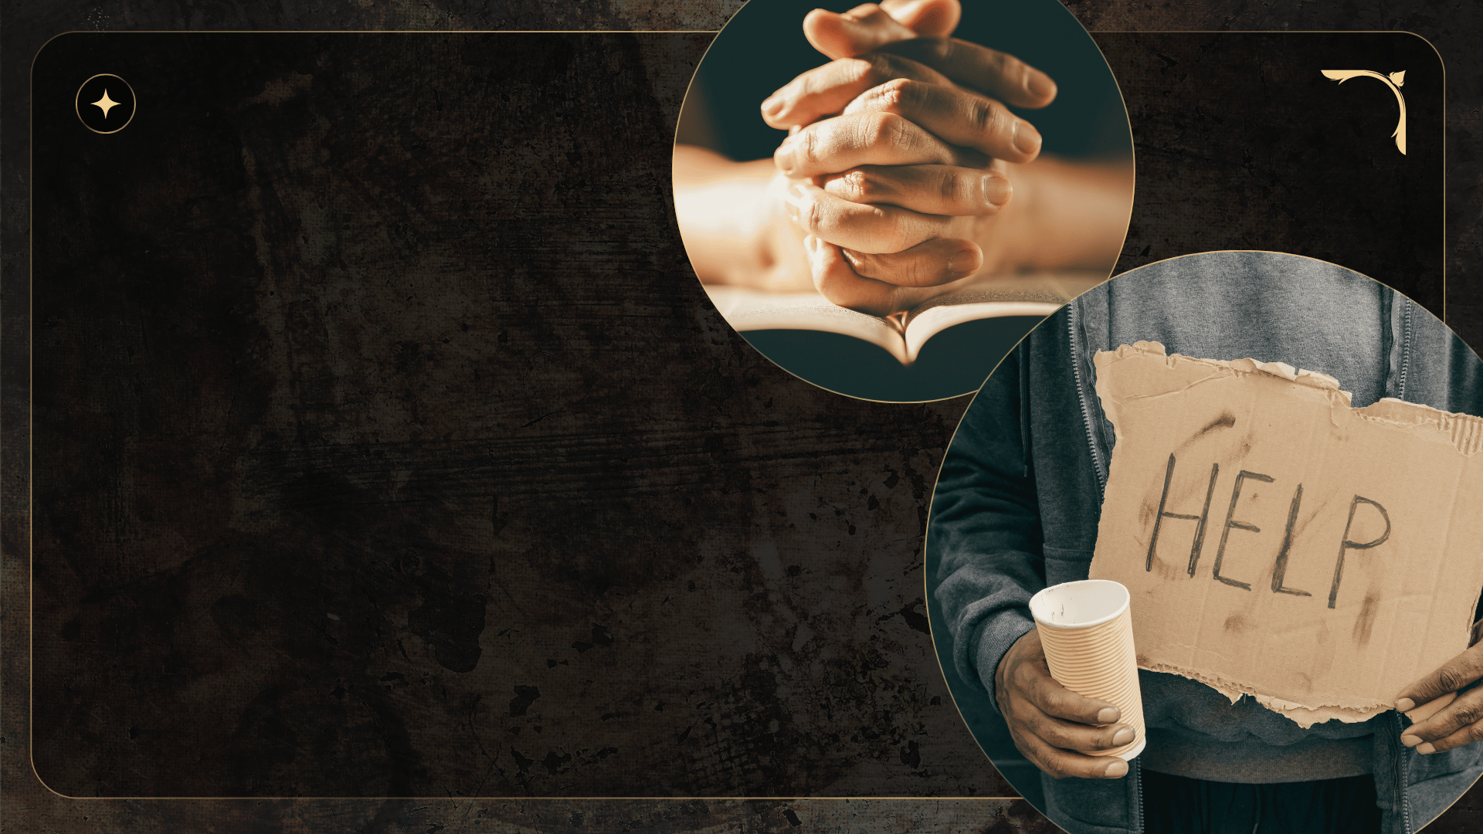
Our True Needs!
Ecclesiastes 1:12-13

Slide 2

Not
Freedom to Do As You Please
Romans 1:28-32
But
Freedom from Sin
Romans 6:17-18; 6:1-2

Slide 3

Not
Worldy Wisdom
Revelation 3:17
But
Spiritual Understanding
Colossians 1:9-12; 1 Cor. 1:18-25; Psa. 147:5

Slide 4

But
The Great Physician
Mark 2:16-17
Justification
Rom. 5:9; Jas. 2:21-24
Spiritual Security
2 Peter 1:5-11
Jesus as a Friend
John 15:14
Not
More & Better Doctors
Social Justice
Social Security
Better Friends

Slide 5

Conclusion
God expects us to enjoy our lives.
However, God has to be in the picture!
Nothing has the value and import of our standing with God!

