Slide 1
The Kingdom Parables (Matthew 13:31-50)
the parables of Christ

Slide 2
Introduction
Jews had many false expectations concerning the nature and coming of the kingdom
expressed even by the disciples (Acts 1:6)
promised kingdom, i.e. the church, came with power on Day of Pentecost (Acts 2)(Eph. 1:22-23)
for those with an ear to hear, the “kingdom parables” in Matthew 13 continue to instruct a true understanding of Christ’s kingdom
Notes:
Acts 2:30-33, 47

Slide 3
The Kingdom Parables
The Sower (13:3-9)
The Wheat and Tares (13:24-30)
The Mustard Seed (13:31-32)
The Leaven (13:33)
The Hidden Treasure (13:44)
The Pearl of Great Price (13:45-46)
The Dragnet (13:47-50)

Slide 4
The Kingdom Parables
The Sower (13:3-9)
The Wheat and Tares (13:24-30)
The Mustard Seed (13:31-32)
The Leaven (13:33)
The Hidden Treasure (13:44)
The Pearl of Great Price (13:45-46)
The Dragnet (13:47-50)

Slide 5
The Mustard Seed
Matthew 13:31-32
³¹ Another parable He put forth to them, saying:
The kingdom of heaven is like a mustard seed, which a man took and sowed in his field, ³² which indeed is the least of all the seeds; but when it is grown it is greater than the herbs and becomes a tree, so that the birds of the air come and nest in its branches.
Also: (Mk. 4:30-32; Lk. 13:18-19)

Slide 6
Salvadora persica
10-15’ tall
2-3 mm
diameter

Slide 7
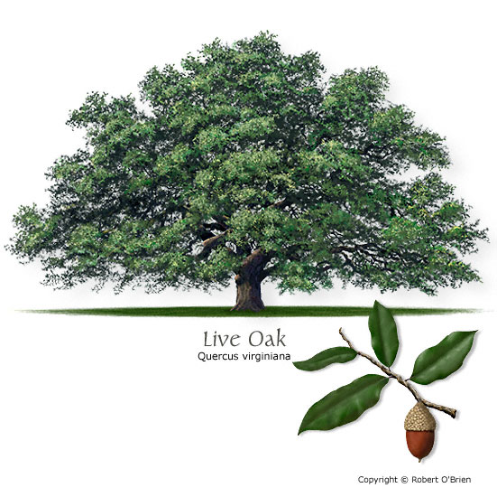

Slide 8
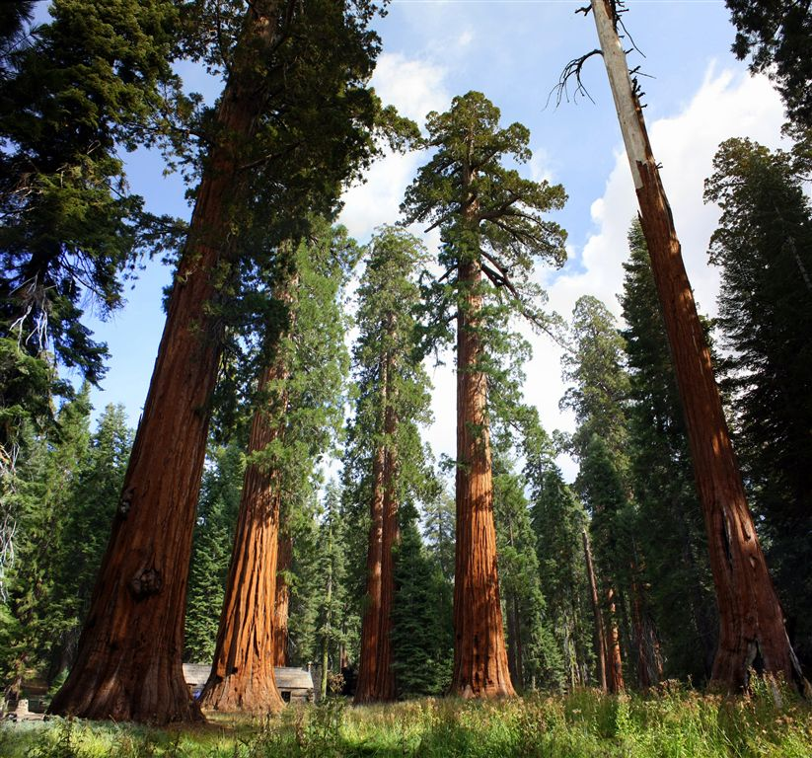
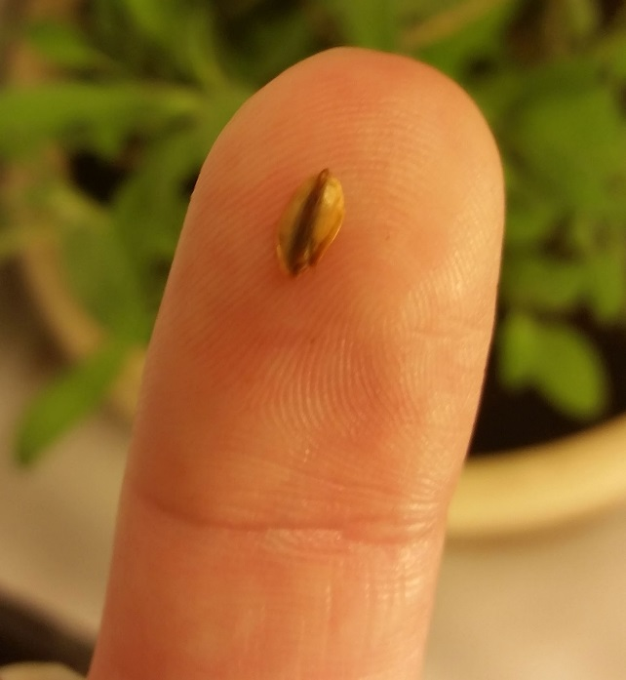
Giant Sequoias

Slide 9
The Mustard Seed
The Potential of the Spiritual Kingdom
just as the size of the mustard seed was not indicative of its potential, the power of this kingdom is not in its apparent size or strength
its King crucified, citizens persecuted, yet church endures (2 Cor. 13:4)(Rom. 8:35-39)(Heb. 12:25-29)
eternal power within the kingdom (Rom. 1:16-17) to those who receive it (1 Cor. 1:18-19, 26-31)

Slide 10
The Leaven
Matthew 13:33
³³ Another parable He spoke to them:
The kingdom of heaven is like leaven, which a woman took and hid in three measures of meal till it was all leavened.
Also: (Lk. 13:20-21)

Slide 11
The Leaven
The Influence of the Spiritual Kingdom
just as a small measure of leaven transforms a large volume of dough, the influence of this kingdom would be immense and powerful
upon the world (Dan. 2:44-45)(Mt. 28:18-20) (Acts 17:6)(2 Cor. 10:3-6)
upon the individual (Heb. 4:12-13)(1 Cor. 6:9-11) leading to eternal life (2 Cor. 4:16-18; 5:14-17)

Slide 12
The Hidden Treasure & The Pearl of Great Price
Matthew 13:44, 45-46
⁴⁴ Again, the kingdom of heaven is like treasure hidden in a field, which a man found and hid; and for joy over it he goes and sells all that he has and buys that field.
⁴⁵ Again, the kingdom of heaven is like a merchant seeking beautiful pearls, ⁴⁶ who, when he had found one pearl of great price, went and sold all that he had and bought it.

Slide 13
The Hidden Treasure & The Pearl of Great Price
The Value of the Spiritual Kingdom
just as the men recognized the value of each treasure and gave everything to obtain them, this kingdom is worthy of the sacrifice of all
its cost (Acts 20:28) and promise (1 Pet. 2:9-10)
for those who seek and find (Lk. 11:9-13)
truth is knowable! (Jn. 8:31-32; 7:17)(Acts 17:11)
for those who discover and turn (Acts 17:26-31) (Rom. 10:20, cf. 13-15)

Slide 14
The Dragnet
Matthew 13:47-50
⁴⁷ Again, the kingdom of heaven is like a dragnet that was cast into the sea and gathered some of every kind, ⁴⁸ which, when it was full, they drew to shore; and they sat down and gathered the good into vessels, but threw the bad away. ⁴⁹ So it will be at the end of the age. The angels will come forth, separate the wicked from among the just, ⁵⁰ and cast them into the furnace of fire. There will be wailing and gnashing of teeth.

Slide 15
The Dragnet
The Judgment of the Spiritual Kingdom
just as the fish in nets are separated only after reaching shore, so the faithful in this kingdom will be alongside the wicked until the End
will be a Judgment, and its consequences are real (2 Cor. 5:9-11)(2 Thess. 1:6-10)(Heb. 10:26-31)
until then, we endure faithfully (Heb. 10:32-39) (James 5:7-8) and humbly (1 Tim. 1:14-16)

Slide 16
Conclusion
Christ’s kingdom is no ordinary kingdom, it is a spiritual kingdom (Heb. 12:22-29)
its power is represented by the mustard seed, its influence by the leaven, its value by the hidden treasure and pearl of great price, and its judgment by the dragnet
Are you a part of that kingdom?

