Slide 1
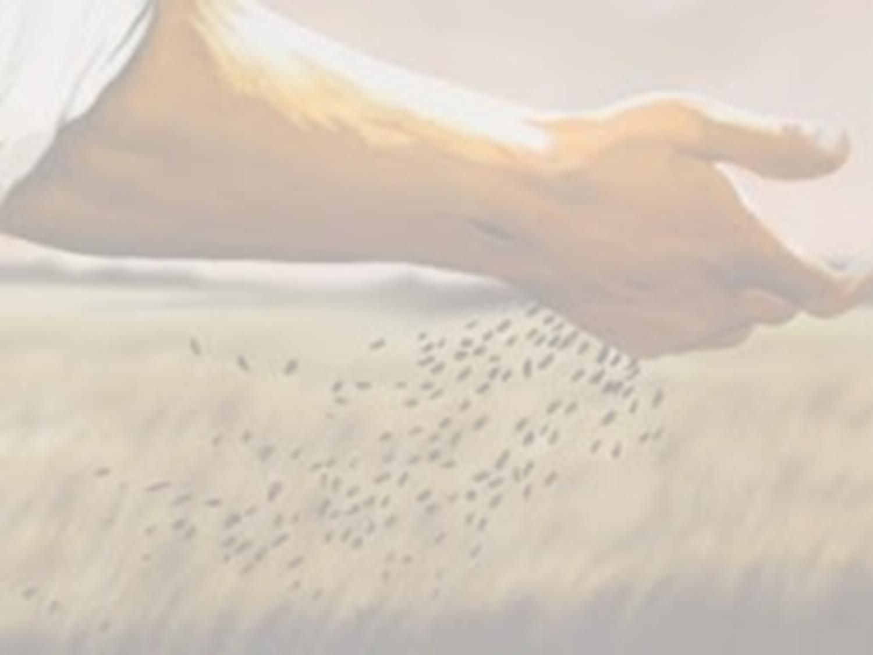
Soil Samples
The Parable of the Sower
Matthew 13 / Mark 4 / Luke 8

Slide 2

The Wayside
Road was too hard to take seed
  Matthew 13:4
Not understanding God’s Word
  Matthew 13:19; Luke 8:12
Examples of hard hearts
  Acts 7:51-53; 1 Timothy 4:1-2
Consequence
  2 Thessalonians 1:6-9

Slide 3
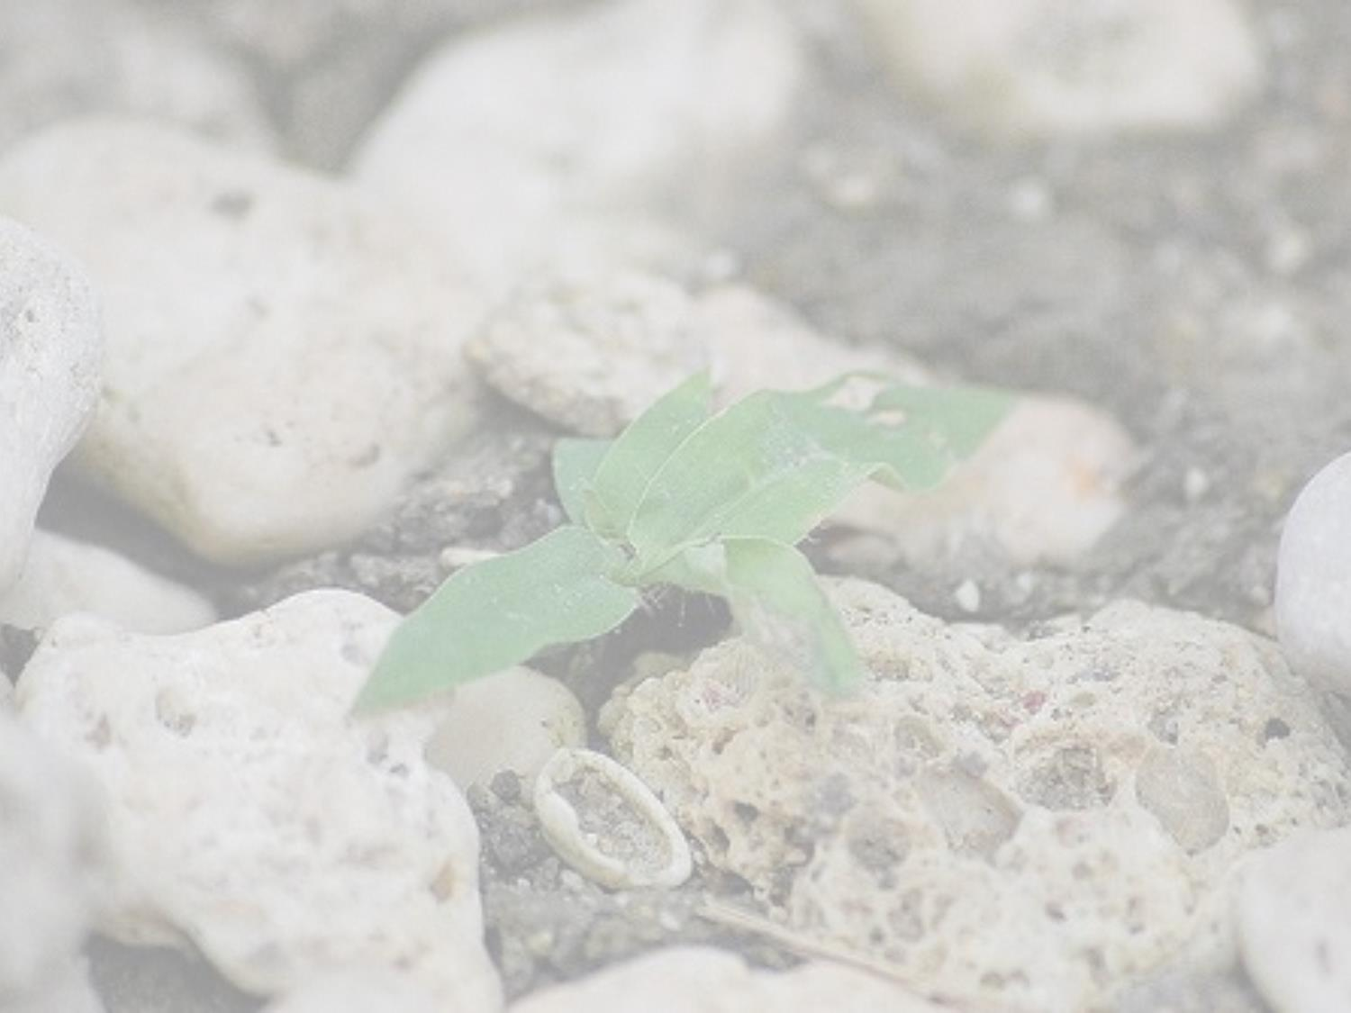
The Rocky Ground
Took the seed, but had no root
  Matthew 13:5-6; Luke 8:13
Fair weathered “Christians”
  Matthew 13:20-21
Fails to count the cost of the Word
  Matthew 13:21; Luke 14:25-33
Lacks endurance
  Hebrews 10:32-39

Slide 4

Among The Thorns
Took seed and grew, but choked out
  Matthew 13:7
Worry, Wealth, and Desires of the World
  Matthew 13:22; Mark 4:18-19
Cannot have it both ways
  Matthew 6:21,24; James 4:1-4
Result of this soil
  Hebrews 6:4-8; John 15:2,6

Slide 5

The Good Soil
Accepted the seed and grew
  Matthew 13:8
Hears the Word and Obeys It
  Matthew 13:23; Mark 4:20
Open Hearts to Obey
  Acts 2:37-41; Acts 22:10, 16; Acts 8:35-36
Continued Growth & Perseverance
  John 8:31-32; 1 Corinthians 15:58

Slide 6

Which Soil Are You?
Wayside – Hard heart, no room for the seed
Rocky – No commitment or endurance
Thorny – Desiring the world over Christ
Good – Open and Obedient to the Word

