Slide 1

Perilous
Times
2 Timothy 3:1-9

Slide 2

Perilous times and
Perilous men
( 2 Timothy 3:1-5 )

Slide 3

2 Timothy 3:1-5 perilous times and blaspheme But know this that in the last days perilous times will come; for man will be lovers of themselves and, lovers of money boasters proud disobedient to parents unthankful unholy. Unloving involving slander.
Bad and ungodly people
Romans 5:6-11
read revelation 21:8

Slide 4

Read revelation 21:8
“But the cowardly,unbelieving,abominable,sexually immoral,sorcerers,idolaters, and all liars shall have their part in the lake which burns with fire and brimstone,which is the second death.”therefore take an eye for an eye,and another example is trade an thumb for a thumb.

Slide 5


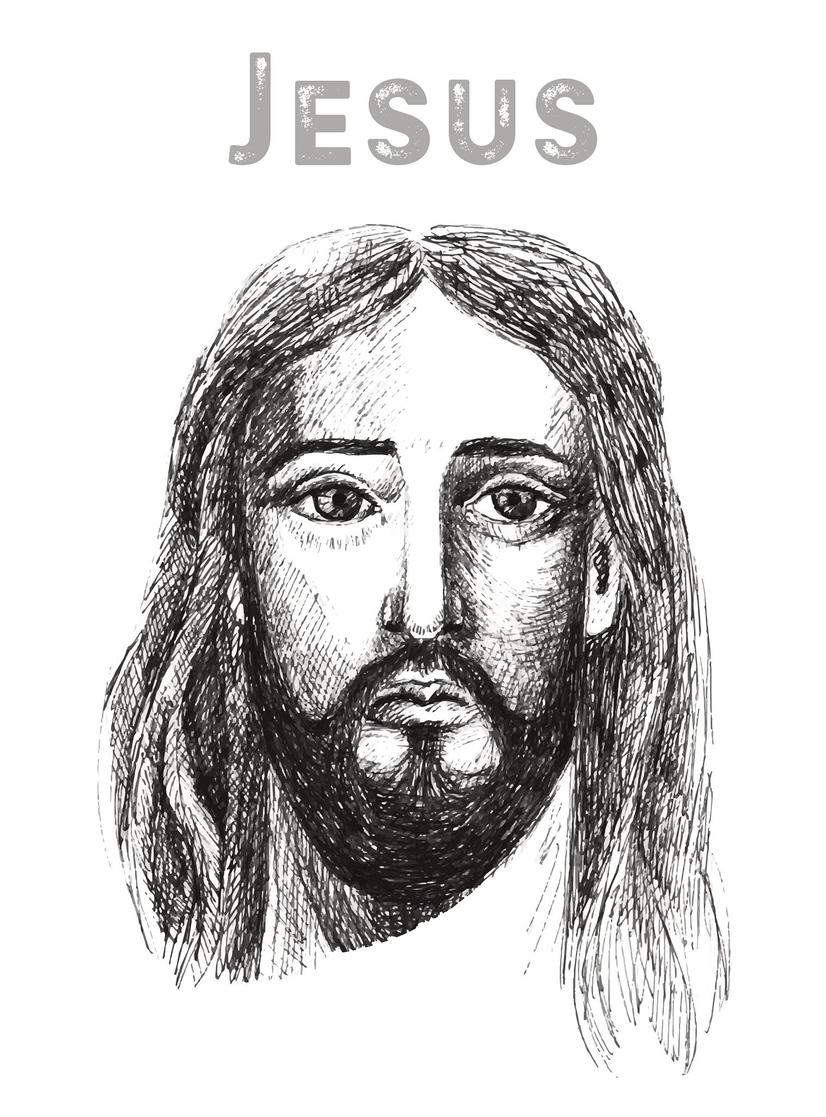
Conclusion 2 timothy 3:14
dark times may come but you must continue in the things which you have learned and been assured of, knowing from whom you have learned them.

Slide 6

The phrase “last days”
  Acts 2; 2 Peter 3:3-4; 2 Peter 3:9-10
Paul warns of chaotic times
The problem of sin lies at our feet
  James 1:13-16
Today we live in perilous times
  Acts 20:19; Romans 5:6-10

Slide 7
Conclusion
“May you live in interesting times”
Live your life by
Christ’s instructions
Matthew 10:28-33

