Slide 2
Philippines Trip
February 21, 2011
– March 11, 2011

Slide 5
Hotel in Bacolod

Slide 6
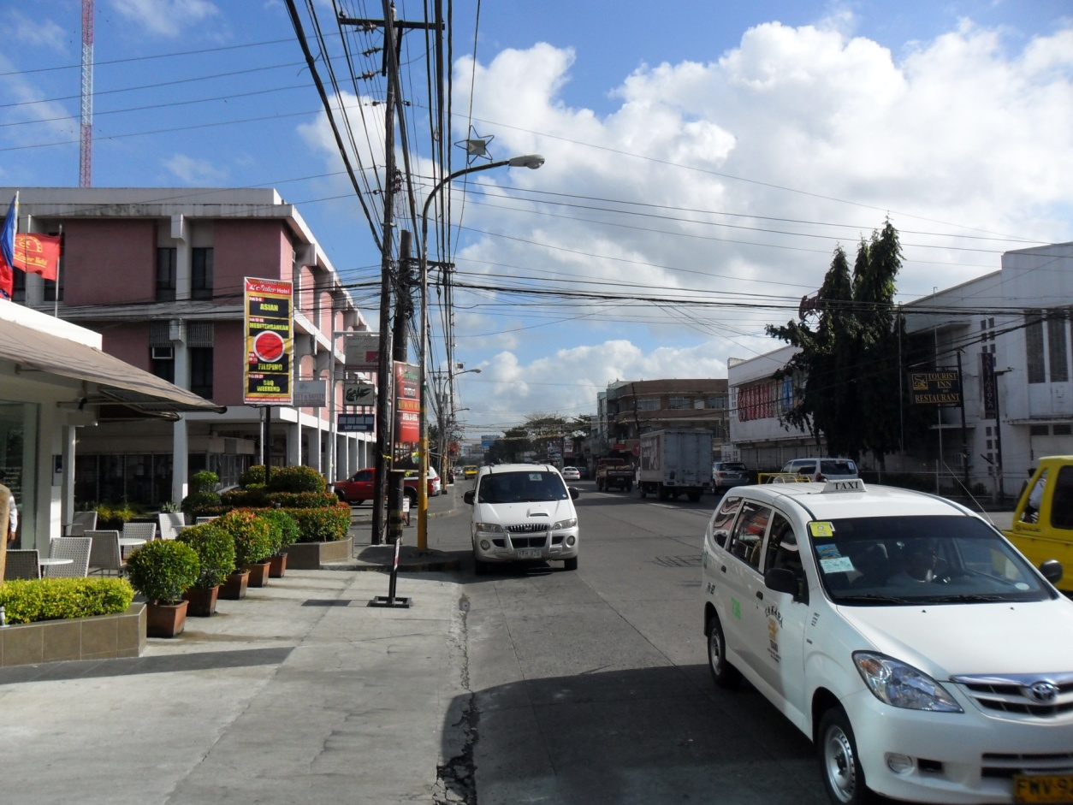

Slide 9
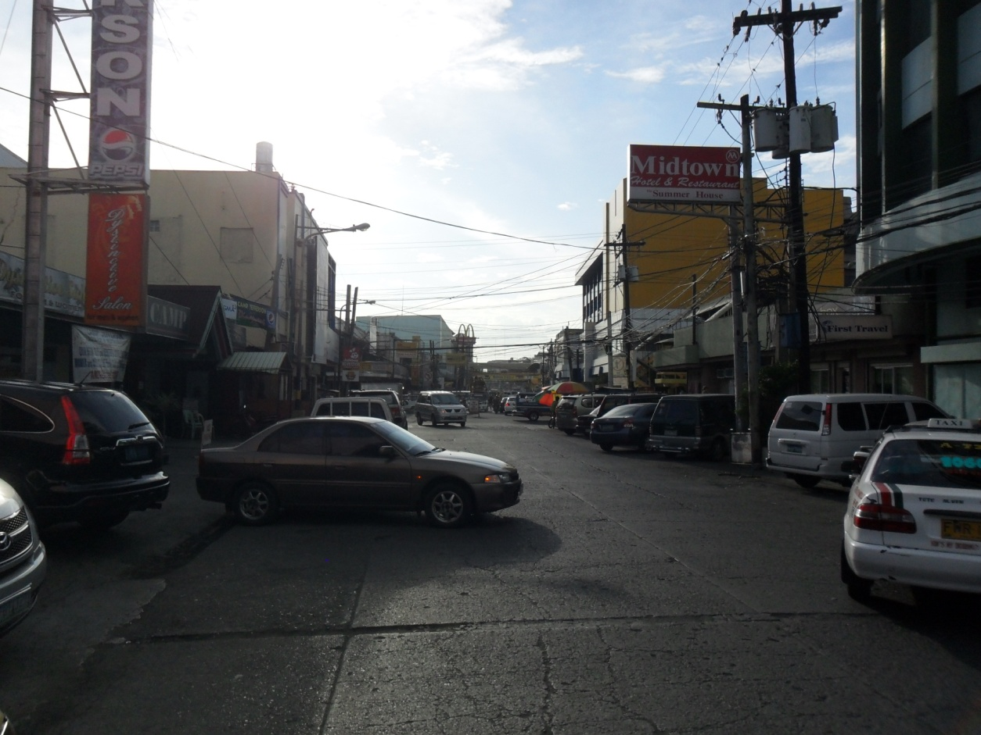

Slide 10
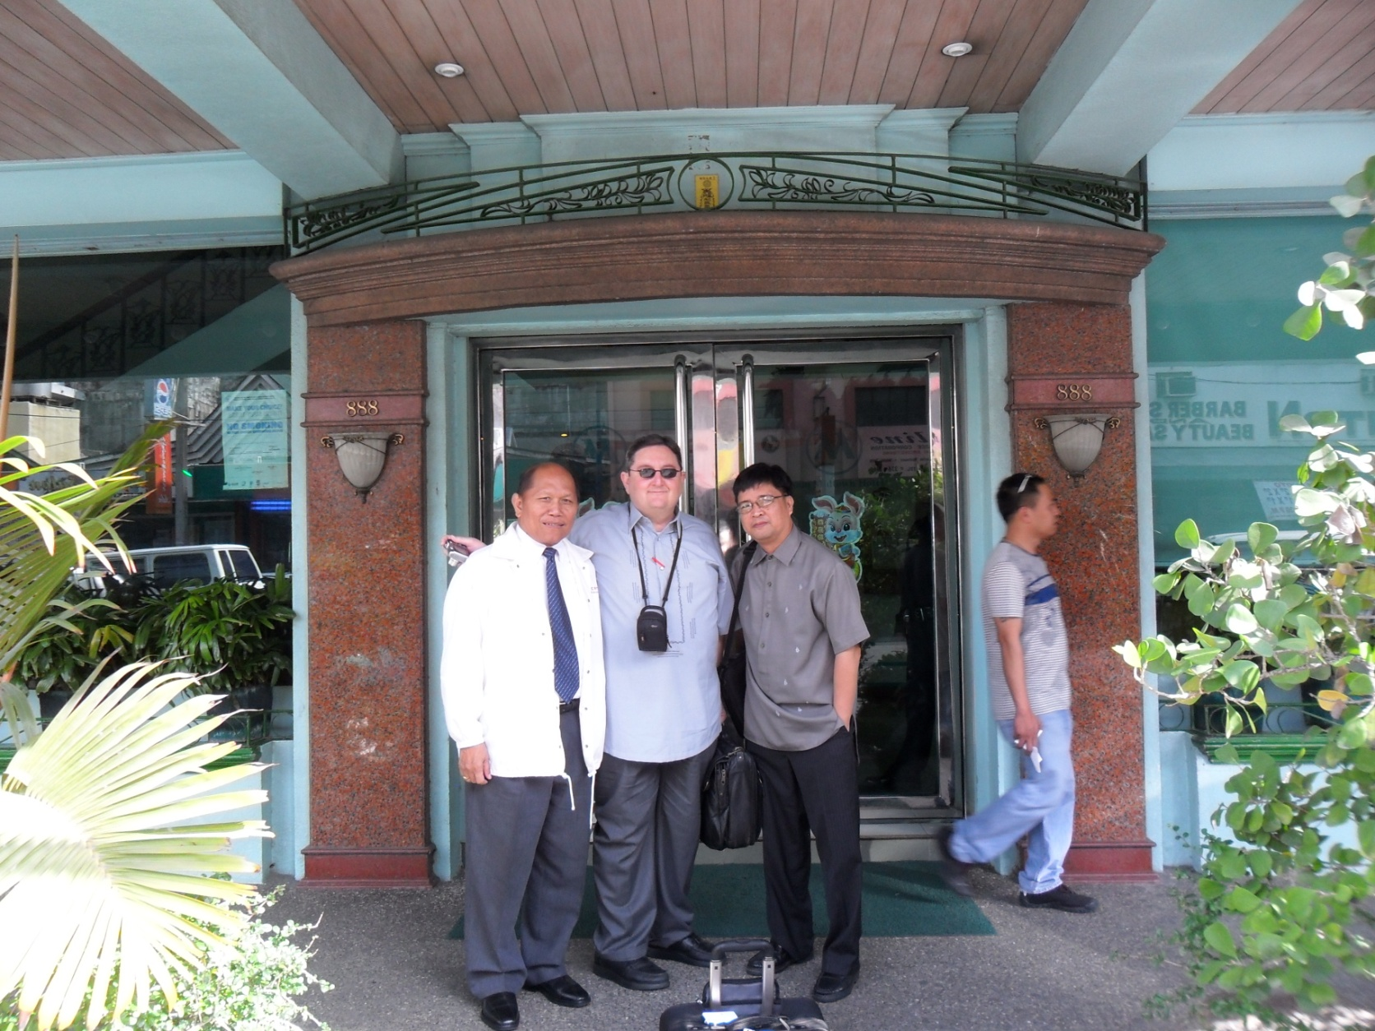
Thursday and Friday, February 24 & 25, 2011
Lectures at Ilo-Ilo
Jonathon Carino, Harry Osborne, Lordy Salunga

Slide 11
Two days of lectures: attendance – 79 first day 76 second day

Slide 13
Each day Jonathan Carino would make a summary statement.

Slide 14
6 baptized in Ilo-Ilo

Slide 15
SuperCat fast craft between Ilo-Ilo and Bacolod.

Slide 16
The fast craft trip is about an 1 ½ hour trip between the islands. Every trip was fine until the last one.

Slide 17
Saturday, February 26, 2011 Silay – Women’s Center

Slide 18
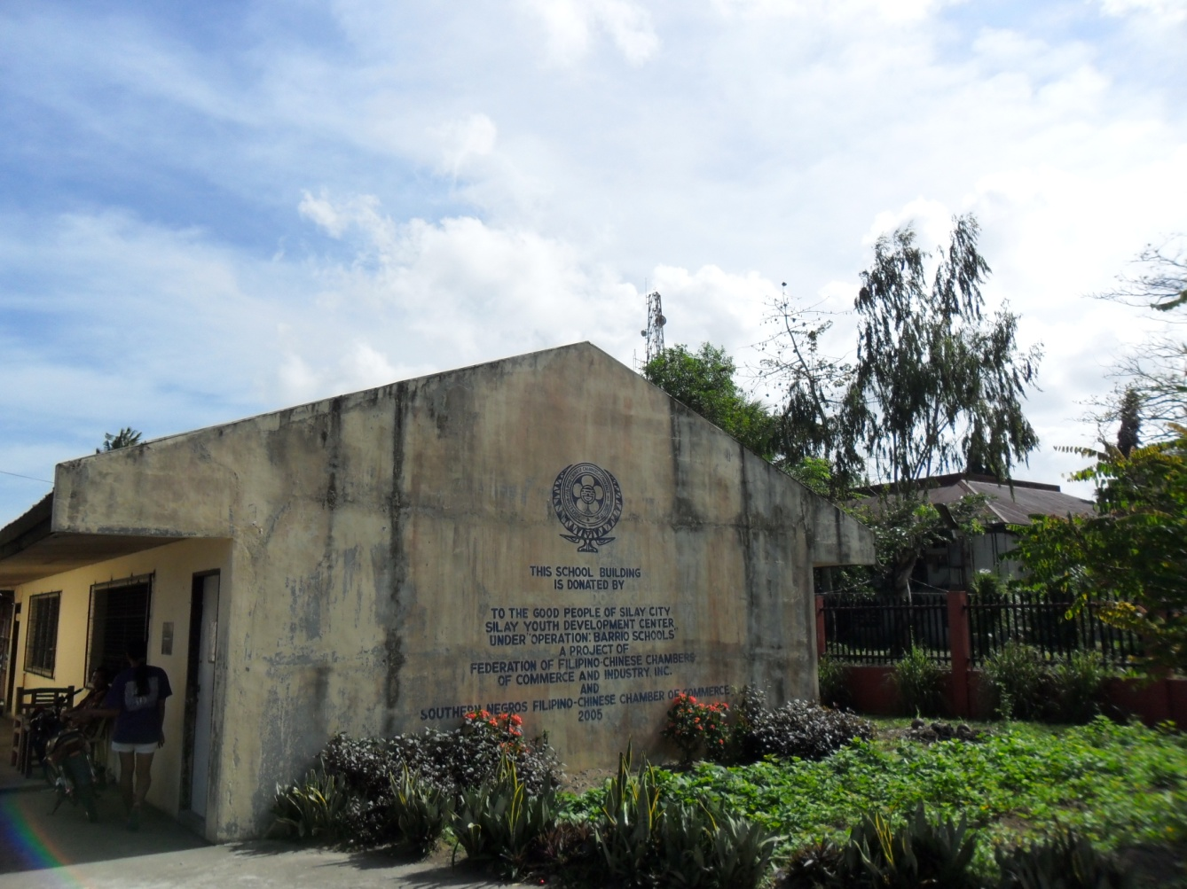

Slide 19
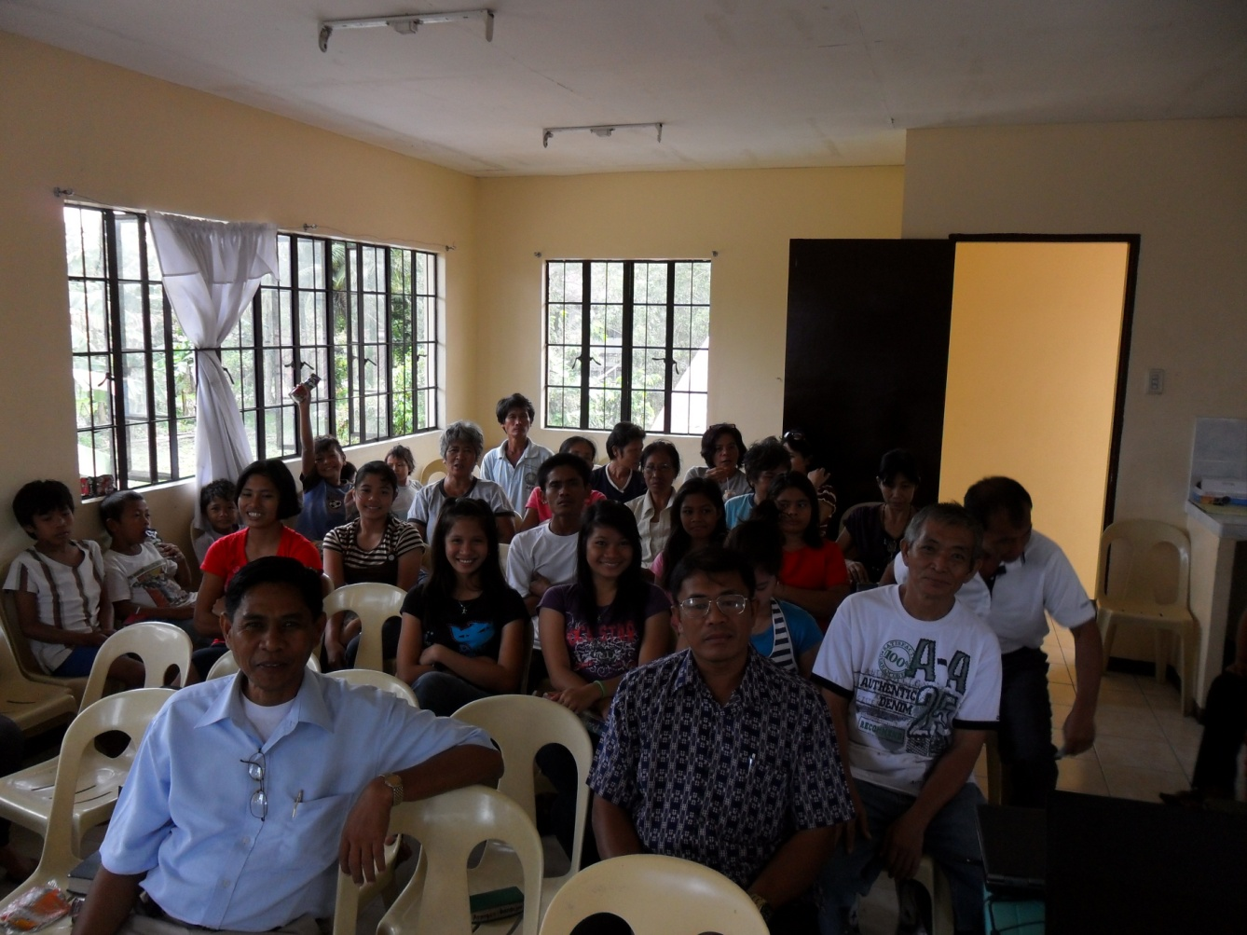
We would give our lessons and Jack Jaco would interpret. Jack offered the invitation in the Ilongo dialect.
Attendance 96

Slide 22
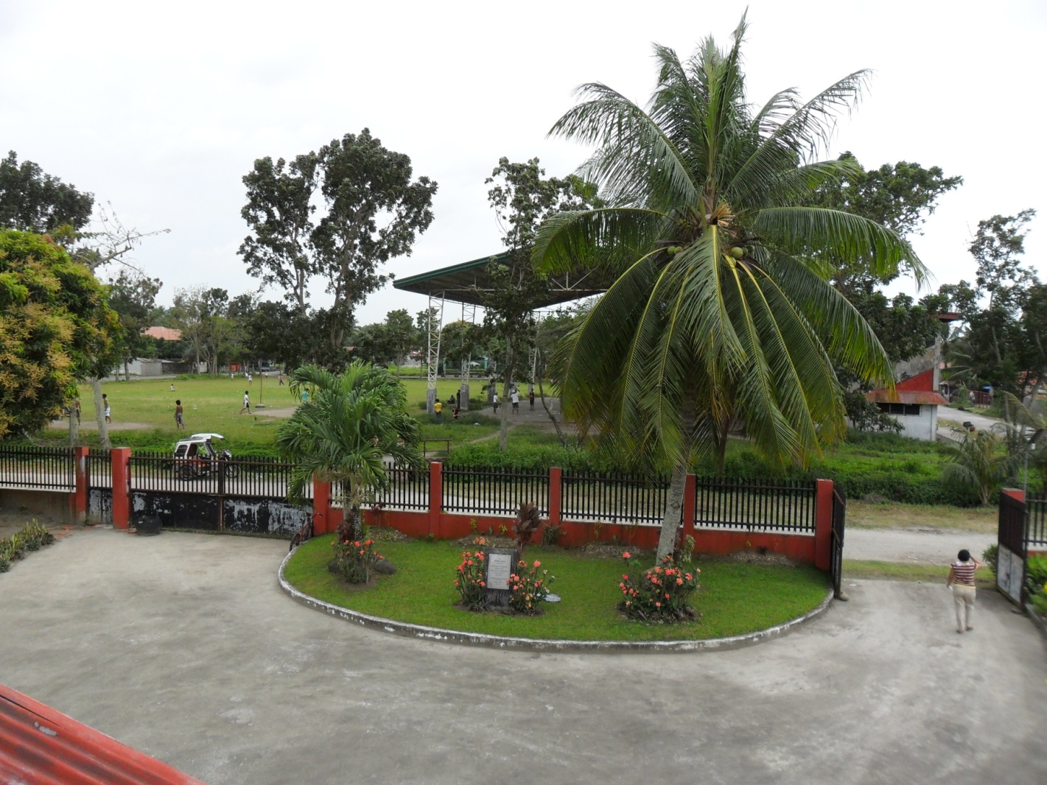

Slide 23
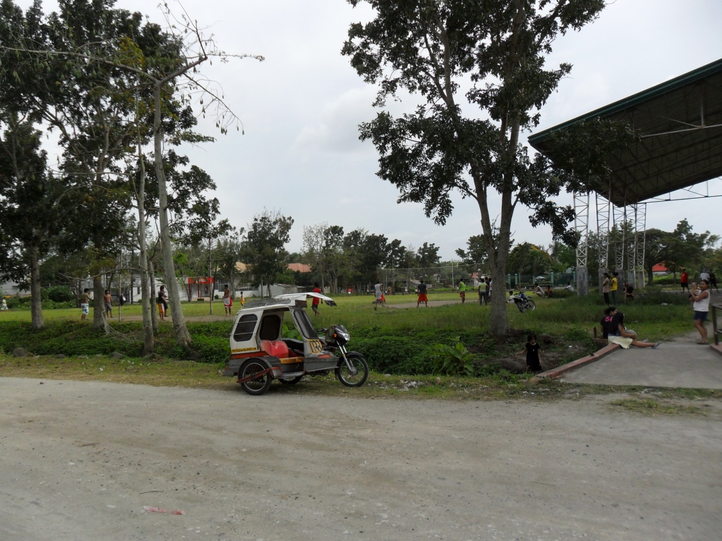

Slide 24
Sunday, February 27, 2011 Escalante City, Cadiz City, Victorias City

Slide 25
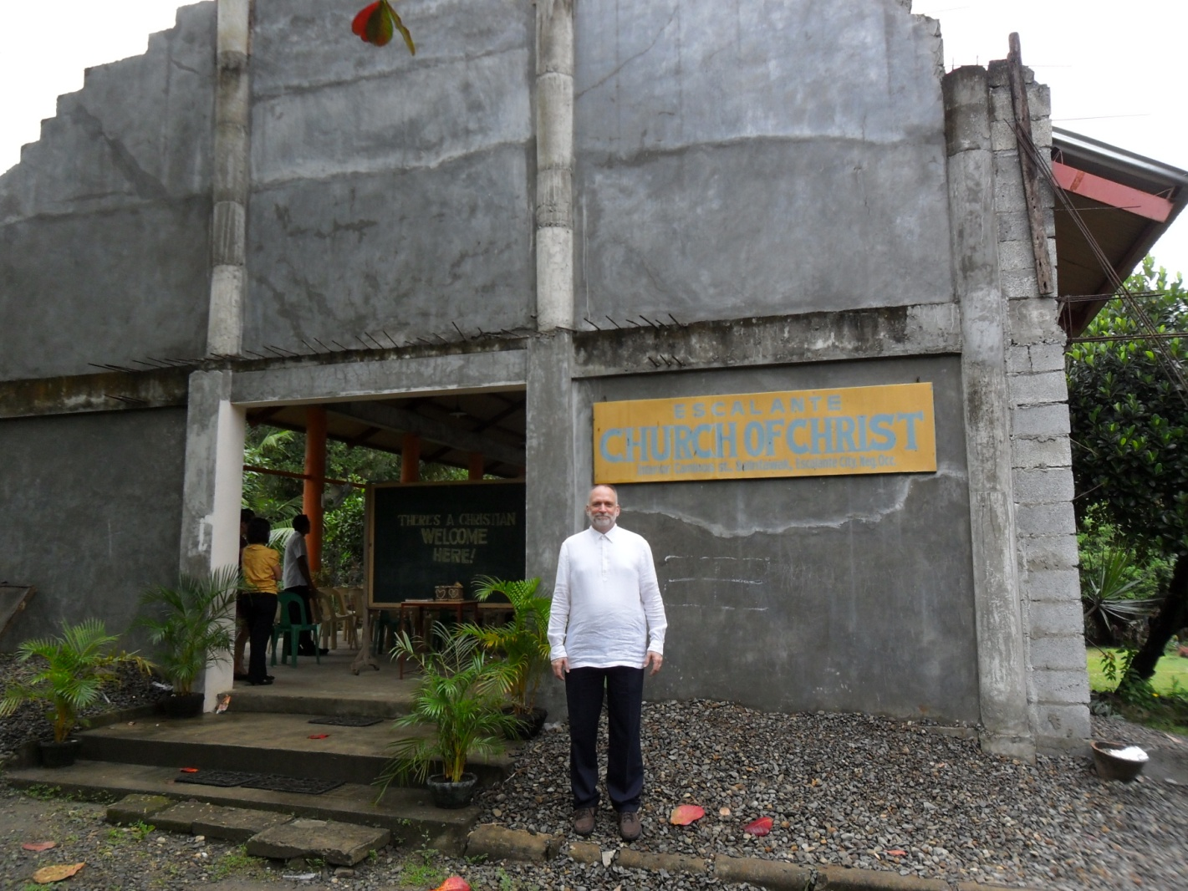
Escalante church of Christ

Slide 27
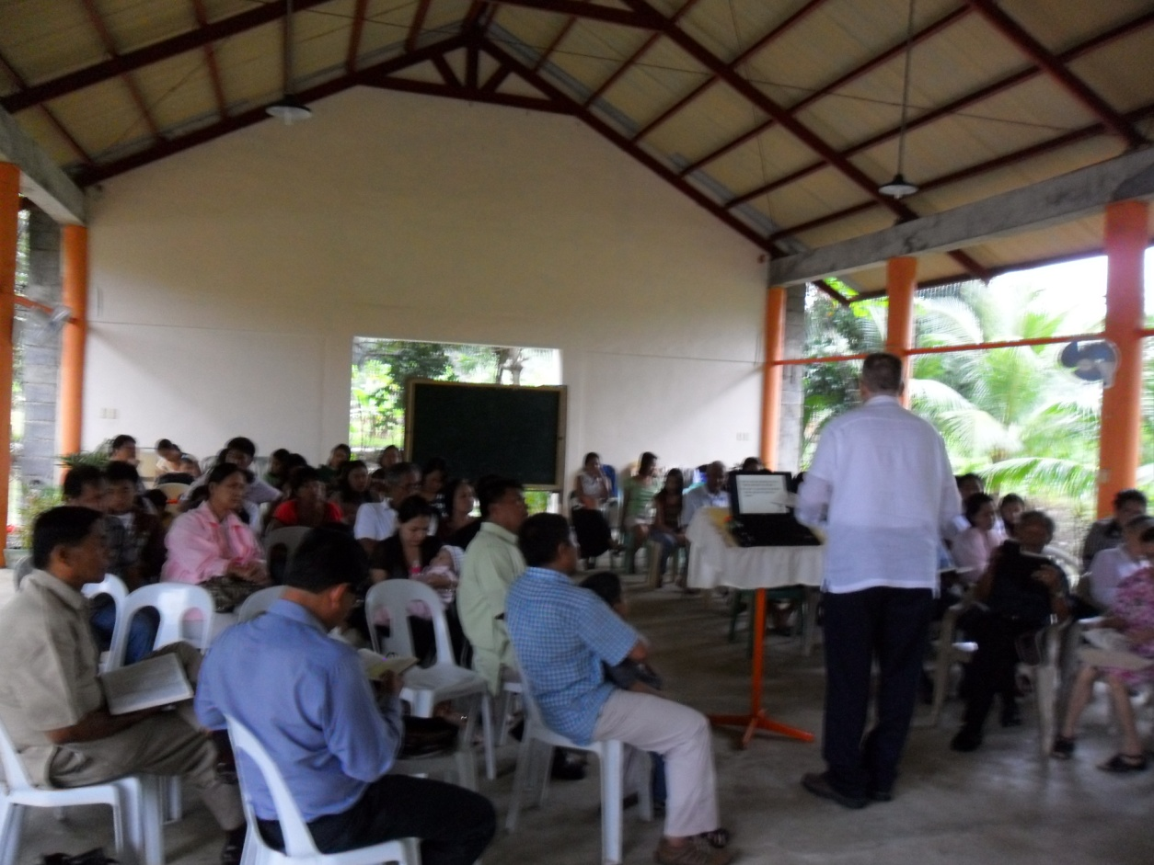
Open air, no walls; brown out in progress; no microphone-speaker system; downpour crashing on tin roof.

Slide 28
James Berden – preacher, his wife and his parents

Slide 29
Men of the congregation Jack, Tony, and Rodney

Slide 32
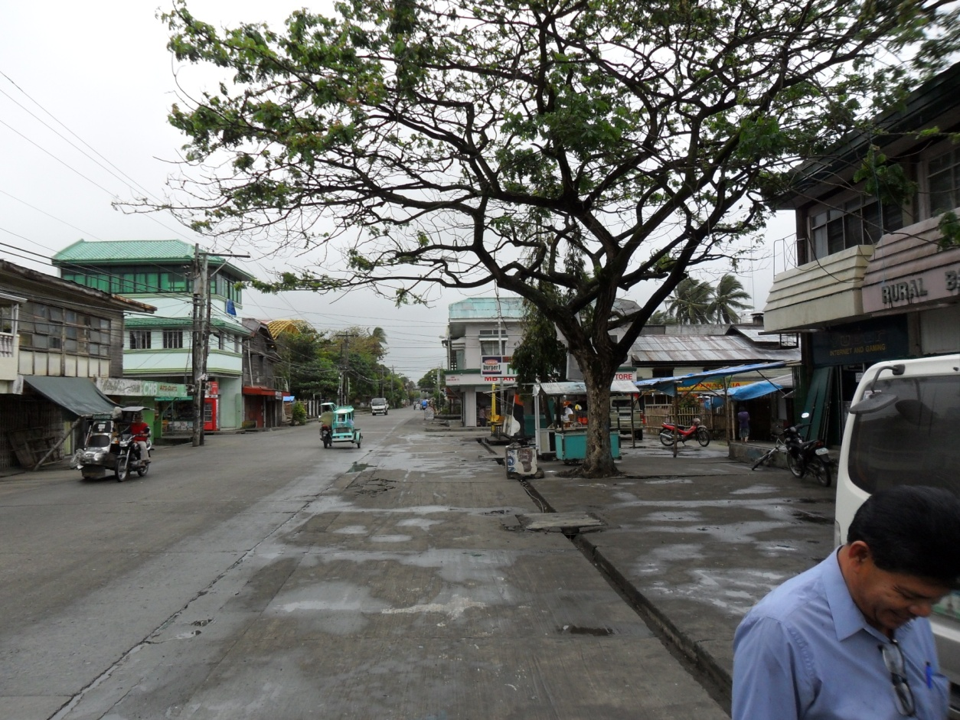
Cadiz City

Slide 34
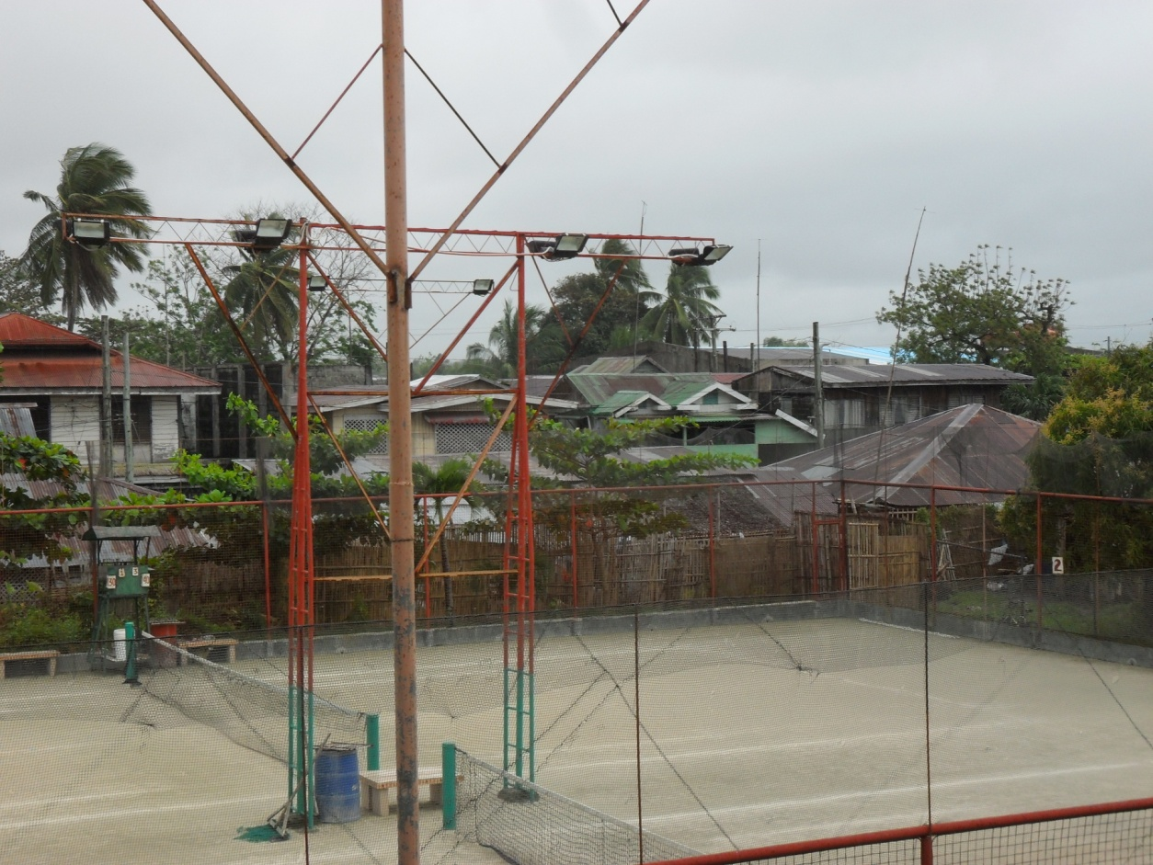

Slide 35
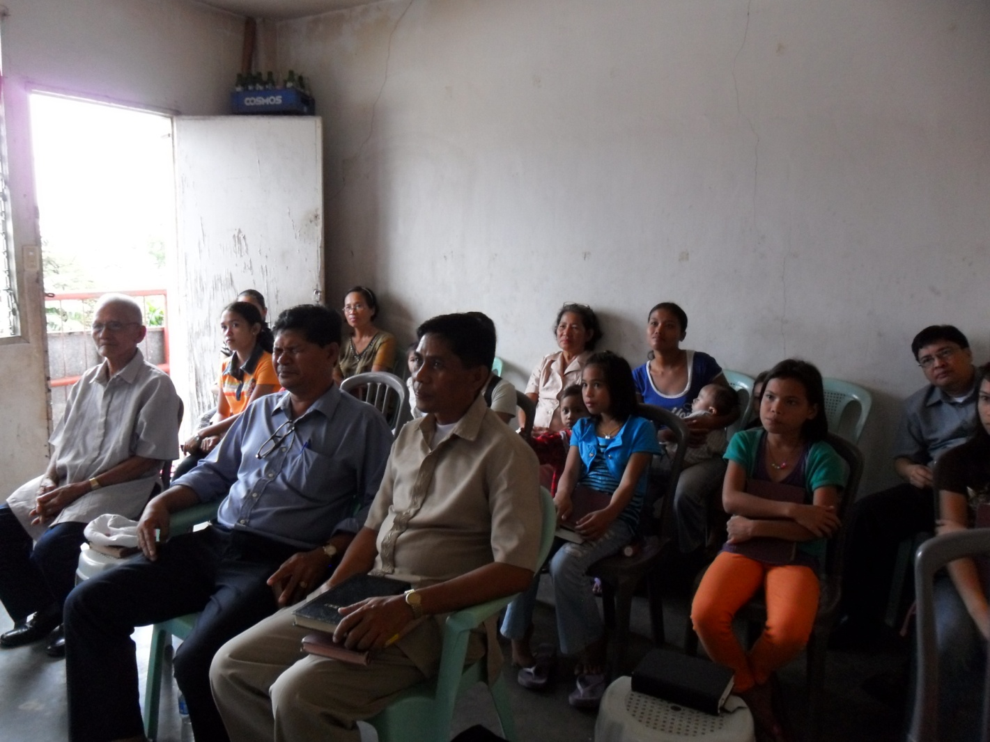

Slide 36
Jesse Isitan - preacher

Slide 37
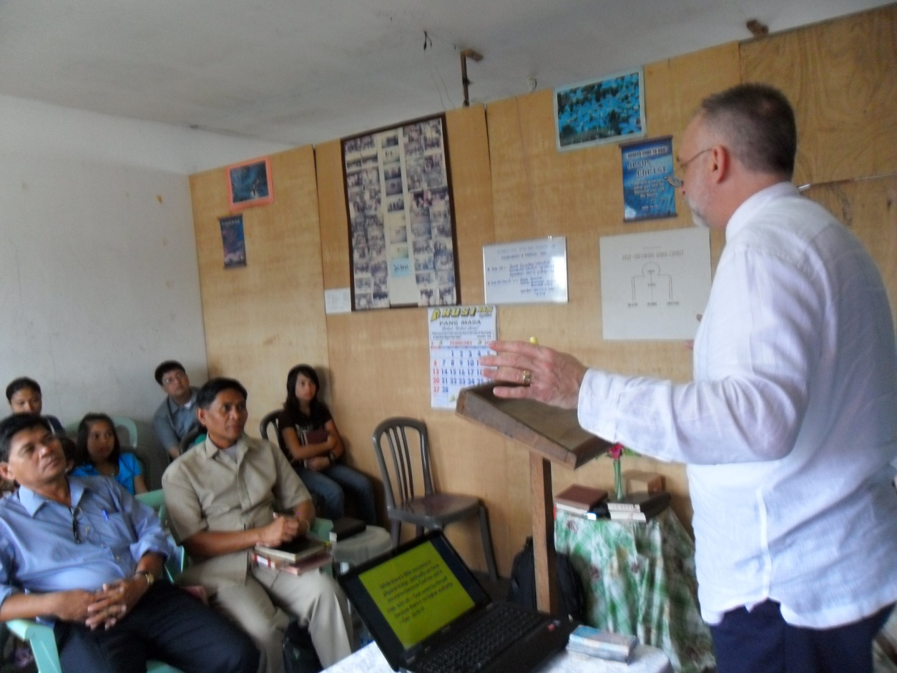

Slide 38
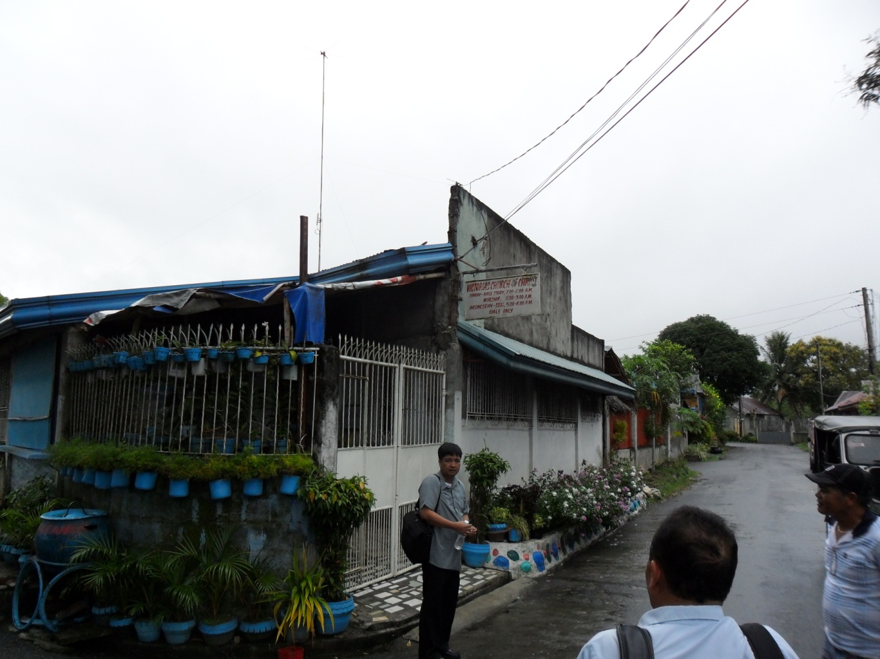
Victorias church of Christ

Slide 39
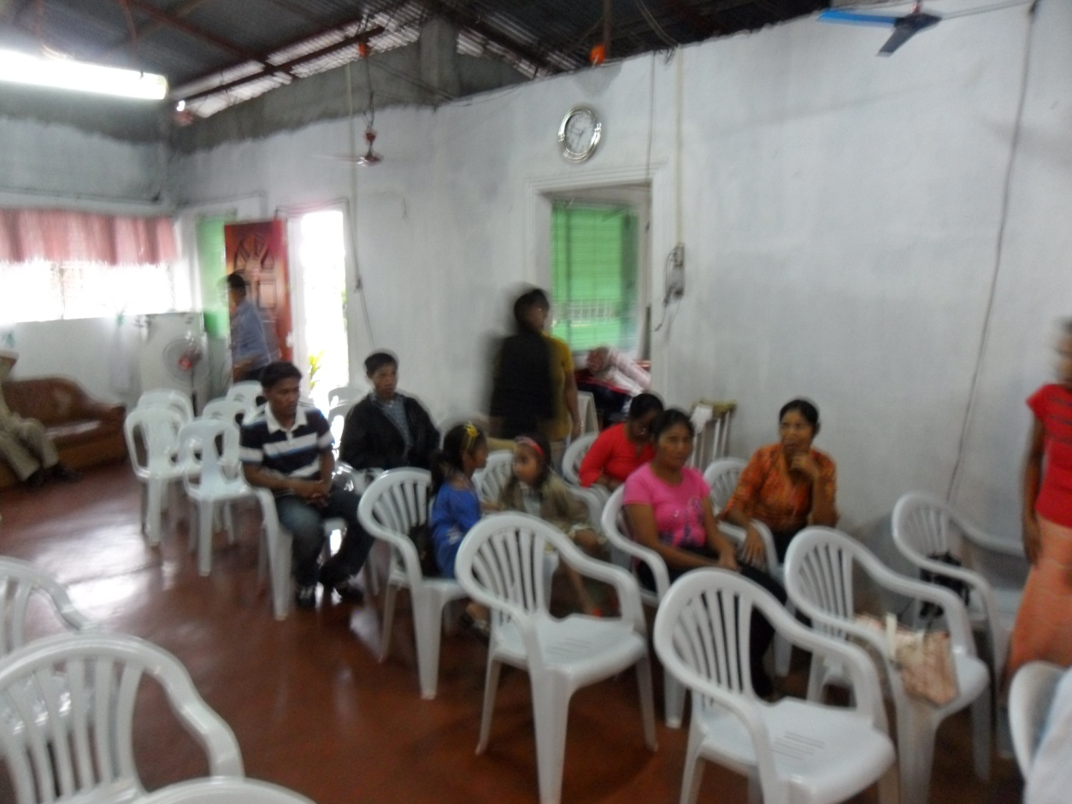

Slide 40
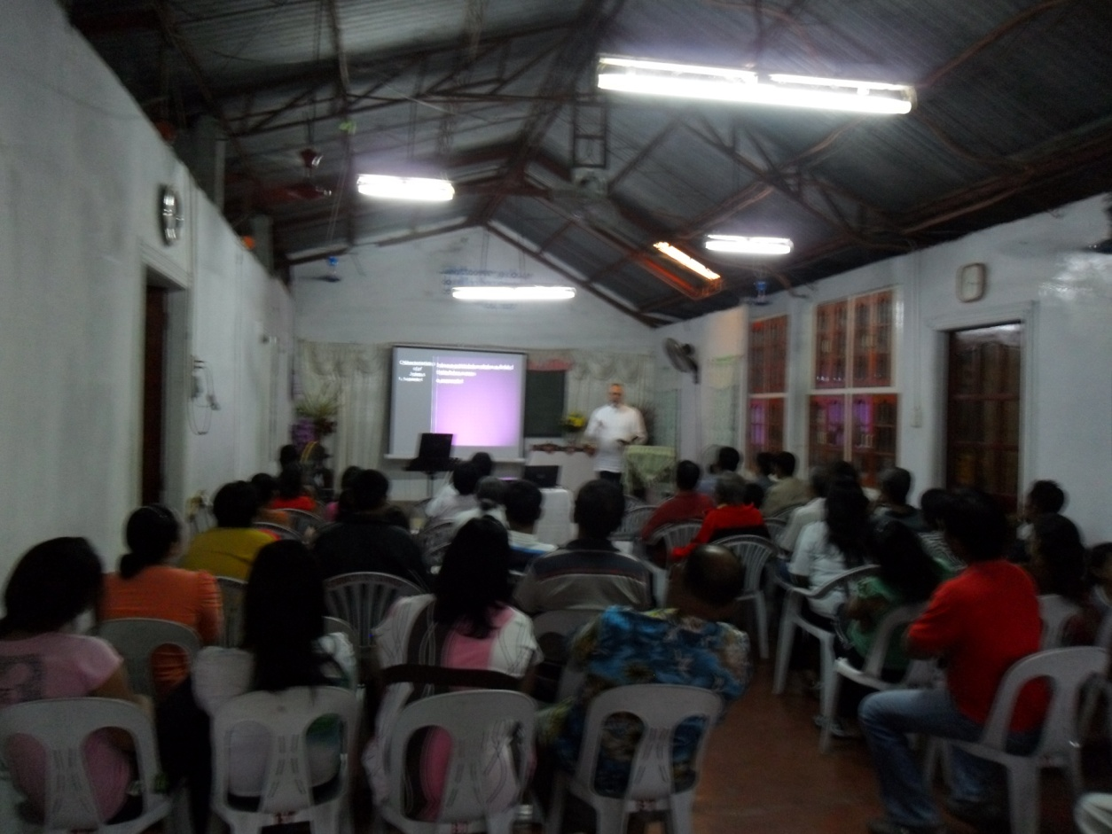

Slide 41
Jack Jaco – preacher, his wife, daughters and son Tony, Rodney, Lordy

Slide 43
Monday and Tuesday, February 28 and March 1, 2011 Lectures in Bacolod

Slide 44
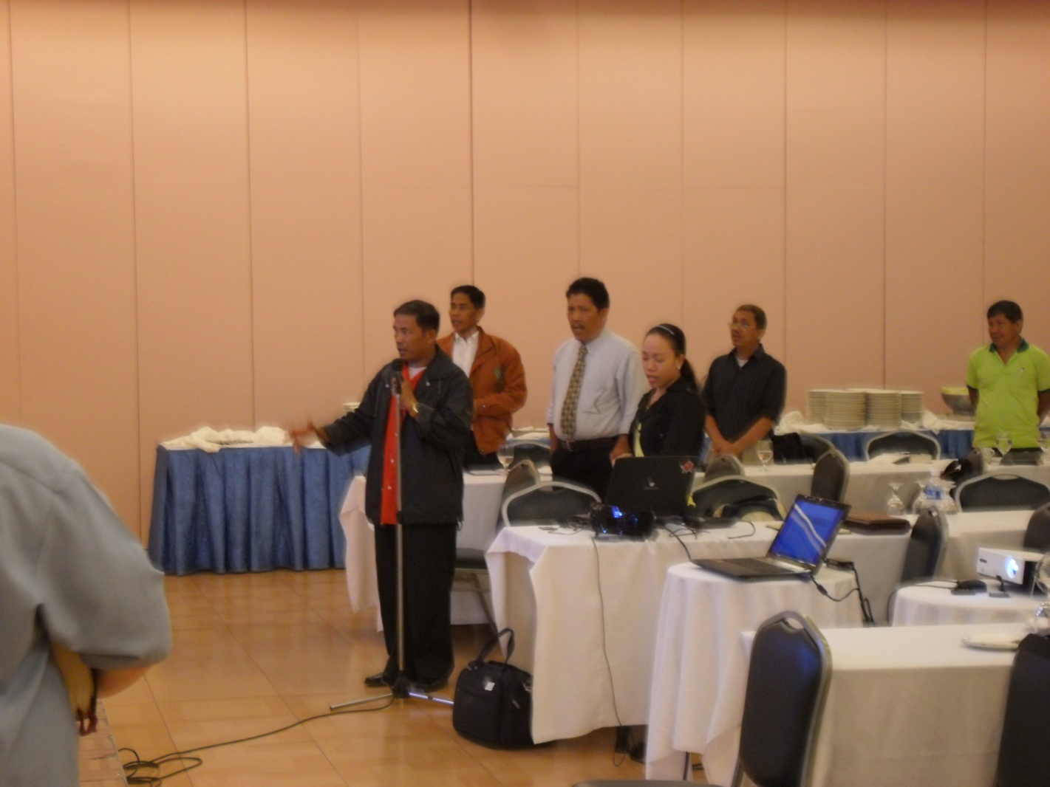

Slide 45
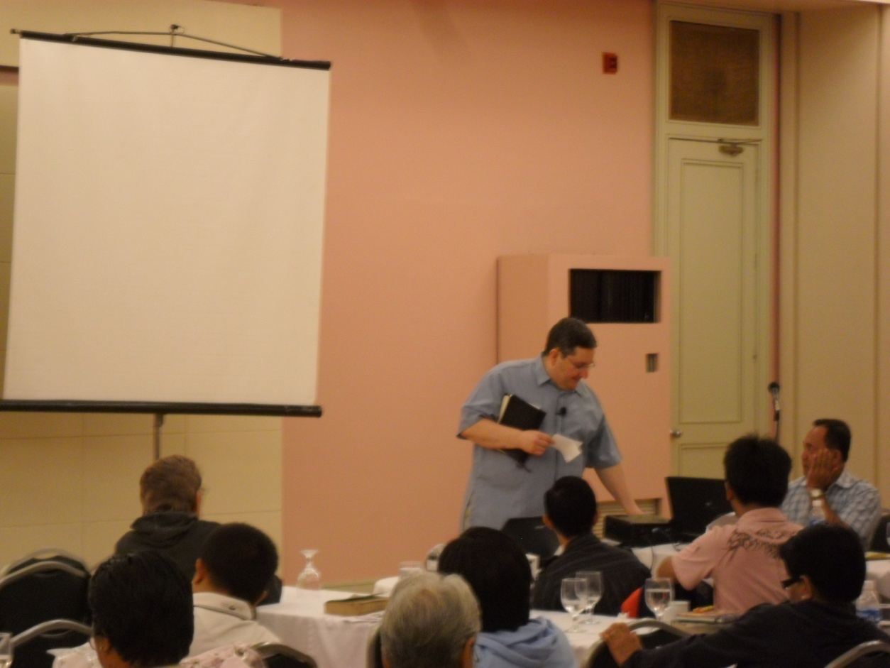
Jack offered the invitation and one expressed a desire to be baptized.
At the and of each day there was a
Q & A session.

Slide 47
Travel to Cebu – Airport in Bacolod

Slide 48
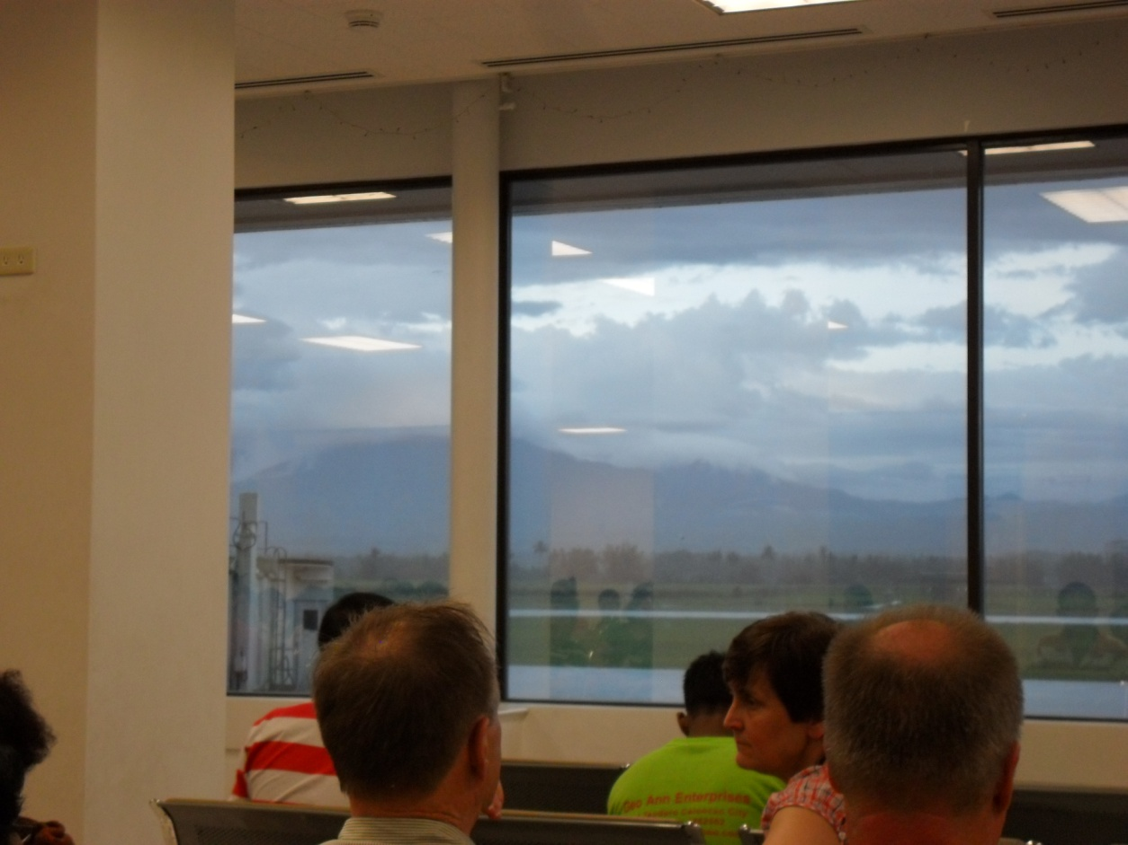

Slide 49
Men’s restroom Women’s restroom
plan well???

Slide 52
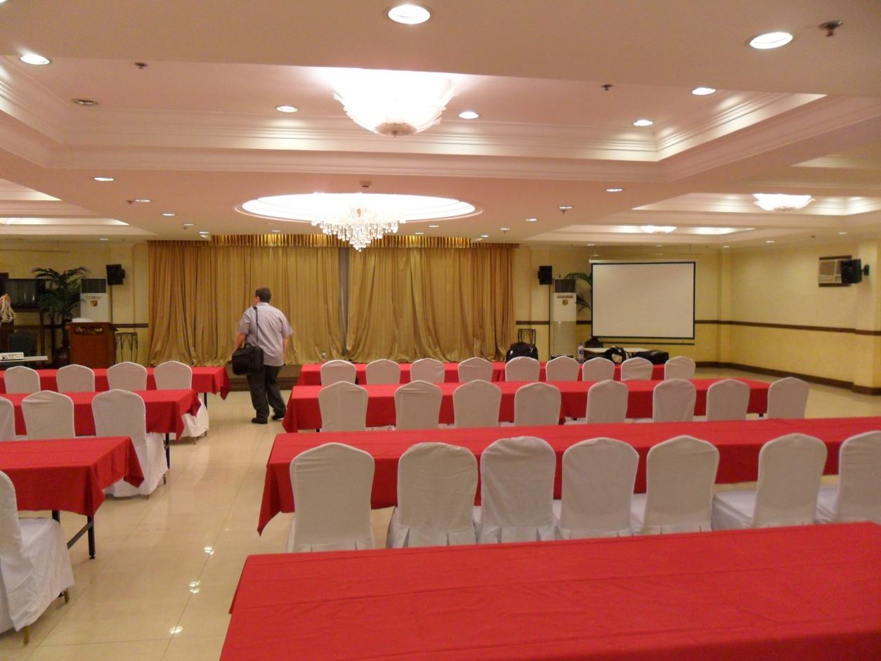

Slide 53
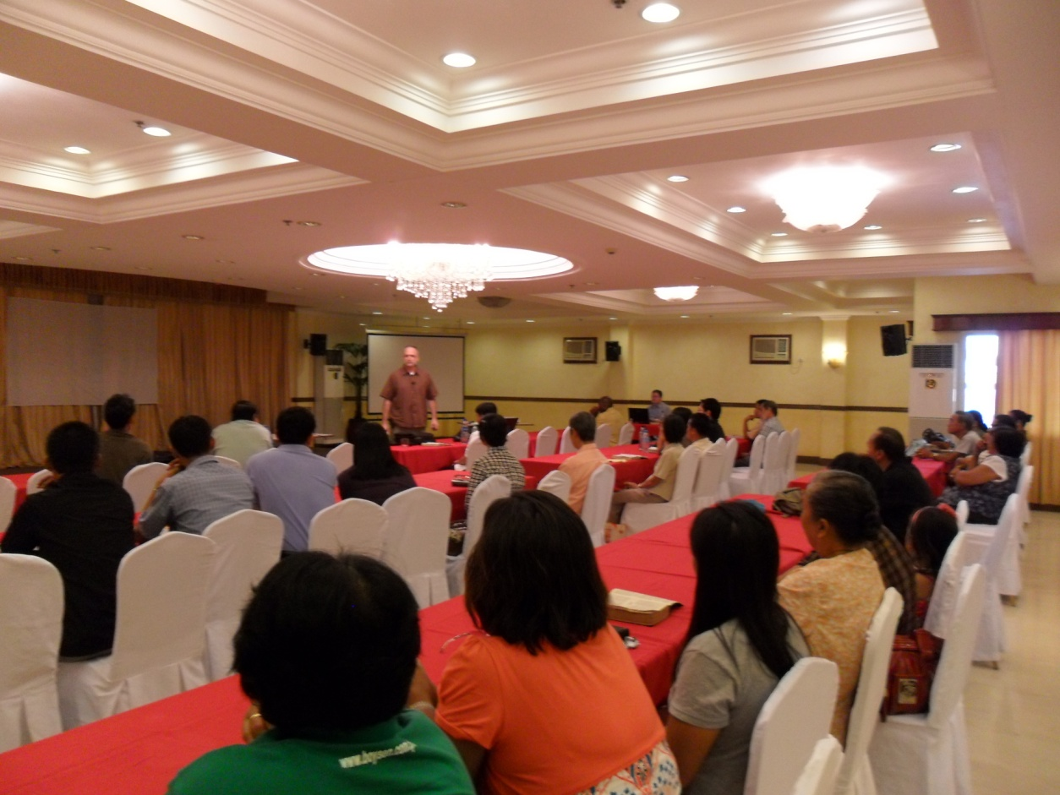

Slide 56
Ronilo Matta and his family

Slide 59
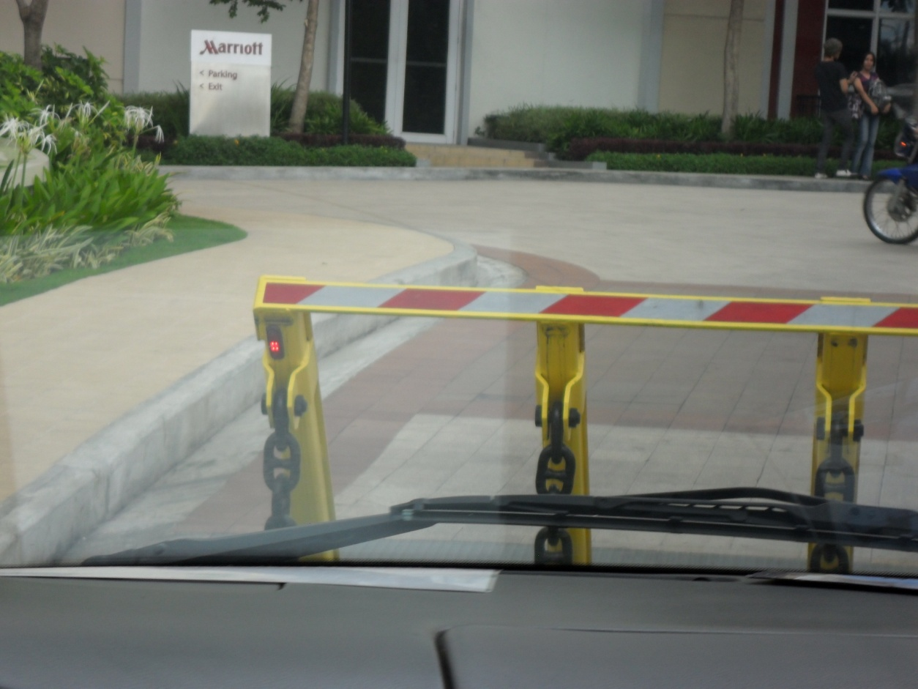

Slide 61
The KEY to this room is leave you card key in the slot!!!

Slide 63
Baggage claim in Tuguegarao

Slide 64
Harry and Rody Gumpad

Slide 70
Ilagan church of Christ

Slide 71
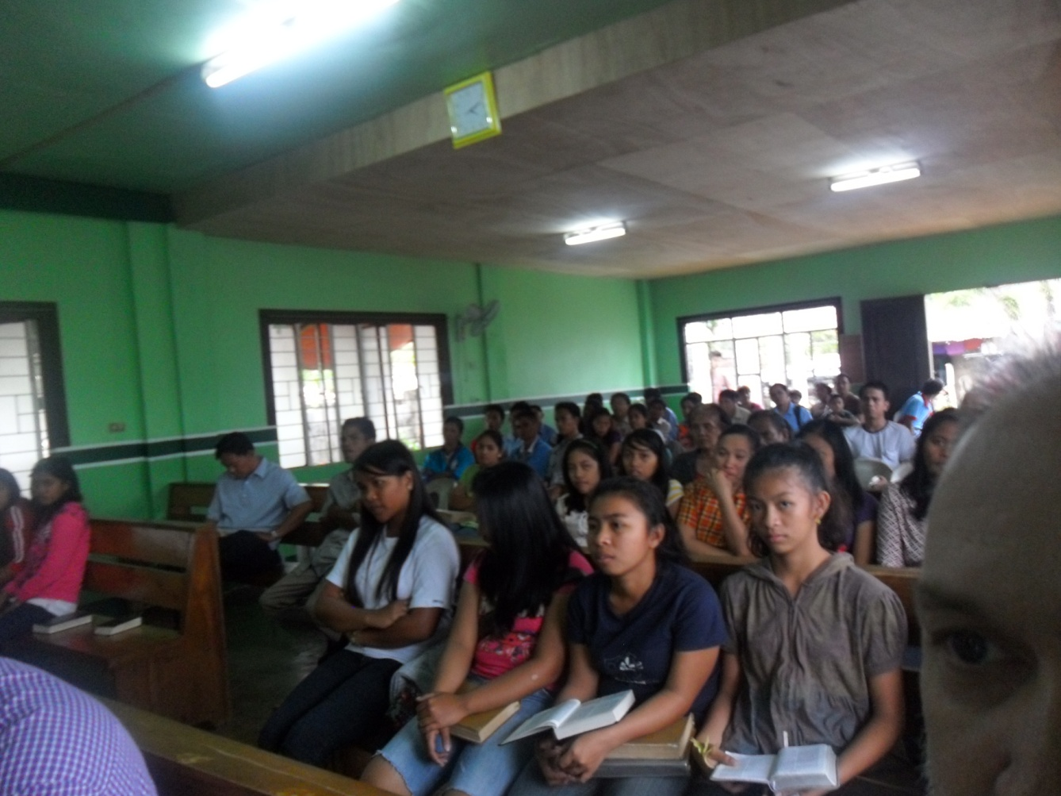
Edgar - preacher

Slide 76
Metro church of Christ Tuguegarao – Rody Gumpad - preacher

Slide 78
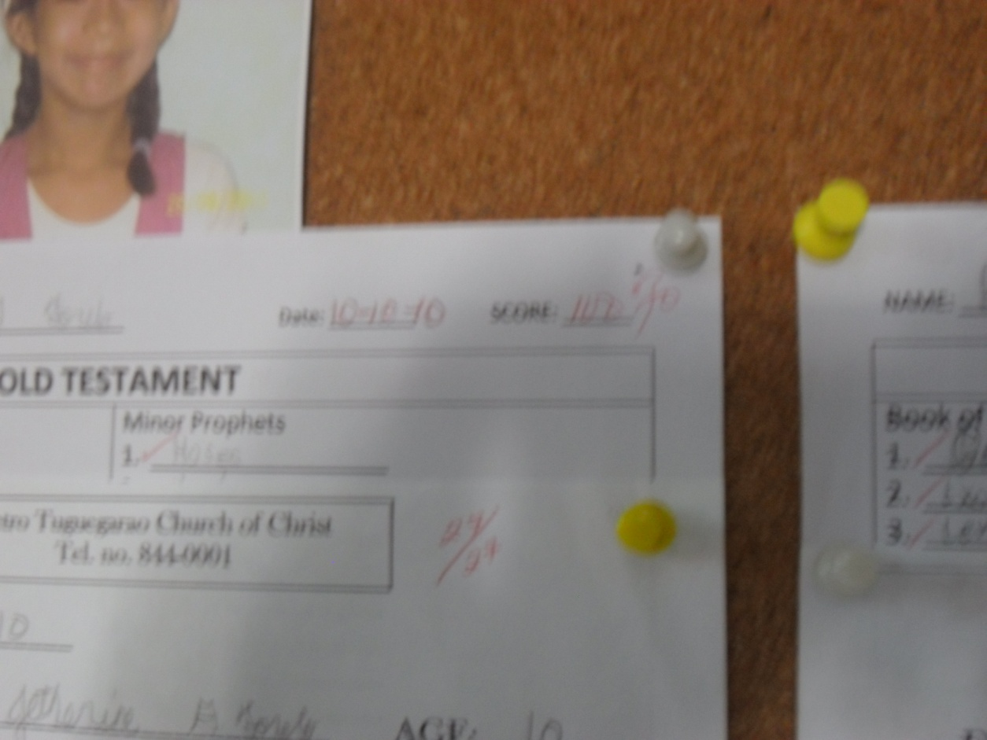
Tests are given in the Bible classes, graded, and posted for all to see.

Slide 81
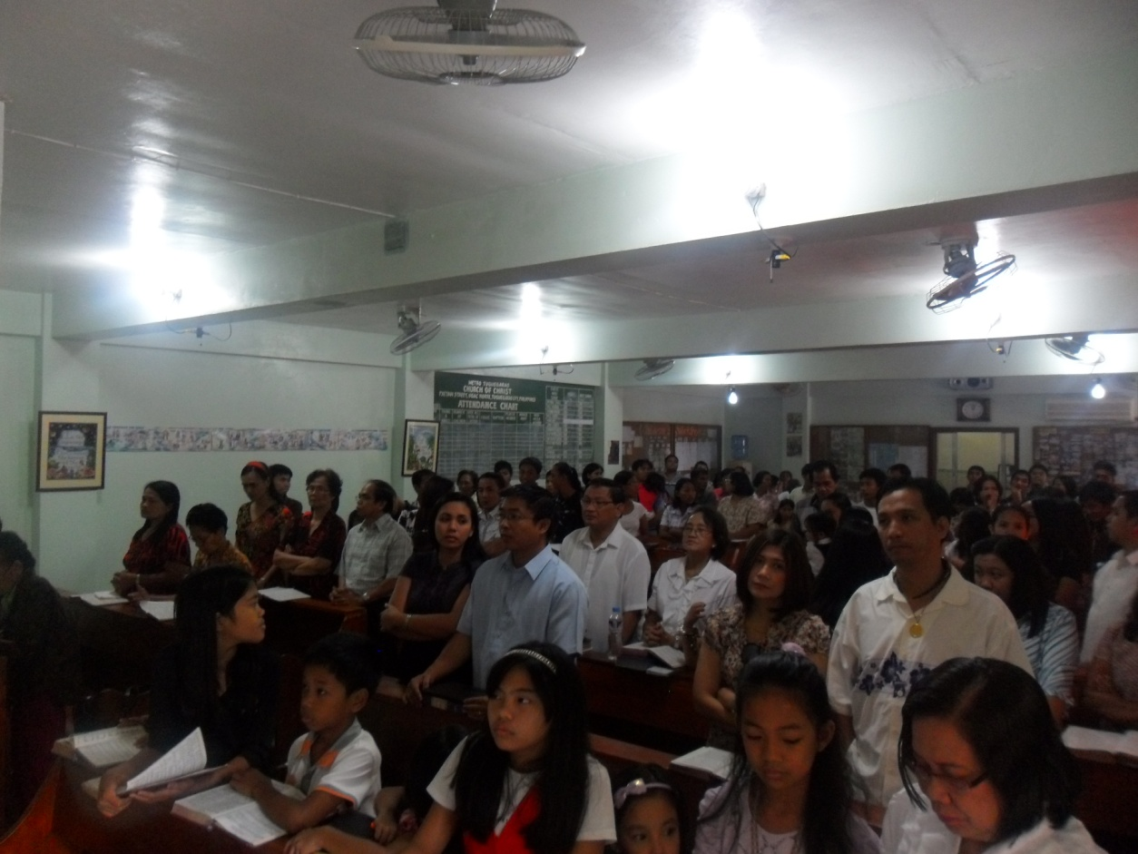

Slide 82
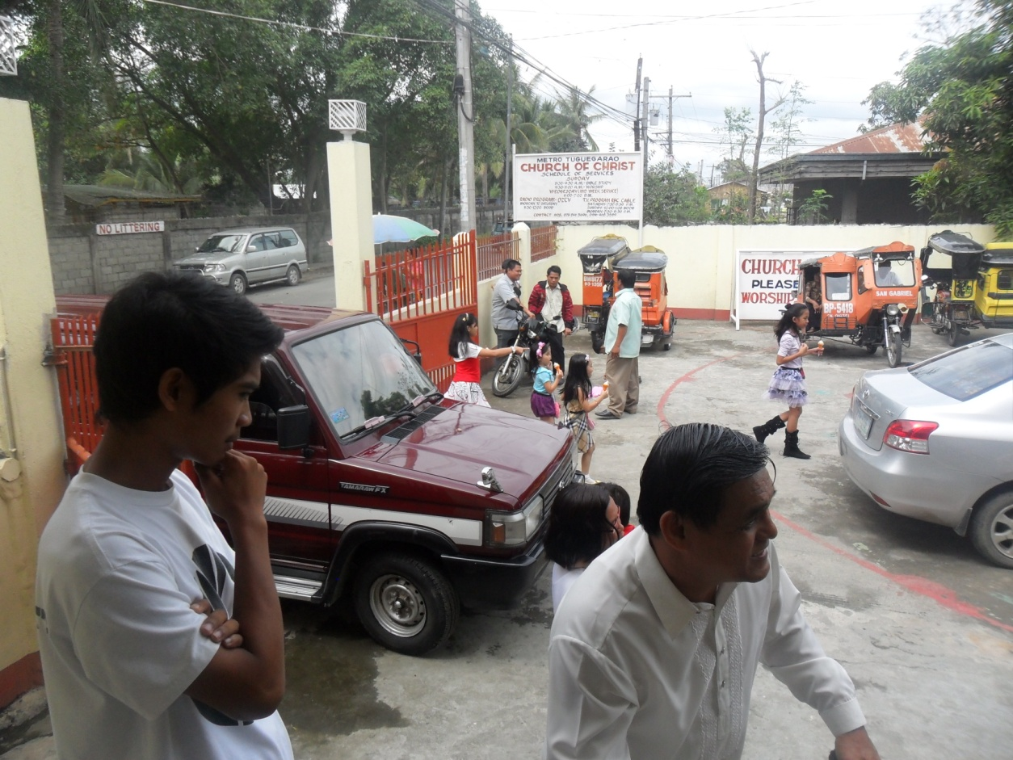

Slide 84
Sunday, March 6, 2011 Church of Christ - Margaurig

Slide 85
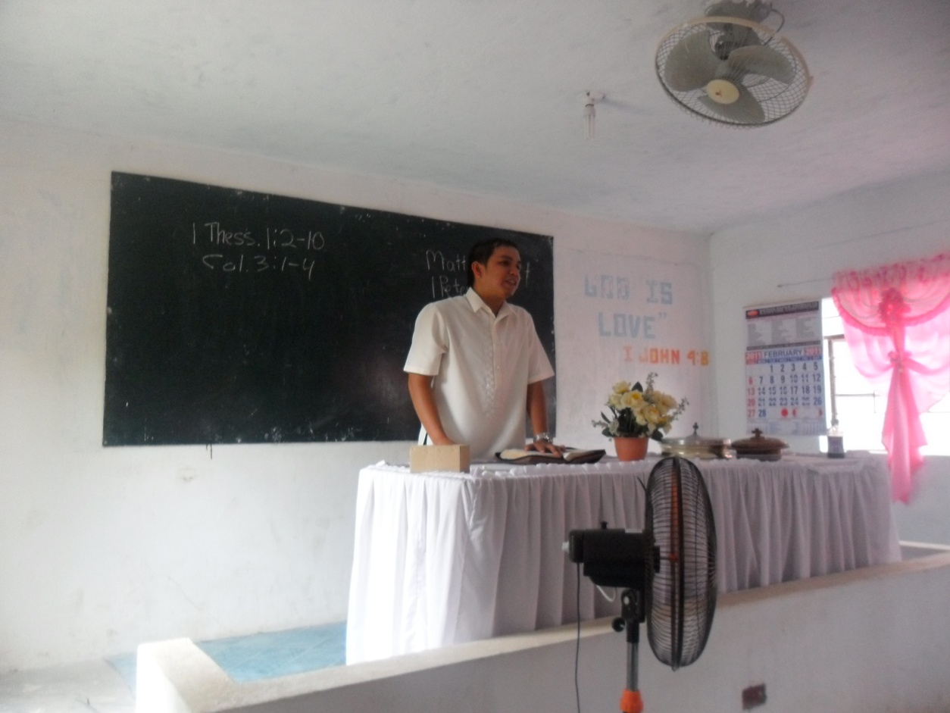
Jun leads singing and then summarizes the lesson in the local dialect.
Jun attends morning worship services in Tuguegarao and then in the afternoon goes to Margaurig and preaches there. Many of the men at Tuguegarao do this including Rody’s sons and sons-in-law.

Slide 87
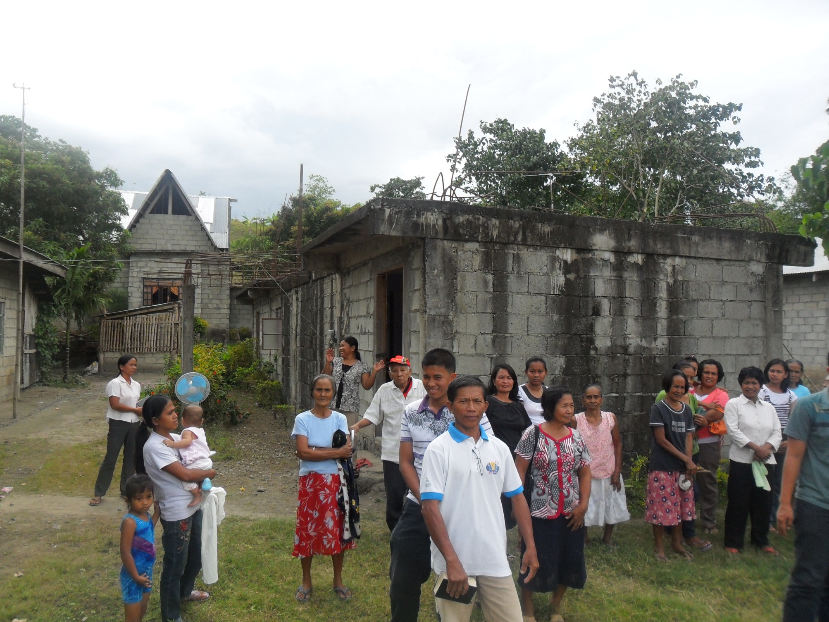

Slide 89
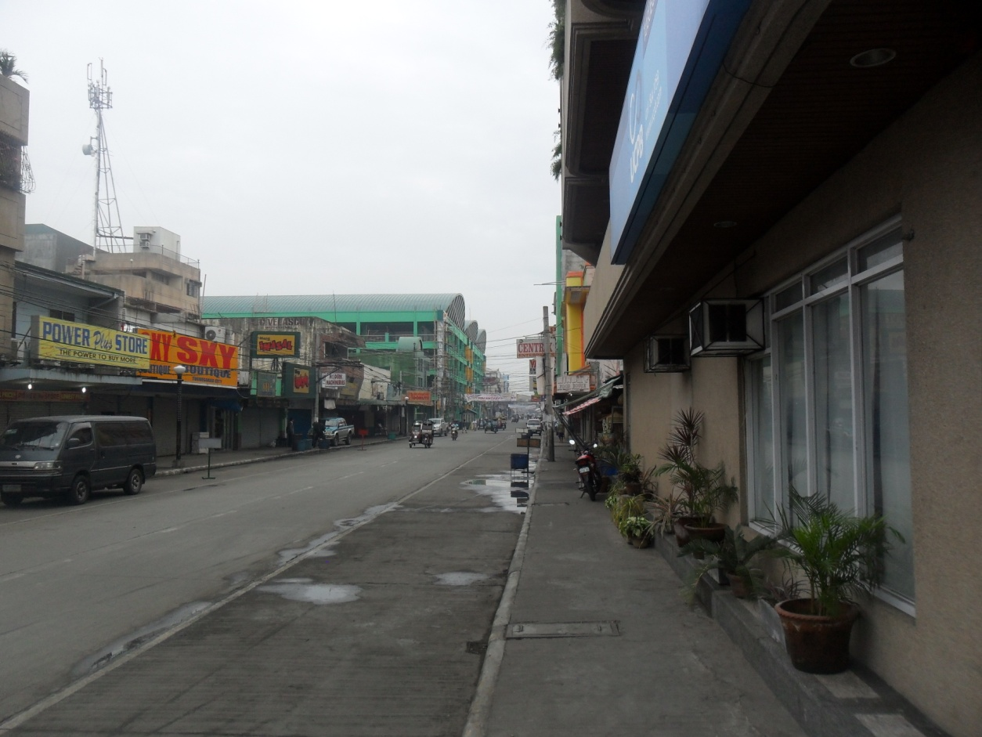

Slide 90
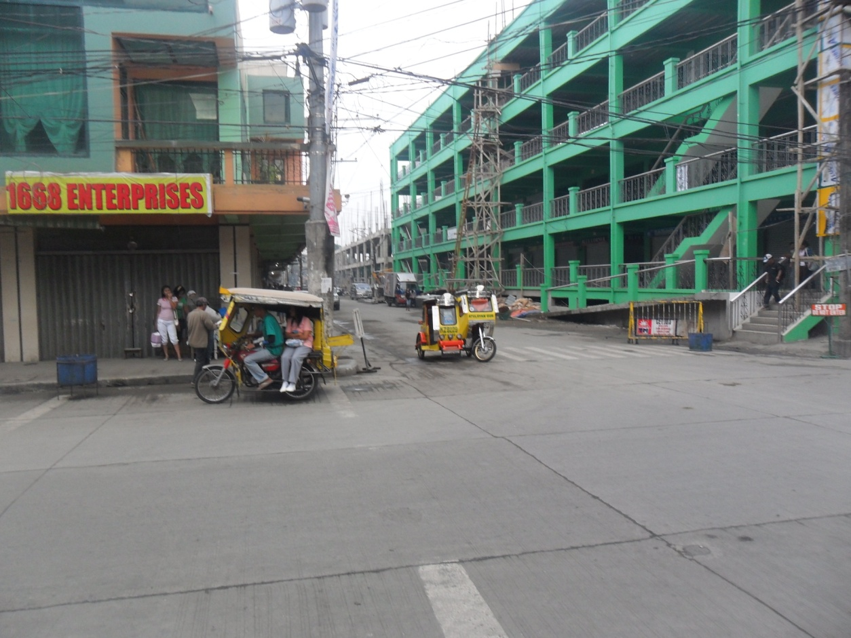

Slide 91
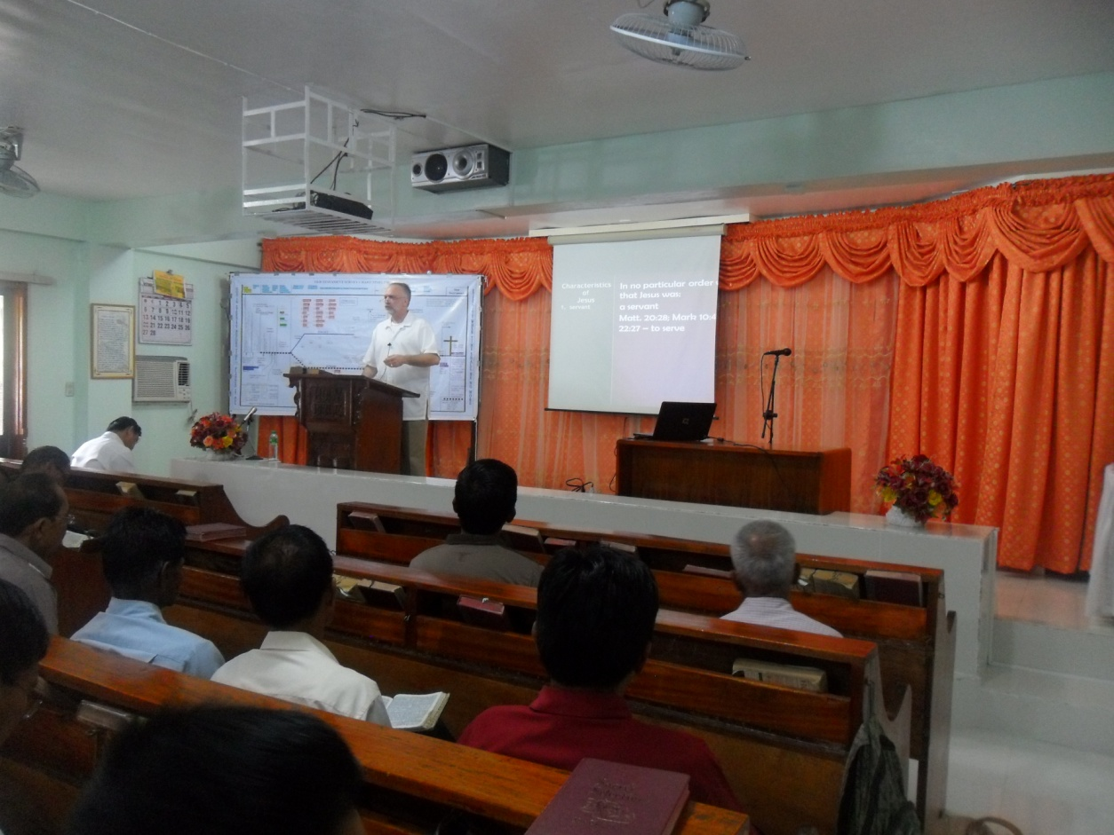
Monday-Thursday, March 7-10, 2011 Lectures at Tuguegarao
Lectures started at 8:30 am and continued through 5pm. Rody start preaching in the morning, I would follow and then Harry. We would break for lunch and then I would bring a lesson followed by Harry.

Slide 92
All of the lesson were video taped for later airing on the television program that Rody hosts, Sat-Mon.

Slide 93
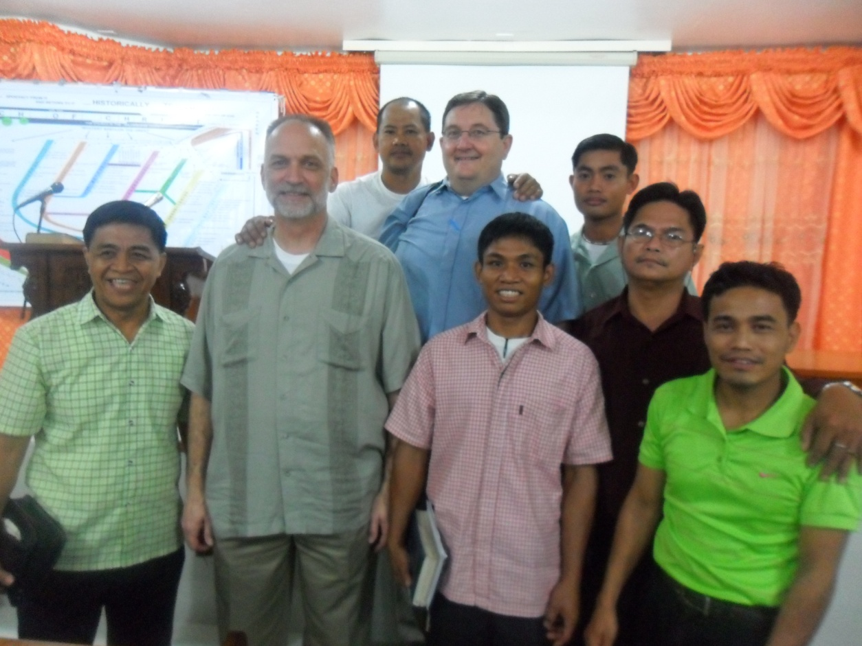
Needs a horse to get to the three congregations where he preaches.

Slide 98
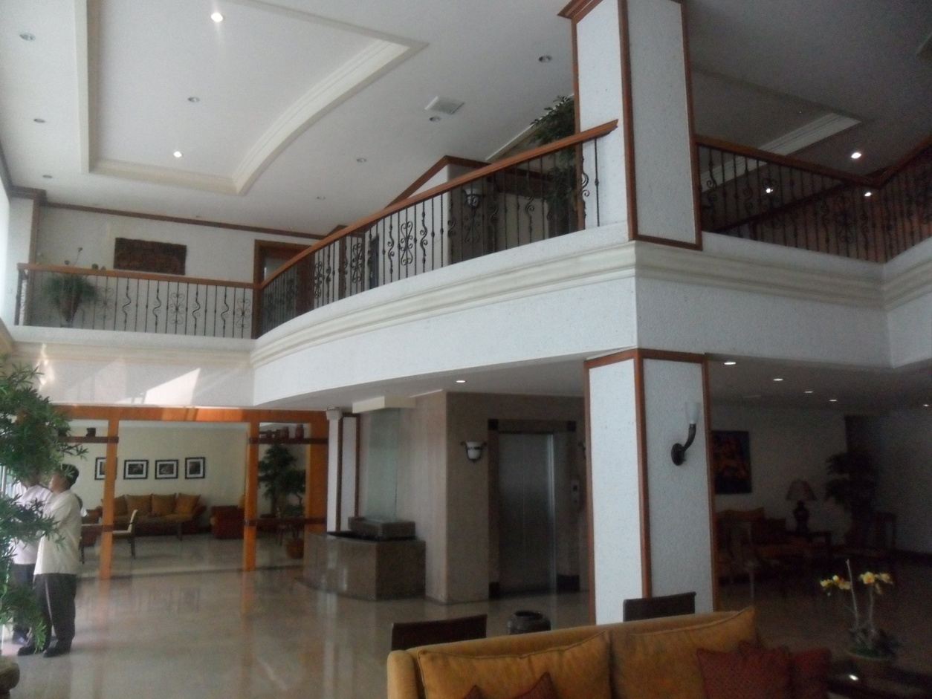
Hotel Roma

Slide 102
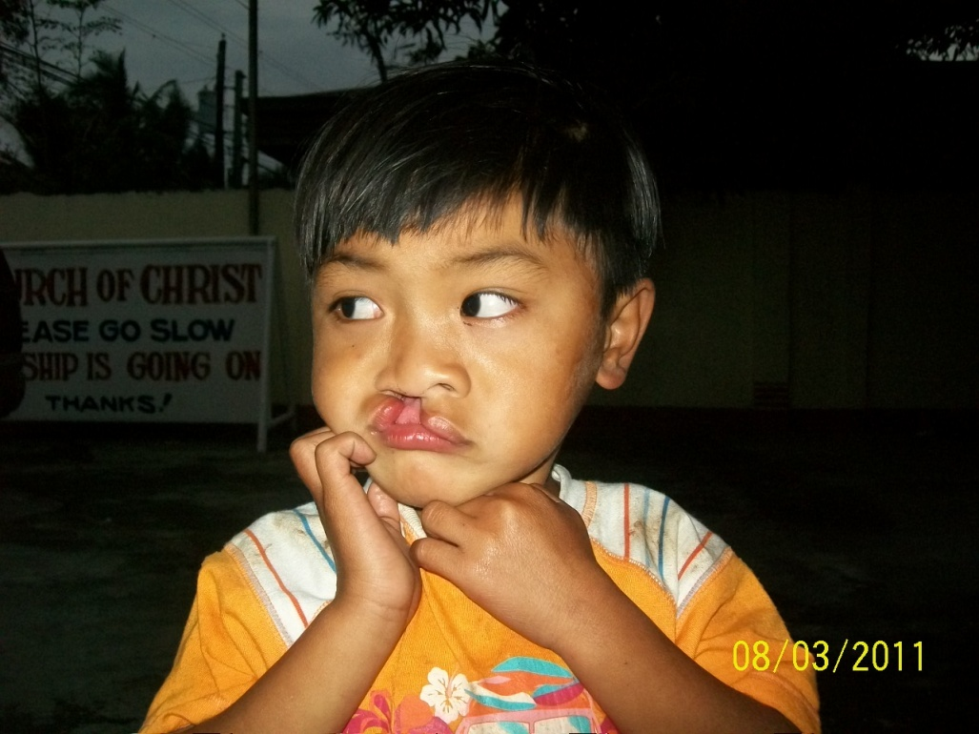
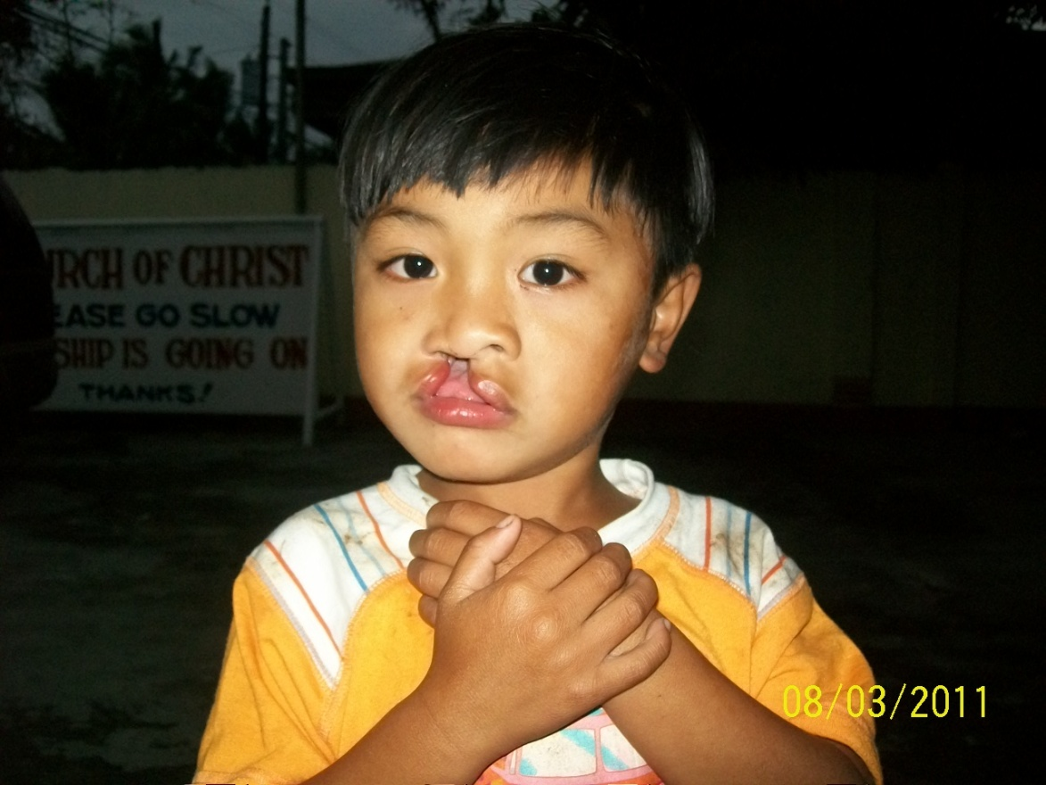
5yr. old with cleft palate. Surgery to correct this about $1200.00
His parents are members of a church in the mountain areas around Tuguegarao.

