Slide 2
Propitiation And Atonement
Understanding The Vocabulary and Process of Reconciliation

Slide 3
Propitiation
Expiation
Appeasement
Atonement
Reconciliation
Redemption
Reparation

Slide 4
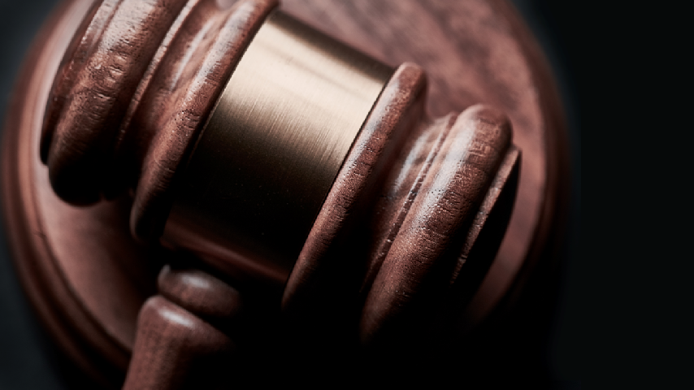
Close Relationship:
US
GOD
Broken Relationship:
SIN
US
GOD

Slide 5
Isaiah 59:2 – “But your iniquities have made a separation between you and your God, And your sins have hidden His face from you so that He does not hear.”
Romans 3:23 – “²³ for all have sinned and fall short of the glory of God,”

Slide 6
Romans 6:23
^{“23} For the wages of sin is death, but the free gift of God is eternal life in Christ Jesus our Lord.”

Slide 7
Close Relationship:
US
GOD
Broken Relationship:
SIN
US
GOD
The Goal: Reconciliation
US
GOD

Slide 8
“Reconcile”
“1: to restore to friendship or harmony; 2: to make consistent or congruous”

Slide 9
Close Relationship:
US
GOD
Broken Relationship:
SIN
US
GOD
The Goal: Reconciliation
US
GOD
SIN

Slide 10
How are my sins atoned?
Lev 17:11
Blood is required!

Slide 11
“Reparation”
“1: a repairing or keeping in repair 2a: the act of making amends, offering expiation, or giving satisfaction for a wrong or injury b: something done or given as amends or satisfaction

Slide 12
The Goal: Reconciliation
US
GOD
SIN
Reparation Must be Made
Two Sides of This Reparation:
Sinned Against
US
Sinned
SIN
GOD
Expiation
Propitiation

Slide 13
“Expiation”
“a: to make amends for b: to extinguish the guilt incurred by”

Slide 14
The Goal: Reconciliation
US
GOD
SIN
Reparation Must be Made
Two Sides of This Reparation:
Sinned Against
US
Sinned
SIN
GOD
Expiation

Slide 15
“Propitiation”
“the act of gaining or regaining the favor or goodwill of someone or something : appeasement : the act of propitiating” - “to make reconciliation”

Slide 16
Two Sides of This Reparation:
Sinned Against
US
Sinned
SIN
GOD
Expiation
Propitiation
Reconciliation:
US
GOD
Atonement:

Slide 17
“Atonement”
“1: reparation for an offense or injury : Satisfaction 2: the reconciliation of God and humankind through the sacrificial death of Jesus Christ”

Slide 18
Two Sides of This Reparation:
Sinned Against
US
Sinned
SIN
GOD
Expiation
Propitiation
Reconciliation:
US
GOD
Atonement:

Slide 19
Atonement is the entire process of being reunited with God; expiation is the guilt being dealt with; propitiation is the satisfying of the one who was wronged; and reconciliation is when we are finally restored to that relationship with God.

Slide 20
The noun form of propitiation is used twice in the NT - 1 John 2:2; 4:10 - ἱλασμός (hilasmos)

Slide 21
1 John 2:1-2
“My little children, I am writing these things to you so that you may not sin. And if anyone sins, we have an Advocate with the Father, Jesus Christ the righteous; ² and He Himself is the propitiation for our sins; and not for ours only, but also for those of the whole world.”

Slide 22
1 John 4:10
^{“10} In this is love, not that we loved God, but that He loved us and sent His Son to be the propitiation for our sins.”

Slide 23
The verb form of propitiation is also used twice - Luke 18:13; Hebrews 2:17 - ἱλάσκεσθαι (hilaskesthai)

Slide 24
Luke 18:13
^{“13} And the tax collector, standing afar off, would not so much as raise his eyes to heaven, but beat his breast, saying, ‘God be merciful to me, a sinner!’…”

Slide 25
Hebrews 2:17
^{“17} Therefore, He had to be made like His brethren in all things, so that He might become a merciful and faithful high priest in things pertaining to God, to make propitiation for the sins of the people.”

Slide 26
ἱλαστήριον (hilastaerion), which is translated in Hebrews 9:5 as “mercy seat”
The Hebrew word for this simply means: “A covering”

Slide 27
Hebrews 9:5
⁵ “and above it were the cherubim of glory overshadowing the mercy seat. Of these things we cannot now speak in detail.”

Slide 28
Let’s put it all together…

Slide 29
Hebrews 9:11-14
¹¹ But when Christ appeared as a high priest of the good things to come, He entered through the greater and more perfect tabernacle, not made with hands, that is to say, not of this creation; ¹² and not through the blood of goats and calves, but through His own blood, He entered the holy place once for all, having obtained eternal redemption.

Slide 30
Hebrews 9:11-14
¹³ For if the blood of goats and bulls and the ashes of a heifer sprinkling those who have been defiled sanctify for the cleansing of the flesh, ¹⁴ how much more will the blood of Christ, who through the eternal Spirit offered Himself without blemish to God, cleanse your conscience from dead works to serve the living God?”

Slide 31
Romans 3:23-26
^{“23} for all have sinned and fall short of the glory of God,
²⁴ being justified as a gift by His grace through the redemption which is in Christ Jesus;

Slide 32
Romans 3:23-26
^{“25} whom God displayed publicly as a propitiation in His blood through faith. This was to demonstrate His righteousness, because in the forbearance of God He passed over the sins previously committed; ²⁶ for the demonstration, I say, of His righteousness at the present time, so that He would be just and the justifier of the one who has faith in Jesus.”

Slide 33
God is just AND the justifier of the one who has faith in Jesus, because Jesus has been offered as a sacrifice for us, and it is through His blood that the guilt is removed (expiation), and the wrath is satisfied (propitiation), and our relationship with God has been restored (reconciliation).

Slide 34
Have your sins been atoned? If not…
Obedient belief – Heb 11:6 & James 2:19
Repent - Luke 13:3
Confess – Luke 12:8
Be Baptized - Acts 2:38
Live faithful til death - Rev 2:10

