Slide 1
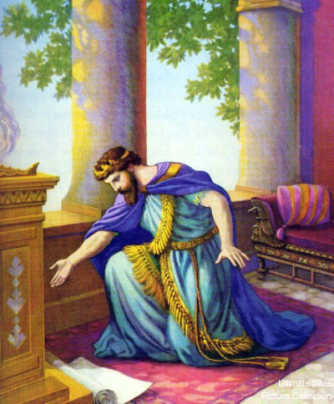
Lessons From Hezekiah’s Prayer
2 Kings 18-19

Slide 2
Lessons From Hezekiah’s Prayer
He started out close to God – 18:3-7
He went to the house of God
19:14; Ps. 122:1; Heb. 4:14-16
He “spread” his trouble out before God
19:14; Ps. 55:22; 1 Pet. 5:6-7
He prayed – 19:15-19

Slide 3
Hezekiah’s Prayer Consisted Of…
His trust in God’s concern – v. 16
His belief in God’s superiority over idols – vs. 17-18
His understanding of God’s sovereign control over all things – v. 19
Hezekiah’s prayer was “God-centered,” not “self-centered” – vs. 16, 19

