Slide 1
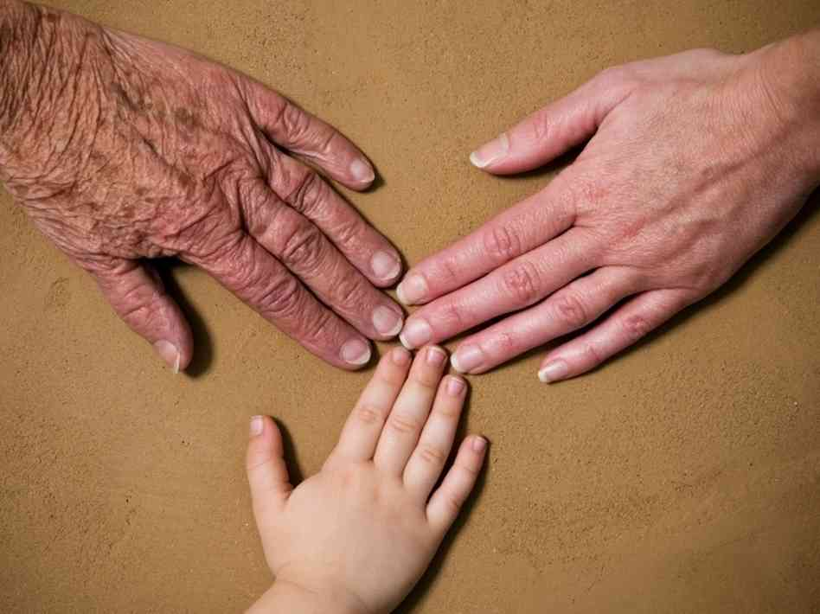

Slide 2
3 Generations
Bible Examples Of Generational Decline
Abraham, Isaac, and Esau
(Gen. 12:7; Gen. 13:4, 18; Gen. 22:9)
Gen. 26:25; Gen. 25:28
Gen. 25:29-34

Slide 3
3 Generations
Bible Examples Of Generational Decline
Abraham, Isaac, and Esau
David, Solomon, Rehoboam
(Acts. 13:22)
1 Kings 1:5-6; 1 Kings 11:1-6
1 Kings 14:22-24

Slide 4
3 Generations
Bible Examples Of Generational Decline
Abraham, Isaac, and Esau
David, Solomon, Rehoboam
Israel
Judges 2:7-12

Slide 5
3 Generations
Bible Examples Of Generational Decline
How Does This Happen?
Time Is Viewed Differently
Luke 10:2; Isaiah 6:8; John 8:33, 39-40

Slide 6
3 Generations
Bible Examples Of Generational Decline
How Does This Happen?
Time Is Viewed Differently
Authority Is Viewed Differently
Matt. 15:8-9; 2 Tim. 3:5, 7; Rom. 10:1-3

Slide 7
3 Generations
Bible Examples Of Generational Decline
How Does This Happen?
Time Is Viewed Differently
Authority Is Viewed Differently
A Different Focus In Life
Heb. 11:8-10; Deut. 6:10-12; Deut. 32:15

Slide 8
3 Generations
Bible Examples Of Generational Decline
How Does This Happen?
How Do We Stop The Decline?
For The 3rd Generation…
Study & Teach – Eph. 6:4; Deut. 6:7

Slide 9
3 Generations
Bible Examples Of Generational Decline
How Does This Happen?
How Do We Stop The Decline?
For The 3rd Generation - Study & Teach
For The 2nd Generation…
Try To Remember Your Place – Rev. 3:14-19

Slide 10
3 Generations
Bible Examples Of Generational Decline
How Does This Happen?
How Do We Stop The Decline?
For The 3rd Generation - Study & Teach
For The 2nd Generation - Try To Remember Your Place
For The 1st Generation…
Hold Onto Your Faith - 1 Peter 5:5-9

Slide 12
Luke 16:27-31
“Then he said, ‘I beg you therefore, father, that you would send him to my father’s house, 28 for I have five brothers, that he may testify to them, lest they also come to this place of torment.’ 29 Abraham said to him, ‘They have Moses and the prophets; let them hear them.’ 30 And he said, ‘No, father Abraham; but if one goes to them from the dead, they will repent.’ 31 But he said to him, ‘If they do not hear Moses and the prophets, neither will they be persuaded though one rise from the dead.’”

