Slide 1
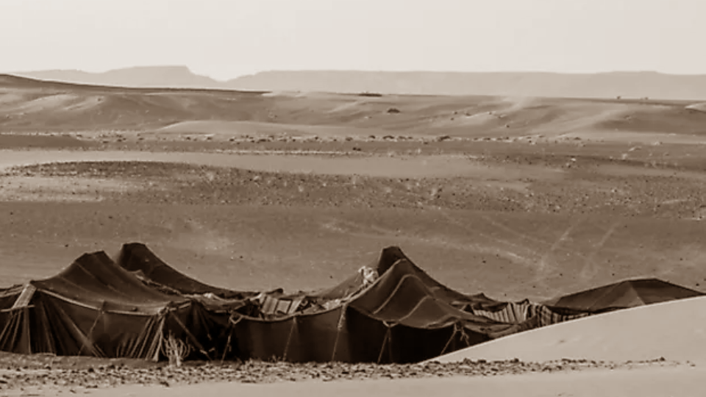
Tents of the Righteous
Psalm 118:15-24
Notes:
(Psalm 118:15-24), “The voice of rejoicing and salvation is in the tents of the righteous; the right hand of the Lord does valiantly. ¹⁶ The right hand of the Lord is exalted; the right hand of the Lord does valiantly. ¹⁷ I shall not die, but live, and declare the works of the Lord. ¹⁸ The Lord has chastened me severely, but He has not given me over to death. ¹⁹ Open to me the gates of righteousness; I will go through them, and I will praise the Lord. ²⁰ This is the gate of the Lord, through which the righteous shall enter. ²¹ I will praise You, for You have answered me, and have become my salvation. ²² The stone which the builders rejected has become the chief cornerstone. ²³ This was the Lord's doing; it is marvelous in our eyes. ²⁴ This is the day the Lord has made; we will rejoice and be glad in it.”
A beautiful Psalm, expressing the redemption promised through David’s house (The Messiah and His kingdom)
Jesus Christ is the chief cornerstone (though rejected by men)
Consider the significance of the words in verses 15-16
While this may seem to be a little gimmicky, talking about the concept of tents in scripture, there are a number of important truths that we can gain from the four points we will make in our lesson today.
Adapted from outline by Joe R. Price
The Spirit’s Sword
12/31/2006

Slide 2
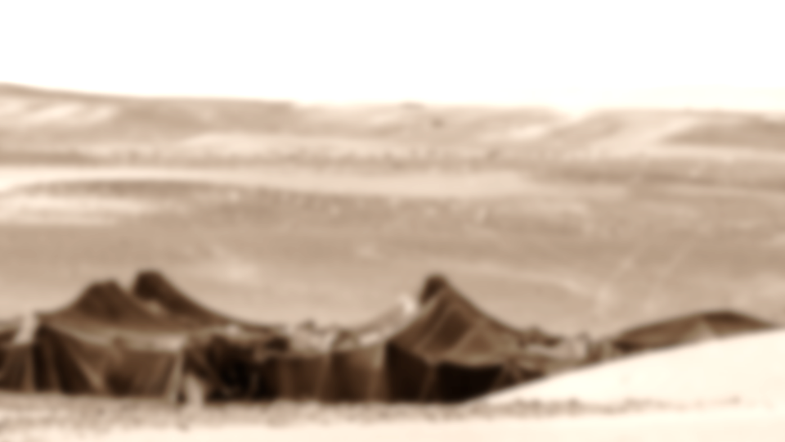
Tents of the Righteous
Living in Tents (Hebrews 11:8-10)
  Numbers 9:17-18; Hebrews 13:12-14
Pitching Tents (Genesis 13:10-13)
  1 John 2:15-17; Psalm 84:10-12; 2 Tim. 2:22
Making Tents (Acts 18:1-4)
  1 Thessalonians 4:9-12; Luke 12:15, 20-21
Putting Off Our Tents (2 Peter 2:12-14)
  2 Corinthians 5:1-8; Hebrews 9:27
Notes:
TENTS OF THE RIGHTEOUS
LIVING IN TENTS
(Hebrews 11:8-10), “By faith Abraham obeyed when he was called to go out to the place which he would receive as an inheritance. And he went out, not knowing where he was going. ⁹ By faith he dwelt in the land of promise as in a foreign country, dwelling in tents with Isaac and Jacob, the heirs with him of the same promise; ¹⁰ for he waited for the city which has foundations, whose builder and maker is God.”
Nomadic Life an Important Symbol in Bible:
Wanderers [Like the Israelites in the Wilderness]
(Numbers 9:17-18), “Whenever the cloud was taken up from above the tabernacle, after that the children of Israel would journey; and in the place where the cloud settled, there the children of Israel would pitch their tents. ¹⁸ At the command of the Lord the children of Israel would journey, and at the command of the Lord they would camp; as long as the cloud stayed above the tabernacle they remained encamped.”
(1 Peter 2:11-12), “Beloved, I beg you as sojourners and pilgrims, abstain from fleshly lusts which war against the soul, ¹² having your conduct honorable among the Gentiles, that when they speak against you as evildoers, they may, by your good works which they observe, glorify God in the day of visitation.”
But, the promise of a homeland
(Hebrews 11:9-10), “By faith he [Abraham] dwelt in the land of promise as in a foreign country, dwelling in tents with Isaac and Jacob, the heirs with him of the same promise; ¹⁰ for he waited for the city which has foundations, whose builder and maker is God.”
(Hebrews 13:12-14), “Therefore Jesus also, that He might sanctify the people with His own blood, suffered outside the gate. ¹³ Therefore let us go forth to Him, outside the camp, bearing His reproach. ¹⁴ For here we have no continuing city, but we seek the one to come.”
[CLICK] PITCHING TENTS (“to stretch out, extend, spread out”).
Some Pitch their Tent toward Sodom
(Genesis 13:10-13), [Lot, when given the choice by his uncle Abram], “And Lot lifted his eyes and saw all the plain of Jordan, that it was well watered everywhere (before the Lord destroyed Sodom and Gomorrah) like the garden of the Lord, like the land of Egypt as you go toward Zoar. ¹¹ Then Lot chose for himself all the plain of Jordan, and Lot journeyed east. And they separated from each other. ¹² Abram dwelt in the land of Canaan, and Lot dwelt in the cities of the plain and pitched his tent even as far as Sodom. ¹³ But the men of Sodom were exceedingly wicked and sinful against the Lord.”
Material choice, 13:10
Selfish choice, 13:11
Shortsighted choice 13:13
(1 John 2:15-17), “Do not love the world or the things in the world. If anyone loves the world, the love of the Father is not in him. ¹⁶ For all that is in the world—the lust of the flesh, the lust of the eyes, and the pride of life—is not of the Father but is of the world. ¹⁷ And the world is passing away, and the lust of it; but he who does the will of God abides forever.”
Some Pitch their Tent away from Wickedness
(Psalm 84:10-12), “For a day in Your courts is better than a thousand. I would rather be a doorkeeper in the house of my God than dwell in the tents of wickedness. ¹¹ For the Lord God is a sun and shield; the Lord will give grace and glory; no good thing will He withhold from those who walk uprightly. ¹² O Lord of hosts, blessed is the man who trusts in You!”
(2 Timothy 2:22), “Flee also youthful lusts; but pursue righteousness, faith, love, peace with those who call on the Lord out of a pure heart.”
[CLICK] MAKING TENTS,
(Acts 18:1-4), “After these things Paul departed from Athens and went to Corinth. ² And he found a certain Jew named Aquila, born in Pontus, who had recently come from Italy with his wife Priscilla (because Claudius had commanded all the Jews to depart from Rome); and he came to them. ³ So, because he was of the same trade, he stayed with them and worked; for by occupation they were tentmakers. ⁴ And he reasoned in the synagogue every Sabbath, and persuaded both Jews and Greeks.”
The Honor of Honest Labor
(1 Thessalonians 4:9-12), “But concerning brotherly love you have no need that I should write to you, for you yourselves are taught by God to love one another; ¹⁰ and indeed you do so toward all the brethren who are in all Macedonia. But we urge you, brethren, that you increase more and more; ¹¹ that you also aspire to lead a quiet life, to mind your own business, and to work with your own hands, as we commanded you, ¹² that you may walk properly toward those who are outside, and that you may lack nothing.”
Beware of Covetousness
(Luke 12:15), [Brothers, arguing over inheritance], “And He said to them, “Take heed and beware of covetousness, for one's life does not consist in the abundance of the things he possesses.”
(Luke 12:20-21), [Lesson gained from the parable of the Rich Fool], “But God said to him, ‘Fool! This night your soul will be required of you; then whose will those things be which you have provided?’ ²¹ “So is he who lays up treasure for himself, and is not rich toward God.”
[CLICK] PUTTING OFF OUR TENTS, [Peter’s need to remind his readers]
(2 Peter 1:12-14), “For this reason I will not be negligent to remind you always of these things, though you know and are established in the present truth. ¹³ Yes, I think it is right, as long as I am in this tent, to stir you up by reminding you, ¹⁴ knowing that shortly I must put off my tent, just as our Lord Jesus Christ showed me. ¹⁵ Moreover I will be careful to ensure that you always have a reminder of these things after my decease.”
We will all Die,
(2 Corinthians 5:1-8), “For we know that if our earthly house, this tent, is destroyed, we have a building from God, a house not made with hands, eternal in the heavens. ² For in this we groan, earnestly desiring to be clothed with our habitation which is from heaven, ³ if indeed, having been clothed, we shall not be found naked. ⁴ For we who are in this tent groan, being burdened, not because we want to be unclothed, but further clothed, that mortality may be swallowed up by life. ⁵ Now He who has prepared us for this very thing is God, who also has given us the Spirit as a guarantee. ⁶ So we are always confident, knowing that while we are at home in the body we are absent from the Lord. ⁷ For we walk by faith, not by sight. ⁸ We are confident, yes, well pleased rather to be absent from the body and to be present with the Lord. (NKJV)
(Hebrews 9:27), “And as it is appointed for men to die once, but after this the judgment”
Are you ready to die?

Slide 3
Conclusion
While in our tent, what will we do?
Complain? Or Rejoice?!
(Proverbs 4:11)
Notes:
Conclusion
What will we do while we live in our “tent” (flesh)?
Will we complain?
(Psalm. 106:24-25), [The wandering generation, who refused to enter Canaan], “Then they despised the pleasant land; they did not believe His word, ²⁵ but complained in their tents, and did not heed the voice of the Lord.”
Or will we rejoice?
(Psalm 118:15), [Our introductory text], ” The voice of rejoicing and salvation is in the tents of the righteous; the right hand of the Lord does valiantly.”
(Proverbs 4:11), “The house of the wicked will be overthrown, but the tent of the upright will flourish.”

