Slide 1
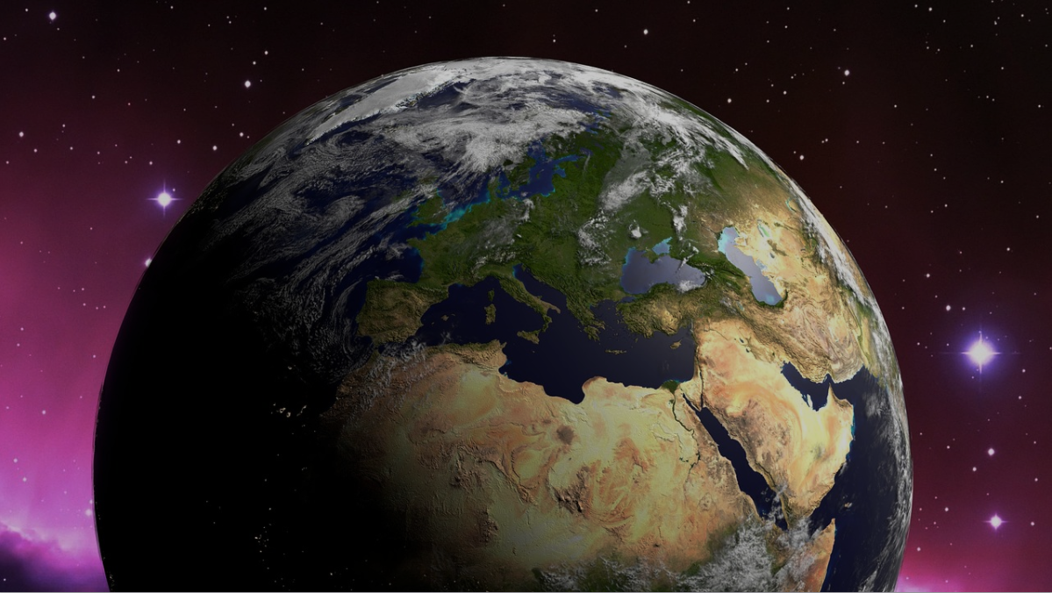
Creation
the Bible doctrine of
“And God saw that it was good”
Notes:
Genesis chapter 1 (written by an inspired Moses) establishes what the Bible teaches about the creation of the Universe, and life in it. While it is not a scientific treatise, it is obvious in the way the narrative was constructed that it is presented as a factual historical account.
(1-2) Creation of Heavens (universe) and earth
(3) Light (1st day, 5) (Note: light physically impossible without sun and stars (supernatural!)
(6) Division of waters (firmament) (2nd day, 8)
(9) Dry land, (11-12) Vegetation (3rd day, 13)
(16) Sun, moon, stars (4th day, 19)
(20) Birds, fish (5th day, 23)
(24) Land animals (26-27) Man and woman (6th day, 31)
Note: Man created in God’s image (27)
Man has dominion over the animals, the earth was created for him (28-30)
All that God created was VERY GOOD (31)
God ceased his work on the 7th day (2:1-3)
Note: Chapter 2 is a restatement of the creative acts, with an emphasis on God’s creation of man.
(2:4), “This is the history of the heavens and the earth when they were created, in the day that the Lord God made the earth and the heavens”

Slide 2
The scripture affirms the historicity
of the Creation Account!
Our text (2:4)
Our Lord (Matthew 19:3-4)
The Apostle Paul (Acts 17:24-26)
The Psalmist (Psalm 8:1-9)
Notes:
Scripture affirms the historicity of the Creation Account!
Our Text
(Genesis 2:4), “This is the history of the heavens and the earth when they were created, in the day that the Lord God made the earth and the heavens”
Our Lord
(Matthew 19:3-4), “The Pharisees also came to Him, testing Him, and saying to Him, “Is it lawful for a man to divorce his wife for just any reason?” ⁴ And He answered and said to them, “Have you not read that He who made them at the beginning ‘made them male and female,’ ⁵ and said, “For this reason a man shall leave his father and mother and be joined to his wife, and the two shall become one flesh’? ⁶ So then, they are no longer two but one flesh. Therefore what God has joined together, let not man separate.”
The Apostle Paul
(Acts 17:24-26), “God, who made the world and everything in it, since He is Lord of heaven and earth, does not dwell in temples made with hands. ²⁵ Nor is He worshiped with men's hands, as though He needed anything, since He gives to all life, breath, and all things. ²⁶ And He has made from one blood every nation of men to dwell on all the face of the earth, and has determined their preappointed times and the boundaries of their dwellings”
The Psalmist
(Psalm 8:1-9), “O Lord, our Lord, how excellent is Your name in all the earth, Who have set Your glory above the heavens! ² Out of the mouth of babes and nursing infants You have ordained strength, because of Your enemies, that You may silence the enemy and the avenger. ³ When I consider Your heavens, the work of Your fingers, the moon and the stars, which You have ordained, ⁴ What is man that You are mindful of him, and the son of man that You visit him?
⁵ For You have made him a little lower than the angels, and You have crowned him with glory and honor. ⁶ You have made him to have dominion over the works of Your hands; You have put all things under his feet, ⁷ All sheep and oxen—Even the beasts of the field, ⁸ the birds of the air, and the fish of the sea that pass through the paths of the seas. ⁹ O Lord, our Lord, how excellent is Your name in all the earth!”

Slide 3
The Divine Watchmaker
(The Teleological Argument)
Romans 1:20
Psalm 139:14
A working watch requires a watchmaker.
Notes:
The argument from design, called the Teleological argument
(Romans 1:20), “For since the creation of the world His invisible attributes are clearly seen, being understood by the things that are made, even His eternal power and Godhead, so that they are without excuse.”
Put simply, the very existence of an ordered universe, with life, is an indication of a Divine Designer
Paul says it is something that can be clearly seen. It is a irrefutable argument
Men’s rejection of it does not make it invalid!
(Psalm 193:14), “I will praise You, for I am fearfully and wonderfully made; Marvelous are Your works,
And that my soul knows very well.”
Illustration: A working watch requires a watchmaker
In the same way, an ordered and working universe requires intelligence and power.

Slide 4
The Word - Creator and Sustainer!
Creator (John 1:1-3, 14)
Sustainer (Colossians 1:16-18)
He will one day bring His creation to an end (2 Peter 3:10-13)
Notes:
The Word (Jesus Christ) is the author of Creation
(John 1:1-3), “In the beginning was the Word, and the Word was with God, and the Word was God. ² He was in the beginning with God. ³ All things were made through Him, and without Him nothing was made that was made.”
(John 1:14), “And the Word became flesh and dwelt among us, and we beheld His glory, the glory as of the only begotten of the Father, full of grace and truth.”
The same Creator is the Sustainer
(Colossians 1:16-18), “For by Him all things were created that are in heaven and that are on earth, visible and invisible, whether thrones or dominions or principalities or powers. All things were created through Him and for Him. ¹⁷ And He is before all things, and in Him all things consist. ¹⁸ And He is the head of the body, the church, who is the beginning, the firstborn from the dead, that in all things He may have the preeminence.”
Consist - to place together, to set in the same place, to bring or band together (Thayer)
Barnes – “The meaning is, that they are kept in the present state; their existence, order, and arrangement are continued by his power. If unsupported by him, they would fall into disorder, or sink back to nothing. If this be the proper interpretation, then it is the ascription to Christ of infinite power - for nothing less could be sufficient to uphold the universe; and of infinite wisdom - for this is needed to preserve the harmonious action of the suns and systems of which it is composed. None could do this but one who is divine; and hence we see the reason why he is represented as the image of the invisible God. He is the great and glorious and everactive agent by whom the perfections of God are made known.”
(Hebrews 1:3), “who being the brightness of His glory and the express image of His person, and upholding all things by the word of His power, when He had by Himself purged our sins, sat down at the right hand of the Majesty on high.”
This creation will come to an end. Heaven is eternal
(2 Peter 3:10-13), “But the day of the Lord will come as a thief in the night, in which the heavens will pass away with a great noise, and the elements will melt with fervent heat; both the earth and the works that are in it will be burned up. ¹¹ Therefore, since all these things will be dissolved, what manner of persons ought you to be in holy conduct and godliness, ¹² looking for and hastening the coming of the day of God, because of which the heavens will be dissolved, being on fire, and the elements will melt with fervent heat? ¹³ Nevertheless we, according to His promise, look for new heavens and a new earth in which righteousness dwells.”

Slide 5
Conclusion
All views regarding the beginning of all things are examples of Faith
We trust in what is evident,
“In the beginning, God…!”
Notes:
Conclusion
Evolutionary theory comes with assumptions
All things today are as they were
There is no evidence of a creator
These are mere assumptions, a world view that colors perceptions.
We, in contrast, assume the obvious. There is a creation, therefore there must be a Creator.
We have evidence that our assumptions are true (God raised His Son from the dead).
(Acts 17:26-27), “And He has made from one blood every nation of men to dwell on all the face of the earth, and has determined their preappointed times and the boundaries of their dwellings, ²⁷ so that they should seek the Lord, in the hope that they might grope for Him and find Him, though He is not far from each one of us.”
Are you groping for the Lord? He is not far from you! Turn to Him in faith and repentance!

