Slide 1
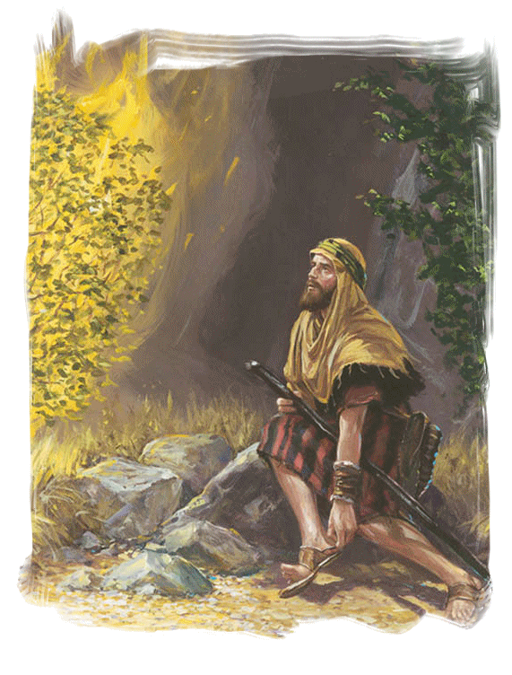
The Burning Bush
Exodus 3
Notes:
Moses in exile from Egypt (He fled to Midian after killing the Egyptian who was beating the Israelite)
(Exodus 3:1-3), “Now Moses was tending the flock of Jethro his father- in- law, the priest of Midian. And he led the flock to the back of the desert, and came to Horeb, the mountain of God. ² And the Angel of the Lord appeared to him in a flame of fire from the midst of a bush. So he looked, and behold, the bush was burning with fire, but the bush was not consumed. ³ Then Moses said, ‘I will now turn aside and see this great sight, why the bush does not burn.’”
A wondrous sight, a flame in the midst of a bush, but the bush did not burn!
What does the sight of the burning bush show us today?

Slide 2
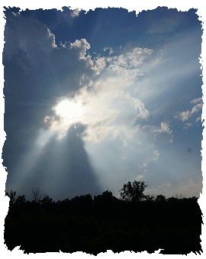
It shows us the Presence of God!
Exodus 3:4
Notes:
God was present as He spoke to Moses from the midst of the bush
(Exodus 3:4). “So when the Lord saw that he turned aside to look, God called to him from the midst of the bush and said, "Moses, Moses!"And he said, "Here I am."
God could have made His presence known in another way; but on that occasion He used a burning bush.
Through the ages, He has used various ways…
(Hebrews 1:1-2), “God, who at various times and in various ways spoke in time past to the fathers by the prophets, ² has in these last days spoken to us by His Son…”
God is everywhere, seeing and knowing all things.
(Jeremiah 23:23-24), “Am I a God near at hand," says the Lord, "And not a God afar off? ²⁴ Can anyone hide himself in secret places, so I shall not see him?" says the Lord; "Do I not fill heaven and earth?" says the Lord.
Do not run from God’s presence; run to Him and abide with Him in Christ
(Matthew 11:28), “Come to Me, all you who labor and are heavy laden, and I will give you rest.”

Slide 3
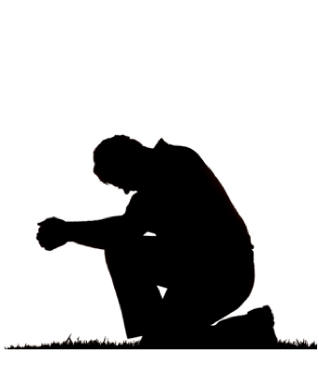
It shows us the Holiness of God!
Exodus 3:5
Notes:
The removal of his shoes symbolized Moses’ recognition of God’s holiness:
(Exodus 3:5), “Then He said, "Do not draw near this place. Take your sandals off your feet, for the place where you stand is holy ground.”
God’s presence made the place holy!
Christians too stand on holy ground, communing with God (Thus, we too must be holy in all our conduct!
(2 Corinthians 6:17 – 7:1), “Therefore "Come out from among them and be separate, says the Lord. Do not touch what is unclean, and I will receive you."¹⁸ "I will be a Father to you, and you shall be My sons and daughters, says the Lord Almighty.” ^{(7:1)} Therefore, having these promises, beloved, let us cleanse ourselves from all filthiness of the flesh and spirit, perfecting holiness in the fear of God.”
(1 Peter 1:15-16), “But as He who called you is holy, you also be holy in all your conduct, ¹⁶ because it is written, "Be holy, for I am holy.”
We cannot live in the presence of God if we are living in sin.

Slide 4
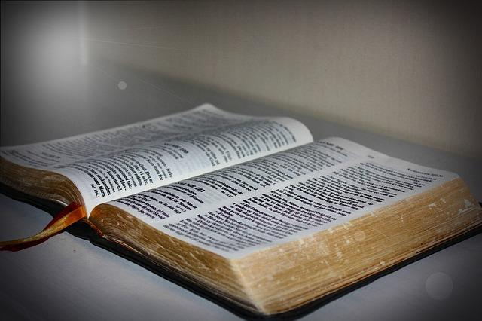
It shows us Scripture is the Word of God!
Exodus 3:6
Notes:
(Exodus 3:6), “Moreover He said, "I am the God of your father—the God of Abraham, the God of Isaac, and the God of Jacob." And Moses hid his face, for he was afraid to look upon God.”
Jesus referred to God’s words to Moses on this occasion in Matthew 22.
(Matthew 22:31-32), “But concerning the resurrection of the dead, have you not read what was spoken to you by God, saying, 32 "I am the God of Abraham, the God of Isaac, and the God of Jacob'? God is not the God of the dead, but of the living.“
The spoken word of God, recorded in writing, is His message to man
The Sadducees did not know the scriptures, and thus twisted them in denying the resurrection
One cannot successfully claim faith in Jesus while rejecting what the Scriptures say.
To reject the Scriptures is to reject the very word spoken to us by God.
In faith we must fully submit and humbly obey
(Luke 6:46), “But why do you call Me 'Lord, Lord,' and not do the things which I say?”

Slide 5
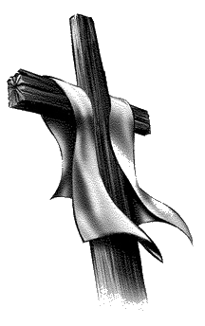
It shows us the Deliverance of God!
Exodus 3:7-10
Notes:
(Exodus 3:7-10), “And the Lord said: "I have surely seen the oppression of My people who are in Egypt, and have heard their cry because of their taskmasters, for I know their sorrows. ⁸ So I have come down to deliver them out of the hand of the Egyptians, and to bring them up from that land to a good and large land, to a land flowing with milk and honey, to the place of the Canaanites and the Hittites and the Amorites and the Perizzites and the Hivites and the Jebusites. ⁹ Now therefore, behold, the cry of the children of Israel has come to Me, and I have also seen the oppression with which the Egyptians oppress them. ¹⁰ Come now, therefore, and I will send you to Pharaoh that you may bring My people, the children of Israel, out of Egypt."
Israel’s deliverance foreshadowed God’s deliverance of sinners from sin’s bondage by the blood of Christ.
(Romans 6:17-18), “But God be thanked that though you were slaves of sin, yet you obeyed from the heart that form of doctrine to which you were delivered. ¹⁸ And having been set free from sin, you became slaves of righteousness.”
Note from the scripture above: Faith that obeys is faith that saves.

Slide 6
Conclusion
The burning bush teaches us lessons of truth and holiness!
cf. Ephesians 4:24
Notes:
Let us remove every defilement of sin and obey God
(Ephesians 4:22-24), “…put off, concerning your former conduct, the old man which grows corrupt according to the deceitful lusts, ²³ and be renewed in the spirit of your mind, ²⁴ and that you put on the new man which was created according to God, in true righteousness and holiness.”

