Slide 1
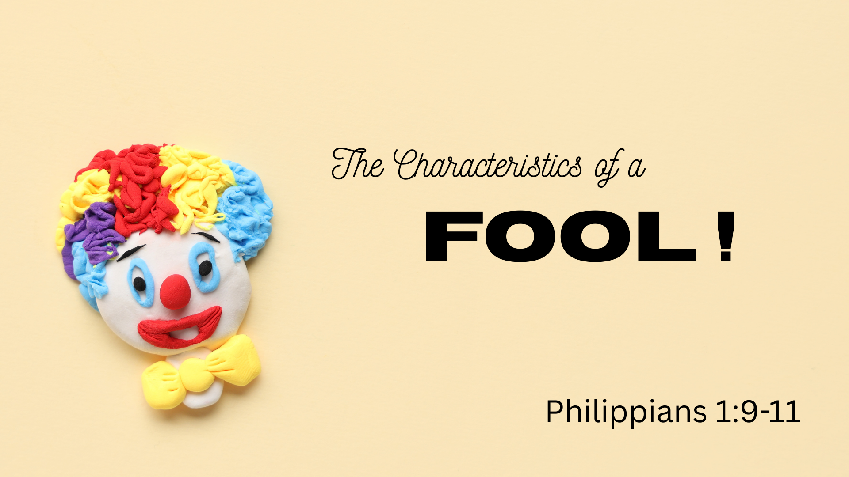

Slide 2

Denies the existence of God
Psalm 14:1; Rom. 1:18-21
Does not control himself
Prov. 19:1; 12:16; 7:24-27
Ignores the dangers of sin
Prov. 10:23; 14:16
Refuses godly counsel (arrogant)
Proverbs 12:15; Ecclesiastes 10:12-14
Does not prepare his soul for death
Luke 12:20-21

Slide 3

The fool brings sorrow ultimately to himself. But, he brings sadness to those who love him as well. “He who begets a scoffer does so to his sorrow, And the father of a fool has no joy.” (Proverbs 17:21)

