Slide 1
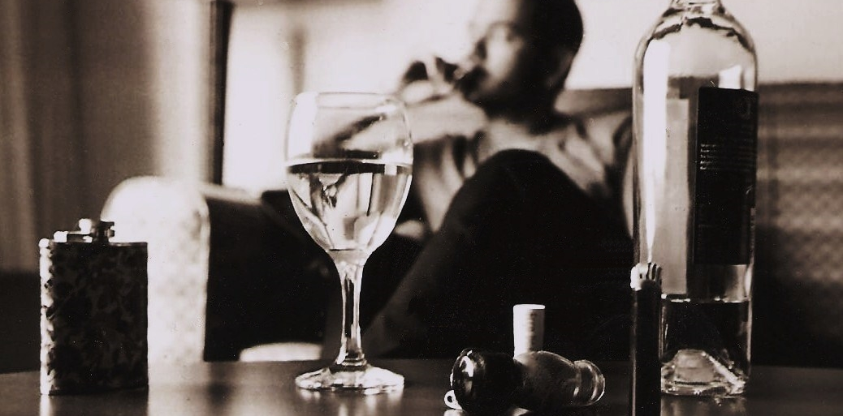
The Christian & Recreational Drug Use
Notes:
Note: I have preached on the subject of alcohol use. (Social drinking). I have noted that I believe there is much misunderstanding that has resulted in some Christians thinking that social drinking is justifiable because of the drinking of wine in the Bible.
I do not believe that social drinking can be justified by the scriptures.
It is not my purpose today to revisit all of those definitions, passages and arguments.
If you have questions after this lesson is over, I can direct you to a recording of that lesson, and a more extensive series that Jeremiah preached a while back.
This lesson is a bit more comprehensive in scope, though the principles contained here will impact the idea of social drinking.
It is difficult as we age to change our conception of how the world is. We tend to look at things the way they were in decades past.
It strikes me that this is true in preaching too. Today’s lesson (at least the way I am approaching it) is a recognition of this fact.
For years preachers have preached on the dangers of alcohol use, because for the longest time it was the PRIMARY intoxicant in society.
Times, they are changing. So, I would like to deal with the subject more broadly, keeping in mind the current trend of states legalizing recreation marijuana use
There are two things to consider in such a discussion.
The present societal reality. How we got here, and the impact (influence) that could have in our thinking as Christians
What principles or teaching from scripture should impact our behavior as we seek to bring our thoughts and actions into the captivity of Christ

Slide 2
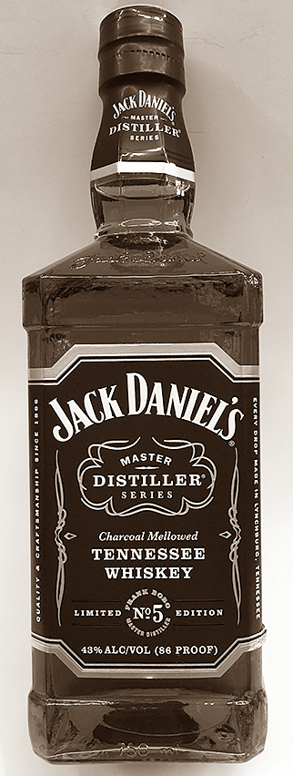
Alcohol Use in America
Prohibition (1920-33) 18th & 21st amendments
Believed to be a failure, but reduced consumption by 50%
Legal drugs in America (for recreational use) Alcohol, tobacco, caffeine
Notes:
Alcohol is often incorrectly classified as a stimulant or "upper". Alcohol is in fact a tranquillizer which depresses the central nervous system.
The short term physical effects depend on the blood-alcohol level. It ranges from mild mood changes to complete loss of coordination, vision, balance and speech.
These effects usually wear off in a matter of hours after a person stops drinking.
Larger amounts of blood alcohol can impair brain functioning and eventually cause unconsciousness.
An extreme overdose, when the blood-alcohol level is higher than 0,50, can be fatal.
Long-term alcohol abuse can be very damaging to one's physical health. Health risks include cirrhosis (hardening) of the liver, gastrointestinal problems, damage to the heart muscle and impaired muscle functioning. Heavy drinkers often tend to miss meals or lack adequate diets and therefore suffer nutritional imbalance and have an impaired immune system.
The prohibition of the public sale and consumption of alcohol became federal law in 1920 with the passage of the 18th amendment to the constitution.
During prohibition, in urban areas (Large cities), organized criminal gangs took control of the beer and liquor supply in many urban areas, bringing a shocking amount of crime.
Prohibition ended with the passage of the 21st amendment in 1933, which repealed the 18th amendment.
Note: Prohibition is believed to have been a failure. However, alcohol consumption decreased 50%, and did not return to pre-prohibition levels until the 1940's. One primary reason for the repeal of Prohibition is the loss of tax revenue by the federal government. This revenue loss was felt deeply as the country entered the great depression of the 1930’s.
Except for alcohol consumption, recreational drug use has been illegal in the United States for most intoxicants beyond tobacco and and caffeine.

Slide 3
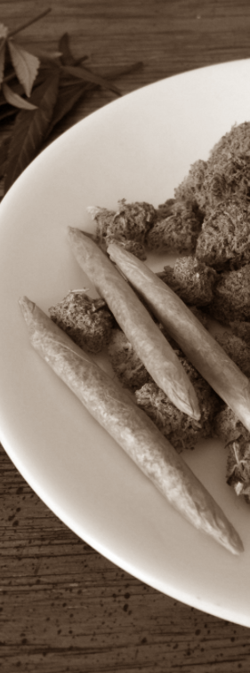
Marijuana Use in America
Under federal law, it is illegal to possess, use, buy, sell, or cultivate marijuana in all United States jurisdictions.
Alaska, California, Colorado, Massachusetts, Nevada, Oregon and Washington D.C. have passed statutes legalizing recreational use.
Notes:
The psychoactive effects of cannabis, known as a "high", are subjective and can vary based on the person and the method of use.
Some effects may include a general alteration of conscious perception, euphoria, feelings of well-being, relaxation or stress reduction, joviality, introspection, enhanced recollection, increased sensuality, increased awareness of sensation, and increased libido.
Abstract or philosophical thinking, disruption of linear memory and paranoia or anxiety are also typical.
Anxiety is the most commonly reported side effect of smoking marijuana. Between 20 and 30 percent of recreational users experience intense anxiety and/or panic attacks after smoking cannabis.
Long term exposure to marijuana may have biologically-based physical, mental, behavioral and social health consequences and is associated with diseases of the liver, lungs, heart, and vasculature.
The Controlled Substances Act of 1970 classifies marijuana as a Schedule 1 drug, claiming it has a high potential for abuse and has no acceptable medical use.
Some states have recently passed laws decriminalizing the recreational use of the drugs. These are Alaska, California, Colorado, Massachusetts, Nevada and Oregon. Also, Washington D.C.
However, under the Supremacy Clause of the United States Constitution, federal law preempts conflicting state and local laws. So, technically, it remains illegal, though the federal law is not being enforced in these states.
Note: the Types of Drugs used for recreational purposes are classified as: Depressants, Stimulants and Hallucinogens
Specific recreational drugs commonly used in America today, both legal and illegal
Alcohol, cannabis, hashish, nicotine (tobacco), caffeine (coffee, tea, soft drinks), controlled substances such as methamphetamines, heroin, cocaine and designer drugs synthesized in labs.
Some of these drugs are physically more dangerous than others. Cause more profound physiological changes. Are more addictive. Are more physically destructive than others.
Society has made decisions as to whether a drug is acceptable or not, often based upon such perceived dangers.
However, such decisions are heavily influenced by prejudice, cultural differences, generational attitudes. As such, there is a great deal of inconsistency.
All of which is irrelevant to the Christian. Our question, what do the scriptures teach with regard to drug use?

Slide 4
What the Scriptures Teach
Very little is said in scripture about drugs other than alcohol
(Galatians 5:20)
pharmakeia – The use of drugs; metaphorically the deceptions and seductions of idolatry - sorcery
Note: “and the like” (21)
Notes:
There is not a lot of specific information in scripture about drugs other than alcohol
One exception is in Galatians 5:20
(Galatians 5:19-21), “Now the works of the flesh are evident, which are: adultery, fornication, uncleanness, lewdness, ²⁰ idolatry, sorcery, hatred, contentions, jealousies, outbursts of wrath, selfish ambitions, dissensions, heresies, ²¹ envy, murders, drunkenness, revelries, and the like; of which I tell you beforehand, just as I also told you in time past, that those who practice such things will not inherit the kingdom of God.”
Pharmakeia – 1) The use or the administering of drugs; 2) poisoning; 3) sorcery, magical arts, often found in connection with idolatry and fostered by it; 4) metaphorically the deceptions and seductions of idolatry
The idea of sorcery comes from the fact that such deceptions and illusions commonly were associated with and accomplished by the use of hallucinogens
In effect, it is sinful to deceive or control through the use of such drugs.
However, the ability of such drugs to intoxicate put them in the same category as alcohol
Too, notice that drunkenness and revelries, and the like (things in the same category) are condemned as lusts of the flesh.
So, what scriptural principles do we use to determine the recreational use or abstinence from any kind of drug?

Slide 5
What the Scriptures Teach
Legality (Romans 13:1-5)
Notes:
Scripture deals with:
Legality
(Romans 13:1-5), “Let every soul be subject to the governing authorities. For there is no authority except from God, and the authorities that exist are appointed by God. ² Therefore whoever resists the authority resists the ordinance of God, and those who resist will bring judgment on themselves. ³ For rulers are not a terror to good works, but to evil. Do you want to be unafraid of the authority? Do what is good, and you will have praise from the same. ⁴ For he is God's minister to you for good. But if you do evil, be afraid; for he does not bear the sword in vain; for he is God's minister, an avenger to execute wrath on him who practices evil. ⁵ Therefore you must be subject, not only because of wrath but also for conscience’ sake.”
A simple principle. The illegal use of drugs is condemned. No gray area here.
In the state of Texas, recreational marijuana use is illegal.
Remember, it remains illegal in every state due to our U.S. constitution’s supremacy clause. Basically, those who states who have legalized it, are assuming (correctly) that the federal government will not expend resources in those localities to enforce the federal law.

Slide 6
What the Scriptures Teach
Legality (Romans 13:1-5)
Addiction (1 Corinthians 6:12-14)
Notes:
Scripture deals with:
Addiction
(1 Corinthians 6:12-14), “All things are lawful for me, but all things are not helpful. All things are lawful for me, but I will not be brought under the power of any. ¹³ Foods for the stomach and the stomach for foods, but God will destroy both it and them. Now the body is not for sexual immorality but for the Lord, and the Lord for the body. ¹⁴ And God both raised up the Lord and will also raise us up by His power.”
Context deals with anything (habit, substance, or influence) that enslaves a child of God.
A Christian must not surrender his control, his ability to make decisions for himself. Drug addiction does exactly that, it enslaves.
Alcoholism, addiction to cocaine, heroin, even nicotine or caffeine (all fall under this admonition).
Anytime a Christian talks about “needing” something to get through the day, to get up and going in the morning, to calm his nerves. He needs to take stock as to whether he is “under the power” of that thing.

Slide 7
What the Scriptures Teach
Legality (Romans 13:1-5)
Addiction (1 Corinthians 6:12-14)
Intoxication (Romans 13:13; 1 Peter 5:8; 4:1-3)
Notes:
Scripture deals with:
Intoxication
This is a primary argument against both alcohol use, or the use of any other drug
Whether it is “getting a buzz” or “getting high” or “getting mellow”, one is referring to getting intoxicated
The Bible condemns drunkenness
(Romans 13:13), “Let us walk properly, as in the day, not in revelry and drunkenness, not in lewdness and lust, not in strife and envy.”
Note: It is a work of the flesh, (cf. Galatians 5:19-21), which will lead to destruction
The Bible calls for sobriety
(1 Peter 5:8), “Be sober, be vigilant; because your adversary the devil walks about like a roaring lion, seeking whom he may devour.”
Any intoxication is sinful for the child of God. It is characteristic of the Gentiles, not appropriate for the Christian
(1 Peter 4:1-3), “Therefore, since Christ suffered for us in the flesh, arm yourselves also with the same mind, for he who has suffered in the flesh has ceased from sin, ² that he no longer should live the rest of his time in the flesh for the lusts of men, but for the will of God. ³ For we have spent enough of our past lifetime in doing the will of the Gentiles—when we walked in lewdness, lusts, drunkenness, revelries, drinking parties, and abominable idolatries.”

Slide 8
What the Scriptures Teach
Legality (Romans 13:1-5)
Addiction (1 Corinthians 6:12-14)
Intoxication (Romans 13:13; 1 Peter 5:8; 4:1-3)
Companionship (1 Cor. 15:33-34)
Notes:
Scripture deals with:
Companionship
Going along with the Gentiles is an affront to God’s call for holiness
(1 Peter 4:1-4), “Therefore, since Christ suffered for us in the flesh, arm yourselves also with the same mind, for he who has suffered in the flesh has ceased from sin, ² that he no longer should live the rest of his time in the flesh for the lusts of men, but for the will of God. ³ For we have spent enough of our past lifetime in doing the will of the Gentiles—when we walked in lewdness, lusts, drunkenness, revelries, drinking parties, and abominable idolatries.” ⁴ In regard to these, they think it strange that you do not run with them in the same flood of dissipation, speaking evil of you.”
When Christians are together, is there EVER recreational drug use? When we have potlucks, do we have beer and wine? When we are watching a football game together, or going out to eat, or having one another in our homes, do we offer marijuana brownies to get high?
(Ephesians 5:17-19), “Therefore do not be unwise, but understand what the will of the Lord is. ¹⁸ And do not be drunk with wine, in which is dissipation; but be filled with the Spirit, ¹⁹ speaking to one another in psalms and hymns and spiritual songs, singing and making melody in your heart to the Lord.”
What is needed above all things is honesty with ourselves. Recreational drug use is something the ungodly do. Any desire on our part to participate comes from that dark place that is contradictory to a life of holiness and service to God.
(1 Corinthians 15:33-34), “Do not be deceived: “Evil company corrupts good habits.” ³⁴ Awake to righteousness, and do not sin; for some do not have the knowledge of God. I speak this to your shame.”

Slide 9
What the Scriptures Teach
Legality (Romans 13:1-5)
Addiction (1 Corinthians 6:12-14)
Intoxication (Romans 13:13; 1 Peter 5:8; 4:1-3)
Companionship (1 Cor. 15:33-34)
Influence (Philippians 2:12-16)
Notes:
Scripture deals with:
Influence
Question: How can we exert a righteous influence to the world when we are engaging in practices that are characterized as “like” the world?
We are called to be different!
(Philippians 2:12-16), “Therefore, my beloved, as you have always obeyed, not as in my presence only, but now much more in my absence, work out your own salvation with fear and trembling; ¹³ for it is God who works in you both to will and to do for His good pleasure. ¹⁴ Do all things without complaining and disputing, ¹⁵ that you may become blameless and harmless, children of God without fault in the midst of a crooked and perverse generation, among whom you shine as lights in the world, ¹⁶ holding fast the word of life, so that I may rejoice in the day of Christ that I have not run in vain or labored in vain.”
Our influence toward our brethren must likewise be pure.
This principle is true even with things that are otherwise not objectionable!
(Romans 14:19-21), “Therefore let us pursue the things which make for peace and the things by which one may edify another. ²⁰ Do not destroy the work of God for the sake of food. All things indeed are pure, but it is evil for the man who eats with offense. ²¹ It is good neither to eat meat nor drink wine nor do anything by which your brother stumbles or is offended or is made weak.”
Our vulnerable members (babes in Christ, the young, those who struggle with worldliness) need to see us as beacons of light and righteousness! You can’t be that with a beer or a joint in your hand. Not to the world, and not to your brethren!

Slide 10
Conclusion
“For we shall all stand before the judgment seat of Christ. ¹¹ For it is written: ‘As I live, says the Lord, every knee shall bow to Me, and every tongue shall confess to God.’ ¹² So then each of us shall give account of himself to God.”
(Romans 14:10-12)
Notes:
We need to think soberly of these words…
(Romans 14:10-12), “For we shall all stand before the judgment seat of Christ. ¹¹ For it is written: “As I live, says the Lord, every knee shall bow to Me, and every tongue shall confess to God.” ¹² So then each of us shall give account of himself to God.”
It is my prayer that no Christian will forfeit his standing with God in eternity because of a fleshly desire to take recreational drugs.
They are physically dangerous. Their use is potentially addictive and destructive
But more devastating is the danger they pose to your eternal soul!

