Slide 2
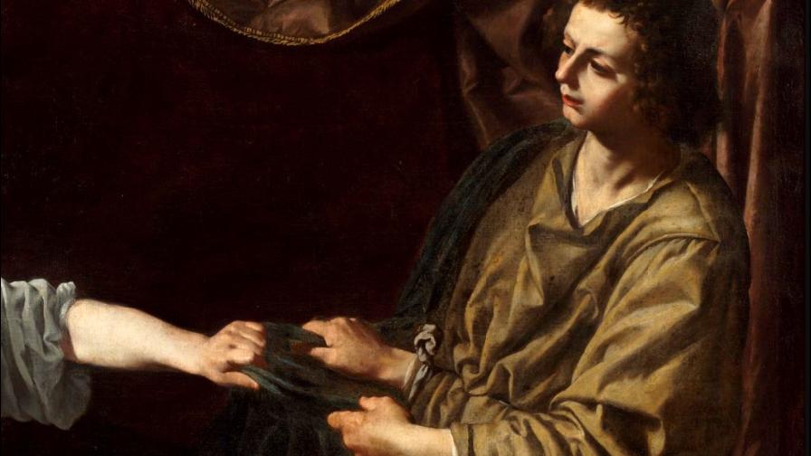
The Cost and Reward of Righteousness
Genesis 39
Notes:
Before getting into the events of Genesis 39, I want to give a bit of background concerning the life of Joseph.
Joseph was the 11th of Jacob/Israel’s 12 sons, the first born of his favorite wife Rachel. (Rachel bore Israel 2 children, Joseph and Benjamin).
Our introduction to Joseph reveals his conflict with his brothers
(Genesis 37:3-4), “Now Israel loved Joseph more than all his children, because he was the son of his old age. Also he made him a tunic of many colors. ⁴ But when his brothers saw that their father loved him more than all his brothers, they hated him and could not speak peaceably to him.”
Joseph could not be held accountable for this favoritism
However, it may be said that he was a bit unwise to reveal two dreams he had to his brothers
(Genesis 37:5-11), “Now Joseph had a dream, and he told it to his brothers; and they hated him even more. ⁶ So he said to them, “Please hear this dream which I have dreamed: ⁷ There we were, binding sheaves in the field. Then behold, my sheaf arose and also stood upright; and indeed your sheaves stood all around and bowed down to my sheaf.” ⁸ And his brothers said to him, “Shall you indeed reign over us? Or shall you indeed have dominion over us?” So they hated him even more for his dreams and for his words. ⁹ Then he dreamed still another dream and told it to his brothers, and said, “Look, I have dreamed another dream. And this time, the sun, the moon, and the eleven stars bowed down to me.” ¹⁰ So he told it to his father and his brothers; and his father rebuked him and said to him, “What is this dream that you have dreamed? Shall your mother and I and your brothers indeed come to bow down to the earth before you?” ¹¹ And his brothers envied him, but his father kept the matter in mind.”
Consider that though he may should have kept his mouth shut, the dreams were prophetic in nature, and eventually came true.
Regardless, his conflict with his brothers led to them betraying him
They sold him into slavery, and reported him as dead to his aged father
The brothers sold him to a band of Midianites, who then sold him to a man named Potiphar in Egypt.
(Genesis 37:36), “Now the Midianites had sold him in Egypt to Potiphar, an officer of Pharaoh and captain of the guard.”
I want to examine what happened, as Joseph served Potiphar, as recorded in Genesis 39

Slide 3
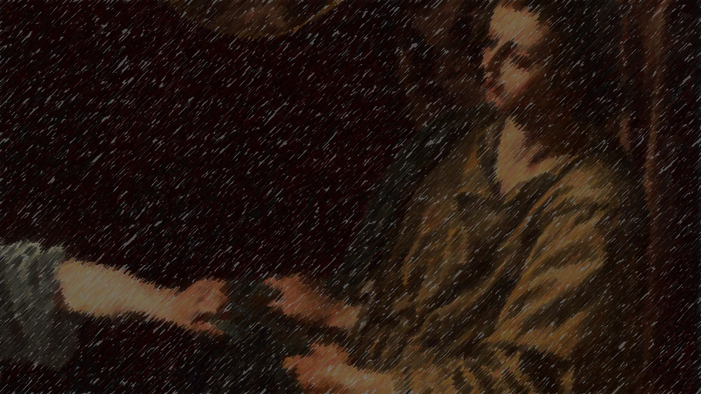
Joseph in Potiphar’s House (39:2-10)
Joseph had God’s favor (39:2-3)
Potiphar promoted Joseph to “overseer of his house” (39:4-6)
Joseph came to the lustful attention of Potiphar’s wife (39:7-10)
Notes:
Joseph in Potiphar’s House
Joseph had God’s favor
(Genesis 39:2-3), “The Lord was with Joseph, and he was a successful man; and he was in the house of his master the Egyptian. ³ And his master saw that the Lord was with him and that the Lord made all he did to prosper in his hand.”
Potiphar promoted Joseph to “overseer of his house”
(Genesis 39:4-6), “So Joseph found favor in his sight, and served him. Then he made him overseer of his house, and all that he had he put under his authority. ⁵ So it was, from the time that he had made him overseer of his house and all that he had, that the Lord blessed the Egyptian's house for Joseph's sake; and the blessing of the Lord was on all that he had in the house and in the field. ⁶ Thus he left all that he had in Joseph's hand, and he did not know what he had except for the bread which he ate. Now Joseph was handsome in form and appearance.”
Joseph came to the lustful attention of Potiphar’s wife
(Genesis 39:7-10), “And it came to pass after these things that his master's wife cast longing eyes on Joseph, and she said, “Lie with me.” ⁸ But he refused and said to his master's wife, “Look, my master does not know what is with me in the house, and he has committed all that he has to my hand. ⁹ There is no one greater in this house than I, nor has he kept back anything from me but you, because you are his wife. How then can I do this great wickedness, and sin against God?” ¹⁰ So it was, as she spoke to Joseph day by day, that he did not heed her, to lie with her or to be with her.”

Slide 4
The Incident (39:11-23)
Potiphar’s wife sought to seduce Joseph (39:11-12) Proverbs 7:4-5
Joseph reacted righteously (39:12-13) 1 Corinthians 6:18-20; 2 Timothy 2:22
Joseph’s actions did not spare him from unfair consequences (39:16-20) Matt. 5:10; 1 Pet. 3:14
God blessed Joseph while in prison (39:21-23) 45:4-8; 1 Peter 4:12-14; Matthew 5:11-12
Notes:
The Incident (Genesis 39:11-23)
Potiphar’s wife sought to seduce Joseph
(Genesis 39:11-12), ”But it happened about this time, when Joseph went into the house to do his work, and none of the men of the house was inside, ¹² that she caught him by his garment, saying, “Lie with me.”…
Temptation and the willingness of the ungodly to seek out sexual sin is a given in our time.
Every Christian needs to be aware of it, and take care to pursue righteousness
This is especially so with the young (which is why the wise man warned his son).
(Proverbs 7:4-5), “Say to wisdom, “You are my sister,” and call understanding your nearest kin, ⁵ that they may keep you from the immoral woman, from the seductress who flatters with her words.”
Joseph reacted righteously
(Genesis 39:12-13), “But he left his garment in her hand, and fled and ran outside. ¹³ And so it was, when she saw that he had left his garment in her hand and fled outside…”
When possible, it is always a good idea to run away from sin!
(1 Corinthians 6:18-20), “Flee sexual immorality. Every sin that a man does is outside the body, but he who commits sexual immorality sins against his own body. ¹⁹ Or do you not know that your body is the temple of the Holy Spirit who is in you, whom you have from God, and you are not your own? ²⁰ For you were bought at a price; therefore glorify God in your body and in your spirit, which are God’s.”
More generally
(2 Timothy 2:22), “Flee also youthful lusts; but pursue righteousness, faith, love, peace with those who call on the Lord out of a pure heart.”
Joseph’s actions did not spare him from unfair consequences
(Genesis 39:16-20), “So she kept his garment with her until his master came home. ¹⁷ Then she spoke to him with words like these, saying, “The Hebrew servant whom you brought to us came in to me to mock me; ¹⁸ so it happened, as I lifted my voice and cried out, that he left his garment with me and fled outside.” ¹⁹ So it was, when his master heard the words which his wife spoke to him, saying, “Your servant did to me after this manner,” that his anger was aroused. ²⁰ Then Joseph's master took him and put him into the prison, a place where the king's prisoners were confined. And he was there in the prison.”
Our lives may become complicated because of our righteous living
(Matthew 5:10), “Blessed are those who are persecuted for righteousness’ sake, for theirs is the kingdom of heaven.”
(1 Peter 3:14), “But even if you should suffer for righteousness’ sake, you are blessed. “And do not be afraid of their threats, nor be troubled.”
God blessed Joseph while in prison
(Genesis 39:21-23), “But the Lord was with Joseph and showed him mercy, and He gave him favor in the sight of the keeper of the prison. ²² And the keeper of the prison committed to Joseph's hand all the prisoners who were in the prison; whatever they did there, it was his doing. ²³ The keeper of the prison did not look into anything that was under Joseph's authority, because the Lord was with him; and whatever he did, the Lord made it prosper.”
In fact, God blessed Joseph greatly because of his righteous life.
God was with Joseph in interpreting the dreams of Pharoah’s baker and butler, who had been thrown into prison for displeasing him.
The butler eventually commended Joseph to Pharoah, and God gave him the interpretation of Pharoah’s dream concerning famine in the land
Pharoah set Joseph over the land of Egypt, to deal with the famine
Joseph’s standing allowed him to protect his own family
(Genesis 45:4-8), “And Joseph said to his brothers, “Please come near to me.” So they came near. Then he said: “I am Joseph your brother, whom you sold into Egypt. ⁵ But now, do not therefore be grieved or angry with yourselves because you sold me here; for God sent me before you to preserve life. ⁶ For these two years the famine has been in the land, and there are still five years in which there will be neither plowing nor harvesting. ⁷ And God sent me before you to preserve a posterity for you in the earth, and to save your lives by a great deliverance. ⁸ So now it was not you who sent me here, but God; and He has made me a father to Pharaoh, and lord of all his house, and a ruler throughout all the land of Egypt.”
We too will ultimately gain an eternal reward for righteousness
(1 Peter 4:12-14), “Beloved, do not think it strange concerning the fiery trial which is to try you, as though some strange thing happened to you; ¹³ but rejoice to the extent that you partake of Christ's sufferings, that when His glory is revealed, you may also be glad with exceeding joy. ¹⁴ If you are reproached for the name of Christ, blessed are you, for the Spirit of glory and of God rests upon you. On their part He is blasphemed, but on your part He is glorified.”
(Matthew 5:11-12), “Blessed are you when they revile and persecute you, and say all kinds of evil against you falsely for My sake. ¹² Rejoice and be exceedingly glad, for great is your reward in heaven, for so they persecuted the prophets who were before you.”

Slide 5
Righteousness may cause conflict on earth, but it guarantees a heavenly reward!
Luke 6:22-23
Conclusion
Notes:
Conclusion:
Righteousness may cause conflict here on earth, but it guarantees a heavenly reward!
(Luke 6:22-23) [Luke’s record of the Beatitudes when Jesus delivered his sermon on the mount], “Blessed are you when men hate you, and when they exclude you, and revile you, and cast out your name as evil, for the Son of Man's sake. ²³ Rejoice in that day and leap for joy! For indeed your reward is great in heaven, for in like manner their fathers did to the prophets.”

