Slide 1
The Easy Way
1 Kings 12:26-29
Notes:
West Texas highways similar to that in the picture
Straight, with little traffic
Maybe a bit boring, but hard to make it an easier drive
Contrast with short trip Friday night, on I-35 going south (construction and traffic)
Way back, we took the back roads… much easier and less stressful drive
(1 Kings 12:26-27), “And Jeroboam said in his heart, "Now the kingdom may return to the house of David: ²⁷ If these people go up to offer sacrifices in the house of the Lord at Jerusalem, then the heart of this people will turn back to their lord, Rehoboam king of Judah, and they will kill me and go back to Rehoboam king of Judah.“
Was Jereboam right in his fear? Who knows…
We do know he was more interested that the people be loyal to him, rather than be loyal to the Lord
Idea taken from an article from Plain Talk (March, 1978)
The Lure Of The Easy Way
Dan S. Shipley

Slide 2
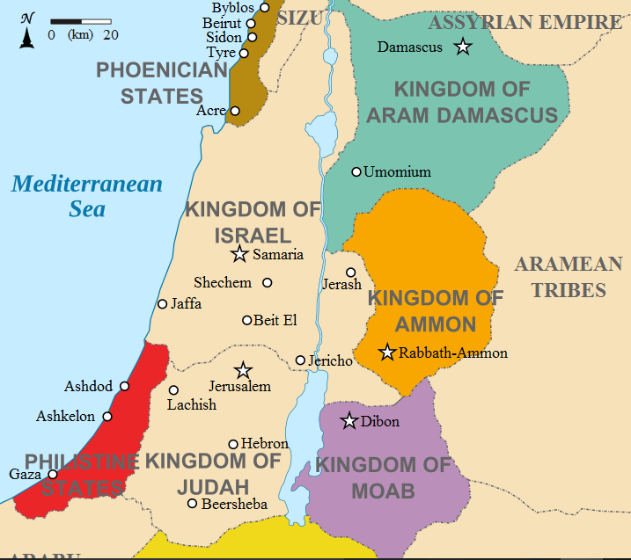
DAN
Dan
At foot of Mt. Hermon
120 miles N. Jerusalem
Bethel
12 miles N. Jerusalem
Jerusalem
Center of worship
Location of Temple of God
BETHEL
JERUSALEM
Notes:
To accomplish his aims, Jereboam shrewdly baited his trap with something that entices most all men — the lure of the easy way.
(28-29), “Therefore the king asked advice, made two calves of gold, and said to the people, "It is too much for you to go up to Jerusalem. Here are your gods, O Israel, which brought you up from the land of Egypt!" ²⁹ And he set up one in Bethel, and the other he put in Dan.
The lure included idols, false priests, vain sacrifices
Didn’t matter, he provided them with an easy religion
They became victims of the easy way!
Many are the mortals who have succumbed to the lure of the easy way, both spiritually and otherwise.

Slide 3
The lure of the easy way
Lose weight, without dieting or exercise!
Quit smoking, the easy way!
Washboard abs in 15 minutes!
Financial independence in 3 easy steps!
Notes:
After giving the examples:
Despite the promise, the numbers of obese, chain smoking, poor people with underdeveloped stomach muscles continue to swell!
People want to believe that you can get what you want, without effort or commitment
Is it any wonder that people today have been lured by Satan’s siren call of the easy way?

Slide 4
The lure of the easy way
Where is “Self-Denial”? (Luke 9:23-24)
Notes:
And, as in Jeroboam's day, the easy way is still a popular way in religion.
The prospects of having to "go up to Jerusalem" (or even across town) is still too much for too many.
Both with regard to the availability of religion, and the willingness of teachers to scratch itching ears, people are lured away from commitment
They would take the denying self out of following Christ
(Luke 9:23-24), “Then He said to them all, " If anyone desires to come after Me, let him deny himself, and take up his cross daily, and follow Me. ²⁴ For whoever desires to save his life will lose it, but whoever loses his life for My sake will save it.”
Note: According to Jesus, commitment UNTO DEATH is required of the child of God…
Is my willingness to deny myself for the Lord this strong?

Slide 5
The lure of the easy way
Where is “Self-Denial”? (Luke 9:23-24)
Where is “giving all diligence”? (2 Peter 1:5-9)
Notes:
They would take the giving diligence out of seeking divine approval
(2 Peter 1:5-9), “But also for this very reason, giving all diligence, add to your faith virtue, to virtue knowledge, ⁶ to knowledge self- control, to self-control perseverance, to perseverance godliness, ⁷ to godliness brotherly kindness, and to brotherly kindness love. ⁸ For if these things are yours and abound, you will be neither barren nor unfruitful in the knowledge of our Lord Jesus Christ. ⁹ For he who lacks these things is shortsighted, even to blindness, and has forgotten that he was cleansed from his old sins.”
Too many have believed the lie that “Jesus accepts you as you are”
He requires Repentance, Rebirth, and Diligent seeking!
(Remember, the unfruitful will be cast off! Cf. John 15:2)
Does my diligent striving for spiritual growth show me to be one who is fruitful in the knowledge of our Lord Jesus Christ?

Slide 6
The lure of the easy way
Where is “Self-Denial”? (Luke 9:23-24)
Where is “giving all diligence”? (2 Peter 1:5-9)
Where is “striving”? (Luke 13:22-24)
Notes:
They would take the striving out of entering in at the strait gate.
(Luke 13:22-24), “And He went through the cities and villages, teaching, and journeying toward Jerusalem. ²³ Then one said to Him, "Lord, are there few who are saved?“ And He said to them, ²⁴ " Strive to enter through the narrow gate, for many, I say to you, will seek to enter and will not be able.”
The idea that you can have the benefits without the bother is false religion
“I am spiritual, but not particularly religious”
“I don’t see why it is necessary to attend worship, or be a member of any church”
“I’m not one of those religious fanatics, those self-righteous prudes, those narrow minded fuddy duddies!”
Can it be said of me that I am really trying hard to get to heaven?

Slide 7
Conclusion
Matthew 7:13-14
Too Much?
Adequate preparation for Bible class… Personal Bible study… Visiting the sick… Personal efforts to evangelize… Practicing discipline… Maintaining personal purity
Notes:
Yes, even the Lord's church has been touched by the lure of the easy way.
It is felt in our teaching program when preachers and teachers find it "too much" to make adequate preparation of their lessons and when Bible class students find it "too much" to study and prepare assigned work.
It affects our visitation program when members find it "too much" to leave their comfortable homes to call on the sick or unfaithful.
It affects our personal evangelism program when brethren think it "too much" to try and teach others the way of salvation.
It affects the purity of the church when we think it "too much" to finally discipline the unruly among us.
It affects our personal purity when we think it “too much” to maintain a moral standard that is higher and stricter than the world around us.
Of all things that contribute to the weakening of the church, none is more influential than taking the easy way.
(Matthew 7:13-14), “Enter by the narrow gate; for wide is the gate and broad is the way that leads to destruction, and there are many who go in by it. ¹⁴ Because narrow is the gate and difficult is the way which leads to life, and there are few who find it.”
"Going up to Jerusalem" may require self-denial, sacrifice and hard work but it's the way of the cross — and that leads home.

