Slide 1
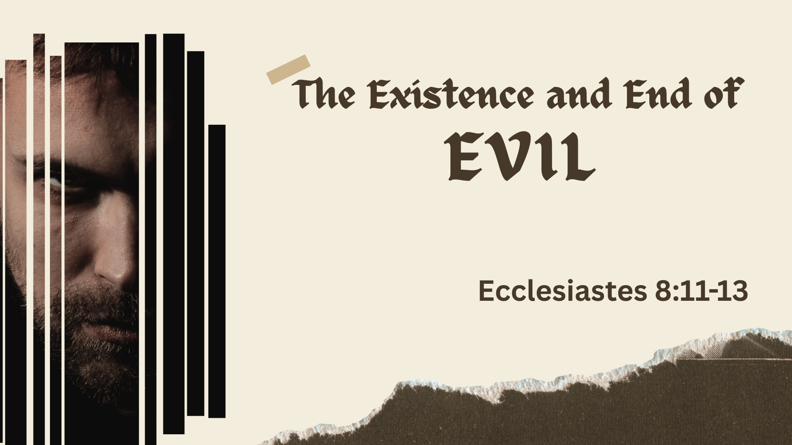

Slide 2

It is important to punish evil quickly (11)
Isaiah 10:1-2
Sometimes the wicked prosper (12)
Psalm 73
The end of the wicked (13)
1 Timothy 5:24; Isaiah 59:13-15
James 4:14; Matthew 16:26

Slide 3

Conclusion
Both the wicked and righteous will have their accounts settled in eternity!
Ecclesiastes 8:12b

