Slide 1
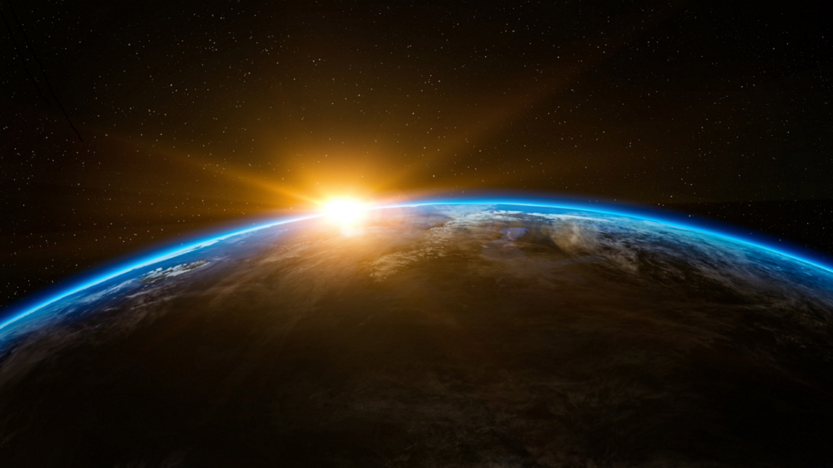
The Glory of God
Exodus 33:18-20
Notes:
At the burning bush Moses hid his face from the powerful presence of God
(Exodus 3:6), “Moreover He said, “I am the God of your father—the God of Abraham, the God of Isaac, and the God of Jacob.” And Moses hid his face, for he was afraid to look upon God.”
God’s conversation w/ Moses after bringing Israel out of Egyptian Bondage
(Exodus 33:18-20), “And he said, “Please, show me Your glory.” ¹⁹ Then He said, “I will make all My goodness pass before you, and I will proclaim the name of the Lord before you. I will be gracious to whom I will be gracious, and I will have compassion on whom I will have compassion.” ²⁰ But He said, “You cannot see My face; for no man shall see Me, and live.”
When Ezekiel saw the glory of God he fell on his face in faithful fear
(Ezekiel 3:23), “So I arose and went out into the plain, and behold, the glory of the Lord stood there, like the glory which I saw by the River Chebar; and I fell on my face.”
God’s glory evokes fear and humility.
The glory of God refers to His majesty, honor, power, goodness and excellence:
(Isaiah 35:2), “They shall see the glory of the Lord, The excellency of our God”
In the dialogue between Moses and Jehovah, God’s glory is equated with His goodness
God’s great glory demands our honor, reverence and praise.
Our duty to “fear God and keep his commandments” ought to be driven by knowing how infinitely greater God is than us (Eccl. 12:13).
(Psalm 8:1), “O Lord, our Lord, How excellent is Your name in all the earth, Who have set Your glory above the heavens!”
Consider what the glory of God compels us to do…
The Spirit’s Sword
5/5/13 Joe Price

Slide 2
The Glory of God
Compels us to live by faith
John 11:40; John 20:29
Hebrews 11:3; 2 Corinthians 5:7
Notes:
The glory of God compels us to live by faith.
Just before He raised Lazarus from the dead, Jesus said to Martha,
(John 11:40), “Did I not say to you that if you would believe you would see the glory of God?”
God blesses those who “have not seen and yet have believed” (John 20:29).
Acknowledging the great goodness and overwhelming power of God induces us to live by faith
(Hebrews 11:3), “By faith we understand that the worlds were framed by the word of God, so that the things which are seen were not made of things which are visible.”
(2 Corinthians 5:7), “For we walk by faith, not by sight.”
Conversely, when one chooses not to live by faith that person demonstrates an unwillingness to honor God’s glory.

Slide 3
The Glory of God
Compels us to live holy lives
1 John 1:5; 1 Peter 1:15-16
2 Timothy 3:1-5
Notes:
The glory of God compels us to live holy lives.
God is utterly holy; there is no darkness in Him
(1 John 1:5), “This is the message which we have heard from Him and declare to you, that God is light and in Him is no darkness at all.”
(1 Peter 1:15-16), [Peter declares that inasmuch as] “He who called you is holy, you also be holy in all your conduct, because it is written, ‘Be holy, for I am holy”
Living unholy lives shows we are not impressed by the holiness of God.
How foolish indeed to disregard His glory by ungodly, unholy living
(2 Timothy 3:1-5), “But know this, that in the last days perilous times will come: ² For men will be lovers of themselves, lovers of money, boasters, proud, blasphemers, disobedient to parents, unthankful, unholy, ³ unloving, unforgiving, slanderers, without self-control, brutal, despisers of good, ⁴ traitors, headstrong, haughty, lovers of pleasure rather than lovers of God, ⁵ having a form of godliness but denying its power. And from such people turn away!”

Slide 4
The Glory of God
Compels that we praise God
Psalm 96:3-9
Revelation 4:8
Notes:
The glory of God compels tat we give praise to God.
(Psalm 96:3-9), “Declare His glory among the nations, His wonders among all peoples. ⁴ For the Lord is great and greatly to be praised; He is to be feared above all gods. ⁵ For all the gods of the peoples are idols, but the Lord made the heavens. ⁶ Honor and majesty are before Him; strength and beauty are in His sanctuary. ⁷ Give to the Lord, O families of the peoples, give to the Lord glory and strength. ⁸ Give to the Lord the glory due His name; bring an offering, and come into His courts.
⁹ Oh, worship the Lord in the beauty of holiness! Tremble before Him, all the earth.”
The ascendant majesty of God reveals the vanity of false gods
It drives us to announce His beauty in praiseful worship.
God’s glory is among the reasons Christians worship Almighty God
(Revelation 4:8-11), “The four living creatures, each having six wings, were full of eyes around and within. And they do not rest day or night, saying: “Holy, holy, holy, Lord God Almighty, Who was and is and is to come!” ⁹ Whenever the living creatures give glory and honor and thanks to Him who sits on the throne, who lives forever and ever, ¹⁰ the twenty-four elders fall down before Him who sits on the throne and worship Him who lives forever and ever, and cast their crowns before the throne, saying: ¹¹ “You are worthy, O Lord, to receive glory and honor and power; for You created all things, and by Your will they exist and were created.”

Slide 5
The Glory of God
Christians will share in that glory!
Philippians 3:20-21; Colossians 3:4-5
2 Peter 3:11-12
Notes:
Christians will share in the glory of Christ when He returns.
This promise compels us to eagerly wait for His return
(Philippians 3:20-21), “For our citizenship is in heaven, from which we also eagerly wait for the Savior, the Lord Jesus Christ, ²¹ who will transform our lowly body that it may be conformed to His glorious body, according to the working by which He is able even to subdue all things to Himself.”
(Colossians 3:4), “When Christ who is our life appears, then you also will appear with Him in glory”
Such eager expectation is possible as we put sin to death to live in holiness and godliness
(Colossians 3:5), “Therefore put to death your members which are on the earth: fornication, uncleanness, passion, evil desire, and covetousness, which is idolatry.”
(2 Peter 3:11-12), “Therefore, since all these things will be dissolved, what manner of persons ought you to be in holy conduct and godliness, ¹² looking for and hastening the coming of the day of God, because of which the heavens will be dissolved, being on fire, and the elements will melt with fervent heat?”

Slide 6
The Glory of God
By grasping the greatness of His glory, we will be moved to reverence and faithfulness!
Notes:
Like Moses and Ezekiel, as we grasp the greatness of God’s glory we too will fall on our faces before Him in reverent, faithful and holy living.
Sustained by the hope of His glorious return and the eternal glory He will bring, we shall continue to declare His glory
(2 Thessalonians 1:10), “when He comes, in that Day, to be glorified in His saints and to be admired among all those who believe”
(2 Timothy 2:10), “Therefore I endure all things for the sake of the elect, that they also may obtain the salvation which is in Christ Jesus with eternal glory.”

