Slide 1
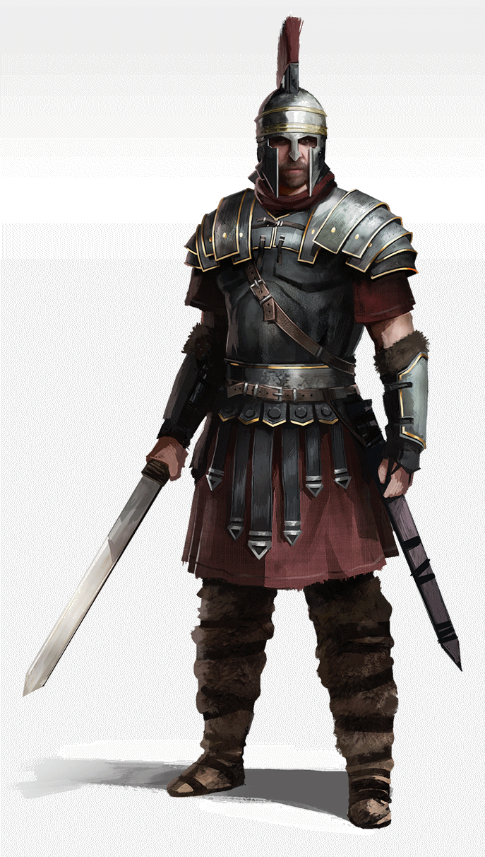
The Good Fight of Faith
1 Timothy 6:6-12
Notes:
Adapted from a powerpoint outline by Mark Copeland.

Slide 2
The Good Fight of Faith
We fight against an unholy trinity...
The world, with unsavory influences
Colossians 2:8
The devil, seeking to devour us
1 Peter 5:8; Ephesians 2:1-3
The flesh, warring against the soul
1 Peter 2:11; Galatians 5:19-21
The best defense begins with knowing your enemy!
Notes:
(Colossians 2:8), “Beware lest anyone cheat you through philosophy and empty deceit, according to the tradition of men, according to the basic principles of the world, and not according to Christ.”
(1 Peter 5:8), “Be sober, be vigilant; because your adversary the devil walks about like a roaring lion, seeking whom he may devour.”
(Galatians 5:17, 19-21), (17), “For the flesh lusts against the Spirit, and the Spirit against the flesh; and these are contrary to one another, so that you do not do the things that you wish.“ (19-21), “Now the works of the flesh are evident, which are: adultery, fornication, uncleanness, lewdness, 20 idolatry, sorcery, hatred, contentions, jealousies, outbursts of wrath, selfish ambitions, dissensions, heresies, 21 envy, murders, drunkenness, revelries, and the like; of which I tell you beforehand, just as I also told you in time past, that those who practice such things will not inherit the kingdom of God.”

Slide 3
The Good Fight of Faith
We fight with the aid of the Holy Trinity...
With God, against the world
1 John 4:4; 5:4
With Jesus, against the devil
Hebrews 2:14-15
With the Spirit, against the flesh
Galatians 5:16-18
The best offense requires using your weapons!
Notes:
(1 John 4:4), “You are of God, little children, and have overcome them, because He who is in you is greater than he who is in the world.”
(1 John 5:4), “For whatever is born of God overcomes the world. And this is the victory that has overcome the world—our faith.”
(Hebrews 2:14-15), “Inasmuch then as the children have partaken of flesh and blood, He Himself likewise shared in the same, that through death He might destroy him who had the power of death, that is, the devil, 15 and release those who through fear of death were all their lifetime subject to bondage.
(Galatians 5:16-18), “I say then: Walk in the Spirit, and you shall not fulfill the lust of the flesh. 17 For the flesh lusts against the Spirit, and the Spirit against the flesh; and these are contrary to one another, so that you do not do the things that you wish. 18 But if you are led by the Spirit, you are not under the law.”
Fruit of the Spirit: love, joy, peace, longsuffering, kindness, goodness, faithfulness, gentleness, self- control.

Slide 4
Conclusion
“Be strong in the Lord”
Ephesians 6:10-18
Notes:
READ Ephesians 6:10-18

