Slide 1
The Great Commission
Matthew 28:16-20
Notes:
The Great Commission
Matthew 28:16-20
INTRODUCTION:
There are many similarities between this occasion recorded by Matthew here, and a different occasion recorded in Mark.
The event in Mark
Mark 16:15-16 And He said to them, "Go into all the world and preach the gospel to every creature. (16) He who believes and is baptized will be saved; but he who does not believe will be condemned.
This took place on the day of Christ's ascension, while the 11 dined together.
The ascension itself (noted in Mark 16-19) is also noted in Luke 24:50-52 and Acts 1:9-11
Our event in Matthew (being discussed the morning)
The disciples travelled to a mountain in Galilee, where they saw and worshipped Jesus
We don't know the location of the mountain, or when the appearance took place, other than it was sometime during the 40 days between the resurrection of Jesus and his ascension
There seemed to be more than the 11 there, though the conversation with the 11 is the emphasis of the text.
First, the phrase, "but some doubted."
It is in contrast to the 11 worshiping Jesus. It seems improbable that the doubt of some included the very close disciples of Jesus.
Thomas did initially, but his doubts were settled when the Lord appeared personally to Him, which would seem to have predated this occasion, only a week after Jesus' resurrection. (cf. John 20:19-29)
Maybe this was the occasion where over 500 brethren saw him at once, as indicated in 1 Corinthians 15. We simply do not know.
There is a difference between rejection and doubt!
Example of Thomas
John 20:26-29 "And after eight days His disciples were again inside, and Thomas with them. Jesus came, the doors being shut, and stood in the midst, and said, "Peace to you!" (27) Then He said to Thomas, "Reach your finger here, and look at My hands; and reach your hand here, and put it into My side. Do not be unbelieving, but believing." (28) And Thomas answered and said to Him, "My Lord and my God!" (29) Jesus said to him, "Thomas, because you have seen Me, you have believed. Blessed are those who have not seen and yet have believed."
A doubter, when presented and understanding the evidence, the truth, will become convinced.
Others will refuse to believe because their hearts are hard, and the reject that evidence.
Knowing now the setting, let's examine the words of Jesus on this occassion.

Slide 2
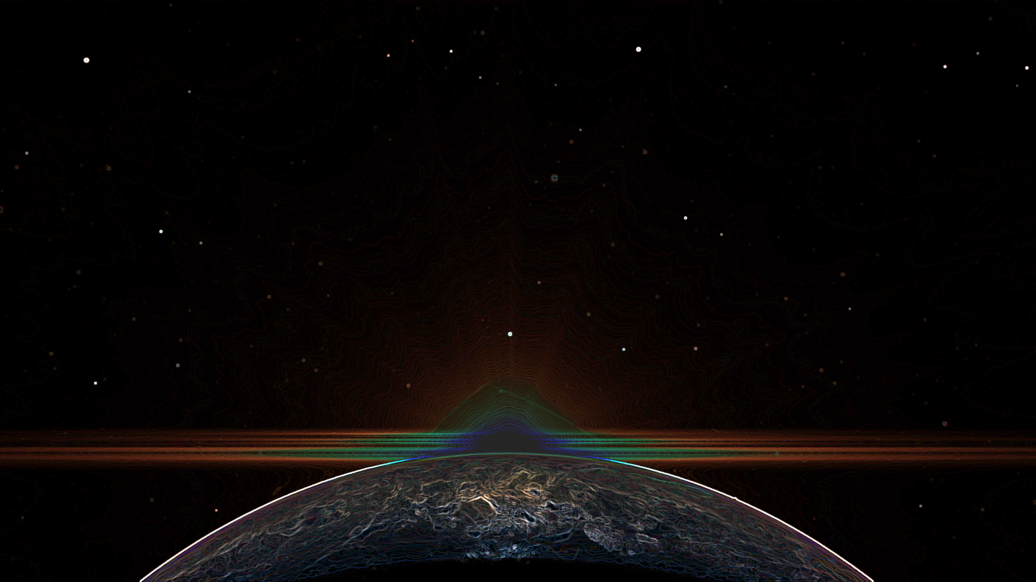
The Great Commission
All Authority Belongs to Jesus (18)
Ephesians 1:15-23
The Commission: Make Disciples (19-20a)
Mark 16:15-16; John 15:7-10
Jesus' Promise of Support (20b)
Acts 7:54-59; Colossians 3:1-4
Notes:
DISCUSSION:
All Authority Belongs to Jesus (18 READ)
This authority was given to Him (by His heavenly Father
It is especially important to note this, with regard to His church!
Ephesians 1:15-23 Therefore I also, after I heard of your faith in the Lord Jesus and your love for all the saints, (16) do not cease to give thanks for you, making mention of you in my prayers: (17) that the God of our Lord Jesus Christ, the Father of glory, may give to you the spirit of wisdom and revelation in the knowledge of Him, (18) the eyes of your understanding being enlightened; that you may know what is the hope of His calling, what are the riches of the glory of His inheritance in the saints, (19) and what is the exceeding greatness of His power toward us who believe, according to the working of His mighty power (20) which He worked in Christ when He raised Him from the dead and seated Him at His right hand in the heavenly places, (21) far above all principality and power and might and dominion, and every name that is named, not only in this age but also in that which is to come. (22) And He put all things under His feet, and gave Him to be head over all things to the church, (23) which is His body, the fullness of Him who fills all in all.
All Christians, especially, should note that our purpose is NOT to authorize or legislate, but to submit! (This would fix a lot of problems regarding digression today.
To also note that this excludes any religion that does not have Christ as Lord and Savior
[CLICK] The Commission: Make Disciples (19-20a READ)
This means to convert the world to Christ
Mark 16:15-16 And He said to them, "Go into all the world and preach the gospel to every creature. (16) He who believes and is baptized will be saved; but he who does not believe will be condemned.
This means to teach. That is what a disciple is, one who learns and submits to "all things that I have commanded you..."
Thayer - mathēteuō - to teach instruct
A disciple is one - (Thayer) who follows the Master's precepts and instructions
John 15:7-10 If you abide in Me, and My words abide in you, you will ask what you desire, and it shall be done for you. (8) By this My Father is glorified, that you bear much fruit; so you will be My disciples. (9) "As the Father loved Me, I also have loved you; abide in My love. (10) If you keep My commandments, you will abide in My love, just as I have kept My Father's commandments and abide in His love.
[CLICK] Jesus' Promise of Support (20b READ)
First, consider that Jesus' promise of support to the disciples was to encourage them in the spread of the gospel message in the beginning.
It no doubt bolstered them in their efforts to share gospel gospel
(When imprisoned for their faith (Acts 4 & 5). Paul's trials. Consider the example of Stephen's death in Acts 7.
Acts 7:54-59 When they heard these things they were cut to the heart, and they gnashed at him with their teeth. (55) But he, being full of the Holy Spirit, gazed into heaven and saw the glory of God, and Jesus standing at the right hand of God, (56) and said, "Look! I see the heavens opened and the Son of Man standing at the right hand of God!" (57) Then they cried out with a loud voice, stopped their ears, and ran at him with one accord; (58) and they cast him out of the city and stoned him. And the witnesses laid down their clothes at the feet of a young man named Saul. (59) And they stoned Stephen as he was calling on God and saying, "Lord Jesus, receive my spirit."
We, of course, have that same promise of Christ's fellowship and care when and if we are His disciples
Colossians 3:1-4 If then you were raised with Christ, seek those things which are above, where Christ is, sitting at the right hand of God. (2) Set your mind on things above, not on things on the earth. (3) For you died, and your life is hidden with Christ in God. (4) When Christ who is our life appears, then you also will appear with Him in glory.

Slide 3
Conclusion
God’s Plan for Redeeming Man is Accomplished Through His Son Jesus Christ
John 3:16-18
Notes:
CONCLUSION:
This declaration tells us all we need to know about the significance of God's plan of redemption
It is accomplished through His Son Jesus Christ
It is Jesus we are to look to, no One else
You have that opportunity to become His disciple today
John 3:16-18 For God so loved the world that He gave His only begotten Son, that whoever believes in Him should not perish but have everlasting life. (17) For God did not send His Son into the world to condemn the world, but that the world through Him might be saved. (18) "He who believes in Him is not condemned; but he who does not believe is condemned already, because he has not believed in the name of the only begotten Son of God.

