Slide 1
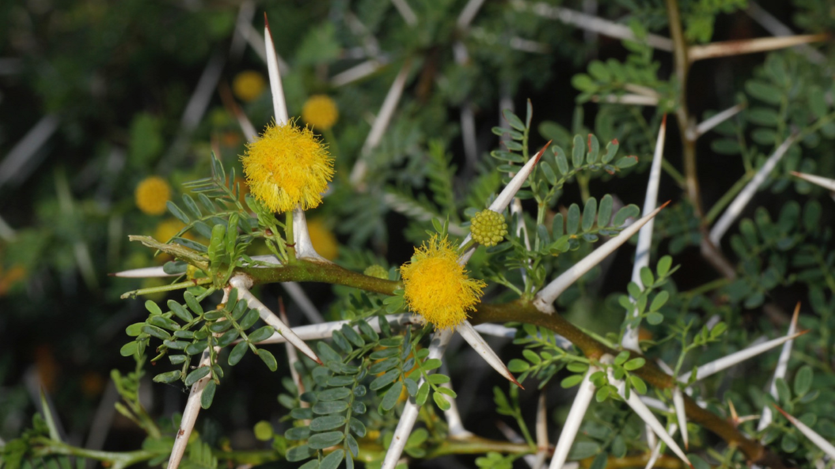
The Hedge of God
Hosea 2
Notes:
Consider a truth found in the Parable of the prodigal that rings true in many instances today
When the prodigal was living sumptuously (off his inheritance), he had no concern for what was right
(Luke 15:13), “the younger son gathered all together, journeyed to a far country, and there wasted his possessions with prodigal living.”
However, the money ran out, and there was “a famine in that land, and he began to be in want” (vs. 14).
His trials finally caused him to come to himself, and return to his father!
(Luke 15:15-19), “Then he went and joined himself to a citizen of that country, and he sent him into his fields to feed swine. ¹⁶ And he would gladly have filled his stomach with the pods that the swine ate, and no one gave him anything. ¹⁷ “But when he came to himself, he said, ‘How many of my father's hired servants have bread enough and to spare, and I perish with hunger! ¹⁸ I will arise and go to my father, and will say to him, “Father, I have sinned against heaven and before you, ¹⁹ and I am no longer worthy to be called your son. Make me like one of your hired servants.” ’
When hardship and adversity comes (sometimes from God’s chastisement, it can be a blessing in disguise!
This happened with idolatrous Israel, and it is described interesting in Hosea 2
(Hosea 2:4-7), “I will not have mercy on her children, For they are the children of harlotry. ⁵ For their mother has played the harlot;
She who conceived them has behaved shamefully. For she said, ‘I will go after my lovers, Who give me my bread and my water, My wool and my linen, My oil and my drink.’ ⁶ “Therefore, behold, I will hedge up your way with thorns, And wall her in, So that she cannot find her paths. ⁷ She will chase her lovers, But not overtake them; Yes, she will seek them, but not find them. Then she will say,
‘I will go and return to my first husband, For then it was better for me than now.’”
Inspiration for this lesson taken from an article by the same title, written by James Sanders
TRUTH MAGAZINE XVII: 7, p. 13 - December 14, 1972
Image: Alexey Yakovlev - Own work/Acacia karroo (Fabaceae: Mimosoideae) from Karoo National Park/CC BY-SA 4.0
File: Acacia karroo (Mimosoideae).jpg/Created: 13 March 2010

Slide 2

The Hedge of God
The Lord will chasten the son in whom He delights (Proverbs 3:12)
Notes:
The Lord will chasten the son in whom He delights
(Proverbs 3: 11-12), “My son, do not despise the chastening of the Lord, nor detest His correction; ¹² For whom the Lord loves He corrects, just as a father the son in whom he delights.”
We do not always know God’s purposes, but we rejoice in the opportunities to learn and grow strong when we are tested!

Slide 3
The Hedge of God
The Lord will chasten the son in whom He delights (Proverbs 3:12)
From a hedge of thorns to a stone wall – Increasing severity (Isaiah 5:5; Lev. 26:14-42)
Notes:
Consider Hosea’s picture in grasping the increasing efforts of God to bring His children to repentance.
(Hosea 2:6), “Therefore, behold, I will hedge up your way with thorns, and wall her in, so that she cannot find her paths.”
The vineyards in Israel were protected with hedges and walls.
(Isaiah 5:5), “And now, please let Me tell you what I will do to My vineyard: I will take away its hedge, and it shall be burned; and break down its wall, and it shall be trampled down.”
Interestingly, a different use of the hedge and wall to make the same point. God, chastising His people.
Also interesting, as rebellion continued, the chastisement increased in severity, as God sought to bring His people to repentance!
He warned of such chastisements in Leviticus 26…
Warning against idolatry (1)
Promise of blessings, based upon obedience (2-13)
(Leviticus 26:12), “I will walk among you and be your God, and you shall be My people.”
(if Israel would not obey, Level 1) “I also will do this to you” (16)
Wasting disease and fever (16)
Defeat at the hands of their enemies (17)
(Level 2) 7 times more for their sins (18)
Strength spent in vain, famine (20)
(Level 3) 7 times more plagues (21)
Wild beasts rob children & destroy livestock (22)
(Level 4) Punish 7 more times for sins, a sword of vengeance, pestilence (24-25)
(Level 5) Walk contrary to them in fury! (28)
You shall eat the flesh of sons and daughters, lay waste to cities (29-31)
Captivity (33-39)
(Leviticus 26:40-42), “‘But if they confess their iniquity and the iniquity of their fathers, with their unfaithfulness in which they were unfaithful to Me, and that they also have walked contrary to Me, ⁴¹ and that I also have walked contrary to them and have brought them into the land of their enemies; if their uncircumcised hearts are humbled, and they accept their guilt—⁴² then I will remember My covenant with Jacob, and My covenant with Isaac and My covenant with Abraham I will remember; I will remember the land.”
The purpose always to bring to repentance, with the promise of reconciliation!

Slide 4
The Hedge of God
The Lord will chasten the son in whom He delights (Proverbs 3:12)
From a hedge of thorns to a stone wall – Increasing severity (Isaiah 5:5; Lev. 26:14-42)
Application: The difficulties of life are not always what they seem! (Hebrews 12:5-11)
Notes:
Application
The difficulties of this life are not always what they seem.
God sends adversity not because He is merciless or unconcerned but rather because He cares.
(Hebrews 12:5-11), “And you have forgotten the exhortation which speaks to you as to sons: “My son, do not despise the chastening of the Lord, nor be discouraged when you are rebuked by Him; ⁶ For whom the Lord loves He chastens, and scourges every son whom He receives.” ⁷ If you endure chastening, God deals with you as with sons; for what son is there whom a father does not chasten? ⁸ But if you are without chastening, of which all have become partakers, then you are illegitimate and not sons. ⁹ Furthermore, we have had human fathers who corrected us, and we paid them respect. Shall we not much more readily be in subjection to the Father of spirits and live? ¹⁰ For they indeed for a few days chastened us as seemed best to them, but He for our profit, that we may be partakers of His holiness. ¹¹ Now no chastening seems to be joyful for the present, but painful; nevertheless, afterward it yields the peaceable fruit of righteousness to those who have been trained by it.”
The problems which sometimes surround local churches
The pressure of unpaid bills
The seeming curse of physical infirmities
All serve to keep us from wandering out of the green pastures and into the wasteland of sin and dissipation.
We need to pray for a blessing upon the thorny hedge of God, just as much as upon our daily bread.

Slide 5
Conclusion
Obstacles and hardships can be blessings, turning us away from an evil course in life.
They are God’s thorny Hedge
Notes:
Obstacles and hardships can be blessings, turning us away from an evil course in life.
They are God’s thorny hedge to restrain us from further transgressions.
It has well been said, "Heaven smites in mercy, even when the blow is severest.“
i.e. – It may hurt, but it is often what is needed for your soul!
(Revelation 3:19), [God’s message to the Lukewarm Laodiceans], “As many as I love, I rebuke and chasten. Therefore be zealous and repent.”

