Slide 1
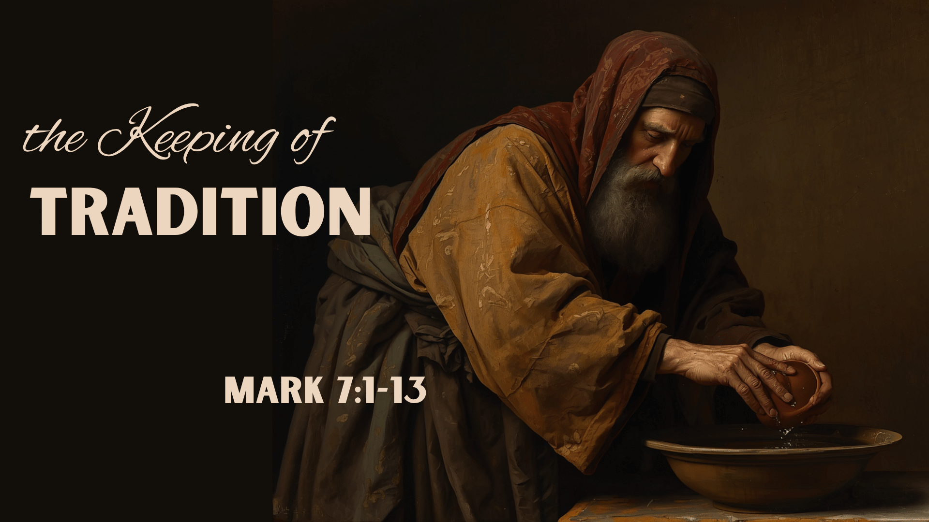

Slide 2
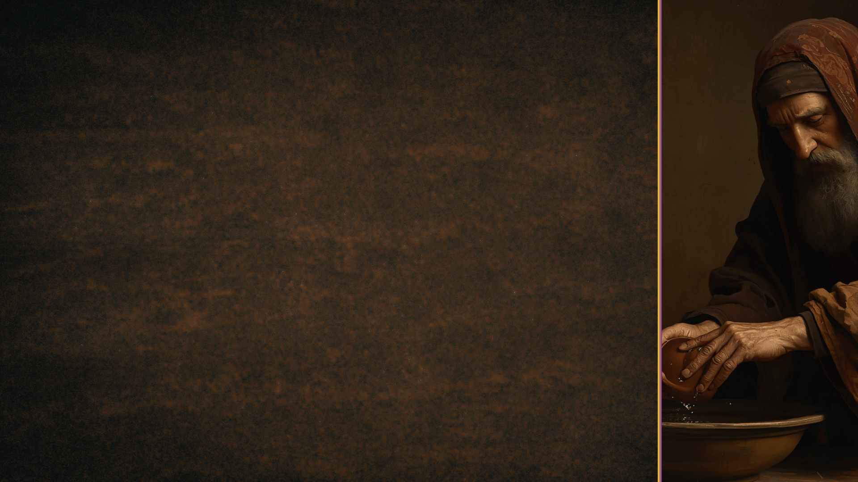
A List: The Traditions of Men
Cleanliness and washing
Definitions regarding what constitutes work
Regulations designed to avoid an "accidental" breaking of the Mosaic Law
The elevation of 7 elements to the level of sacraments.
The liturgical calendar:
Praying the Rosary; signs of the Cross; confession to the priest; honoring saints
Instrumental music
Sabbath Day observance
Distinguishing between venial and mortal sin
Ecclesiastical hierarchy
Elevation of clergy
Praise teams and choirs
etc., etc., etc.

Slide 3
The Religious Traditions of Men
They often excite zealous emotions (7:9)
Galatians 1:13-14; Romans 10:1-3
They are easily regarded as equal to God’s word (7:8)
Galatians 1:6-9; 2 John 9
They invalidate God’s word (7:11-13)
They spoil one’s Faith in Christ
John 14:15; Colossians 2:20-23; 6-8

Slide 4
Apostolic Traditions
The Apostle’s Teaching: God’s Word
1 Thessalonians 2:13; John 16:12-15
How were these traditions delivered?
Jude 3; Galatians 1:11-12; 2 Peter 1:16-19
Any traditions taught by inspiration are to be held fast
2 Thessalonians 2:13; 3:6

Slide 5
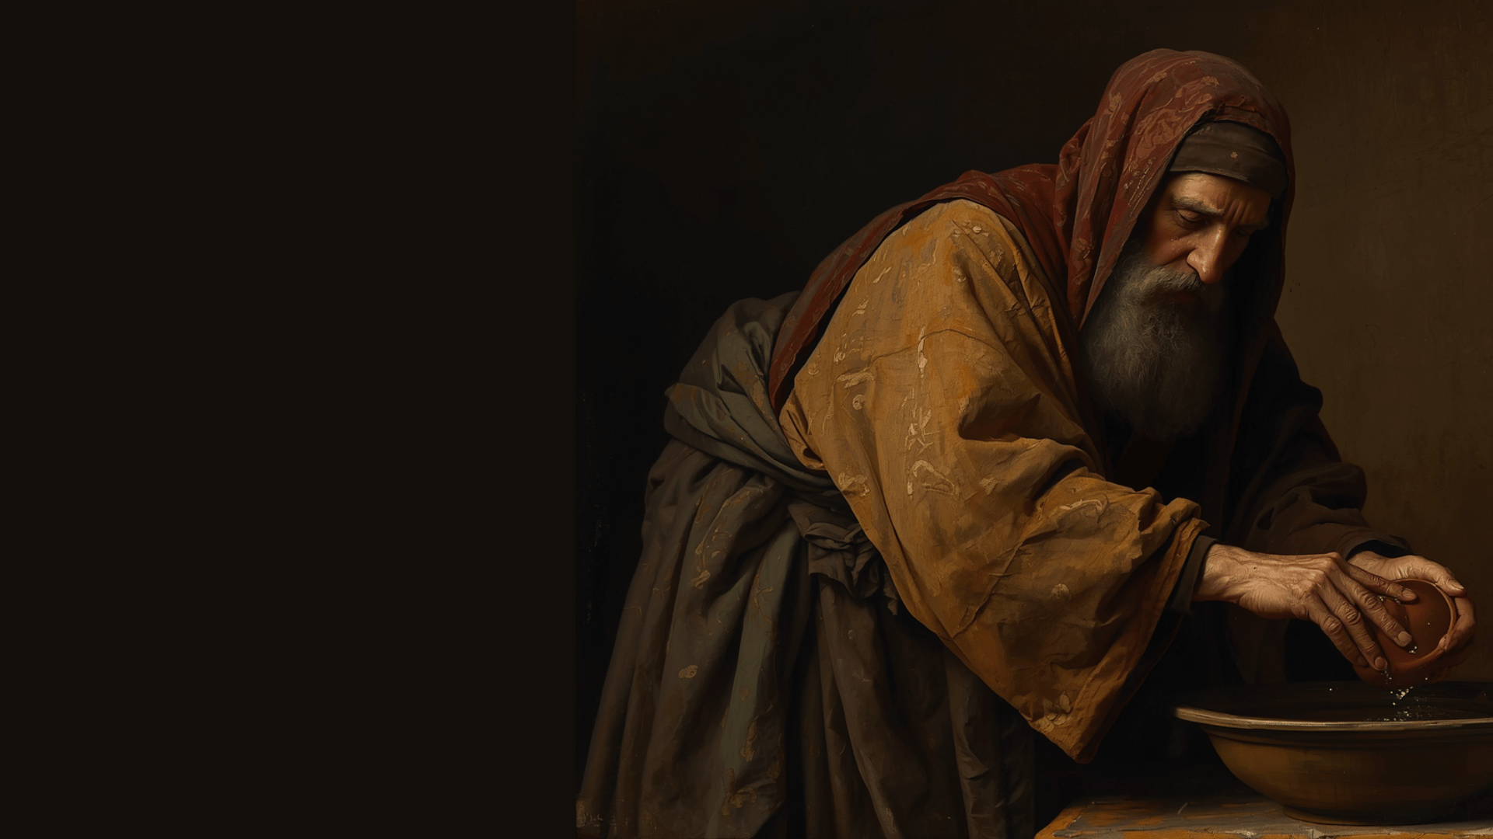
WE MUST NOT ESTABLISH OUR OWN TRADITIONS & VIOLATE SCRIPTURE
Be people of the book – Hosea 4:6
Don’t elevate men too highly – 1 Corinthians 4:6
Hold fast the apostolic traditions – Colossians 2:6-8

