Slide 1
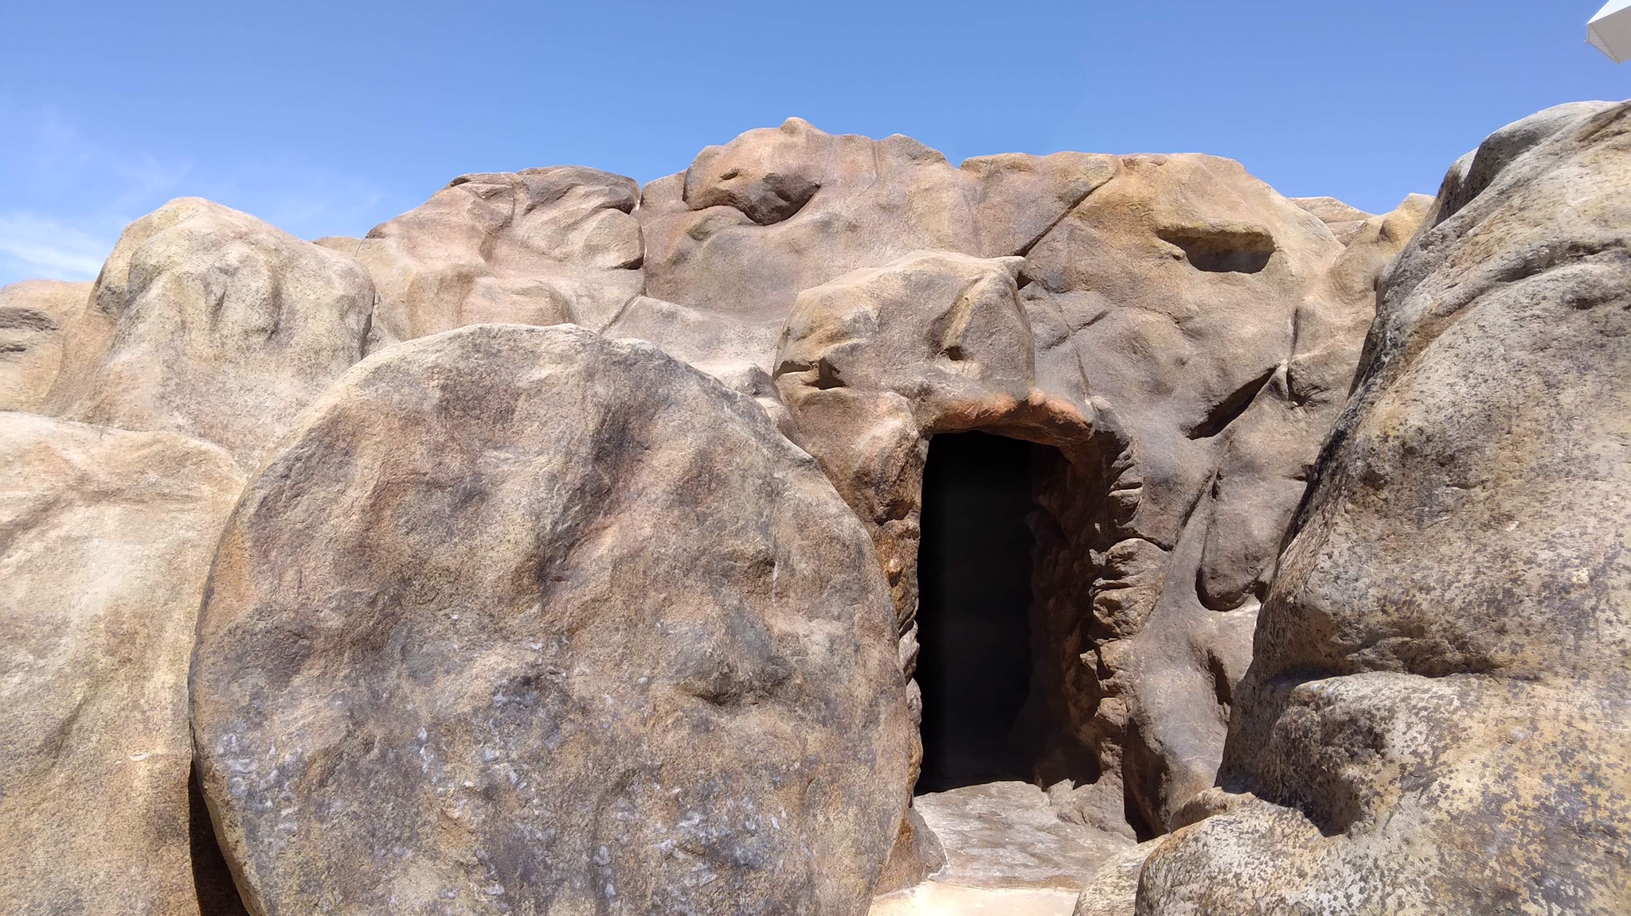
The Resurrection of Christ
Predicted
Promised
Proclaimed
Notes:
(Mark 16:1-7), “Now when the Sabbath was past, Mary Magdalene, Mary the mother of James, and Salome bought spices, that they might come and anoint Him. ² Very early in the morning, on the first day of the week, they came to the tomb when the sun had risen. ³ And they said among themselves, “Who will roll away the stone from the door of the tomb for us?” ⁴ But when they looked up, they saw that the stone had been rolled away—for it was very large. ⁵ And entering the tomb, they saw a young man clothed in a long white robe sitting on the right side; and they were alarmed. ⁶ But he said to them, “Do not be alarmed. You seek Jesus of Nazareth, who was crucified. He is risen! He is not here. See the place where they laid Him. ⁷ But go, tell His disciples—and Peter—that He is going before you into Galilee; there you will see Him, as He said to you.”
For centuries the accuracy of the Bible record of the bodily resurrection of Jesus has been studied, debated, rejected and believed.
(Mark 16:4-7) (Mark affirms the empty tomb (READ ABOVE)
(Mark 16:9), “Now when He rose early on the first day of the week, He appeared first to Mary Magdalene, out of whom He had cast seven demons.”
(Mark 16:12), “After that, He appeared in another form to two of them as they walked and went into the country.”
(Mark 16:14), [Even the apostles were dubious], “Later He appeared to the eleven as they sat at the table; and He rebuked their unbelief and hardness of heart, because they did not believe those who had seen Him after He had risen.”
The empty tomb and the appearances of the risen Christ are the two strands of evidence that persuade us and give us comforting assurance
(Acts 1:3), “The former account I made, O Theophilus, of all that Jesus began both to do and teach, ² until the day in which He was taken up, after He through the Holy Spirit had given commandments to the apostles whom He had chosen, ³ to whom He also presented Himself alive after His suffering by many infallible proofs, being seen by them during forty days and speaking of the things pertaining to the kingdom of God.”

Slide 2
The Resurrection of Christ
Predicted by Prophets
Psalm 16:8-11; Acts 2:25-32; 17:2-3
Promised by Jesus
John 2:18-22; Matthew 16:21-23; 27:62-64
Proclaimed the Deity of Christ
John 10:31-33; Romans 1:3-4; Philippians 2:8-11
Notes:
THE RESURRECTION OF CHRIST:
Was Predicted (foretold) by the Old Testament Prophets (Consider Psalm 16 as an example)
(Psalm 16:8-11), [David’s Words], “I have set the Lord always before me; because He is at my right hand I shall not be moved. ⁹ Therefore my heart is glad, and my glory rejoices; My flesh also will rest in hope. ¹⁰ For You will not leave my soul in Sheol, or will You allow Your Holy One to see corruption. ¹¹ You will show me the path of life; in Your presence is fullness of joy; at Your right hand are pleasures forevermore.”
Peter’s explanation of David’s words
(Acts 2:25-28), [The Quote], “For David says concerning Him: ‘I foresaw the Lord always before my face, for He is at my right hand, that I may not be shaken. ²⁶ Therefore my heart rejoiced, and my tongue was glad; moreover my flesh also will rest in hope. ²⁷ For You will not leave my soul in Hades, nor will You allow Your Holy One to see corruption. ²⁸ You have made known to me the ways of life;
You will make me full of joy in Your presence.’”
(Acts 2:29-32), [The Argument], “Men and brethren, let me speak freely to you of the patriarch David, that he is both dead and buried, and his tomb is with us to this day. ³⁰ Therefore, being a prophet, and knowing that God had sworn with an oath to him that of the fruit of his body, according to the flesh, He would raise up the Christ to sit on his throne, ³¹ he, foreseeing this, spoke concerning the resurrection of the Christ, that His soul was not left in Hades, nor did His flesh see corruption. ³² This Jesus God has raised up, of which we are all witnesses.”
This was necessary, and preached by Paul
(Acts 17:2-3) [At synagogue in Thessalonica], “Then Paul, as his custom was, went in to them, and for three Sabbaths reasoned with them from the Scriptures, ³ explaining and demonstrating that the Christ had to suffer and rise again from the dead, and saying, “This Jesus whom I preach to you is the Christ.”
[CLICK] Was Promised by Jesus
(John 2:18-22), [Early in His ministry], “So the Jews answered and said to Him, “What sign do You show to us, since You do these things?” ¹⁹ Jesus answered and said to them, “Destroy this temple, and in three days I will raise it up.” ²⁰ Then the Jews said, “It has taken forty-six years to build this temple, and will You raise it up in three days?” ²¹ But He was speaking of the temple of His body. ²² Therefore, when He had risen from the dead, His disciples remembered that He had said this to them; and they believed the Scripture and the word which Jesus had said.”
(Matthew 16:21), [The disciples initially rejected the thought], “From that time Jesus began to show to His disciples that He must go to Jerusalem, and suffer many things from the elders and chief priests and scribes, and be killed, and be raised the third day. ²² Then Peter took Him aside and began to rebuke Him, saying, “Far be it from You, Lord; this shall not happen to You!” ²³ But He turned and said to Peter, “Get behind Me, Satan! You are an offense to Me, for you are not mindful of the things of God, but the things of men.”
(Matthew 27:62-64), [The Jews referred to Jesus’ Claim in addressing Pilate], “On the next day, which followed the Day of Preparation, the chief priests and Pharisees gathered together to Pilate, ⁶³ saying, “Sir, we remember, while He was still alive, how that deceiver said, ‘After three days I will rise.’ ⁶⁴ Therefore command that the tomb be made secure until the third day, lest His disciples come by night and steal Him away, and say to the people, ‘He has risen from the dead.’ So the last deception will be worse than the first.”
[CLICK] Proclaimed (proved) the Deity of Christ
(John 10:31-33), [The Jews were not wrong, Jesus did make the claim to be God, but He was not blaspheming. He was speaking the truth], “Then the Jews took up stones again to stone Him. ³² Jesus answered them, “Many good works I have shown you from My Father. For which of those works do you stone Me?” ³³ The Jews answered Him, saying, “For a good work we do not stone You, but for blasphemy, and because You, being a Man, make Yourself God.”
(Romans 1:3-4), “concerning His Son Jesus Christ our Lord, who was born of the seed of David according to the flesh, ⁴ and declared to be the Son of God with power according to the Spirit of holiness, by the resurrection from the dead.”
(Philippians 2:8-11), “And being found in appearance as a man, He humbled Himself and became obedient to the point of death, even the death of the cross. ⁹ Therefore God also has highly exalted Him and given Him the name which is above every name, ¹⁰ that at the name of Jesus every knee should bow, of those in heaven, and of those on earth, and of those under the earth, ¹¹ and that every tongue should confess that Jesus Christ is Lord, to the glory of God the Father.”

Slide 3
The Resurrection of Christ
Notes:
(John 11:25-27), [Jesus’ conversation with Martha at the death of her brother Lazarus], “Jesus said to her, “I am the resurrection and the life. He who believes in Me, though he may die, he shall live. ²⁶ And whoever lives and believes in Me shall never die. Do you believe this?” ²⁷ She said to Him, “Yes, Lord, I believe that You are the Christ, the Son of God, who is to come into the world.”
Conclusion:
The tomb is not empty, He is not there
He was raised from the dead, and has ascended to the right hand of the Father
He is both your Lord and your Christ
Will you accept Him today?

