Slide 1
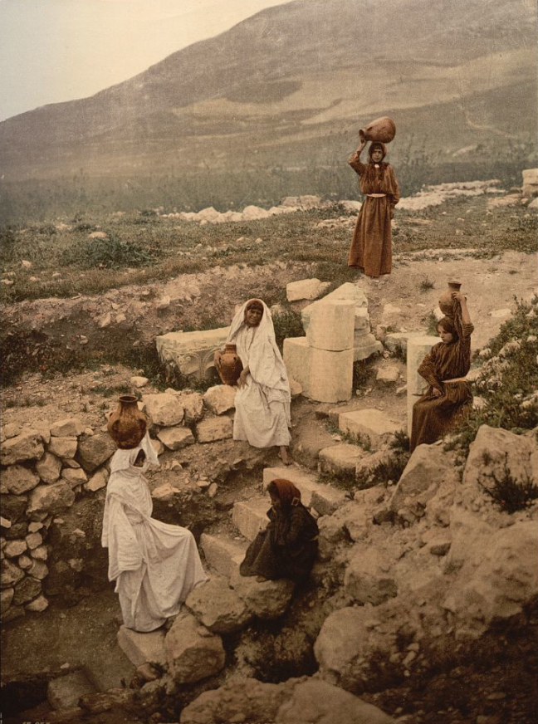
the Samaritans (2 Kings 17)
An old photo of Jacob’s well at the base of Mount Gerizim. Sacred to the Samaritans of Jesus’ day.
Notes:
Note: Scripture reading is John 4:19-26
Introduction:
At the end of lesson, we will turn back to John 4, where Jesus spoke with the Samaritan woman at Jacob’s well.
The photgraph is basically an old postcard, showing the steps leading down to Jacob’s well, with Mt. Gerezim (the mountain to which the Samaritan woman referred) in the background
The ladies’ are no doubt models who were placed there to reenact how it would have been in Jesus’ day.
Before we discuss the text of John 4, I would like to give some background regarding the Samaritans
Throughout the history of the northern kingdom of Israel, which had it’s beginning approx. 931 B.C. with the reign of Jeroboam, the kings all led the people into idolatry and disobedience to God.
Remnants of the high places can still be seen (for example) in the ruins of the city of Dan. (I’ll show you a picture in a moment).
After a couple of centuries, the northern Kingdom fell to the Assyrians (722 B.C.)
It was the practice of the Assyrians to displace the native people of a region, and then repopulate the land with foreigners.
This is what they did with Israel, which is why the period is referred to as Assyrian captivity.
These events are revealed in 2 Kings 17.

Slide 2
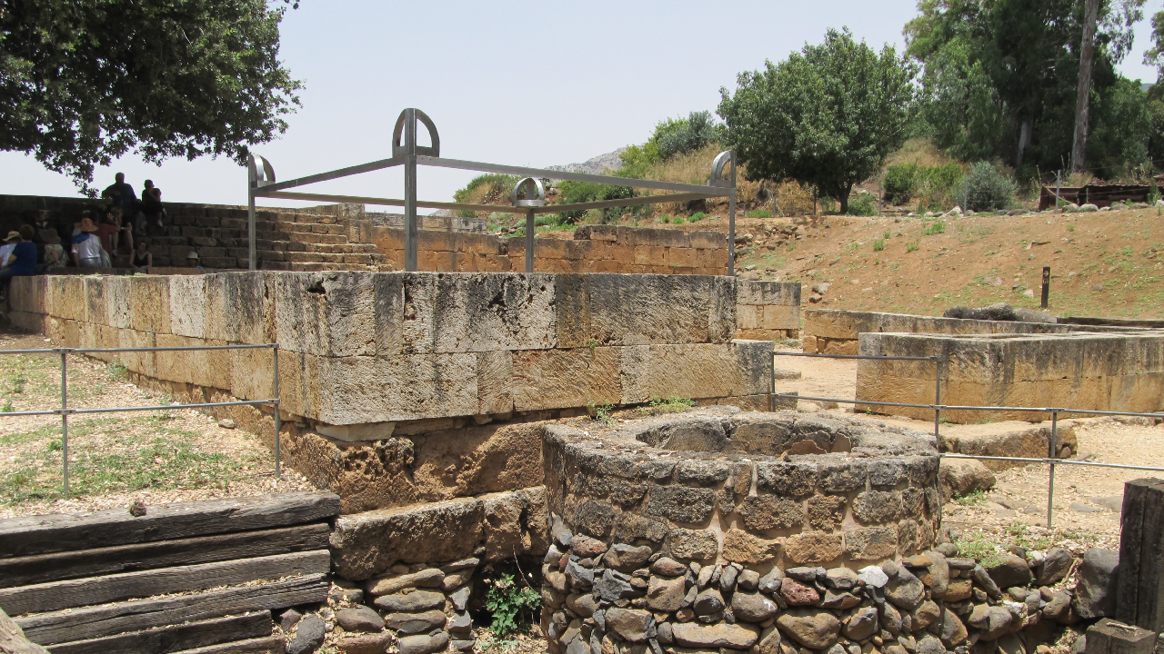
Notes:
As mentioned, this is a photo of the excavation of the tell (mound) at Dan. (The northern city designated by Jeroboam as a place to go and worship God, in the 10th century B.C.)
The lower level consists of structures and buildings for the priests
T the top left are the stairs leading to the “high place” where sacrifices were made
This file is licensed under the Creative Commons Attribution 2.5 Generic license.
Attribution: תמר מרום Pikiwiki Israel

Slide 3
Fall of Israel
Subjugation (1-4)
Defeat and Captivity (5-6)
God’s Reason (7-12)
No Repentance (13-18)
Resettlement (24-28)
Corrupted Religion (29-33)
Even today (34-41)
Notes:
2 Kings 17 gives us a linear history of Israel’s fall and captivity to the Assyrians, as well as the reason for God’s judgment upon them.
We will not read every verse, but I would like to share with you an overview.
During the reign of King Hoshea, Shalmaneser, the king of Assyria, subjugated Him and Israel
Hoshea became a vassal, and was required to pay tribute to the king of Assyria
But, Hoshea conspired with the king of Egypt against Shalmaneser, who found out and threw him into prison.
Israel besieged the capitol city of Samaria for 3 years, and took the city and the people
The practice of the Assyrians was to exile subjugated peoples to dissuade rebellion.
(2 Kings 17:6), “In the ninth year of Hoshea, the king of Assyria took Samaria and carried Israel away to Assyria, and placed them in Halah and by the Habor, the River of Gozan, and in the cities of the Medes.”
God is the one who establishes both the rise and fall of nations
(Acts 17:26), “And He has made from one blood every nation of men to dwell on all the face of the earth, and has determined their preappointed times and the boundaries of their dwellings.”
Assyria was a tool used by God to judge the northern Kingdom
(2 Kings 17:7-12), “For so it was that the children of Israel had sinned against the Lord their God, who had brought them up out of the land of Egypt, from under the hand of Pharaoh king of Egypt; and they had feared other gods, ⁸ and had walked in the statutes of the nations whom the Lord had cast out from before the children of Israel, and of the kings of Israel, which they had made. ⁹ Also the children of Israel secretly did against the Lord their God things that were not right, and they built for themselves high places in all their cities, from watchtower to fortified city. ¹⁰ They set up for themselves sacred pillars and wooden images on every high hill and under every green tree. ¹¹ There they burned incense on all the high places, like the nations whom the Lord had carried away before them; and they did wicked things to provoke the Lord to anger, ¹² for they served idols, of which the Lord had said to them, “You shall not do this thing.”
This is significant for us, as applications can be made
They sinned against God by engaging in idolatry
The embraced the statutes of men rather than the statutes of God
They built for themselves, set up for themselves (Religion is not for self/it is for God!)
They engaged in wickedness
God called upon them to repent. But, repentance did not occur as they continued in their sin until God judged them.
(2 Kings 17:13-14), “Yet the Lord testified against Israel and against Judah, by all of His prophets, every seer, saying, “Turn from your evil ways, and keep My commandments and My statutes, according to all the law which I commanded your fathers, and which I sent to you by My servants the prophets.” ¹⁴ Nevertheless they would not hear, but stiffened their necks, like the necks of their fathers, who did not believe in the Lord their God.”
It is their unwillingness to repent that led to their downfall
(2 Kings 17:18), “Therefore the Lord was very angry with Israel, and removed them from His sight; there was none left but the tribe of Judah alone.”
The Assyrians resettled the land of Israel with foreigners. (Note: There is evidence that some Jews remained behind, and intermarried and mingled with the foreigners in the land).
For sure the civic and religious leaders, and people of influence were taken away into captivity
(2 Kings 17:24), “Then the king of Assyria brought people from Babylon, Cuthah, Ava, Hamath, and from Sepharvaim, and placed them in the cities of Samaria instead of the children of Israel; and they took possession of Samaria and dwelt in its cities.”
These people brought their false religion with them, bringing reprisals from God (He sent lions to kill some of them).
They petitioned the king (in superstition) for a priest to help them understand and appease “the God of the land.”
(2 Kings 17:27-28), “Then the king of Assyria commanded, saying, “Send there one of the priests whom you brought from there; let him go and dwell there, and let him teach them the rituals of the God of the land.” ²⁸ Then one of the priests whom they had carried away from Samaria came and dwelt in Bethel, and taught them how they should fear the Lord.”
Unfortunately, their attitude toward God that was similar to the Athenians in Acts 17, leading to a corruption of the Jewish religion and worship
(Acts 17:22-23), “Then Paul stood in the midst of the Areopagus and said, “Men of Athens, I perceive that in all things you are very religious; ²³ for as I was passing through and considering the objects of your worship, I even found an altar with this inscription: TO THE UNKNOWN GOD. Therefore, the One whom you worship without knowing, Him I proclaim to you.”
Because of their superstitions, what could have become a blessing to their people turned into corrupt worship and religion
(2 Kings 17:33-34), “They feared the Lord, yet served their own gods—according to the rituals of the nations from among whom they were carried away. ³⁴ To this day they continue practicing the former rituals; they do not fear the Lord, nor do they follow their statutes or their ordinances, or the law and commandment which the Lord had commanded the children of Jacob, whom He named Israel.”
Finally, the writer of the book of Kings stated that the corrupted religion of these people (known in the New Testament as Samaritans), continued to his day.
(2 Kings 17:41), “So these nations feared the Lord, yet served their carved images; also their children and their children's children have continued doing as their fathers did, even to this day.”
The reference here was probably to the time of the prophet Jeremiah during the Babylonians captivity.
We know from John 4 the Samaritans continued their practice during New Testament times.
Interestingly, their peculiar religion continues even to this day!
An article dating to August of 2018 states that the Samaritans have rebounded from a low of only 141 members in 1919 to a present number of 800.
It is now a cloistered community, living in the shadow of Mt. Gerizim, and claiming exclusive acceptance by God.

Slide 4
1st Century Attitudes
Jews
Matt. 10:5; John 4:8
Jesus
Luke 10:33; John 4:10
Notes:
First Century Attitudes toward the Samaritans
It seems that by Jesus’ time, the Samaritans had become monotheistic
They differed with the Jews in a number of areas, though the both believed in the Pentateuch
They followed only the Pentateuch (Genesis-Deuteronomy)
They did not recognize the legitimacy of the temple and Jerusalem as the center of worship
Great animosity existed in the first century between the Jews and Samaritans
The Jews were God’s chosen people, even given precedence in the establishment of Christ’s kingdom
(Matthew 10:5-7), “These twelve Jesus sent out and commanded them, saying: “Do not go into the way of the Gentiles, and do not enter a city of the Samaritans. ⁶ But go rather to the lost sheep of the house of Israel. ⁷ And as you go, preach, saying, ‘The kingdom of heaven is at hand.’”
No doubt this brought conflict. Arrogance on the part of the Jew – resentment by the Samaritans
The woman at the well acknowledge this rancor to the Lord, when he asked her for water
(John 4:9), “Then the woman of Samaria said to Him, ‘How is it that You, being a Jew, ask a drink from me, a Samaritan woman?’ For Jews have no dealings with Samaritans.”
Note: Luke records an indication that Samaritans harbored the same dislike of the Jews
(Luke 9:51-54), “Now it came to pass, when the time had come for Him to be received up, that He steadfastly set His face to go to Jerusalem, ⁵² and sent messengers before His face. And as they went, they entered a village of the Samaritans, to prepare for Him. ⁵³ But they did not receive Him, because His face was set for the journey to Jerusalem. ⁵⁴ And when His disciples James and John saw this, they said, “Lord, do You want us to command fire to come down from heaven and consume them, just as Elijah did?”
Meaning: He steadfastly set His face to go to Jerusalem
It was His intent to finish the work His Father gave Him in Jerusalem
The Samaritans would be hostile to a Jew determining to go to Jerusalem (It contradicted their own views, as indicated in John 4).
So, they rejected Him (Note the anger of James and John, which was admonished by Jesus).
(Luke 9:55-56), “But He turned and rebuked them, and said, “You do not know what manner of spirit you are of. ⁵⁶ For the Son of Man did not come to destroy men's lives but to save them.” And they went to another village.”
This passage in Luke indicates that Jesus had a different view of the Samaritans
His purpose was to save the souls of mankind!
(Romans 1:16), “For I am not ashamed of the gospel of Christ, for it is the power of God to salvation for everyone who believes, for the Jew first and also for the Greek.”
His inclusive attitude is seen in the parable of the Good Samaritan
(Luke 10:33), “But a certain Samaritan, as he journeyed, came where he was. And when he saw him, he had compassion.”
Samaritans were capable of good. Here the Samaritan is the one who kept the law, not the priest or Levite.
It also is seen in patient conversation with the woman at the well.
(John 4:10), “Jesus answered and said to her, “If you knew the gift of God, and who it is who says to you, ‘Give Me a drink,’ you would have asked Him, and He would have given you living water.”

Slide 5
(John 4) The Conversation
Jesus is the Messiah
(10,14,22,25-26)
True Worship
(21-24)
Notes:
A few thoughts about the conversation Jesus had with the Samaritan Woman in John 4
Jesus is the Messiah
Jesus is the giver of Living water (10)
The Living water brings everlasting life (14)
Salvation is of the Jews (22)
The Messiah was of the lineage of David (Judah), not a Samaritan
Jesus is the Messiah (25-26)
True Worship (Tying 2 Kings 17 and John 4 together)
What was wrong with the worship of the new inhabitants of Samaria?
(2 Kings 17:25a), “And it was so, at the beginning of their dwelling there, that they did not fear the Lord…”
(2 Kings 17:28-29), “Then one of the priests whom they had carried away from Samaria came and dwelt in Bethel, and taught them how they should fear the Lord. ²⁹ However every nation continued to make gods of its own, and put them in the shrines on the high places which the Samaritans had made, every nation in the cities where they dwelt.”
(2 Kings 17:32-33), “So they feared the Lord, and from every class they appointed for themselves priests of the high places, who sacrificed for them in the shrines of the high places. ³³ They feared the Lord, yet served their own gods—according to the rituals of the nations from among whom they were carried away.” ³⁴ To this day they continue practicing the former rituals; they do not fear the Lord, nor do they follow their statutes or their ordinances, or the law and commandment which the Lord had commanded the children of Jacob, whom He named Israel.”
Compare Jesus’ words in John 4
(John 4:21-24), “Jesus said to her, ‘Woman, believe Me, the hour is coming when you will neither on this mountain, nor in Jerusalem, worship the Father. ²² You worship what you do not know; we know what we worship, for salvation is of the Jews. ²³ But the hour is coming, and now is, when the true worshipers will worship the Father in spirit and truth; for the Father is seeking such to worship Him. ²⁴ God is Spirit, and those who worship Him must worship in spirit and truth.’”
Fear the Lord - YET
Fear the Lord – HOWEVER
Not truly fear of the Lord at all. True fear of the Lord leads men to follow the statutes, ordinances, law and commandments of God.
(Ecclesiastes 12:13-14), “Let us hear the conclusion of the whole matter: fear God and keep His commandments, for this is man's all. ¹⁴ For God will bring every work into judgment, including every secret thing, whether good or evil.”
Notice the words, “including every secret thing”. Compare to Israel’s sin in 1 Kings 17.
(2 Kings 17:9), “Also the children of Israel secretly did against the Lord their God things that were not right, and they built for themselves high places in all their cities, from watchtower to fortified city.”
Anytime an action is taken without bringing God into your confidence, it is sin!
Our lives are lived for God, and in accord with His will for us… PERIOD!

Slide 6
Conclusion
Jesus was accepted by the Samaritans as well.
(John 4:39-42)
All who believe and obey may be saved!
Notes:
In John, Jesus’ teaching was accepted by the Samaritans in that city.
(John 4:39-42), “And many of the Samaritans of that city believed in Him because of the word of the woman who testified, “He told me all that I ever did.” ⁴⁰ So when the Samaritans had come to Him, they urged Him to stay with them; and He stayed there two days. ⁴¹ And many more believed because of His own word. ⁴² Then they said to the woman, “Now we believe, not because of what you said, for we ourselves have heard Him and we know that this is indeed the Christ, the Savior of the world.”
No matter if you are a Jew, Samaritan or a Gentile, you too can be saved through obedience to the gospel
You can maintain your standing with God by Fearing Him, and keeping His commandments.

