Slide 1
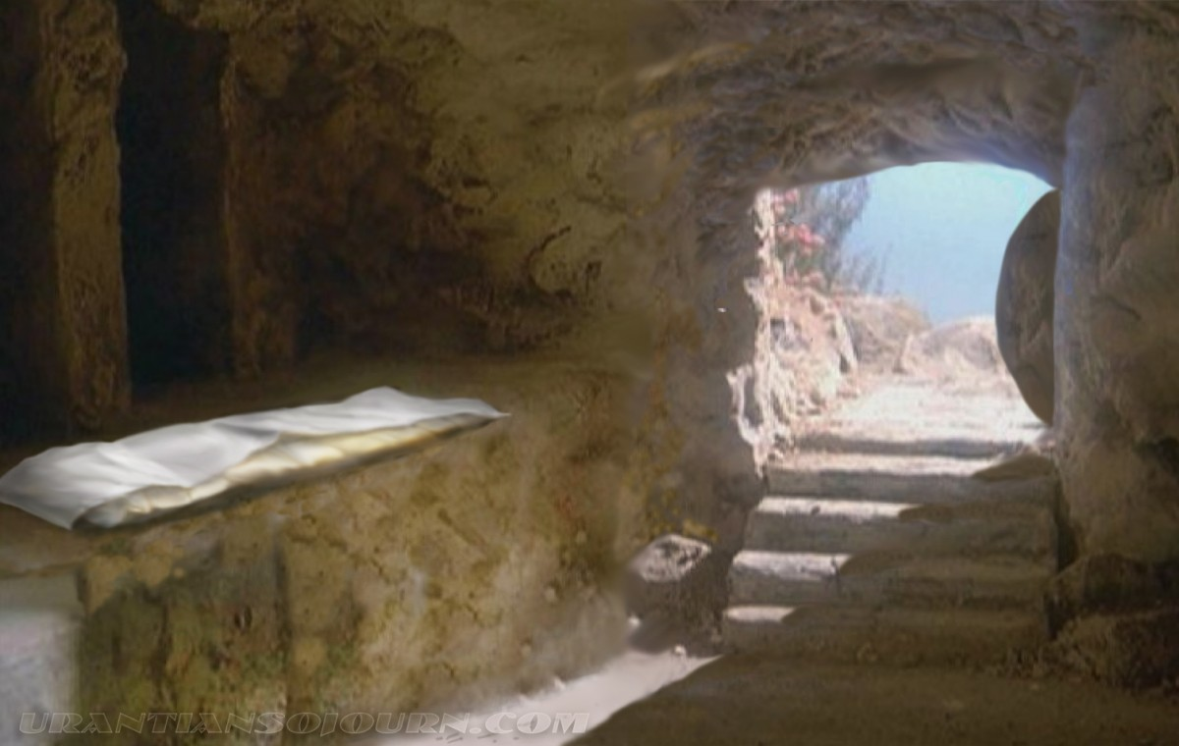
The Significance of the Lord’s Resurrection

Slide 2
The Significance of the Lord’s Resurrection
Proves Jesus is the Son of God!
Romans 1:3-4

Slide 3
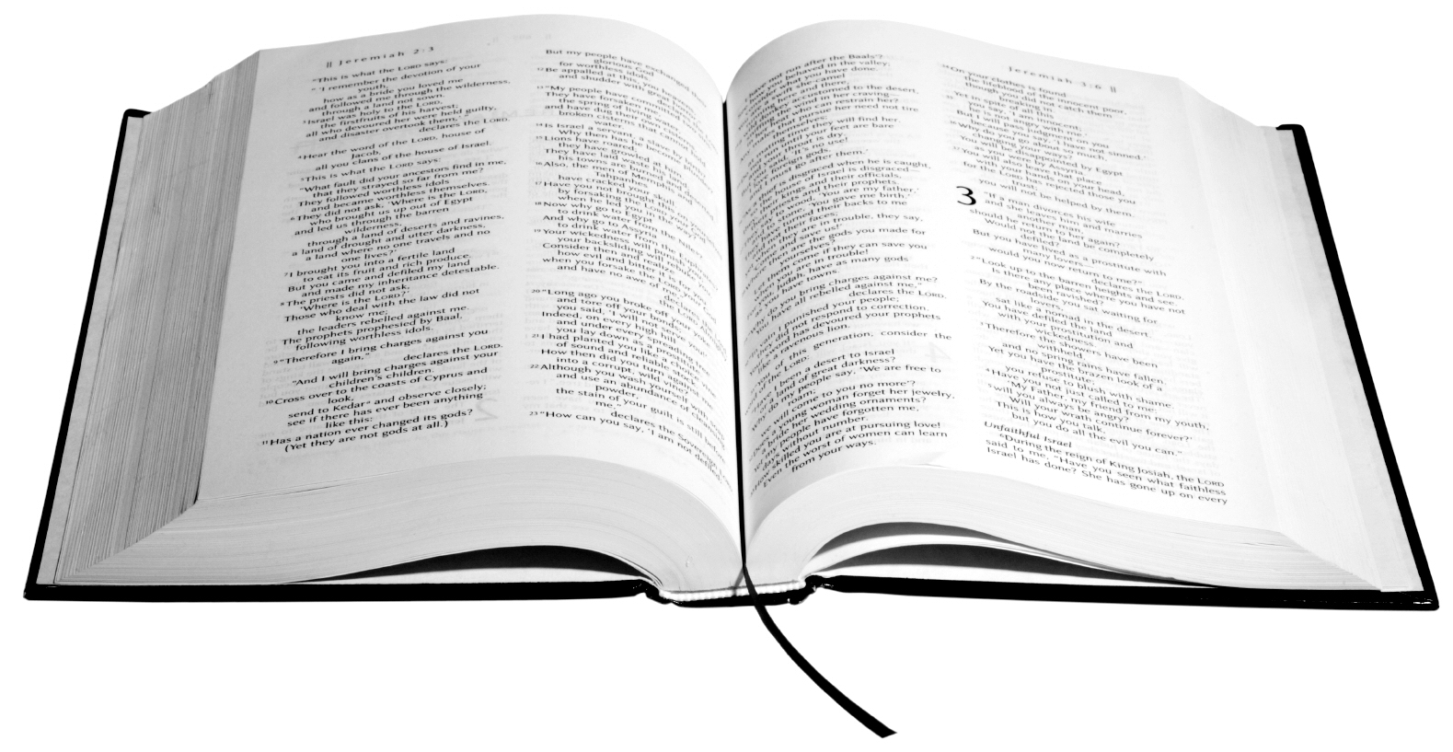
Romans 1:3-4
Paul, a bondservant of Jesus Christ, called to be an apostle, separated to the gospel of God ² which He promised before through His prophets in the Holy Scriptures, ³ concerning His Son Jesus Christ our Lord, who was born of the seed of David according to the flesh, ⁴ and declared to be the Son of God with power according to the Spirit of holiness, by the resurrection from the dead.

Slide 4
The Significance of the Lord’s Resurrection
Proves Jesus is the Son of God!
Romans 1:3-4
Validates Our Faith!
1 Corinthians 15:12-19 (READ)

Slide 5
Consequences of no resurrection
1 Corinthians 15:12-19
the preaching of the apostles is vain (14)
our faith is vain (14)
the apostles were false witnesses (15)
we are still in our sins (17)
the dead have perished without hope of a resurrection (18)
Christians are the most pitiable of all people upon the earth (19).

Slide 6
1 Corinthians 15:20-22
But now Christ is risen from the dead, and has become the firstfruits of those who have fallen asleep. ²¹ For since by man came death, by Man also came the resurrection of the dead. ²² For as in Adam all die, even so in Christ all shall be made alive.

Slide 7
The Significance of the Lord’s Resurrection
Proves Jesus is the Son of God!
Romans 1:3-4
Validates Our Faith!
1 Corinthians 15:12-19 (READ)
Assures Us of Future Judgment!
Acts 17:30-31

Slide 8
Acts 17:30-31
Truly, these times of ignorance God overlooked, but now commands all men everywhere to repent, ³¹ because He has appointed a day on which He will judge the world in righteousness by the Man whom He has ordained. He has given assurance of this to all by raising Him from the dead.

Slide 9
Conclusion
The reality of a future judgment holds far different implications, depending upon our standing with God.
If you wish to be resurrected to be with Christ, obey Jesus today!

