Slide 1
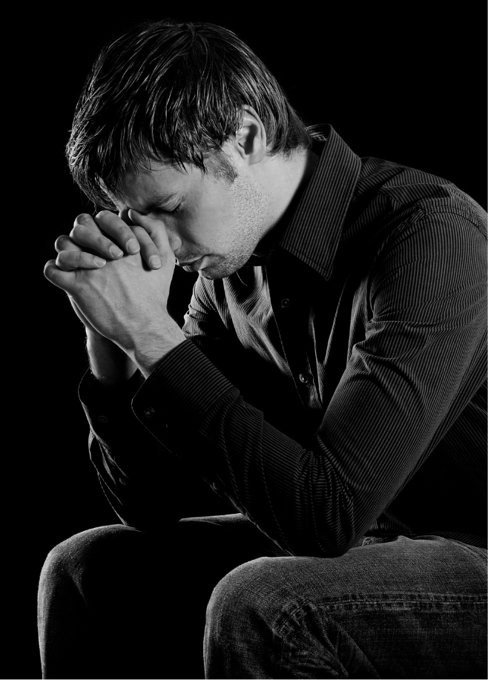
The Sinner’s Prayer
Is this how God has chosen to save mankind?
Notes:
The Sinner’s Prayer
(Is this how God has chosen to save mankind?)
No method of conversion has gained such popularity amongst mainstream denominations in the last century than that of the "Sinner's Prayer."
Millions believe that they have been saved by the blood of Christ simply by saying or repeating a prayer offered by another
A couple of weeks ago, I was told about a commercial that asked the question – “Do you know whether you are going to heaven or not?”
Heavenornot.net
Starts by establishing what the scripture teaches about: 1) God’s Existence – Genesis 1:1; 2) Our universal sin – Romans 3:23; 3) God’s gift of Grace – John 3:16; 4) The conditional nature of Salvation, receiving Christ – John 1:12
All of these points are established by scripture
What is not backed up by scripture is the means by which we “receive Christ”
The unsupported contention is that you receive Christ by praying the “Sinner’s Prayer”

Slide 2
The Sinner’s Prayer
(Example)
Dear God...I know I have sinned against you. Please forgive me. I receive Jesus...your only Son...right now as Savior of my life...having died to pay for my sins. Thank you for forgiving my sins...and for my new life. I pray this prayer in Jesus’ holy name, Amen!
Notes:
The Sinner’s Prayer (The example from heavenornot.net)
Heavenornot.net
A typical type of “Sinner’s prayer.” The contention being after the prayer is said, salvation has been obtained.
“Dear God...I know I have sinned against you. Please forgive me. I receive Jesus...your only Son...right now as Savior of my life...having died to pay for my sins. Thank you for forgiving my sins...and for my new life. I pray this prayer in Jesus’ holy name, Amen!”
Franklin Graham on Fox News commercial (Is another example).
However, we have objections to the idea that sinners can be saved through this simple prayer!
First, it came from men, not God
John’s Baptism as an example
(Matthew 21:23-26), “Now when He came into the temple, the chief priests and the elders of the people confronted Him as He was teaching, and said, “By what authority are You doing these things? And who gave You this authority?” But Jesus answered and said to them, “I also will ask you one thing, which if you tell Me, I likewise will tell you by what authority I do these things: The baptism of John—where was it from? From heaven or from men?” And they reasoned among themselves, saying, “If we say, ‘From heaven,’ He will say to us, ‘Why then did you not believe him?’ But if we say, ‘From men,’ we fear the multitude, for all count John as a prophet.”
Let’s examine – “From heaven or from men?”

Slide 3
The Sinner’s Prayer
(A History)
1741 (Eleazar Wheelock) “Mourner’s Seat [Bench]”
1801 (Cane Ridge Revival) Manipulation in Preaching
1835 (Charles Finney) “Anxious Seat”
1860 (Dwight Moody) “Inquiry Room”
1899 (R. A. Torrey) “On the Spot” street conversions
Early 1900’s (Billy Sunday) “The Sawdust Trail”
1940’s (Billy Graham) Prayer at Altar Call
1950’s (Bill Bright) “Sinner’s Prayer”
Notes:
The Sinner’s Prayer (A history)
The Origin of the Sinner’s Prayer (February 12, 2014) by Ryan Hasty
To find the origin of this method of conversion, one must rely on extra-biblical evidence as neither the term "sinner's prayer" nor the concept can be found in God's holy word.
It was in 1741 that a preacher named Eleazar Wheelock devised a technique called the "Mourner's Seat" by which to draw the penitent believer. Wheelock would target sinners by having them sit in the front pew while pronouncing from the pulpit "salvation is looming over your heads." Not only were these individuals susceptible to further counsel, but they were also vulnerable to whatever method of conversion Wheelock prescribed. False conversions from his revivals were numerous though it took almost a hundred years for other preachers to begin mimicking his process.
In 1801, the "Cane Ridge Revival" began in Kentucky and lasted for several weeks. The temperature outside was so hot and attendees endured such long periods without food that many became delirious and began rolling around in the aisles and barking like dogs. Such abuse of emotions by the preachers at this revival gave thousands of individuals a mistaken notion about their rebirth. Other ministers caught on to the fact that gospel preaching could be modified to manipulate the emotions of the listeners into "conversion". Others in pews around the country placed unreasonable expectations on preachers to produce the same "religious experience" that was found at the Cane Ridge Revival.
In1835 another preacher named Charles Finney emerged on the scene to develop a hybrid system of conversion by combining Wheelock's "Mourner's Seat" with the experience of the Cane Ridge Revival. This traveling preacher named his technique the "Anxious Seat" Finney did not attempt to hide his confidence in this man-made system when he stated, "The church has always felt it necessary to have something of this kind to answer this very purpose. In the days of the apostles, baptism answered this purpose. The gospel was preached to the people, and then all those who were willing to be on the side of Christ were called out to be baptized. It held the place that the anxious seat does now as a public manifestation of their determination to be Christians.“
In the 1860s, the concept of the "Anxious Seat" was modified further by a preacher named Dwight Moody. Moody's method was named the "Inquiry Room". Moody utilized the same psychological techniques that preyed on emotions, but in addition, asked those who responded to his teaching to join him and his trained counselors in another room. In this "Inquiry Room", Moody and/or his counselors would pray with the potential converts. Moody considered prayer to be the last step in the conversion process. A man named R. A. Torrey succeeded Moody in 1899 and he modified Moody's system by taking the "room" out of the equation and performing "on the spot" street conversions.
In the early 1900s, well-known baseball player Bill Sunday left the diamond to pursue preaching. Sunday was one of the most popular, charismatic, and entertaining speakers of his generation. Sunday preached that one could be saved simply by walking down his tent's "sawdust trail" to the front where he was standing. Later on, people were said to have received salvation simply by publicly shaking Sunday's hand and stating that they would follow Christ.
Finally, in the 1940s, the next big crusade preacher hit the scene. A young man named Bill Graham trained counselors to encourage those who responded to his "altar call" to pray that Jesus would come into their hearts.
In the 1950s, Bill Bright took this concept and coined the expression, "The Four Spiritual Laws" which ends with the so-called "Sinner's Prayer“
So now, let’s look more closely at our objections

Slide 4
The Sinner’s Prayer
(Objections)
The Bible doesn’t teach it
Colossians 3:17
Prayer is for God’s children
1 John 1:9; 2:1
The Example of Saul of Tarsus
Acts 9:6, 10-12; 22:16
How do you actually receive Christ?!
Mark 16:15-16; Acts 2:36-39; Acts 8:35-39
Notes:
The Sinner’s Prayer (Objections)
Bible doesn’t teach it!
(Colossians 3:17), “And whatever you do in word or deed, do all in the name of the Lord Jesus, giving thanks to God the Father through Him.”
As we saw in our example, there were no passages to establish anything resembling the Sinner’s prayer
This is because there is no example, command, or intimation that any alien sinner ever prayed to God to receive salvation. It is not part of the Biblical pattern
It is presumptuous and wrong to think that God will save us in any way of our own devising, rather than submitting to His divine plan receiving Christ
[CLICK] Prayer for the forgiveness of sins is the way God has chosen to bring forgiveness to God’s children
(1 John 1:9), “If we confess our sins, He is faithful and just to forgive us our sins and to cleanse us from all unrighteousness.”
(1 John 2:1), “My little children, these things I write to you, so that you may not sin. And if anyone sins, we have an Advocate with the Father, Jesus Christ the righteous.”
[CLICK] The Example of Saul of Tarsus
(Acts 9:6), “So he, trembling and astonished, said, “Lord, what do You want me to do?” Then the Lord said to him, “Arise and go into the city, and you will be told what you must do.”
The clear indication was the Saul had to do something to have his sins washed away
Remember prayer (“Thank you for forgiving my sins.”)
But, Saul was already praying! It did not bring him salvation
Note the word’s of the Lord to Ananias
(Acts 9:10-12), “Now there was a certain disciple at Damascus named Ananias; and to him the Lord said in a vision, ‘Ananias.’ And he said, ‘Here I am, Lord.’ So the Lord said to him, ‘Arise and go to the street called Straight, and inquire at the house of Judas for one called Saul of Tarsus, for behold, he is praying. And in a vision he has seen a man named Ananias coming in and putting his hand on him, so that he might receive his sight.’”
Now, let’s go to Paul’s account to Agrippa, telling him what he (Saul) had to do
(Acts 22:14-16), “Then he said, The God of our fathers has chosen you that you should know His will, and see the Just One, and hear the voice of His mouth. For you will be His witness to all men of what you have seen and heard. And now why are you waiting? Arise and be baptized, and wash away your sins, calling on the name of the Lord.’”
The he had accepted Christ as Lord, and wanted to be saved, and had prayed, his sins remained until he was baptized!
How do you actually receive Christ?
The example of Pentecost
Belief, Repentance, Baptism
(Acts 2:36-38), “’Therefore let all the house of Israel know assuredly that God has made this Jesus, whom you crucified, both Lord and Christ.’ Now when they heard this, they were cut to the heart, and said to Peter and the rest of the apostles, ‘Men and brethren, what shall we do?’ Then Peter said to them, ‘Repent, and let every one of you be baptized in the name of Jesus Christ for the remission of sins; and you shall receive the gift of the Holy Spirit.’”
Confession
(Matthew 10:32-33), “Therefore whoever confesses Me before men, him I will also confess before My Father who is in heaven. But whoever denies Me before men, him I will also deny before My Father who is in heaven.”

Slide 5
conclusion
Listen to God rather than listening to men!
Galatians 1:6-9
Notes:
Conclusion:
Sadly, the concept of the Sinner's Prayer can be found neither in Jesus and the Apostles' teaching nor seen in the' numerous conversions found in the book of Acts.
It is entirely man-made and falls under the category of "another gospel“
Paul confirms and then reaffirms such a thing will condemn those who proclaim it.
(Galatians 1:6-9), “I marvel that you are turning away so soon from Him who called you in the grace of Christ, to a different gospel, which is not another; but there are some who trouble you and want to pervert the gospel of Christ. But even if we, or an angel from heaven, preach any other gospel to you than what we have preached to you, let him be accursed. As we have said before, so now I say again, if anyone preaches any other gospel to you than what you have received, let him be accursed.”
While the temptation is great to listen to the words of men as they tell us a simple prayer will do the trick, let us instead listen to the simple words of God and put our trust in His plan and no other!

