Slide 1
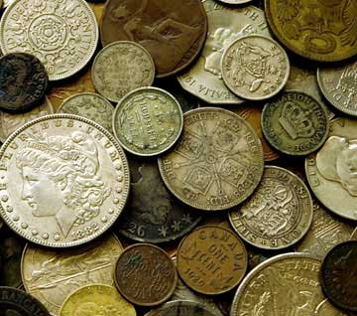
The Tax Collector
Luke 19:1-10
(Read)
Why were they unpopular,
and likened to the worst of sinners?

Slide 2
The Tax Collector
Was notorious for greed, and tactics of extortion and blackmail

Slide 3
McGarvey (The Fourfold Gospel) pg. 76
The Roman Government did not collect its own taxes. Instead of doing so, it divided the empire into districts, and sold the privilege of collecting the taxes in these districts to certain capitalists and men of rank. The capitalists employed agents to do the actual collecting. These agents were usually natives of the districts in which they lived, and those in Palestine were called publicans. Their masters urged and encouraged them to make the most fraudulent and vexatious exactions. They systematically overcharged the people and often brought false accusation to obtain money by blackmail. These publicans were justly regarded by the Jews as apostates and traitors, and were classed with the lowest and most abandoned characters. The system was bad, but its practitioners were worse. The Greeks regarded the word “publican” as synonymous with “plunderer.” Suidas pictures the life of a publican as “unrestrained plunder, unblushing greed, unreasonable pettifogging, shameless business.”

Slide 4
The Tax Collector
Was notorious for greed, and tactics of extortion and blackmail
So, regarded with contempt
Luke 7:34

Slide 5
Luke 7:33-34
For John the Baptist came neither eating bread nor drinking wine, and you say, ‘He has a demon.’ ³⁴ The Son of Man has come eating and drinking, and you say, ‘Look, a glutton and a winebibber, a friend of tax collectors and sinners!’

Slide 6
The Tax Collector
Was notorious for greed, and tactics of extortion and blackmail
So, regarded with contempt
Luke 7:34
Note: The stereotype was not always accurate
Luke 19:7-10

Slide 7
Luke 19:7-10
But when they saw it, they all complained, saying, “He has gone to be a guest with a man who is a sinner.” ⁸ Then Zacchaeus stood and said to the Lord, “Look, Lord, I give half of my goods to the poor; and if I have taken anything from anyone by false accusation, I restore fourfold.” ⁹ And Jesus said to him, “Today salvation has come to this house, because he also is a son of Abraham; ¹⁰ for the Son of Man has come to seek and to save that which was lost.”

Slide 8
The Tax Collector
Was notorious for greed, and tactics of extortion and blackmail
So, regarded with contempt
Luke 7:34
Note: The stereotype was not always accurate
Luke 19:7-10
The Lord desires to save all who come to repentance!
Luke 15:1-7 (Read)

Slide 9
Conclusion
What is your reputation?
Is the reputation well deserved?
Do you judge others by stereotype?
Jesus is able to save all men!
Are you willing to come to Jesus?
Notes:
Taken from some notes by Joe Price, in “The Spirit’s Sword” (May 26, 2002)
Preached at West Side on July 8, 2012 PM
Print Slides: 3, 8, 9

