Slide 1

Notes:
Preached at West Side church of Christ on Sunday morning, June 29, 2025

Slide 2

Kingdom of God
(Acts 8:12)
House of God
(1 Timothy 3:15)
Church of the Living God
(1 Timothy 3:15)
Kingdom of God’s Dear Son
(Colossians 1:13)
etc.
Churches of Christ
(Romans 16:16)
Church of God
(1 Corinthians 1:2)

Slide 3

Designation of our congregation
Associated with no denomination/ fellowship other than that of Christ
Notice the “little ‘c’”. Not a proper name!
Preposition “of” denotes ownership. Located on the west side of Ft. Worth, belongs to Christ!

Slide 4
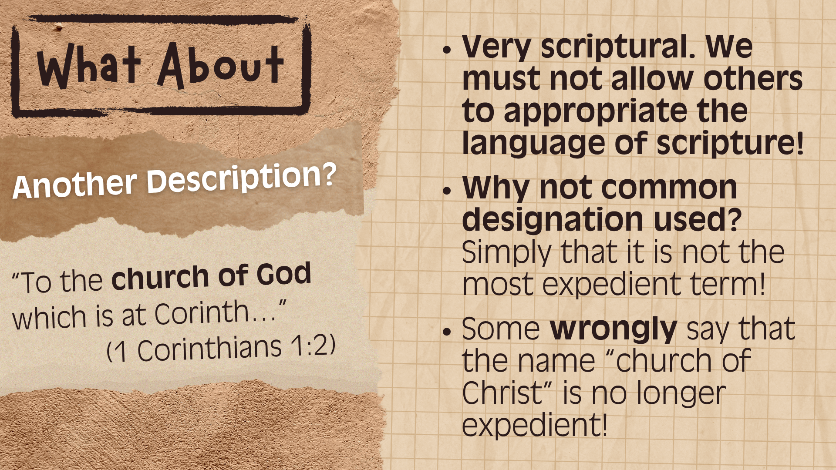

Slide 5
