Slide 1
Notes:
Preached at West Side on July 20, 2014 am
Print Slides: 2,9,11

Slide 2
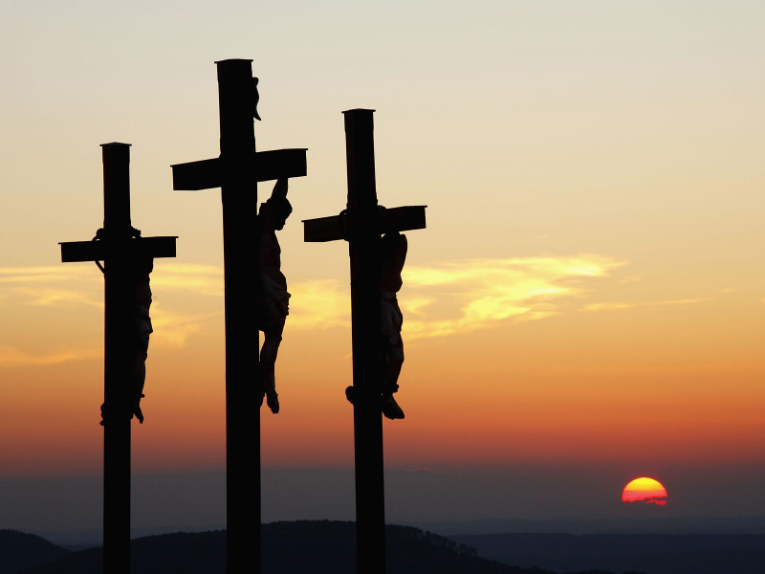
What About the Thief?
Luke 23:32-43
Notes:
The thief acknowledged Jesus as Lord (remember the inscription above His head, vs. 38)
The thief indicated an penitent spirit, as he acknowledged his guilt, (vs. 40-41)
Jesus promised him salvation, “Assuredly, I say unto you, today you will be with me in Paradise” (vs. 43)
Many attempt to use this thief to justify salvation by faith only, apart from Baptism, for us today.

Slide 3
What about the Thief?
Fulfillment of prophecy - Isaiah 53:12
Notes:
(Isaiah 53:12), “Therefore I will divide Him a portion with the great, And He shall divide the spoil with the strong, Because He poured out His soul unto death, And He was numbered with the transgressors, And He bore the sin of many, And made intercession for the transgressors.”
The two thieves were transgressors, guilty of sin.
Jesus died for their sins, as well as our own!

Slide 4
What about the Thief?
Fulfillment of prophecy - Isaiah 53:12
Was the thief baptized? - Matthew 3:5-6
Notes:
Those who claim that the thief on the cross was not baptized are arguing from silence.
Actually, there is no way of knowing whether that is the case
Many were baptized during the ministry of John (cf. Matthew 3:5-6)
”Then Jerusalem, all Judea, and all the region around the Jordan went out to him ⁶ and were baptized by him in the Jordan, confessing their sins.”
Until the death of Jesus, John’s baptism was the only one authorized by God!

Slide 5
What about the Thief?
Fulfillment of prophecy - Isaiah 53:12
Was the thief baptized? - Matthew 3:5-6
An attempt to deny plain teaching in scripture!
Mark 16:16; Acts 2:38; 22:16; Galatians 3:27; 1 Peter 3:21
Notes:
Regardless, God has clearly required us today to be baptized for salvation
(Mark 16:16), “He that believes and is baptized shall be saved.”
(Acts 2:38), “Repent, and let everyone of you be baptized, for the remission of sins”
(Acts 22:15), “Arise, and be baptized, and wash away your sins.”
(Galatians 3:27), “For as many of you as were baptized into Christ have put on Christ.”
(1 Peter 3:21), “There is an antitype which now saves us, namely baptism.”

Slide 6
What about the Thief?
Fulfillment of prophecy - Isaiah 53:12
Was the thief baptized? - Matthew 3:5-6
An attempt to deny plain teaching in scripture!
Mark 16:16; Acts 2:38; 22:16; Galatians 3:27; 1 Peter 3:21
He lived and died under the Old Law
Hebrews 7:11-13; Colossians 2:13-14
Notes:
What about the thief? What is required of us is not the same as that required of Him!
The Old Covenant did not command the obedience to the Plan of Salvation that is part of the New Covenant!

Slide 7
Hebrews 7:11-13
Therefore, if perfection were through the Levitical priesthood (for under it the people received the law), what further need was there that another priest should rise according to the order of Melchizedek, and not be called according to the order of Aaron? ¹² For the priesthood being changed, of necessity there is also a change of the law. ¹³ For He of whom these things are spoken belongs to another tribe, from which no man has officiated at the altar.
Notes:
There has been a change of law, and it did not happen until after His death! The New Covenant was ratified by the blood of Christ.

Slide 8
Colossians 2:13-14
And you, being dead in your trespasses and the uncircumcision of your flesh, He has made alive together with Him, having forgiven you all trespasses, ¹⁴ having wiped out the handwriting of requirements that was against us, which was contrary to us. And He has taken it out of the way, having nailed it to the cross.
Notes:
The thief lived under a different law. One we cannot appeal to for our salvation. Nor should we want to!

Slide 9
What about the Thief?
Fulfillment of prophecy - Isaiah 53:12
Was the thief baptized? - Matthew 3:5-6
An attempt to deny plain teaching in scripture!
Mark 16:16; Acts 2:38; 22:16; Galatians 3:27; 1 Peter 3:21
He lived and died under the Old Law
Hebrews 7:11-13; Colossians 2:13-14
Christ had the authority to forgive him while alive on the earth
Matthew 9:1-8
Notes:
Read Matthew 9:1-8
But, Today there is the same requirements for all men!
(cf. Acts 10:34-35) NEXT SLIDE

Slide 10
Acts 10:34-35
Then Peter opened his mouth and said: “In truth I perceive that God shows no partiality. ³⁵ But in every nation whoever fears Him and works righteousness is accepted by Him.
Notes:
Under the New Covenant:
No partiality with God
Same standard for the Jew and the Greek!
It is presumptuous to appeal to the thief, and ignore what God calls ALL MEN to do!

Slide 11
The thief was promised… Paradise! Luke 16:22-25
We should be willing to do whatever Jesus requires of us to obtain that same promise!
Notes:
So it was that the beggar died, and was carried by the angels to Abraham’s bosom. The rich man also died and was buried. ²³ And being in torments in Hades, he lifted up his eyes and saw Abraham afar off, and Lazarus in his bosom. ²⁴ “Then he cried and said, ‘Father Abraham, have mercy on me, and send Lazarus that he may dip the tip of his finger in water and cool my tongue; for I am tormented in this flame.’ ²⁵ But Abraham said, ‘Son, remember that in your lifetime you received your good things, and likewise Lazarus evil things; but now he is comforted and you are tormented. (Luke 16:22-25)

