Slide 1

Notes:
WHEN ADVERSITY HITS
Lamentations 3:19-33
INTRODUCTION:
The book of Lamentations (no attribution in the book, but traditionally though to be written by Jeremiah) is a series of laments regarding the destruction of the city of Jerusalem at the hands of the Babylonians
It was a time of despair that the author felt deeply
Lamentations 1:12 "Is it nothing to you, all you who pass by? Behold and see If there is any sorrow like my sorrow, which has been brought on me, which the LORD has inflicted In the day of His fierce anger.
Yet, despite the despair there was an air of hope in the author
Lamentations 3:25-29 The LORD is good to those who wait for Him, To the soul who seeks Him. (26) It is good that one should hope and wait quietly For the salvation of the LORD. (27) It is good for a man to bear The yoke in his youth. (28) Let him sit alone and keep silent, Because God has laid it on him; (29) Let him put his mouth in the dust—There may yet be hope.
The book concerns a people being severely punished for their unfaithfulness
But, it provides for us a standard of facing adversity and turmoil with confidence in the mercy, compassion and faithfulness of God
There are things to remember whenever adversity hits us during our lives.
Whether it is the consequence of sin, or the frailty of life lived under the sun.
Consider the five following points, taken from Lamentations 3

Slide 2
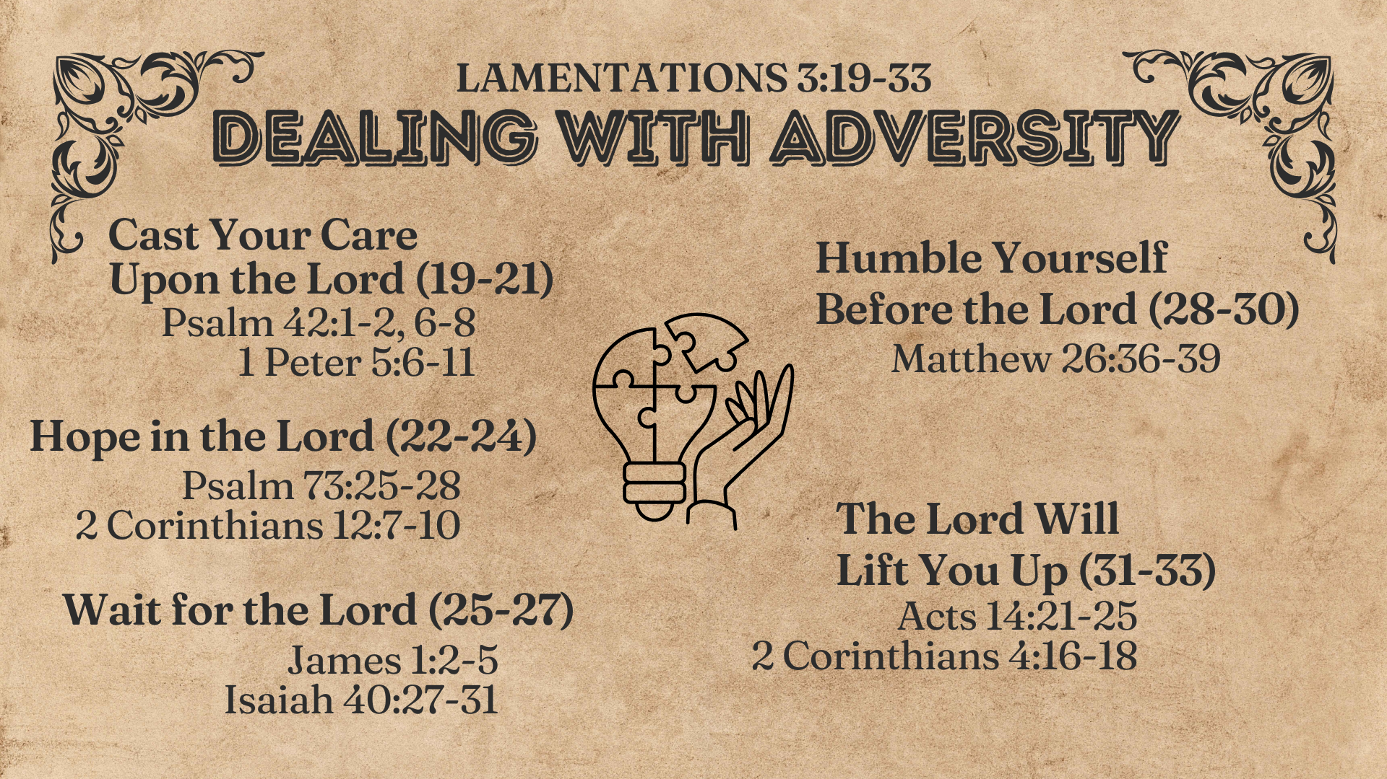

Notes:
DISCUSSION:
Cast your care upon the Lord
Lamentations 3:19-21 Remember my affliction and roaming, The wormwood and the gall. (20) My soul still remembers And sinks within me. (21) This I recall to my mind, Therefore I have hope.
The text of lamentation consists of the reflections of the author (first person) upon adversity.
Here he reaches out with a positive request. For God to do something to help him.
wormwood (bitterness). Gall (poison).
Thinking about adversity can cause us to become despondent
But, honestly admitting your need for God to help leads to hope!
If we are close to God, the turn to God is natural!
Psalms 42:1-2 As the deer pants for the water brooks, So pants my soul for You, O God. (2) My soul thirsts for God, for the living God. When shall I come and appear before God?
Even when God seems so far away, the devout man of God turns to Him!
Psalms 42:6-8 O my God, my soul is cast down within me; Therefore I will remember You from the land of the Jordan, And from the heights of Hermon, From the Hill Mizar. (7) Deep calls unto deep at the noise of Your waterfalls; All Your waves and billows have gone over me. (8) The LORD will command His lovingkindness in the daytime, And in the night His song shall be with me—A prayer to the God of my life.
Peter states it clearly and well
1 Peter 5:6-11 Therefore humble yourselves under the mighty hand of God, that He may exalt you in due time, (7) casting all your care upon Him, for He cares for you. (8) Be sober, be vigilant; because your adversary the devil walks about like a roaring lion, seeking whom he may devour. (9) Resist him, steadfast in the faith, knowing that the same sufferings are experienced by your brotherhood in the world. (10) But may the God of all grace, who called us to His eternal glory by Christ Jesus, after you have suffered a while, perfect, establish, strengthen, and settle you. (11) To Him be the glory and the dominion forever and ever. Amen.
[CLICK HERE FOR NEXT POINT]
Hope in the Lord
Lamentations 3:22-24 Through the LORD's mercies we are not consumed, Because His compassions fail not. (23) They are new every morning; Great is Your faithfulness. (24) "The LORD is my portion," says my soul, "Therefore I hope in Him!"
An extension of the preceding verse, showing the reason for our hope
Casting our cares upon Him brings hope because of who He is!
God's compassion (22). The word is one indicating how a mother cherishes her unborn child. Such a wonderful picture!
While we have one eye on our own miseries, the faithful child of God keeps the other eye on God's mercy!
The Psalmist came to this understanding
Psalms 73:25-28 Whom have I in heaven but You? And there is none upon earth that I desire besides You. (26) My flesh and my heart fail; But God is the strength of my heart and my portion forever. (27) For indeed, those who are far from You shall perish; You have destroyed all those who desert You for harlotry. (28) But it is good for me to draw near to God; I have put my trust in the Lord GOD, That I may declare all Your works.
We come to know God more intimately because of our suffering and despair!
2 Corinthians 12:7-10 [Paul as an example] And lest I should be exalted above measure by the abundance of the revelations, a thorn in the flesh was given to me, a messenger of Satan to buffet me, lest I be exalted above measure. (8) Concerning this thing I pleaded with the Lord three times that it might depart from me. (9) And He said to me, "My grace is sufficient for you, for My strength is made perfect in weakness." Therefore most gladly I will rather boast in my infirmities, that the power of Christ may rest upon me. (10) Therefore I take pleasure in infirmities, in reproaches, in needs, in persecutions, in distresses, for Christ's sake. For when I am weak, then I am strong.
Understand that the man who has everything has nothing more than the man who only has God!
[CLICK HERE FOR NEXT POINT]
Wait for the Lord
Lamentations 3:25-27 The LORD is good to those who wait for Him, To the soul who seeks Him. (26) It is good that one should hope and wait quietly For the salvation of the LORD. (27) It is good for a man to bear The yoke in his youth.
These three verses each start with the word "good." Understand, these are the things that are good to do while in pain or suffering
It is good to wait on the Lord and seek Him (The two are intertwined).
Not talking about moping or doubting. Active faith in Him in His time.
It is good to hope and wait quietly for the salvation of God
This salvation is His desired outcome for us. Ultimately, our spiritual salvation.
Quietness (not loud, grumbling, reluctant waiting.)
It is good to bear the yoke of adversity!
Believe it or not, such things strengthen and grow our faith
James 1:2-5 My brethren, count it all joy when you fall into various trials, (3) knowing that the testing of your faith produces patience. (4) But let patience have its perfect work, that you may be perfect and complete, lacking nothing. (5) If any of you lacks wisdom, let him ask of God, who gives to all liberally and without reproach, and it will be given to him.
The result is well described by Isaiah
Isaiah 40:27-31 Why do you say, O Jacob, And speak, O Israel: "My way is hidden from the LORD, And my just claim is passed over by my God"? (28) Have you not known? Have you not heard? The everlasting God, the LORD, The Creator of the ends of the earth, Neither faints nor is weary. His understanding is unsearchable. (29) He gives power to the weak, And to those who have no might He increases strength. (30) Even the youths shall faint and be weary, And the young men shall utterly fall, (31) But those who wait on the LORD Shall renew their strength; They shall mount up with wings like eagles, They shall run and not be weary, They shall walk and not faint.
[CLICK HERE FOR NEXT POINT]
Humble yourself before the Lord
Lamentations 3:28-30 Let him sit alone and keep silent, Because God has laid it on him; (29) Let him put his mouth in the dust—There may yet be hope. (30) Let him give his cheek to the one who strikes him, And be full of reproach.
This portion immediately references the rebellion of Judah, but is applicable to us as well, when our adversity is caused by our own sin.
God does not want you to fight against what He has brought forth
Whether it is His direct agency, or what he allows from Satan
God allowed Satan to test Job.
God allowed a Messenger of Satan to buffet Paul.
These things brough growth to men because of their character and acceptance of such pain.
We are to lower ourselves to the dust in reverence and humility.
Our hope is not despite Him, it is because of Him.
We don't fight against such adversity, we yield to it.
This humility is what brings forth needed response to God!
Consider, it is not by resisting trials that we find victory in Jesus, but in the quiet and confident endurance of it. (Remember the example of Jesus Himself, who learned obedience even to the death of the cross).
Matthew 26:36-39 Then Jesus came with them to a place called Gethsemane, and said to the disciples, "Sit here while I go and pray over there." (37) And He took with Him Peter and the two sons of Zebedee, and He began to be sorrowful and deeply distressed. (38) Then He said to them, "My soul is exceedingly sorrowful, even to death. Stay here and watch with Me." (39) He went a little farther and fell on His face, and prayed, saying, "O My Father, if it is possible, let this cup pass from Me; nevertheless, not as I will, but as You will."
[CLICK HERE FOR FINAL POINT]
The Lord will lift you up
Lamentations 3:31-33 For the Lord will not cast off forever. (32) Though He causes grief, Yet He will show compassion According to the multitude of His mercies. (33) For He does not afflict willingly, Nor grieve the children of men.
Though you can't always see it, the adversity has an end!
You can imagine the difficulties of Judah knowing this while in captivity.
God's compassion always outways any temporary chastisement or other adversity!
Job had his life and possession restored to him.
Paul understood that death in prison was "gain" to him (Philippians 1:21).
God is not capricious. Our adversity brings growth and maturity. God doesn't rejoice in our suffering. Just like a parent gets no joy out of disciplining a child, only joy from the fruit in brings.
God wants us in heaven. Suffering helps bring that reality to bear!
Acts 14:21-22 [Paul and Barnabas word's after Paul was stoned] And when they had preached the gospel to that city and made many disciples, they returned to Lystra, Iconium, and Antioch, (22) strengthening the souls of the disciples, exhorting them to continue in the faith, and saying, "We must through many tribulations enter the kingdom of God."
While suffering here, our view must be on heaven!
2 Corinthians 4:16-18 Therefore we do not lose heart. Even though our outward man is perishing, yet the inward man is being renewed day by day. (17) For our light affliction, which is but for a moment, is working for us a far more exceeding and eternal weight of glory, (18) while we do not look at the things which are seen, but at the things which are not seen. For the things which are seen are temporary, but the things which are not seen are eternal.

Slide 3
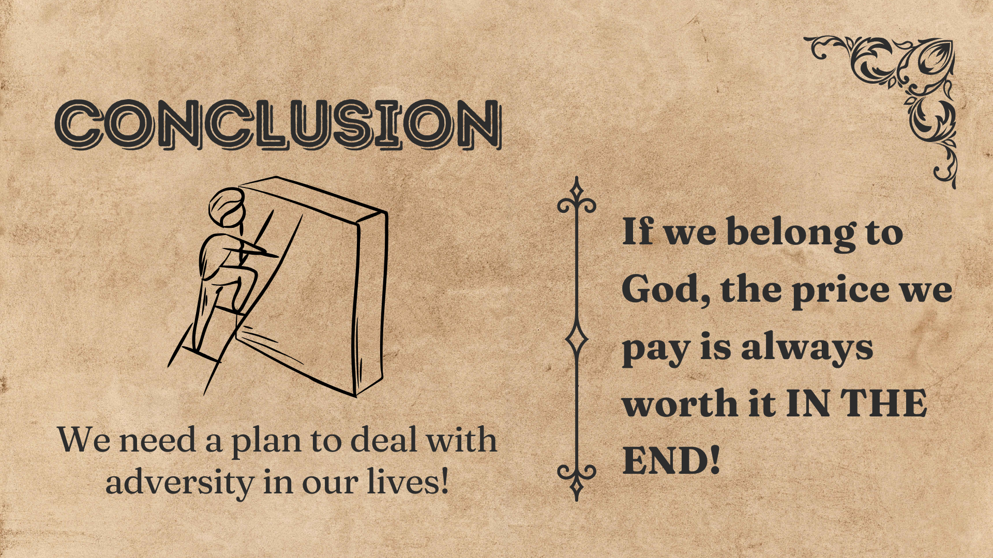
Notes:
CONCLUSION:
We need a plan to deal with adversity here in life
As He does in our text, God gives us many examples of how we ought to respond!
Remember, a relationship with God is always worth it in the end!

