Slide 1
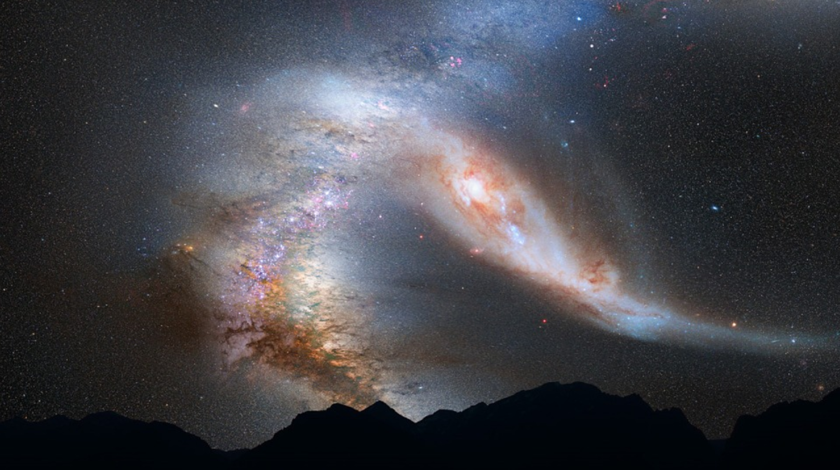
“ When I consider Your heavens”
Psalm 8
Notes:
Psalm 8
“O Lord, our Lord, How excellent is Your name in all the earth, Who have set Your glory above the heavens! ² Out of the mouth of babes and nursing infants you have ordained strength, because of Your enemies, that You may silence the enemy and the avenger. ³ When I consider Your heavens, the work of Your fingers, the moon and the stars, which You have ordained, ⁴ what is man that You are mindful of him, and the son of man that You visit him? ⁵ For You have made him a little lower than the angels, and You have crowned him with glory and honor. ⁶ You have made him to have dominion over the works of Your hands; You have put all things under his feet, ⁷ all sheep and oxen—even the beasts of the field, ⁸ the birds of the air, and the fish of the sea that pass through the paths of the seas. ⁹ O Lord, our Lord, how excellent is Your name in all the earth!”
There is no mention of the sun in this text. It seems probable that its inspiration was the night sky, as David looked up, and gloried in God’s creative work.
This Psalm of David is a wonderful example of the idea that God is worthy of Praise because of the evident works that manifest His glory!
(Romans 1:20), [With this sentiment, the apostle Paul is in agreement], “For since the creation of the world His invisible attributes are clearly seen, being understood by the things that are made, even His eternal power and Godhead, so that they are without excuse.”
We might note that there are several references to the Psalm in the New Testament, several of which indicate a Messianic message in the Psalm. We will address this in our study.
The theme of God as Creator, tied in with His redemptive work is a natural one. Both show His excellence and power.
Slide background from maxpixel.net
https://www.maxpixel.net/Stars-Space-Collision-Andromeda-Galaxy-Milky-Way-755442

Slide 2
Praise to God
“O Lord, our Lord, How excellent is Your name in all the earth, Who have set Your glory above the heavens!” (1)
Psalm 139:14 - Nehemiah 9:5-6
Notes:
(Psalm 8:1), “O Lord, our Lord, How excellent is Your name in all the earth, Who have set Your glory above the heavens!
The first phrase is interesting “O Lord” (Yahweh – The name (sometimes translated Jehovah, that is most often used for God in the Old Testament). “our Lord” (adonay – means properly master, lord, ruler, owner) It indicates God’s authority, in this case over all creation!
God’s name is known in all the earth. As we contemplate the creation, we acknowledge the excellence of our creator!
(Psalm 139:14), “I will praise You, for I am fearfully and wonderfully made; marvelous are Your works, and that my soul knows very well.”
Contemplate the nature of the created universe
This is what David was doing. He was enthralled by the starry sky.
A new dwarf planet has been discovered, named Goblin. It is 84 times farther way from the sun than the earth. At its farthest point in orbit around the sun, it is an astounding 2,300 times farther away than the earth. (In contrast, Pluto, is only 34 times farther away from the sun than the earth.
Because of how large the orbit of Goblin is, it will take 44,000 years to make a single orbit (if the universe remains for that long). And, that is only in our own solar system.
Our solar system is one small part of the Milky Way galaxy. The Hubble telescope has made visible an estimated 100 billion galaxies, but scientists believe there are twice as many or more.
The glory of the Creator of these things is greater than the creation itself!
(Nehemiah 9:5-6) [In the time of Nehemiah, the people were instructed to Praise God in this way], “Blessed be Your glorious name, which is exalted above all blessing and praise! ⁶ You alone are the Lord; You have made heaven, the heaven of heavens, with all their host, the earth and everything on it, the seas and all that is in them, and You preserve them all. The host of heaven worships You.”

Slide 3
The Sovereignty of God
“Out of the mouth of babes and nursing infants you have ordained strength, because of Your enemies, that You may silence the enemy and the avenger.” (2)
Matthew 21:15-16; 11:25-26
Matthew 5:3-5
Notes:
(Psalm 8:2), “Out of the mouth of babes and nursing infants you have ordained strength, because of Your enemies, that You may silence the enemy and the avenger.”
God exhibits His power through the vulnerable and weak, thus showing His sovereignty
Jesus, illustrates this in Matthew 21
He drove out the moneychangers, and when he did, the children rejoiced. Notice the entire context, and the objections of those in power (chief priests and scribes)…
(Matthew 21:15-16), “But when the chief priests and scribes saw the wonderful things that He did, and the children crying out in the temple and saying, “Hosanna to the Son of David!” they were indignant ¹⁶ and said to Him, “Do You hear what these are saying?” And Jesus said to them, “Yes. Have you never read,
‘Out of the mouth of babes and nursing infants you have perfected praise’?”
On another occasion, Jesus condemned the unbelief of the cities of Chorazin, Bethsaida and Capernaum. These cities had exalted themselves against God. Jesus then prayed to His Father…
(Matthew 11:25-26), “At that time Jesus answered and said, “I thank You, Father, Lord of heaven and earth, that You have hidden these things from the wise and prudent and have revealed them to babes. ²⁶ Even so, Father, for so it seemed good in Your sight.”
It is God’s way to exalt the weak, and to defeat the proud and mighty
(Matthew 5:3-5) [First 3 beatitudes], “Blessed are the poor in spirit, for theirs is the kingdom of heaven. ⁴ Blessed are those who mourn, for they shall be comforted. ⁵ Blessed are the meek, for they shall inherit the earth.”

Slide 4
God’s Patronage of Man
“When I consider Your heavens, the work of Your fingers, the moon and the stars, which You have ordained, ⁴ what is man that You are mindful of him, and the son of man that You visit him?” (3-4)
Psalm 84:10-12
Notes:
(Psalm 8:3-4), “When I consider Your heavens, the work of Your fingers, the moon and the stars, which You have ordained, ⁴ what is man that You are mindful of him, and the son of man that You visit him?”
The creation of the universe is set in relief against His obvious concern and patronage of man
Seen in the position he has placed man in (crowned him with glory and honor, vs. 5)
Put simply, God has condescended to show His interest in, and favor upon mankind.
Word “condescension” is typically viewed in a negative fashion.
Definition – “an attitude of patronizing superiority”
We object when men do this. How dare you think you are better than me! How dare you patronize (treat with kindness, as if you are superior) me?
But, God IS superior. And when a truly superior being deigns to recognize, and care for an inferior creature, it is kindness and a wonderful blessing. (That’s what humans do to dogs and cats).
(Psalm 84:10-12), “For a day in Your courts is better than a thousand. I would rather be a doorkeeper in the house of my God than dwell in the tents of wickedness. ¹¹ For the Lord God is a sun and shield; the Lord will give grace and glory; no good thing will He withhold from those who walk uprightly. ¹² O Lord of hosts, blessed is the man who trusts in You!”

Slide 5
God’s Elevation of Man
“For You have made him a little lower than the angels, and You have crowned him with glory and honor” (5)
Hebrews 2:5-9
Philippians 2:6-8; 9-11
Notes:
(Psalm 8:5), “For You have made him a little lower than the angels, and You have crowned him with glory and honor.”
When we consider the worth and position of man, he is second in God’s creation only to the angels themselves
(Hebrews 2:5-9), [This is seen in Jesus’ incarnation as a man], “For He has not put the world to come, of which we speak, in subjection to angels. ⁶ But one testified in a certain place, saying: “What is man that You are mindful of him, or the son of man that You take care of him? ⁷ You have made him a little lower than the angels; You have crowned him with glory and honor, and set him over the works of Your hands. ⁸ You have put all things in subjection under his feet.” For in that He put all in subjection under him, He left nothing that is not put under him. But now we do not yet see all things put under him. ⁹ But we see Jesus, who was made a little lower than the angels, for the suffering of death crowned with glory and honor, that He, by the grace of God, might taste death for everyone.”
Jesus, came to earth, and humbled Himself
(Philippians 2:6-8), “who, being in the form of God, did not consider it robbery to be equal with God, ⁷ but made Himself of no reputation, taking the form of a bondservant, and coming in the likeness of men. ⁸ And being found in appearance as a man, He humbled Himself and became obedient to the point of death, even the death of the cross.”
When He left the earth, He was exalted by the Father
(Philippians 2:9-11), “Therefore God also has highly exalted Him and given Him the name which is above every name, ¹⁰ that at the name of Jesus every knee should bow, of those in heaven, and of those on earth, and of those under the earth, ¹¹ and that every tongue should confess that Jesus Christ is Lord, to the glory of God the Father.”

Slide 6
God’s Granting of Dominion
“You have made him to have dominion over the works of Your hands; You have put all things under his feet, ⁷ all sheep and oxen—even the beasts of the field, ⁸ the birds of the air, and the fish of the sea that pass through the paths of the seas.” (6-8)
Genesis 1:26-28 – 1 Cor. 15:25-28
Notes:
(Psalm 8:6-8), “You have made him to have dominion over the works of Your hands; You have put all things under his feet, ⁷ all sheep and oxen—even the beasts of the field, ⁸ the birds of the air, and the fish of the sea that pass through the paths of the seas.”
This dominion was evident from the very beginning
(Genesis 1:26-28), “Then God said, “Let Us make man in Our image, according to Our likeness; let them have dominion over the fish of the sea, over the birds of the air, and over the cattle, over all the earth and over every creeping thing that creeps on the earth.” ²⁷ So God created man in His own image; in the image of God He created him; male and female He created them. ²⁸ Then God blessed them, and God said to them, “Be fruitful and multiply; fill the earth and subdue it; have dominion over the fish of the sea, over the birds of the air, and over every living thing that moves on the earth.”
What is also evident is the dominion of Jesus Christ (notice the same language)
(1 Corinthians 15:25-28), “For He must reign till He has put all enemies under His feet. ²⁶ The last enemy that will be destroyed is death. ²⁷ For “He has put all things under His feet.” But when He says “all things are put under Him,” it is evident that He who put all things under Him is excepted. ²⁸ Now when all things are made subject to Him, then the Son Himself will also be subject to Him who put all things under Him, that God may be all in all.”

Slide 7
Conclusion
“O Lord, our Lord, how excellent is Your name in all the earth!” (9)
By studying this passage, we have a better understanding of why the name of God is excellent “in all the earth”!
Notes:
(Psalm 8:9), “O Lord, our Lord, how excellent is Your name in all the earth!”
By studying this passage, I trust we have come to a better understanding of why the name of God is excellent “in all the earth”!
His sovereignty and power over all of creation
His patronage and favor of mankind
His gift of His Son!
(John 3:16-17), “For God so loved the world that He gave His only begotten Son, that whoever believes in Him should not perish but have everlasting life. ¹⁷ For God did not send His Son into the world to condemn the world, but that the world through Him might be saved.”
Therefore, we are right to praise His name. And, we are compelled to come before Him, seeking Him for the redemption of our souls!

