Slide 1
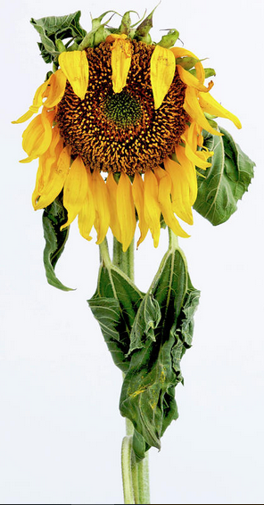
Why Don’t Some Christians Grow?
Hebrews
5:11 – 6:3
Notes:
Read text, note first phrase, dull of hearing…
Some Christian’s remain babes
Some need to reestablish the foundation of faith
Why is that?

Slide 2
Why a lack of Spiritual Growth?
They have become dull of hearing (11)
Notes:
(5:11), “of whom we have much to say, and hard to explain, since you have become dull of hearing.”
Israel as an example (cf. Amos 7:12-13) [Amaziah – priest at Bethel during Jereboam’s reign in Israel]
(Amos 7:12-13), “Then Amaziah said to Amos: ‘Go, you seer! Flee to the land of Judah. There eat bread, and there prophesy. 13 But never again prophesy at Bethel, for it is the king's sanctuary, and it is the royal residence.’"

Slide 3
Why a lack of Spiritual Growth?
They have become dull of hearing (11)
They think they have grown enough (12)
Notes:
(5:12), “For though by this time you ought to be teachers, you need someone to teach you again the first principles of the oracles of God; and you have come to need milk and not solid food.”
Indicates a lack of awareness of their immature state. They thought that where they were was enough.
INSTEAD, ALWAYS PRESS TO PERFECTION!
(Philippians 3:12-14), “Not that I have already attained, or am already perfected; but I press on, that I may lay hold of that for which Christ Jesus has also laid hold of me. 13 Brethren, I do not count myself to have apprehended; but one thing I do, forgetting those things which are behind and reaching forward to those things which are ahead, 14 I press toward the goal for the prize of the upward call of God in Christ Jesus.”

Slide 4
Why a lack of Spiritual Growth?
They have become dull of hearing (11)
They think they have grown enough (12)
They will not allow the word to change them (13-14)
Notes:
(5:13-14), “For everyone who partakes only of milk is unskilled in the word of righteousness, for he is a babe. 14 But solid food belongs to those who are of full age, that is, those who by reason of use have their senses exercised to discern both good and evil.”
Those who diligently use the word (apply it) will grow as a result!
Growth in Knowledge will bring spiritual growth
(Philippians 1:9-11), “And this I pray, that your love may abound still more and more in knowledge and all discernment, 10 that you may approve the things that are excellent, that you may be sincere and without offense till the day of Christ, 11 being filled with the fruits of righteousness which are by Jesus Christ, to the glory and praise of God.”

Slide 5
Why a lack of Spiritual Growth?
They have become dull of hearing (11)
They think they have grown enough (12)
They will not allow the word to change them (13-14)
They are accustomed only to “milk” (12; 6:1-3)
Notes:
(5:12), “and you have come to need milk and not solid food.”
Paul’s Admonition
(6:1-3), “Therefore, leaving the discussion of the elementary principles of Christ, let us go on to perfection, not laying again the foundation of repentance from dead works and of faith toward God, 2 of the doctrine of baptisms, of laying on of hands, of resurrection of the dead, and of eternal judgment. 3 And this we will do if God permits.

Slide 6
Why a lack of Spiritual Growth?
They have become dull of hearing (11)
They think they have grown enough (12)
They will not allow the word to change them (13-14)
They are accustomed only to “milk” (12; 6:1-3)
They fail to “press on” to maturity (6:1)
Notes:
(6:1), “Therefore, leaving the discussion of the elementary principles of Christ, let us go on to perfection.”
(Hebrews 3:14), “For we have become partakers of Christ if we hold the beginning of our confidence steadfast to the end.”
(Hebrews 4:14), “Seeing then that we have a great High Priest who has passed through the heavens, Jesus the Son of God, let us hold fast our confession.”

Slide 7
Why a lack of Spiritual Growth?
They have become dull of hearing (11)
They think they have grown enough (12)
They will not allow the word to change them (13-14)
They are accustomed only to “milk” (12; 6:1-3)
They fail to “press on” to maturity (6:1)
They have already fallen away (6:4-8)
Notes:
The eventual outcome of not growing is apostasy. They don’t grow because they are already DEAD!
(Hebrews 6:4-8), “For it is impossible for those who were once enlightened, and have tasted the heavenly gift, and have become partakers of the Holy Spirit, 5 and have tasted the good word of God and the powers of the age to come, 6 if they fall away, to renew them again to repentance, since they crucify again for themselves the Son of God, and put Him to an open shame. 7 For the earth which drinks in the rain that often comes upon it, and bears herbs useful for those by whom it is cultivated, receives blessing from God; 8 but if it bears thorns and briers, it is rejected and near to being cursed, whose end is to be burned.”
(Hebrews 3:12-13), “Beware, brethren, lest there be in any of you an evil heart of unbelief in departing from the living God; 13 but exhort one another daily, while it is called "Today," lest any of you be hardened through the deceitfulness of sin.”

Slide 8
Conclusion: God sees our efforts to grow and mature, and He is sure to reward us for our efforts!
Hebrews 6:9-10
Notes:
(Hebrews 6:9-10), “But, beloved, we are confident of better things concerning you, yes, things that accompany salvation, though we speak in this manner. 10 For God is not unjust to forget your work and labor of love which you have shown toward His name, in that you have ministered to the saints, and do minister.”

