Slide 1


Slide 2
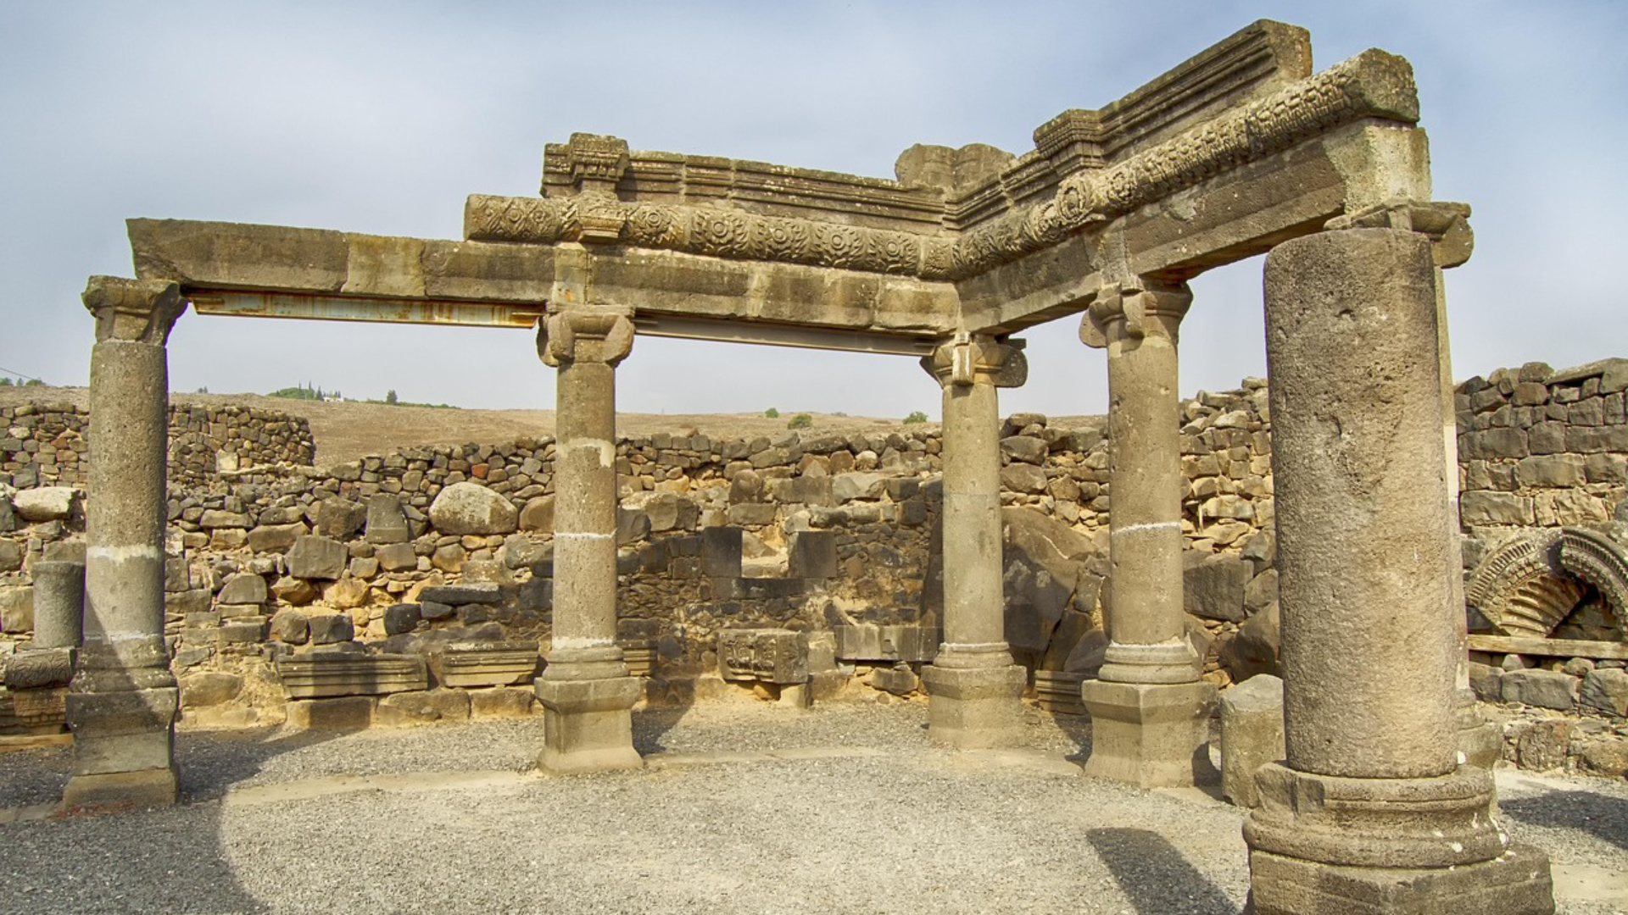
CHORAZIN
It is suggested that in His earthly ministry, Jesus spent approximately 70% of His time in this region.
This is the region where most of the mighty works we read of in scripture were performed
Though we have no specific references, it is evident Jesus performed the same types of healings, exorcisms, and miracles over nature as those indicated in Scripture.
Rear of interior of the Synagogue

Slide 3
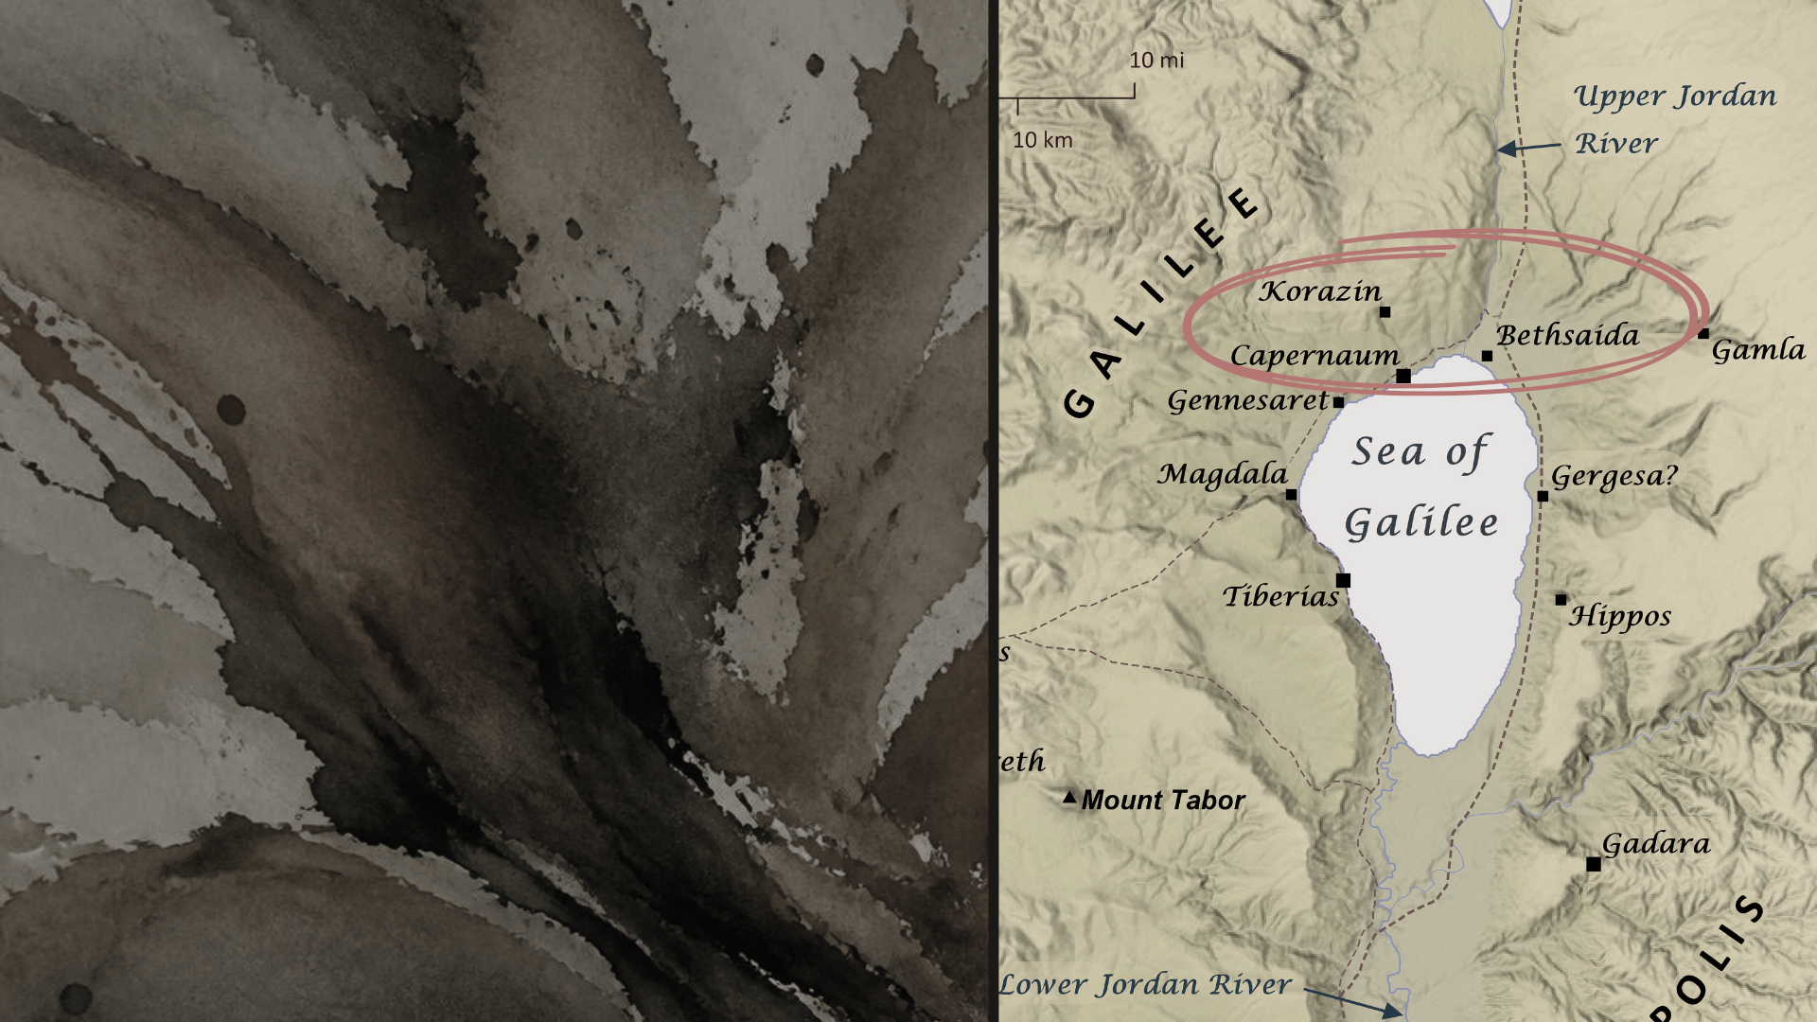
BETHSAIDA
Philip, Peter & Andrew from there (John 1:43-44)
Jesus healed a blind man (Mark 8:22-25)
Feeding of the 5,000 (Luke 9:10-17)
Jesus walked on water
(cf. Mark 6:45-51)

Slide 4
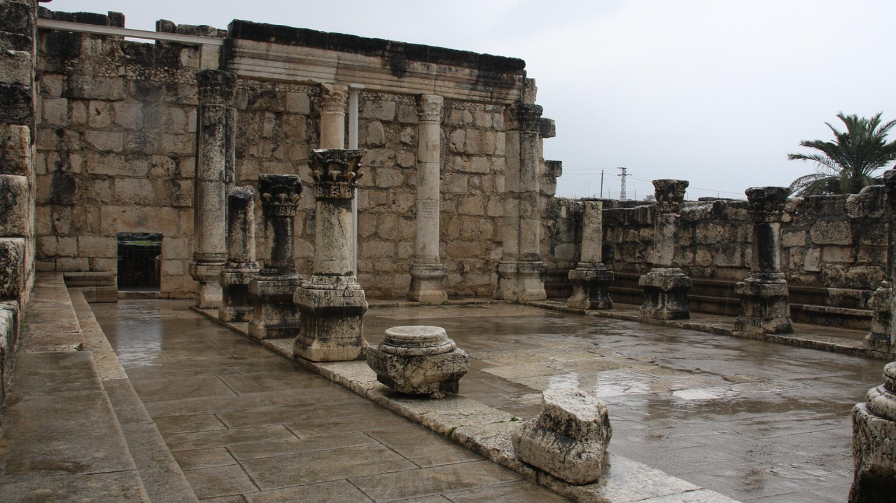
CAPERNAUM
White Synagogue
Jesus healed Peter’s mother & others
(Mark 1:29-34)
Jesus forgave and healed a paralytic (probably at Peter’s house!) (Mark 2:1-5)
Jesus taught His kingdom parables
(Matthew 13:1-3)
Jesus called Matthew (Matthew 9:9)

Slide 5
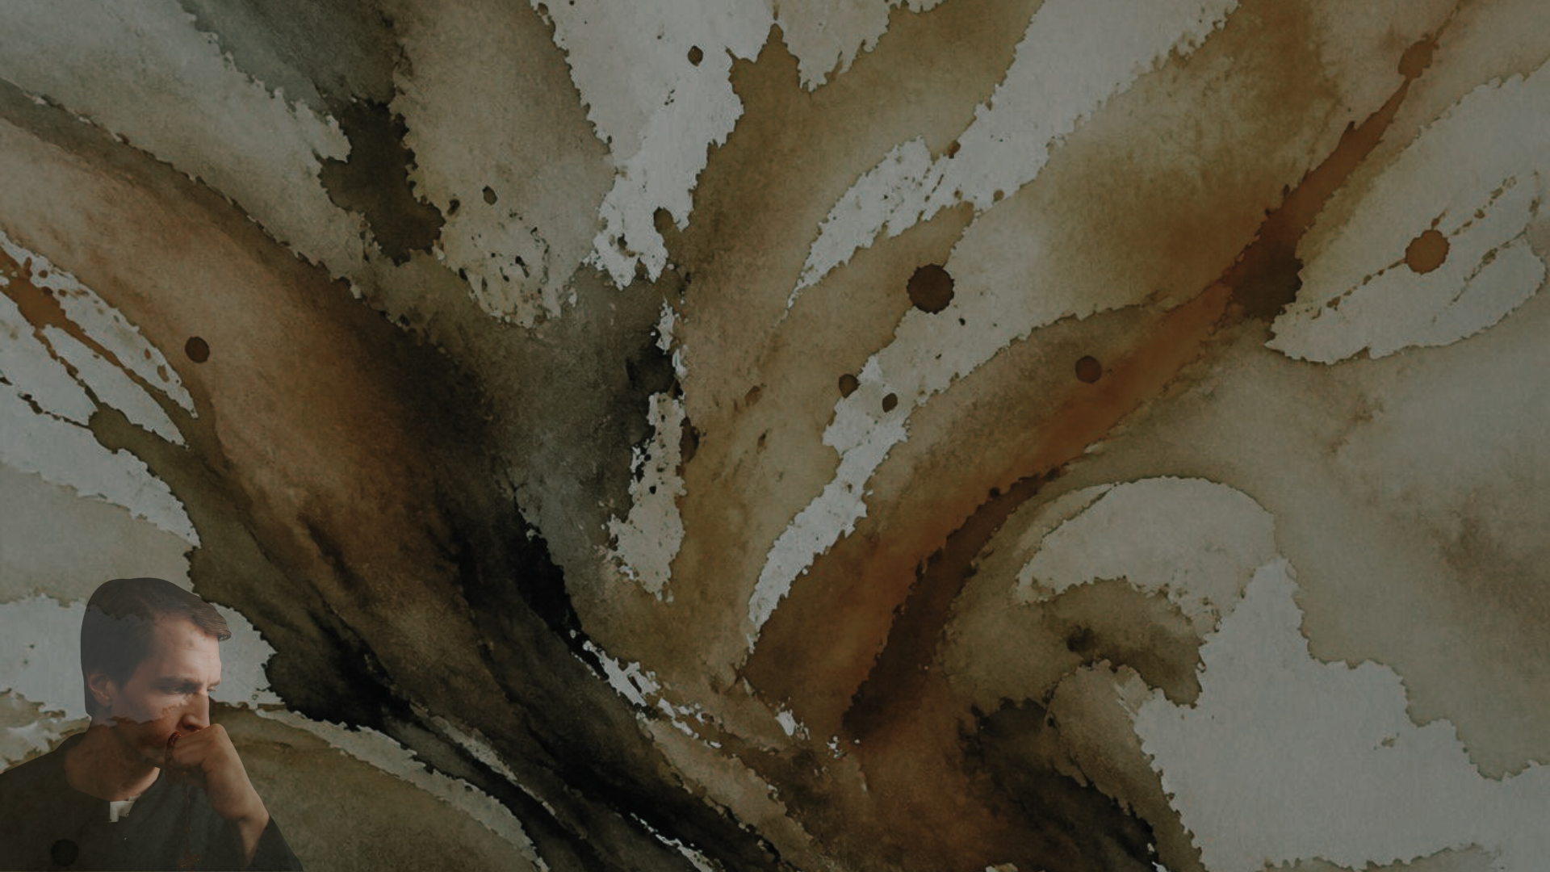
REBUKE: BECAUSE THEY DID NOT REPENT
Miracles proved Jesus was from God and must be heard and obeyed!
John 5:36; Acts 20:21
Everyone Must Repent
Luke 13:1-3
Where much is given, much is required!
Hebrews 2:1-4; Luke 12:47-48

Slide 6

QUESTIONS REGARDING OUR TEXT
What does “more tolerable in the day of judgment” mean?
Matthew 10:15
What about the special case of Capernaum (11:23)
Luke 1:30; Isaiah 14:13-15

Slide 7

CONCLUSION
We have been granted eternal salvation through faith in Jesus Christ
REPENT !
Acts 3:19
Notes:
re

