Slide 1
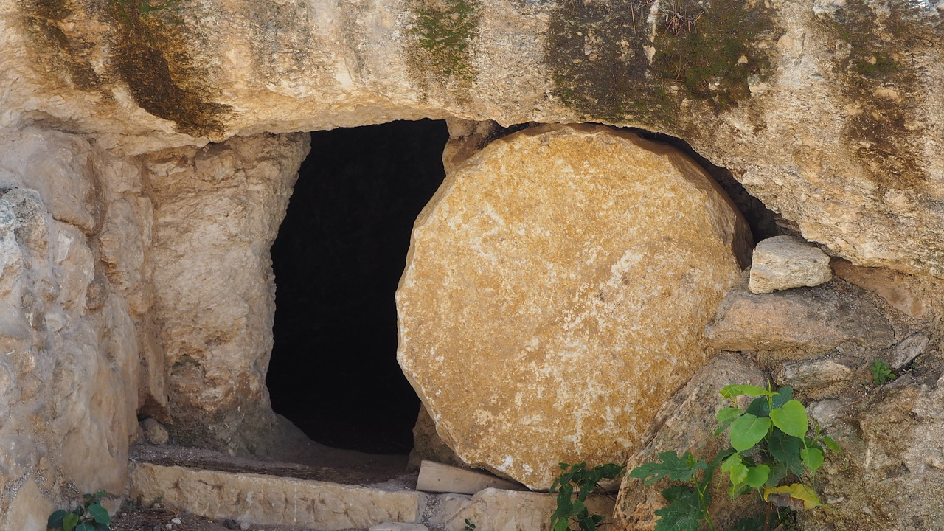
The Empty Tomb
1 Corinthians 15
Notes:
Introduction:
The resurrection of Jesus Christ is a foundational tenet of the Christian faith
(1 Corinthians 15:3-4) [Paul’s testimony], “For I delivered to you first of all that which I also received: that Christ died for our sins according to the Scriptures, ⁴ and that He was buried, and that He rose again the third day according to the Scriptures.”
The resurrection of Jesus is God’s proof that He is the chosen Messiah!
(Acts 2:32,36), (32), “This Jesus God has raised up, of which we are all witnesses” … (36), “Therefore let all the house of Israel know assuredly that God has made this Jesus, whom you crucified, both Lord and Christ.”
Matthew’s Account of the resurrection
(Matthew 28:1-8), “Now after the Sabbath, as the first day of the week began to dawn, Mary Magdalene and the other Mary came to see the tomb. ² And behold, there was a great earthquake; for an angel of the Lord descended from heaven, and came and rolled back the stone from the door, and sat on it. ³ His countenance was like lightning, and his clothing as white as snow. ⁴ And the guards shook for fear of him, and became like dead men. ⁵ But the angel answered and said to the women, “Do not be afraid, for I know that you seek Jesus who was crucified. ⁶ He is not here; for He is risen, as He said. Come, see the place where the Lord lay. ⁷ And go quickly and tell His disciples that He is risen from the dead, and indeed He is going before you into Galilee; there you will see Him. Behold, I have told you.” ⁸ So they went out quickly from the tomb with fear and great joy, and ran to bring His disciples word.”
But, there are many who deny the resurrection of our Lord

Slide 2

The Denials of Men
Disciples came at night and stole His body
Matthew 28:13-15
Jesus was not dead, but in a swoon, later reviving and leaving the tomb
John 19:32-35
Notes:
The Denials of Men
In the narrative of scripture there are a few things that are universally accepted
Jesus lived and was crucified
Note: The dispute regarding the existence of Jesus, and the manner of His death is recent in origin
The lack of physical evidence of the existence of an itinerant preacher from a subjugate people is not hard to explain
The fact is, there is more eyewitness testimony concerning the life of Jesus than any other man who lived in ancient times.
Jesus was buried in a sealed tomb
(Matthew 27:57-60), “Now when evening had come, there came a rich man from Arimathea, named Joseph, who himself had also become a disciple of Jesus. ⁵⁸ This man went to Pilate and asked for the body of Jesus. Then Pilate commanded the body to be given to him. ⁵⁹ When Joseph had taken the body, he wrapped it in a clean linen cloth, ⁶⁰ and laid it in his new tomb which he had hewn out of the rock; and he rolled a large stone against the door of the tomb, and departed.”
(Matthew 27:62-66), “On the next day, which followed the Day of Preparation, the chief priests and Pharisees gathered together to Pilate, ⁶³ saying, “Sir, we remember, while He was still alive, how that deceiver said, ‘After three days I will rise.’ ⁶⁴ Therefore command that the tomb be made secure until the third day, lest His disciples come by night and steal Him away, and say to the people, ‘He has risen from the dead.’ So the last deception will be worse than the first.” ⁶⁵ Pilate said to them, “You have a guard; go your way, make it as secure as you know how.” ⁶⁶ So they went and made the tomb secure, sealing the stone and setting the guard.”
On the third day, the tomb was empty
Of course, the disciples testified of the empty tomb
The enemies of Jesus knew the tomb was empty as well!
(Matthew 28:11-15), “Now while they were going, behold, some of the guard came into the city and reported to the chief priests all the things that had happened. ¹² When they had assembled with the elders and consulted together, they gave a large sum of money to the soldiers, ¹³ saying, “Tell them, ‘His disciples came at night and stole Him away while we slept.’ ¹⁴ And if this comes to the governor's ears, we will appease him and make you secure.” ¹⁵ So they took the money and did as they were instructed; and this saying is commonly reported among the Jews until this day.”
As seen in these verses, the common denial of that day was, “His disciples came at night and stole Him away.”
Not a legitimate possibility
There was only one entrance, which had been sealed and was guarded by soldiers.
The soldiers testifying to facts that they could not have witnessed if asleep shows the silliness of the claim.
The idea that the entire group of trained soldiers slept on duty is ludicrous. (If so, the penalty for sleeping while on guard was steep).
(sciencesource.com), “Official punishment by the infliction of pain or injury was practiced in most civilizations since ancient times. When the Roman soldier enrolled in service to the state, he swore a military oath known as the sacramentum: originally to the Senate and Roman People, later to the general and the emperor. The sacramentum stated that he would fulfill his conditions of service on pain of punishment up to and inclusive of death. Discipline in the army was extremely rigorous by modern standards, and the general had the power to summarily execute any soldier under his command. Beating to death was the punishment for many offenses, such as falling asleep on guard duty, giving false evidence, stealing, homosexual practice, and committing the same fault three times. Leaving your post out of fear and throwing away any of your weapons on the battlefield was also punished with death.”
Matthew’s description of bribery and the appeasement of the governor through intervention is a plausible refutation of the story of that day.
Jesus had merely swooned, and later revived in the tomb and left the scene
This is an absurd “conspiracy theory” that few take seriously. It proponents have motivation to deny the resurrection.
An example of an early hypothesis: “Early proponents of this hypothesis include German Karl Friedrich Bahrdt, who suggested in around 1780 that Jesus deliberately feigned his death, using drugs provided by the physician Luke to appear as a spiritual messiah and get Israel to abandon the idea of a political messiah. In this interpretation of the events described in the Gospels, Jesus was resuscitated by Joseph of Arimathea, with whom he shared a connection through a secret order of the Essenes.” (Wikipedia, Swoon Hypothesis).
The theory denies the credibility of the trained soldiers whose job it was to execute the punishment
(John 19:32-35), “Then the soldiers came and broke the legs of the first and of the other who was crucified with Him. ³³ But when they came to Jesus and saw that He was already dead, they did not break His legs. ³⁴ But one of the soldiers pierced His side with a spear, and immediately blood and water came out. ³⁵ And he who has seen has testified, and his testimony is true; and he knows that he is telling the truth, so that you may believe.”
Jesus was sealed inside the tomb by the soldiers. He could not have left the tomb if He was a in a weakened state that approximated death
Consider these two truths:
It was the intent of the Jews and the guard to make it impossible for the narrative of a resurrected Jesus to be spread (and yet it did)
The disciples were depressed, did not know what happened to Jesus’ body either
(Luke 24:17-24) [Ex: Jesus met up with two disciples on the road to Emmaus]. “And He said to them, “What kind of conversation is this that you have with one another as you walk and are sad?” ¹⁸ Then the one whose name was Cleopas answered and said to Him, “Are You the only stranger in Jerusalem, and have You not known the things which happened there in these days?” ¹⁹ And He said to them, “What things?” So they said to Him, “The things concerning Jesus of Nazareth, who was a Prophet mighty in deed and word before God and all the people, ²⁰ and how the chief priests and our rulers delivered Him to be condemned to death, and crucified Him. ²¹ But we were hoping that it was He who was going to redeem Israel. Indeed, besides all this, today is the third day since these things happened. ²² Yes, and certain women of our company, who arrived at the tomb early, astonished us. ²³ When they did not find His body, they came saying that they had also seen a vision of angels who said He was alive. ²⁴ And certain of those who were with us went to the tomb and found it just as the women had said; but Him they did not see.”
Jesus admonished these men for their lack of faith
(Luke 24:25-27), “Then He said to them, “O foolish ones, and slow of heart to believe in all that the prophets have spoken! ²⁶ Ought not the Christ to have suffered these things and to enter into His glory?” ²⁷ And beginning at Moses and all the Prophets, He expounded to them in all the Scriptures the things concerning Himself.”
The truth is, the tomb was empty because Jesus was resurrected from the dead, as He had predicted
(John 2:19-22), “Jesus answered and said to them, “Destroy this temple, and in three days I will raise it up.” ²⁰ Then the Jews said, “It has taken forty-six years to build this temple, and will You raise it up in three days?” ²¹ But He was speaking of the temple of His body. ²² Therefore, when He had risen from the dead, His disciples remembered that He had said this to them; and they believed the Scripture and the word which Jesus had said.”

Slide 3
The Meaning of the Empty Tomb
Demonstrated in the “what if” of no resurrection (1 Corinthians 15)
Gospel preaching is vain (14)
Our faith is vain (14,17)
The apostles are liars (15)
You are still in your sins (17)
Dead Christians have merely perished (18)
Christians are truly to be pitied (19)
Notes:
What does the empty tomb mean for you and me?
What is the practical value of the resurrection of Jesus?
One way to see this is in the consequence of no resurrection. What if there were no resurrection of the dead? What if Jesus remained in His tomb to this day?
Paul asked that question
(1 Corinthians 15:12-19), “Now if Christ is preached that He has been raised from the dead, how do some among you say that there is no resurrection of the dead? ¹³ But if there is no resurrection of the dead, then Christ is not risen. ¹⁴ And if Christ is not risen, then our preaching is empty and your faith is also empty. ¹⁵ Yes, and we are found false witnesses of God, because we have testified of God that He raised up Christ, whom He did not raise up—if in fact the dead do not rise. ¹⁶ For if the dead do not rise, then Christ is not risen. ¹⁷ And if Christ is not risen, your faith is futile; you are still in your sins! ¹⁸ Then also those who have fallen asleep in Christ have perished. ¹⁹ If in this life only we have hope in Christ, we are of all men the most pitiable.”
If Jesus has not been raised, then He was not who he claimed to be, and all is lost!

Slide 4
The Tomb IS Empty!
Christ Has Been Raised from the Dead!
1 Corinthians 15:20-23
Eyewitness Testimony is Conclusive!
1 Corinthians 15:3-8
(Paul is the unimpeachable witness)
Notes:
The Tomb IS Empty!
Christ has been raised from the dead!
(1 Corinthians 15:20-23 But now Christ is risen from the dead, and has become the firstfruits of those who have fallen asleep. ²¹ For since by man came death, by Man also came the resurrection of the dead. ²² For as in Adam all die, even so in Christ all shall be made alive. ²³ But each one in his own order: Christ the firstfruits, afterward those who are Christ's at His coming.”
The Eyewitness testimony is conclusive!
(1 Corinthians 15:3-8), “For I delivered to you first of all that which I also received: that Christ died for our sins according to the Scriptures, ⁴ and that He was buried, and that He rose again the third day according to the Scriptures, ⁵ and that He was seen by Cephas, then by the twelve. ⁶ After that He was seen by over five hundred brethren at once, of whom the greater part remain to the present, but some have fallen asleep. ⁷ After that He was seen by James, then by all the apostles. ⁸ Then last of all He was seen by me also, as by one born out of due time.”
Paul is the unimpeachable witness of the resurrected Christ (An enemy became a most ardent disciple).
Do you believe in the resurrection of Christ?
Then [like Paul], “arise and be baptized, and wash away your sins, calling on the name of the Lord” (Acts 22:16).

