Slide 1
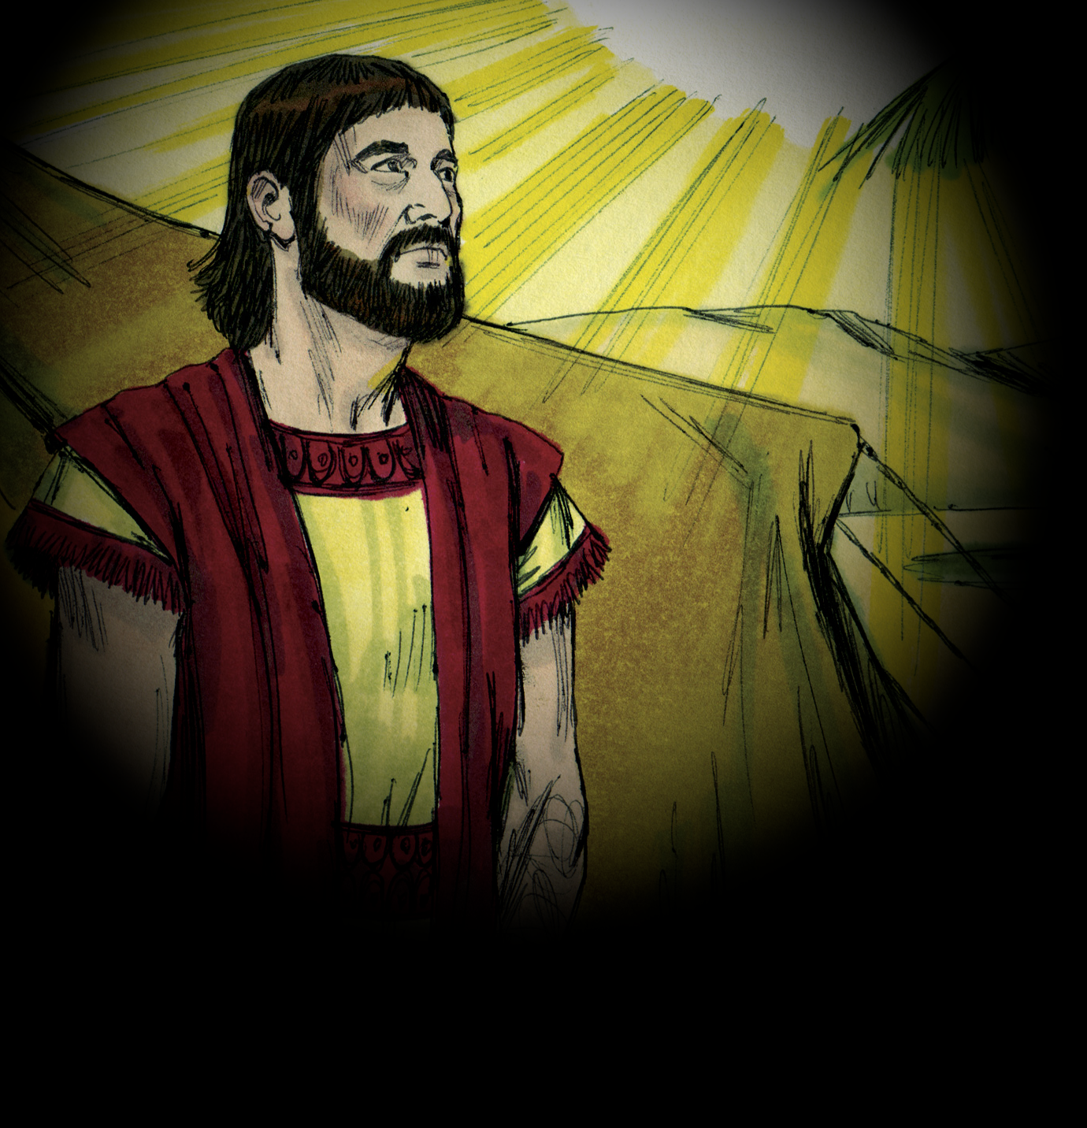
God’s Covenant with Abraham
Principles of Authority
Genesis 12:1-3
Notes:
Lesson 1 in series on Authority
Introduction:
God’s Scheme of Redemption was in His mind before Creation.
(Ephesians 1:3-6), “Blessed be the God and Father of our Lord Jesus Christ, who has blessed us with every spiritual blessing in the heavenly places in Christ, ⁴ just as He chose us in Him before the foundation of the world, that we should be holy and without blame before Him in love, ⁵ having predestined us to adoption as sons by Jesus Christ to Himself, according to the good pleasure of His will, ⁶ to the praise of the glory of His grace, by which He made us accepted in the Beloved.”
It was God’s intent to save man through the sacrifice of His Son on the cross. Salvation comes only by Jesus Christ.
(John 14:6), “Jesus said to [Thomas], “I am the way, the truth, and the life. No one comes to the Father except through Me.”
Ephesians 1 teaches us a few important truths
Every spiritual blessing comes exclusively in Christ Jesus
Before the world began, we were chosen by God (Not individual, but God predetermined who the acceptable ones would be).
It was predestined… our adoption as sons by Jesus Christ.
Note: Richard Dawkins (famous atheist), answering question “What if you are wrong”, ridiculed our concept of one God. We disbelieve the Hindu gods, the Greek gods, etc. They all make the same claim, how do you know you are right?
The proof of course, is the resurrection of the Christ! (Our faith has foundation).
(Acts 2:29-36), “Men and brethren, let me speak freely to you of the patriarch David, that he is both dead and buried, and his tomb is with us to this day. ³⁰ Therefore, being a prophet, and knowing that God had sworn with an oath to him that of the fruit of his body, according to the flesh, He would raise up the Christ to sit on his throne, ³¹ he, foreseeing this, spoke concerning the resurrection of the Christ, that His soul was not left in Hades, nor did His flesh see corruption. ³² This Jesus God has raised up, of which we are all witnesses. ³³ Therefore being exalted to the right hand of God, and having received from the Father the promise of the Holy Spirit, He poured out this which you now see and hear. ³⁴ “For David did not ascend into the heavens, but he says himself: ‘The Lord said to my Lord, “Sit at My right hand, ³⁵ Till I make Your enemies Your footstool.” ’ ³⁶ “Therefore let all the house of Israel know assuredly that God has made this Jesus, whom you crucified, both Lord and Christ.”
There is a big difference between true religion and false religion
(John 4:19-22), “The [Samaritan] woman said to Him, “Sir, I perceive that You are a prophet. ²⁰ Our fathers worshiped on this mountain, and you Jews say that in Jerusalem is the place where one ought to worship.” ²¹ Jesus said to her, “Woman, believe Me, the hour is coming when you will neither on this mountain, nor in Jerusalem, worship the Father. ²² You worship what you do not know; we know what we worship, for salvation is of the Jews.”
When Jesus said to the woman, “salvation is of the Jews” what did he mean? How should we understand and apply this statement today?
Galatians 3:15-18

Slide 2
Three Promises
Land
Joshua 24:13
Nation
46:26-27; Ex. 12:37-38
Seed
Galatians 3:15-18
Genesis 12:1-3
Notes:
God’s Covenant with Abraham, seen in three promises given and fulfilled.
A bit later, we will deal with the text of Galatians 3, but I want now to note that Paul describes the promises made with Abraham to be a covenant
(Galatians 3:17-18), “And this I say, that the law, which was four hundred and thirty years later, cannot annul the covenant that was confirmed before by God… but God gave it to Abraham by promise.”
Let’s examine the text of Genesis 12 to note the promises God made to Abraham
First, he was known as Abram at this time, God did not change his name until he reaffirmed the covenant when Abraham was 99 years old, and established the token of circumcision as a sign of the agreement.
(Genesis 17:13-14), “He who is born in your house and he who is bought with your money must be circumcised, and My covenant shall be in your flesh for an everlasting covenant. ¹⁴ And the uncircumcised male child, who is not circumcised in the flesh of his foreskin, that person shall be cut off from his people; he has broken My covenant.”
Abraham was living with his father Terah in Haran (11:31-32)
Abraham was about 75 years old when God appeared to him in Genesis 12: He and his wife were childless
(Genesis 12:1-7), “Now the Lord had said to Abram: “Get out of your country, from your family and from your father's house, to a land that I will show you. ² I will make you a great nation; I will bless you and make your name great; and you shall be a blessing. ³ I will bless those who bless you, and I will curse him who curses you; and in you all the families of the earth shall be blessed.” ⁴ So Abram departed as the Lord had spoken to him, and Lot went with him. And Abram was seventy-five years old when he departed from Haran. ⁵ Then Abram took Sarai his wife and Lot his brother's son, and all their possessions that they had gathered, and the people whom they had acquired in Haran, and they departed to go to the land of Canaan. So they came to the land of Canaan. ⁶ Abram passed through the land to the place of Shechem, as far as the terebinth tree of Moreh. And the Canaanites were then in the land. ⁷ Then the Lord appeared to Abram and said, “To your descendants I will give this land.”
Three promises were made: Land Promise, Nation Promise, Seed Promise (Take them chronologically)
Nation Promise – Isaac, Jacob (Israel), 12 sons, travel to Egypt (Joseph there) to avoid famine.
(Genesis 46:26-27), “All the persons who went with Jacob to Egypt, who came from his body, besides Jacob's sons’ wives, were sixty-six persons in all. ²⁷ And the sons of Joseph who were born to him in Egypt were two persons. All the persons of the house of Jacob who went to Egypt were seventy.”
(Exodus 1:5-7), “All those who were descendants of Jacob were seventy persons (for Joseph was in Egypt already). ⁶ And Joseph died, all his brothers, and all that generation. ⁷ But the children of Israel were fruitful and increased abundantly, multiplied and grew exceedingly mighty; and the land was filled with them.”
The Bible reveals that the new nation formed in the Exodus was a multitude.
(Exodus 12:37-38), “Then the children of Israel journeyed from Rameses to Succoth, about six hundred thousand men on foot, besides children. ³⁸ A mixed multitude went up with them also, and flocks and herds—a great deal of livestock.”
Though we don’t have the time to go through the history of that nation, we see here that God kept His promise to Abraham.
Land Promise – From Exodus to Canaan, rebellion, a generation wandering in the wilderness, Joshua’s leadership (Battles for the land, book of Joshua).
(Joshua 24:13) [Thus says the Lord God of Israel…], “I have given you a land for which you did not labor, and cities which you did not build, and you dwell in them; you eat of the vineyards and olive groves which you did not plant.”
Seed Promise – (bless all nations – A reference to the Messiah)
(Galatians 3:15-18), “Brethren, I speak in the manner of men: Though it is only a man's covenant, yet if it is confirmed, no one annuls or adds to it. ¹⁶ Now to Abraham and his Seed were the promises made. He does not say, “And to seeds,” as of many, but as of one, “And to your Seed,” who is Christ. ¹⁷ And this I say, that the law, which was four hundred and thirty years later, cannot annul the covenant that was confirmed before by God in Christ, that it should make the promise of no effect. ¹⁸ For if the inheritance is of the law, it is no longer of promise; but God gave it to Abraham by promise.”
Through Jesus’ redemptive work, all nations are blessed with a hope for heaven.
(Acts 11:15-18), [Peter to the Jews regarding the conversions in Cornleius’ house], “ And as I began to speak, the Holy Spirit fell upon them, as upon us at the beginning. ¹⁶ Then I remembered the word of the Lord, how He said, ‘John indeed baptized with water, but you shall be baptized with the Holy Spirit.’ ¹⁷ If therefore God gave them the same gift as He gave us when we believed on the Lord Jesus Christ, who was I that I could withstand God?” ¹⁸ When they heard these things they became silent; and they glorified God, saying, “Then God has also granted to the Gentiles repentance to life.”
(Galatians 3:2-29), “There is neither Jew nor Greek, there is neither slave nor free, there is neither male nor female; for you are all one in Christ Jesus. ²⁹ And if you are Christ's, then you are Abraham's seed, and heirs according to the promise.”

Slide 3
New Covenant
Old Covenant
Galatians 3:19, 23-25
New Covenant
Isa. 2:1-3; Heb. 8:7-13
Christ’s Authority
Matt. 28:18; Acts 2:36
Galatians 3:15-18
Notes:
The Seed Promise – The New Covenant of Christ (Authority)
(Galatians 3:15-18), “Brethren, I speak in the manner of men: Though it is only a man's covenant, yet if it is confirmed, no one annuls or adds to it. ¹⁶ Now to Abraham and his Seed were the promises made. He does not say, “And to seeds,” as of many, but as of one, “And to your Seed,” who is Christ. ¹⁷ And this I say, that the law, which was four hundred and thirty years later, cannot annul the covenant that was confirmed before by God in Christ, that it should make the promise of no effect. ¹⁸ For if the inheritance is of the law, it is no longer of promise; but God gave it to Abraham by promise.”
The Old Covenant did not annul the Covenant that was confirmed before by God in Christ!
Remember, the Seed promise actually predated the giving of the law (which came 430 years later).
The law was intended as an interim for Israel until such time as redemption came available through the Seed
(Galatians 3:19), “What purpose then does the law serve? It was added because of transgressions, till the Seed should come to whom the promise was made; and it was appointed through angels by the hand of a mediator.”
(Galatians 3:23-25), “But before faith came, we were kept under guard by the law, kept for the faith which would afterward be revealed. ²⁴ Therefore the law was our tutor to bring us to Christ, that we might be justified by faith. ²⁵ But after faith has come, we are no longer under a tutor.”
The New Covenant brings to an end the Old Covenant (A change of law).
Though misunderstood by many, this was always God’s intent! (Prophecy shows this)
(Isaiah 2:1-3), “The word that Isaiah the son of Amoz saw concerning Judah and Jerusalem. ² Now it shall come to pass in the latter days that the mountain of the Lord's house shall be established on the top of the mountains, and shall be exalted above the hills; and all nations shall flow to it. ³ Many people shall come and say, “Come, and let us go up to the mountain of the Lord, to the house of the God of Jacob; He will teach us His ways, and we shall walk in His paths.” For out of Zion shall go forth the law, and the word of the Lord from Jerusalem.”
It is a better covenant, ratified with the blood of God’s Son
Consider the clear and unassailable argument made by the Hebrew writer:
(Hebrews 8:7-13), “For if that first covenant had been faultless, then no place would have been sought for a second. ⁸ Because finding fault with them, He says: “Behold, the days are coming, says the Lord, when I will make a new covenant with the house of Israel and with the house of Judah— ⁹ not according to the covenant that I made with their fathers in the day when I took them by the hand to lead them out of the land of Egypt; because they did not continue in My covenant, and I disregarded them, says the Lord. ¹⁰ For this is the covenant that I will make with the house of Israel after those days, says the Lord: I will put My laws in their mind and write them on their hearts; and I will be their God, and they shall be My people. ¹¹ None of them shall teach his neighbor, and none his brother, saying, ‘Know the Lord,’ for all shall know Me, from the least of them to the greatest of them. ¹² For I will be merciful to their unrighteousness, and their sins and their lawless deeds I will remember no more.” ¹³ In that He says, “A new covenant,” He has made the first obsolete. Now what is becoming obsolete and growing old is ready to vanish away.”
It was God’s intent finally and conclusively to invest all authority in His Son!
(Hebrews 1:1-4), “God, who at various times and in various ways spoke in time past to the fathers by the prophets, ² has in these last days spoken to us by His Son, whom He has appointed heir of all things, through whom also He made the worlds; ³ who being the brightness of His glory and the express image of His person, and upholding all things by the word of His power, when He had by Himself purged our sins, sat down at the right hand of the Majesty on high, ⁴ having become so much better than the angels, as He has by inheritance obtained a more excellent name than they.”
He has been given all authority, and in Him is divested Lordship over man
(Matthew 28:18) [Self-declared], “And Jesus came and spoke to them, saying, “All authority has been given to Me in heaven and on earth.”
(Acts 2:36) [Declared by His Father], “Therefore let all the house of Israel know assuredly that God has made this Jesus, whom you crucified, both Lord and Christ.”

Slide 4
Conclusion and Application
Christ has all authority, as we seek standing with God under His covenant.
Colossians 3:17
Notes:
As we contemplate the significance of God’s promises to Abraham
Consider the fact that the Seed promise was always intended to be fulfilled last, in the fullness of time…
It is in the Seed promise that redemption is promised to all mankind
It is in the Seed promise that God’s mercy is found
To have standing with God we must understand, respect and submit to the authority of the Christ
(Colossians 3:17), “And whatever you do in word or deed, do all in the name of the Lord Jesus, giving thanks to God the Father through Him.”

