Slide 1
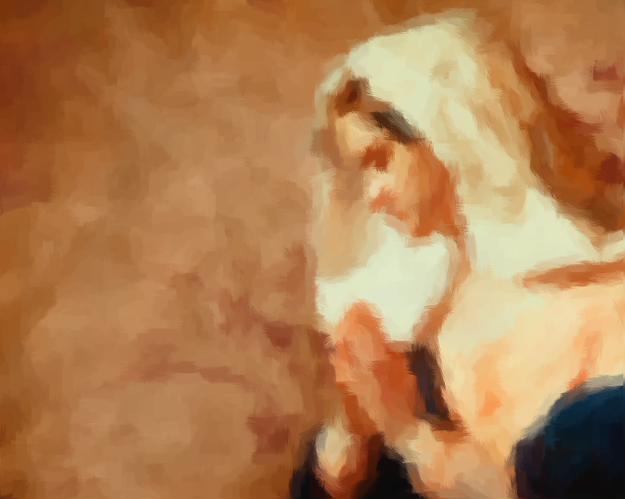
Hannah’s
Prayer
1 Samuel 1
Notes:
Based loosely on material from Mark Copeland’s lesson “Hannah – A Woman of Faith”
Preached at West Side on April 6, 2014 AM
Preached again at West Side on September 18, 2022 @ 11am

Slide 2

1 Samuel 1:1-2
Now there was a certain man of Ramathaim Zophim, of the mountains of Ephraim, and his name was Elkanah the son of Jeroham, the son of Elihu, the son of Tohu, the son of Zuph, an Ephraimite. ² And he had two wives: the name of one was Hannah, and the name of the other Peninnah. Peninnah had children, but Hannah had no children.
Godly women can have problems, as did Hannah
Notes:
Introduction
(1 Samuel 1:1-2), “Now there was a certain man of Ramathaim Zophim, of the mountains of Ephraim, and his name was Elkanah the son of Jeroham, the son of Elihu, the son of Tohu, the son of Zuph, an Ephraimite. ² And he had two wives: the name of one was Hannah, and the name of the other Peninnah. Peninnah had children, but Hannah had no children.”
Godly women can have problems, as did Hannah

Slide 3
1 Samuel 1:4-7
And whenever the time came for Elkanah to make an offering, he would give portions to Peninnah his wife and to all her sons and daughters. ⁵ But to Hannah he would give a double portion, for he loved Hannah, although the Lord had closed her womb. ⁶ And her rival also provoked her severely, to make her miserable, because the Lord had closed her womb. ⁷ So it was, year by year, when she went up to the house of the Lord, that she provoked her; therefore she wept and did not eat.
Notes:
(1 Samuel 1:4-7), “And whenever the time came for Elkanah to make an offering, he would give portions to Peninnah his wife and to all her sons and daughters. ⁵ But to Hannah he would give a double portion, for he loved Hannah, although the Lord had closed her womb. ⁶ And her rival also provoked her severely, to make her miserable, because the Lord had closed her womb. ⁷ So it was, year by year, when she went up to the house of the Lord, that she provoked her; therefore she wept and did not eat.”

Slide 4
1 Samuel 1:8
Then Elkanah her husband said to her, “Hannah, why do you weep? Why do you not eat? And why is your heart grieved? Am I not better to you than ten sons?”
Nothing can replace or substitute for the presence of a child.
Psalm 113:5,9; 127:3
Notes:
(1 Samuel 1:8), “Then Elkanah her husband said to her, “Hannah, why do you weep? Why do you not eat? And why is your heart grieved? Am I not better to you than ten sons?”
Nothing can replace or substitute for the presence of a child.
(Psalm 113:5), “Who is like the LORD our God, who is seated on high, …”
(Psalm 113:9), “… He gives the barren woman a home, making her the joyous mother of children. Praise the LORD!” (English Standard Version)
(Psalm 127:3), “Behold, children are a heritage from the Lord, The fruit of the womb is a reward.”

Slide 5
Hannah’s Prayer
With bitterness of soul (10)
With anguished weeping (10)
With offers of a solemn vow (11)
With persistence (12)
With her heart (13)
With all her soul (15-16)
With faith in God’s promise (18)
Notes:
Discussion:
When godly women like Hannah have problems and sadness, what distinguishes them as godly is the way they handle those problems.
They go to God in Prayer
Consider the prayer of Hannah, and what is found within
(1 Samuel 1:9-18) READ
What you see in her prayer:
With bitterness of soul (10)
With anguished weeping (10)
With offers of a solemn vow (11)
With persistence (12)
With her heart (13)
With all her soul (15-16)
With faith in God’s promise (18)

Slide 6
What we learn from Hannah’s Prayer
Pray fervently and consistently
  Colossians 4:2
Pray with Faith
  1 John 5:14-15
God answers prayer
  1 Samuel 1:19-20
You must keep your promises!
  1 Samuel 1:24-28
Notes:
What we learn from Hannah’s Prayer
Pray fervently and consistently
(Colossians 4:2), ”Continue earnestly in prayer, being vigilant in it with thanksgiving.”
(cf. 1 Thessalonians 5:17, “Pray without ceasing.”)
[CLICK] Pray with Faith
(1 John 5:14-15), “Now this is the confidence that we have in Him, that if we ask anything according to His will, He hears us. ¹⁵ And if we know that He hears us, whatever we ask, we know that we have the petitions that we have asked of Him.”
God answers prayer
(1 Samuel 1:19-20), “Then they rose early in the morning and worshiped before the Lord, and returned and came to their house at Ramah. And Elkanah knew Hannah his wife, and the Lord remembered her. ²⁰ So it came to pass in the process of time that Hannah conceived and bore a son, and called his name Samuel, saying, “Because I have asked for him from the Lord.”
Note: God sometimes gives us what we want, but always gives us what we need!
You must keep your promises!
(1 Samuel 1:24-28), “Now when she had weaned him, she took him up with her, with three bulls, one ephah of flour, and a skin of wine, and brought him to the house of the Lord in Shiloh. And the child was young. ²⁵ Then they slaughtered a bull, and brought the child to Eli. ²⁶ And she said, “O my lord! As your soul lives, my lord, I am the woman who stood by you here, praying to the Lord. ²⁷ For this child I prayed, and the Lord has granted me my petition which I asked of Him. ²⁸ Therefore I also have lent him to the Lord; as long as he lives he shall be lent to the Lord.” So they worshiped the Lord there.”

Slide 7
Conclusion
Each of us can and should react as godly Hannah during times of difficulty and provocation. And, if we do, like her we will be able to say…
Notes:
Conclusion:
Each of us can and should react as godly Hannah during times of difficulty and provocation.
And, if we do, like her we will be able to say… [Click to next slide]

Slide 8
1 Samuel 2:1-2
And Hannah prayed and said:
“My heart rejoices in the Lord; my horn is exalted in the Lord. I smile at my enemies, because I rejoice in Your salvation.
² “No one is holy like the Lord, for there is none besides You, nor is there any rock like our God.
Notes:
(1 Samuel 2:1-2), “And Hannah prayed and said:
“My heart rejoices in the Lord;
My horn is exalted in the Lord.
I smile at my enemies,
Because I rejoice in Your salvation.
² “No one is holy like the Lord,
For there is none besides You,
Nor is there any rock like our God.”

